Slide 1
Water Supply Utilities Project Database (WaSUP) 2026 Update
Matt Stahley
Water Supply Specialist
September 14th, 2026
Notes:
Good afternoon everyone, I’m Matt Stahley with SFWMD and I’ll be the main contact person for public water supply utilities and the liaison for the Water Supply Utilities Project Database, also known as WaSUP, I provide outreach and technical assistance to local governments and utilities in submitting their annual progress reports.
The goal today is to provide a review of the reporting requirements and the benefits of reporting, a walkthrough of the process for using the WaSUP database to submit your report, and a demonstration of accessing and updating the database.
Please save your questions for the end.

Slide 2
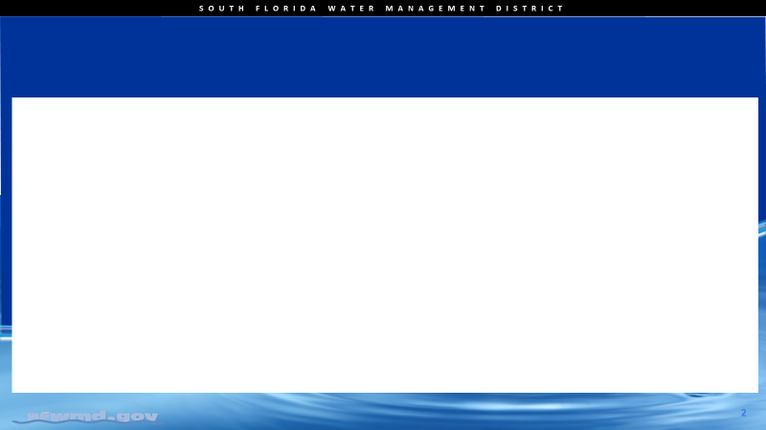
Statutory Requirements
Annual Progress Report required pursuant to Section 373.709, Florida Statutes
Utilities must provide an update on water supply projects by November 15th, 2026.
Notes:
Ch 373 requires utilities to provide the Annual Progress Report.
Statute says the report must include:
Water supply projects that have been developed or are intended to be developed,
An estimate of the quantity of water to be produced by each project, or saved for conservation projects, and
The status of project implementation.

Slide 3
The WaSUP Database
WaSUP provides an easier method for you to submit the required report.
Submission of a report using the WaSUP database completes your requirement for an Annual Progress Report, due by Nov. 15 of each year.
Notes:
The Database was implemented in order to have a consistent method of reporting the water supply project information which obviously would be challenging with over 100 utilities, and it fulfills the requirement for the annual progress report.

Slide 4
WaSUP Data Applications
WaSUP utility data is used for:
  Regional water supply plans
    Service area map updates, population and per capita trends
    Identifying new water supply and conservation projects and tracking the status, capacity, and capital costs
Notes:
The intent of this legislation is to include water suppliers in the regional water supply plan process.
Information provided is also important in the development of the Regional Water Supply Plans
The WaSUP tool can also be useful for
Providing service Area Maps,
Tracking population and per capita use trends,
Identifying new conservation and water supply development projects, and
Tracking the status (estimated start/completion dates), capacity, and capital costs of projects.

Slide 5

WaSUP Data Applications
Providing annual reports and info requests to FDEP
Legislative requests for water supply/conservation funding
Notes:
Perhaps, most importantly,
Info in WaSUP is used for Annual Reports and information requests to FDEP to fulfill legislative requests for water supply funding needs.
The information provided in WaSUP was used to identify projects and notify utilities to apply for funding.

Slide 6
Accessing WaSUP
On October 15th, the database will be open and a follow up email will be sent to the verified utility contacts on file.
  The email will contain an attachment with instructions and links to WaSUP and the password application.
Notes:
The WaSUP database will be open for reporting on October 15th.
A notification email will be sent on October 15th with a Guidelines document attached.
Links to the WaSUP database and the password application will be provided in the Guidelines document.
The password application allows returning existing users to reset their passwords online, and new users can self-register.

Slide 7
WaSUP Password Application/Self Register:
All new users in 2026 must create a User ID (e-mail address) and password to access the WaSUP database. It’s important to note this is a different URL than the WaSUP login screen.
https://webauth.sfwmd.gov/portal/selfservice/ssp_ext_apps/
Notes:
A “new user” is anyone who hasn’t registered before, or an existing user with a new email address.
Each new individual user needs to create an account using the password application, which is a separate application from the WaSUP database.

Slide 8
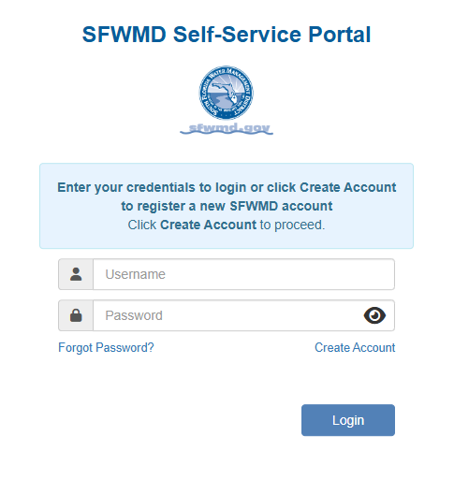
Self-Registration Screen – New User/Returning Users:
New users will need to use the create account link.
Returning users will simply navigate to the WaSUP login screen (different URL) and use their username and passwords created last year.
Instructions for the create account
process will also be included in a user
guide that will be sent on October 15th.
Notes:
This is what the self service portal looks like where new users will need to create an account or returning users will be able to reset their passwords if needed.

Slide 9
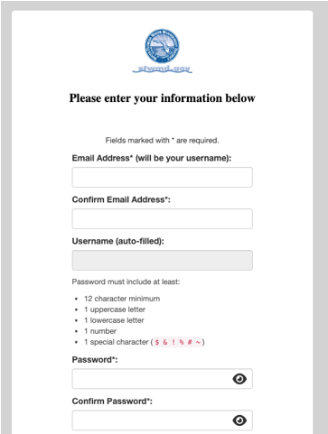
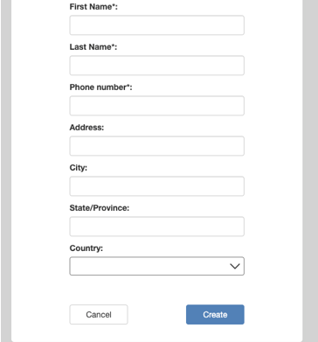
Self-Registration Screen – New User/Returning Users:
Notes:
This is what the Self-Registration Create an account Screen looks like for New Users you’ll enter your information and select create:

Slide 10
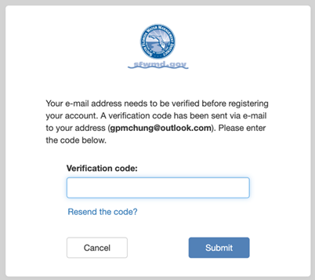
Self-Registration Screen – New User/Returning Users:
After you click Create, you will be sent a verification code in your email to complete your registration.
Enter that verification code in the next screen shown here
Notes:
After you click Create, you will be sent a verification code in your email to complete your registration.
Enter that verification code in the next screen shown here

Slide 11
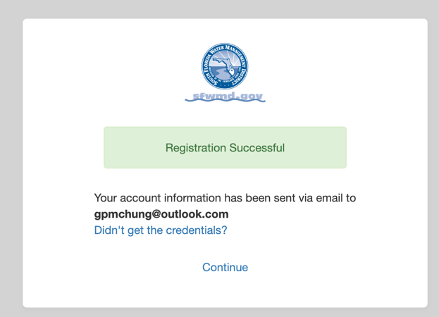
Self-Registration Screen – New User/Returning Users:
You will receive a notification
indicating the registration was
successful.
Clicking continue takes back to the self registration screen.
Now that the account is created you’ll need to navigate to the WaSUP login screen.
  https://wsup.sfwmd.gov/
Notes:
You will receive a notification indicating the registration was successful.
Important**** Clicking continue takes back to the self registration screen. Now that the account is created you’ll need to navigate to the WaSUP login screen using this link.

Slide 12
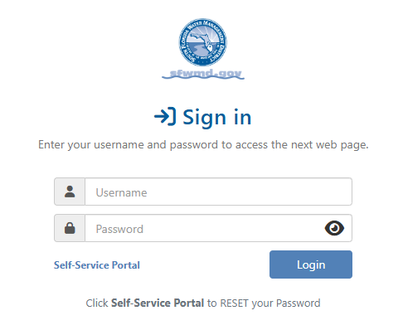
WaSUP Login Screen:
Notes:
The link provided in the Guidance document directs you to this login screen for WaSUP. You can access the self service portal from here as well by clicking the link to the self service portal if you need to reset your password.

Slide 13
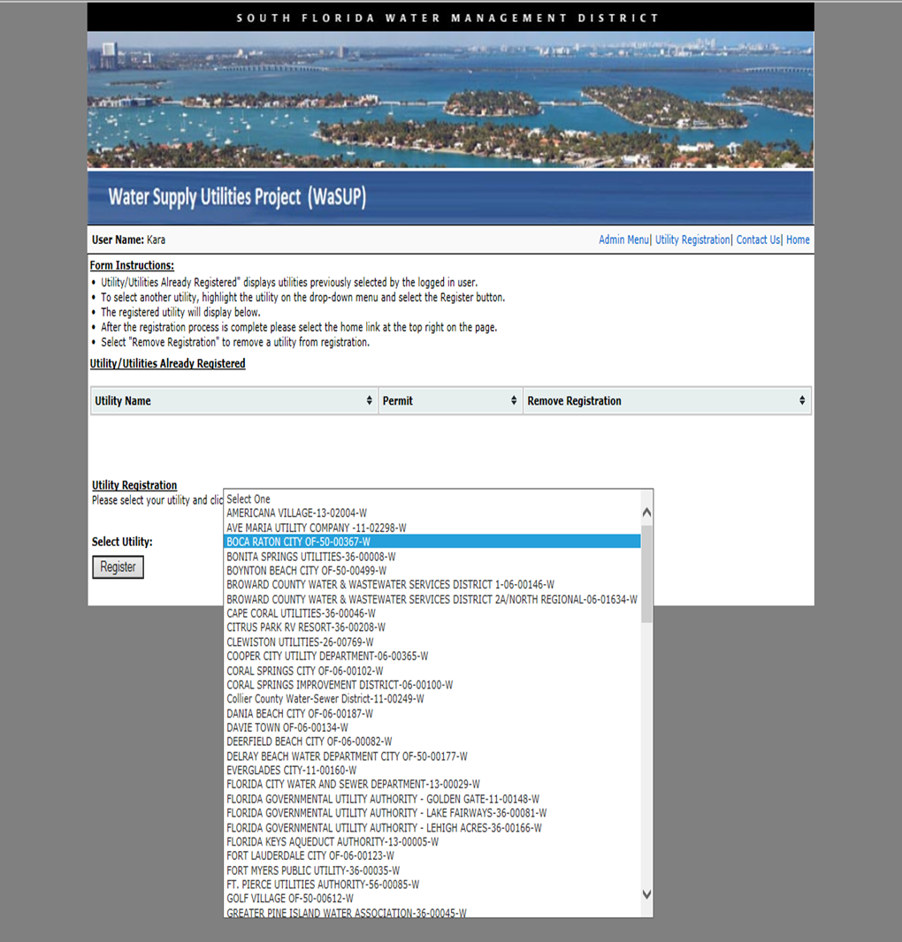
Utility Registration: New Users
Notes:
If this is your first-time entering data in WaSUP, or if you’re using a new email account/username, you’ll need to register a utility.
Click the Utility Registration Link.
Select utility’s name from the list. (Note that utility names were revised slightly to be consistent with the Water Supply Plan utility profiles ( i.e. City of West Palm Beach is now West Palm Beach)
Click the Register button. The program will take you to the home page.

Slide 14
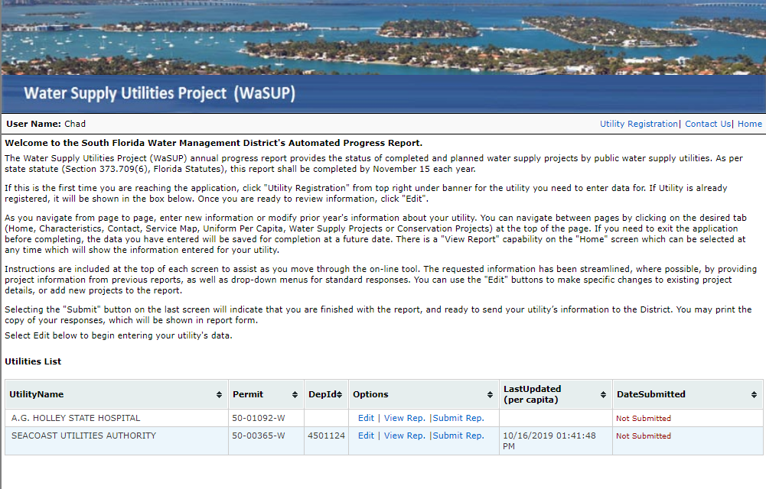
Data Entry/Review
Notes:
This is the Home Screen.
The utility you’re registered for should be listed on the Home Page in the Utilities List.
The home screen lets you edit the data, view your annual progress report, and submit your report to the District.
To begin entering data, click on the Edit link.
Once in Edit mode you’ll go through the webpages with the information for your utility prepopulated from the last Annual Progress Report.

Slide 15
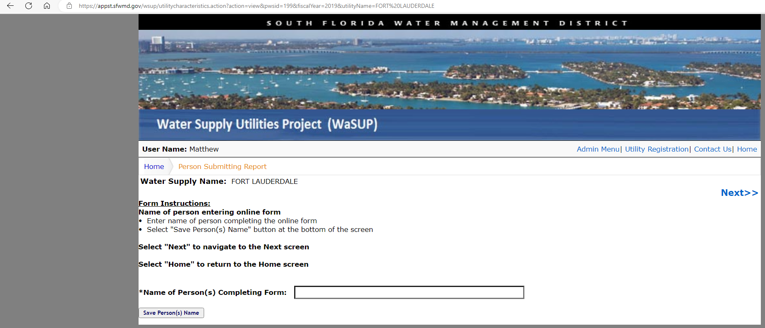
Data Entry:
Name of Person Completing Form
Notes:
The first screen is self-explanatory, just enter your name and save before selecting Next button. (This field will now be Mandatory to allow users to move to the next screen)
The Next link takes you to the next page
At any time, you can click on the Home link or tab to return to the homepage.
Don’t use the back feature on your browser, you’ll want to only navigate using the next button or click on the particular tab you want to navigate to.

Slide 16
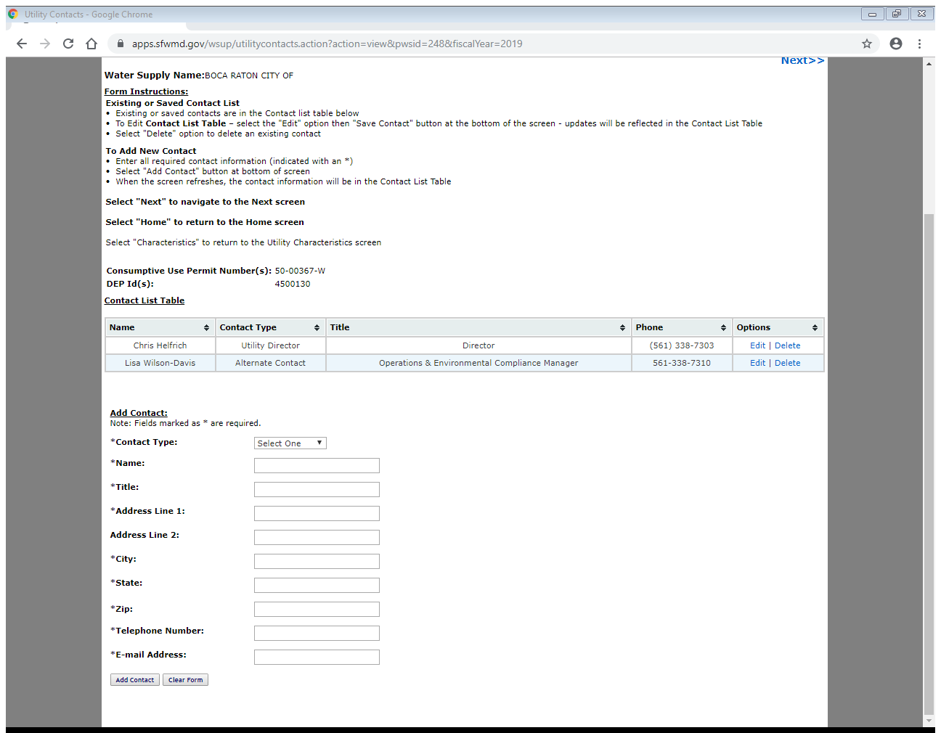
Data Entry: Contact Information
Notes:
The second screen is used to add new contact information or update/delete old contacts.
Please take the time to delete outdated contacts from the list, i.e. (if you are the compliance person and the utility director has changed please take a second and update that for us).
Use the Edit or Delete links for existing info.
Complete the Add Contact form for new contacts (e-mail is important).

Slide 17
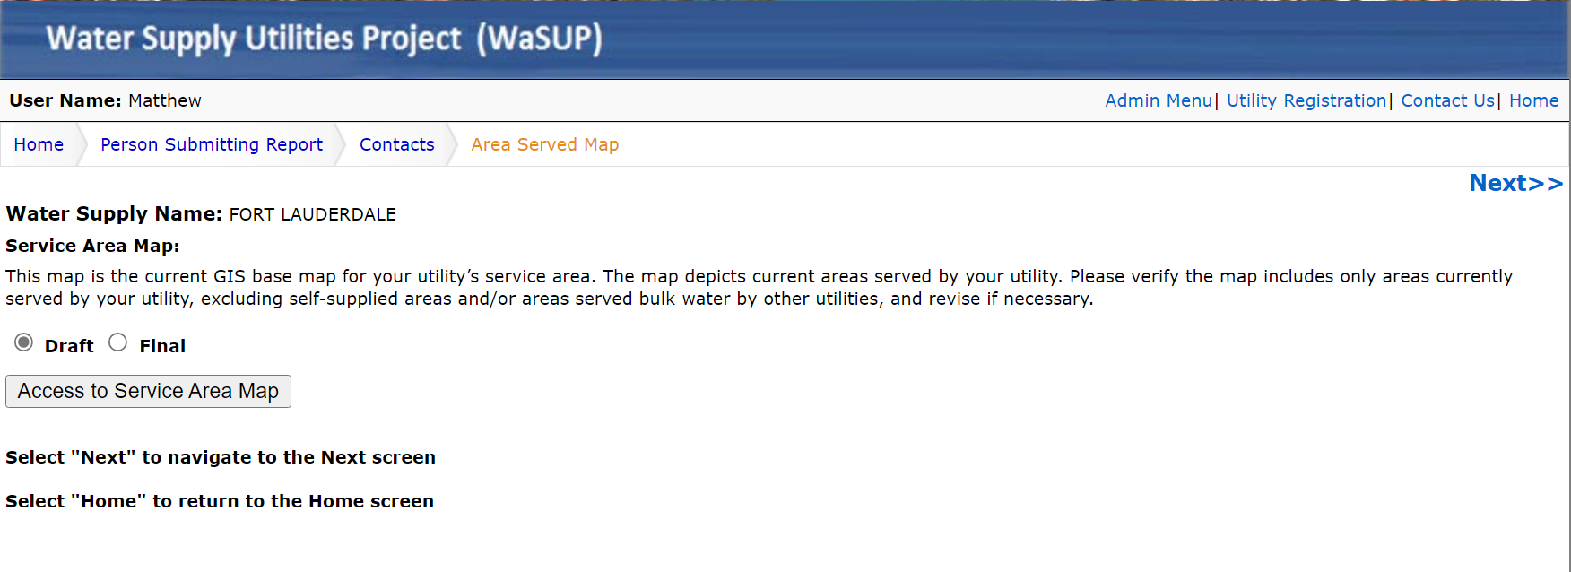
Data Entry: Area Served Map
Notes:
Select the Access Service Area Map to view the current GIS map on file.
Leave the Draft radio button selected. The final button is for an internal Administrator to approve any updates, after confirming changes with the utility.

Slide 18
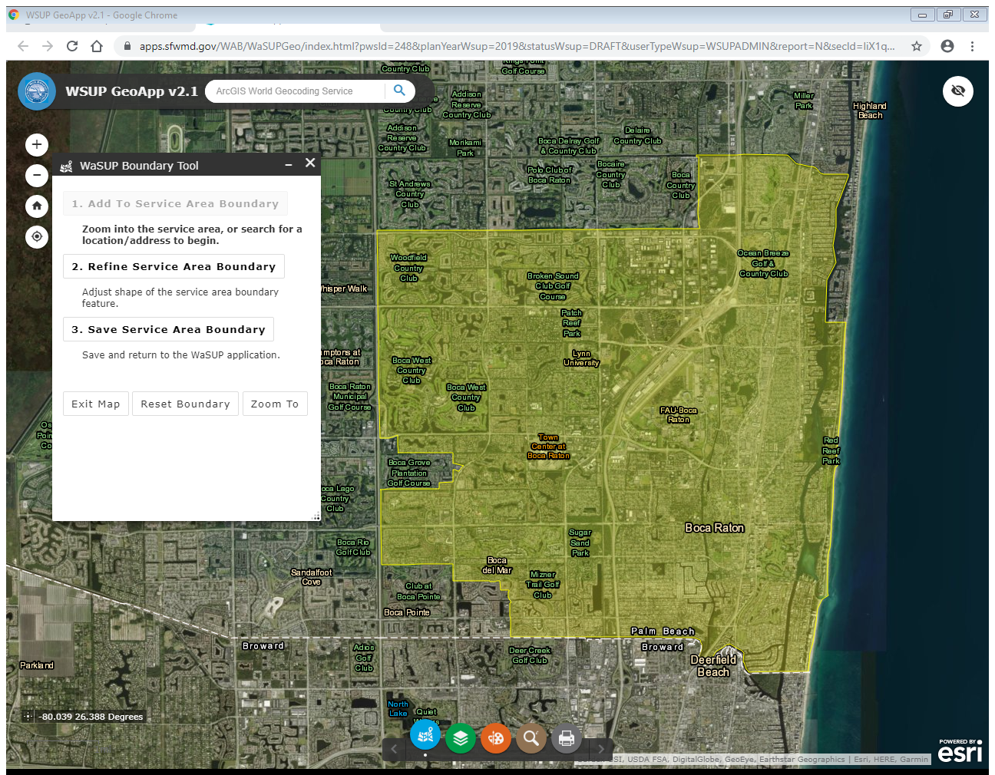
Area Served
Notes:
The area served shown for your utility will be from the last Annual Progress Report provided.
If the map is current. You do not need to update here.
If the service area map needs updating, click on the Refine Service Area button, or zoom in to activate the option to Add to Service Area Boundary, which includes options to manually draw boundaries, select parcels, or upload Shapefiles.
The Reset Boundary Button will restore the boundary to the map on file.
Once done with edits, click on the Save Service Area Boundary.
Detailed instructions are included in the Guidance Document. Please call me if you need assistance. If you do need to make revisions to the area served map its probably easier to send me the shapefile.

Slide 19
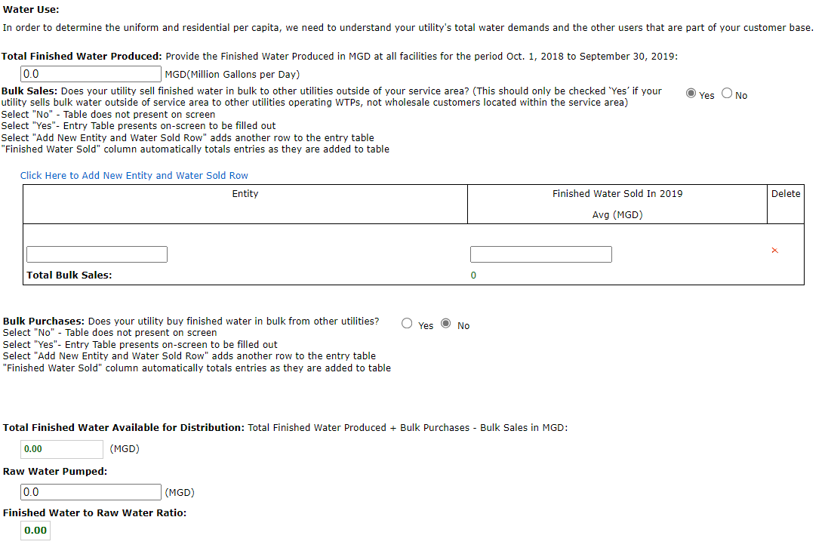
Uniform Residential Per Capita
Notes:
The Uniform Residential Per Capita page is the one page that will not include information from the previous reports.
The intent is to capture the current information, so the annual average should be based on the most recent data available
Oct 1, 2025 to Sept 30, 2026
Units need to be in Million Gallons per Day (Average Annual) for
Total Finished Water Produced,
Bulk Water, and
Raw Water.
Once this information is entered, WaSUP will calculate the,
Total Finished Water Available for Distribution, and
A Finished to Raw Water Ratio.
The boxes with numbers in Green will be calculated by WaSUP.

Slide 20
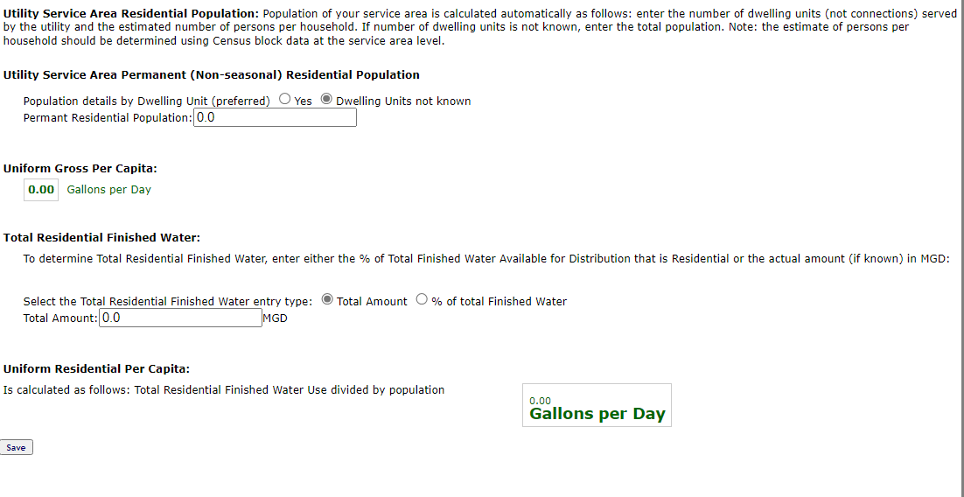

Uniform Residential Per Capita
Notes:
Two per capita rates are calculated,
The Uniform Gross Per Capita (in gallons per person per day) will be calculated by WaSUP after updating the Residential Population, either by entering:
The number of dwelling units and the number of people per unit, or
The total population of the area served.
The Uniform Residential Per Capita deducts other metered uses, to estimate the residential use rate
WaSUP will calculate the Uniform Residential Per Capita after entering either:
The total residential water, subtracting other metered uses (MGD) , or
The average annual percentage of residential water, deducting the percentage of other metered uses
For example, 10% of total finished water goes to metered industrial and commercial customers, so enter 90% for residential water

Slide 21
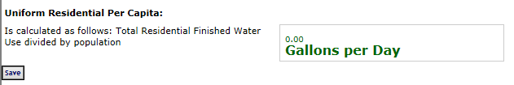
Uniform Residential Per Capita
Notes:
Very important! When finished with this page click the save button on the bottom of the page before clicking Next.
If you do not hit the Save button, the information you entered will not be saved and will need to be entered again.
404 error – check for commas or other format issues

Slide 22
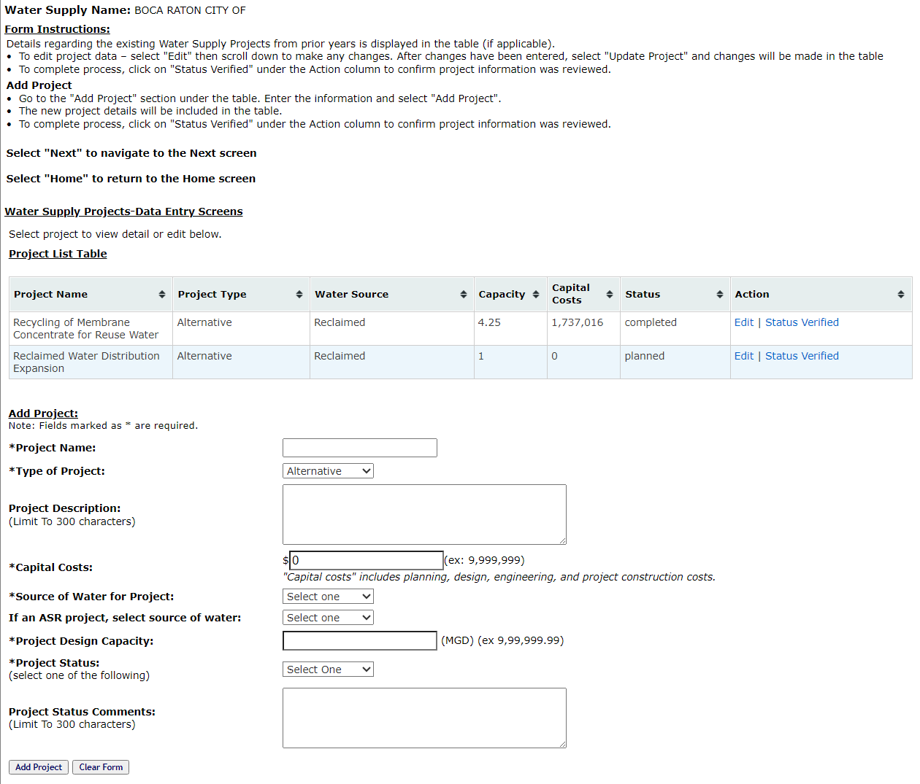
Water Supply
Projects
Notes:
Please check the information for all projects currently listed in the database.
*Be sure to check the progress and/or status dates, as these can be critical for funding considerations
To edit an existing project – click Edit in the Action field and make changes to the information listed in the form below.
Please be sure to update the status of old projects (mark Complete or discontinued or revise the start/complete dates if needed)
This helps us filter out old projects when compiling current information. (New Script should help remove old projects and cancelled projects)
To add a project – fill out the form under the project list table
Use dollars for capital costs – not thousands or millions of dollars
Use MGD for Project Design Capacity (what capacity is added by the project or project phase not total capacity).
Specify estimated completion date and start date, important for funding considerations.
Once the form is completed for a project, click the add project button to save the project to the list.
*Please click the “Status Verified” link for each project.
If the status of the projects is not verified, you will not be able to continue to the next page
Click on Next to go to the Conservation Projects screen.

Slide 23
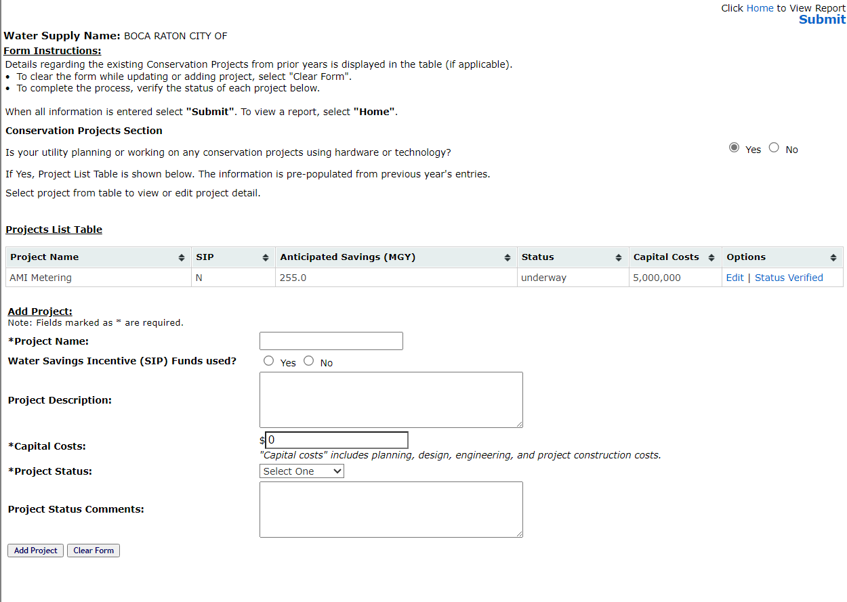
Conservation Projects
Notes:
Conservation projects are entered the same way as water supply projects. Remember to check the information on file and click the “Status Verified” link for each project before submitting the Annual Progress Report.
Once the annual report is complete it can be submitted to the District by selecting Submit, or you can go to the Home Page to view the report and select Submit.
Clicking on Submit from either page will send your annual report to the District, completing your annual reporting requirement.
You can submit and edit the report at any time before the deadline, November 15, 2024.
You can update the information then submit again, as needed.

Slide 24
SFWMD Contact Info
Matt Stahley
  Mastahle@sfwmd.gov
  (561) 682-2088
Chad Brcka
  cbrcka@sfwmd.gov
  (561) 682-2816
Notes:
If you are new to WaSUP or just need help, don’t hesitate to call us. We’ll be happy to work with you to get your Annual Progress Report completed.
If you have any ideas for improvements to this process, please let me know.
The back-up contact person this year is Chad Brcka

Slide 25
Links
Application Login
To login to the WaSUP application, go to:
https://wsup.sfwmd.gov/
Self Registration and Self Service
To register for an account, reset password use the self-registration URL:
https://webauth.sfwmd.gov/portal/selfservice/ssp_ext_apps/

Slide 26

Questions??
Questions??
Notes:
That concludes my presentation, and I will be happy to answer any questions

