Slide 1
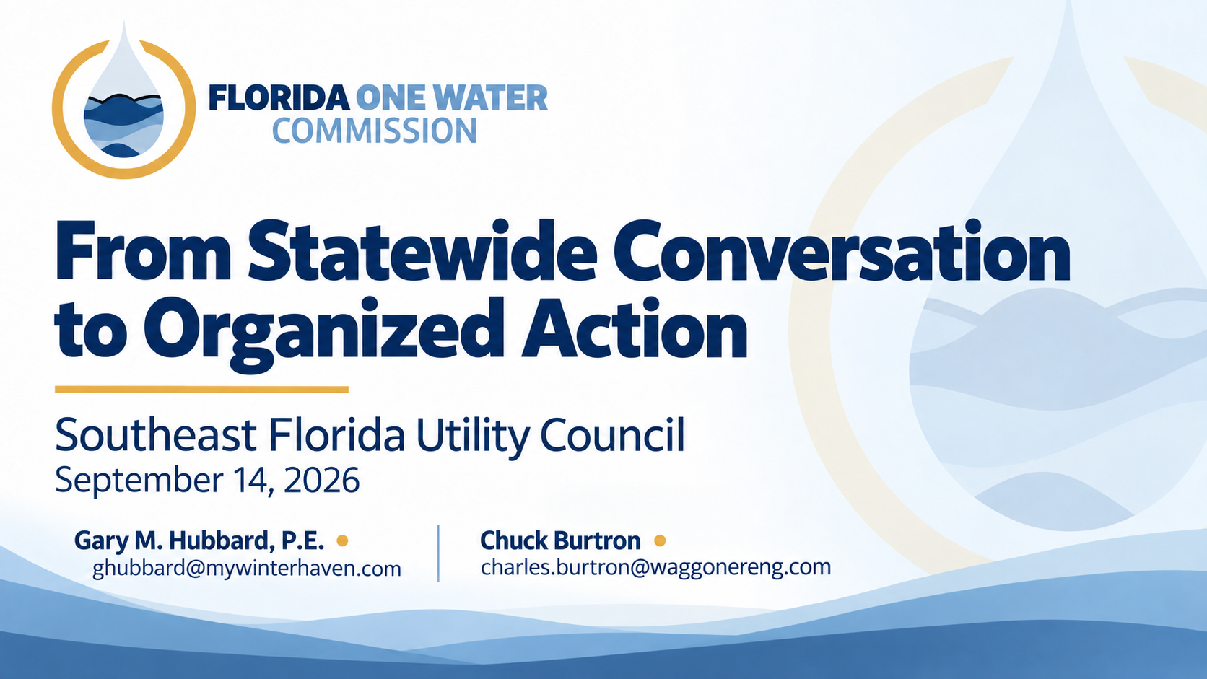
Notes:
Speaker: Gary
Time: 1 minute
Talking points
Thank Maria and SEFLUC for the invitation.
Recognize the utilities represented from Martin, Palm Beach, Broward, and Miami-Dade counties.
Establish that this will not be a general lesson about One Water:
“We are not here to explain integrated water management to people who practice it every day. We are here to share what FLOWCOM has learned from three years of statewide conversations and to ask you to test a proposition about what Florida needs next.”
Explain the two-part presentation:
“I will briefly describe why FLOWCOM formed and what those first three years revealed. Chuck will then present the capability we believe Florida now needs—and a specific opportunity for South Florida to help shape it.”

Slide 2
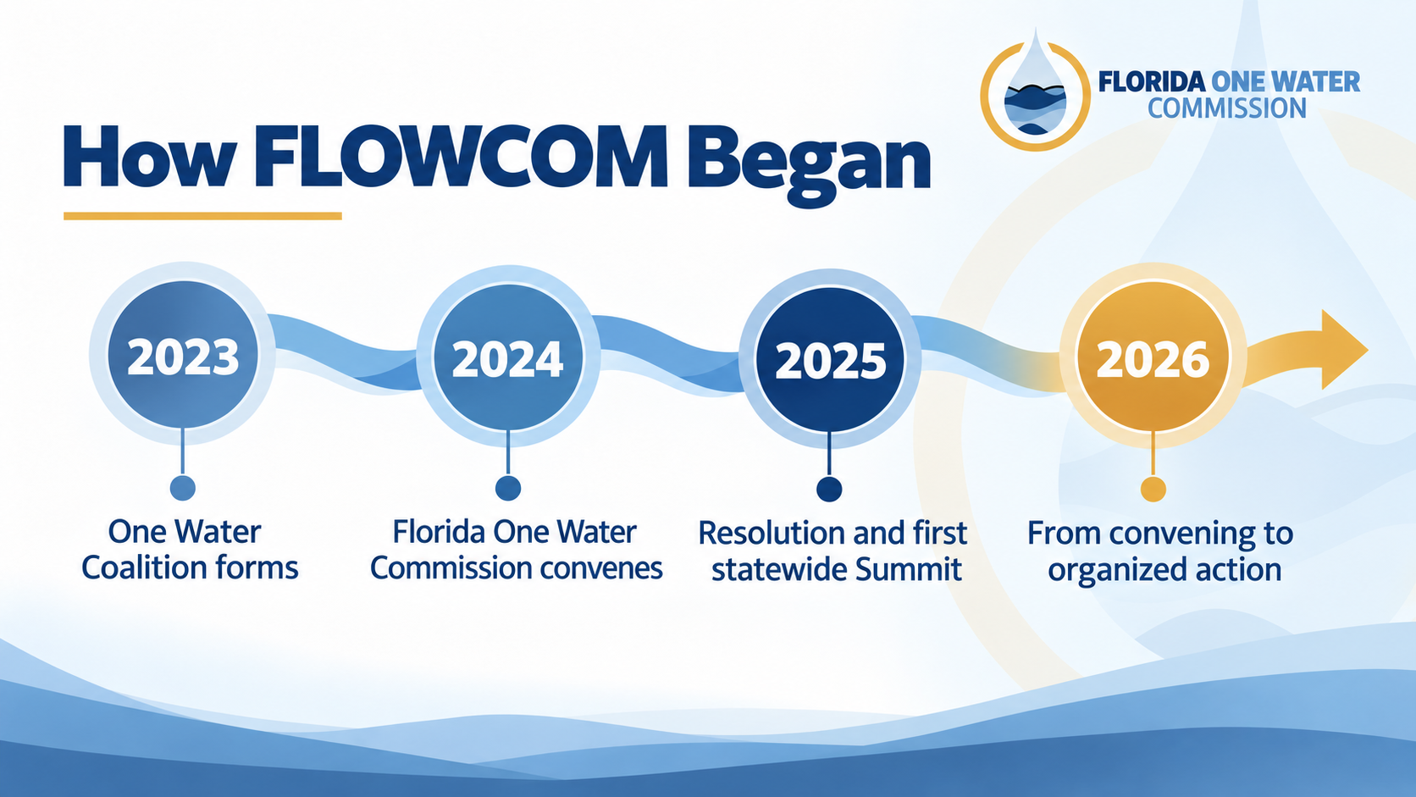
Notes:
Slide 2 — How FLOWCOM Began
Speaker: Gary
Time: 2–3 minutes
Talking points
FLOWCOM grew from conversations following the 2023 legislative session about how Florida could advance and support One Water more effectively.
The One Water Coalition first convened in September 2023.
As participation expanded, the Florida One Water Commission was created to provide more formal leadership.
The Commission first met in July 2024 at the Environmental Permitting Summer School.
During 2025, FLOWCOM advanced a One Water Resolution:
It was filed in both chambers.
It passed the Senate but did not pass the House.
That experience provided an early lesson about the difference between having a sound idea and building the complete pathway required to move it.
The first Florida One Water Summit widened the conversation and surfaced barriers, opportunities, and commitments from across the state.
By 2026, the central question had changed:
“The question was no longer whether people supported One Water. The question was whether we could turn broad support into practical, coordinated, and measurable action.”

Slide 3
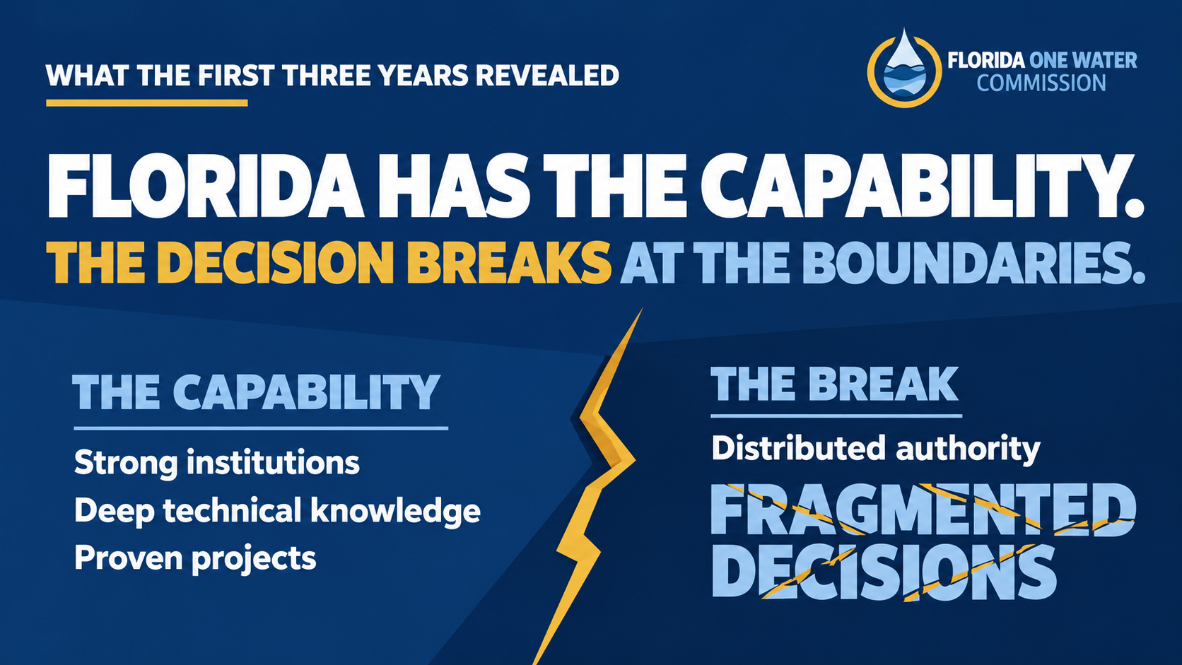
Notes:
Slide 3 — What the First Three Years Revealed
Speaker: Gary
Time: 3 minutes
Talking points
Florida has capable utilities, agencies, water management districts, scientists, engineers, elected officials, environmental organizations, businesses, and community leaders.
These institutions generally perform well within their own legal, geographic, financial, and operational responsibilities.
The difficulty appears when an important water decision crosses those boundaries.
The 2025 Summit and subsequent conversations repeatedly surfaced:
Fragmented governance
Permitting complexity
Funding constraints
Workforce limitations
Data and measurement gaps
Separation of water-quality and water-quantity decisions
Public understanding arriving after positions have already hardened
No participant holds the whole answer, but every participant holds part of the answer and part of the stake.
Convening these people created relationships and shared understanding, but the first three years also revealed a limitation:
“Convening is necessary, but convening alone does not assign responsibility, remove a barrier, finance a pathway, or deliver a result.”

Slide 4
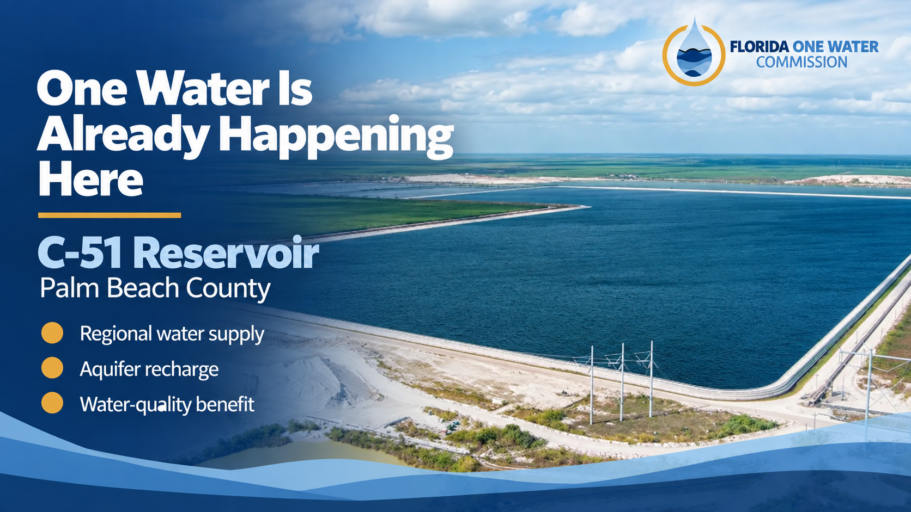
Notes:
Slide 4 — One Water Is Already Happening Here
Speaker: Gary
Time: 2–3 minutes
Talking points
Acknowledge that members of the audience understand C-51 more deeply than FLOWCOM does:
“We are not here to explain C-51 to South Florida. We include it because it demonstrates something important about Florida’s larger opportunity.”
C-51 connects stormwater capture, regional alternative water supply, aquifer replenishment, and water-quality benefits.
It demonstrates that integrated, multi-benefit water solutions are not theoretical.
Florida already possesses the technical, institutional, and delivery capability needed to produce broader water value.
The statewide question is:
“How do we make more consequential water decisions capable of producing multiple benefits—and how do we clear the institutional, financial, regulatory, and public-understanding barriers that prevent viable solutions from moving?”
Handoff to Chuck
“C-51 demonstrates that Florida has the ability to act. But our first three years also revealed that we do not yet have a consistent way to connect those abilities around the complete decision. Chuck, let’s test whether that matches what South Florida utilities experience.”
Chuck — audience test
Keep the C-51 image visible. Chuck should step forward and ask:
“How many of you have seen a technically viable water solution stall for reasons that had little to do with the technology?”
Pause and look for hands or visible reactions.
“How many have been accountable for delivering a result when the authority, funding, permitting, public understanding, and institutional responsibilities belonged to organizations operating on different clocks?”
Pause again.
“How many have watched the public story form before the complete evidence, choices, costs, and tradeoffs were visible?”
Pause again.
“That is the institutional gap. Florida does not lack water expertise. It does not lack capable institutions. And it does not lack projects worth advancing. What is missing is the connective capacity to assemble the complete choice, make the tradeoffs visible, build understanding before positions harden, and connect a specific barrier with the people able to remove it.”
Then clarify:
“We do not need another organization trying to control work already entrusted to utilities, agencies, districts, governments, and communities. We need connective capacity that helps those institutions succeed together.”
Advance to the next slide
“That brings us to the proposition we are asking you to test.”
Then advance to An Independent Voice for Florida’s Water.

Slide 5
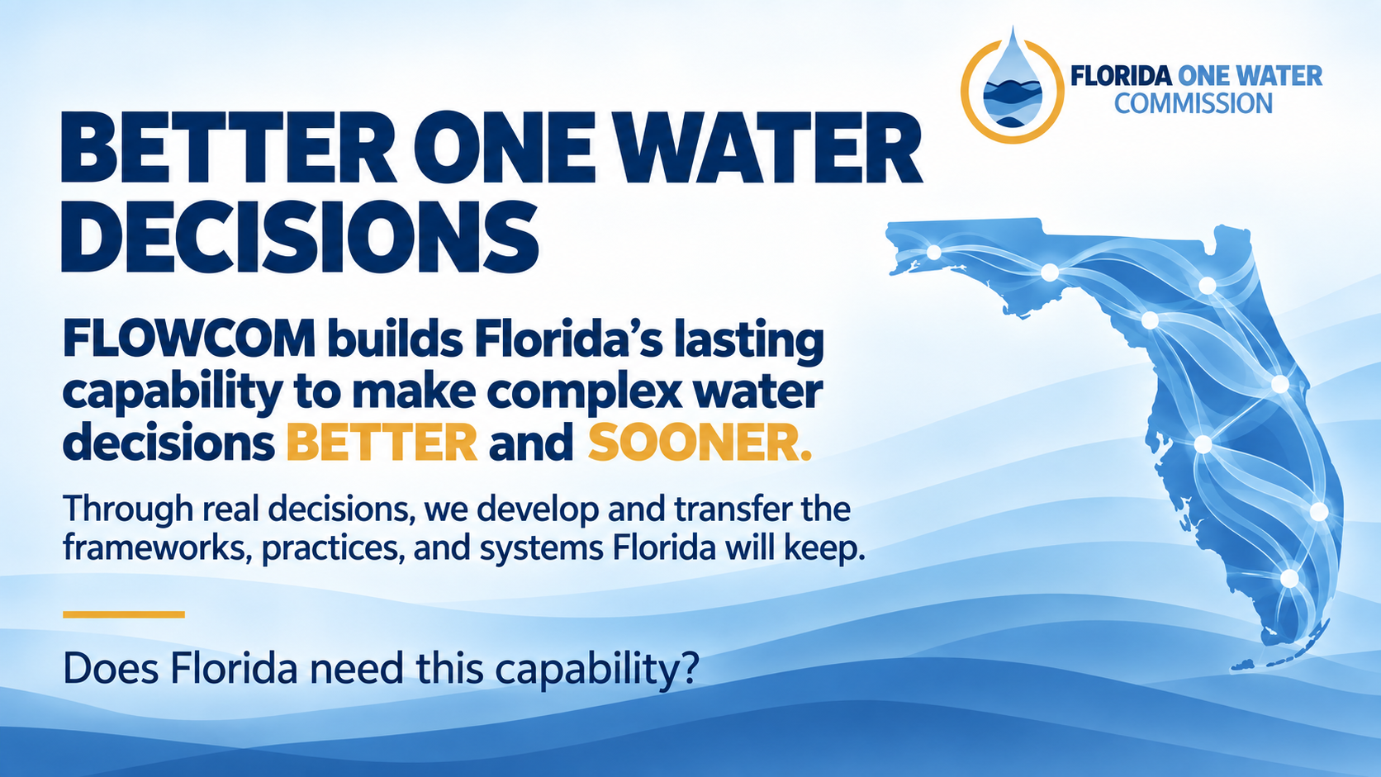
Notes:
Slide 5 — Better One Water Decisions
Speaker: Chuck
Time: 75–90 seconds
Speaker notes
“C-51 demonstrates what a strong One Water decision can produce.”
“It also demonstrates how much persistence complex water decisions can require. The result deserves recognition. The difficulty of reaching it deserves our attention.”
“Here is the proposition we are asking you to test.”
“FLOWCOM builds Florida’s lasting capability to make complex water decisions better and sooner.”
Pause.
“Better does not mean every proposed solution moves forward. Better means Florida sees the complete choice, understands the tradeoffs, and reaches a decision that can withstand scrutiny.”
“Sooner does not mean rushed. Complex regional decisions will still require serious work.”
“It means losing less time to fragmented information, unclear responsibilities, funding barriers, disconnected public conversations, and relationships that must be rebuilt for every major decision.”
“The capability must live across Florida’s water community. Utilities, public institutions, communities, researchers, businesses, and elected leaders must become better at working the same decision from their different responsibilities.”
Pause.
“Does Florida need this capability?”
Allow the question to register.
“If the answer is yes, let us show you how we intend to build it.”

Slide 6
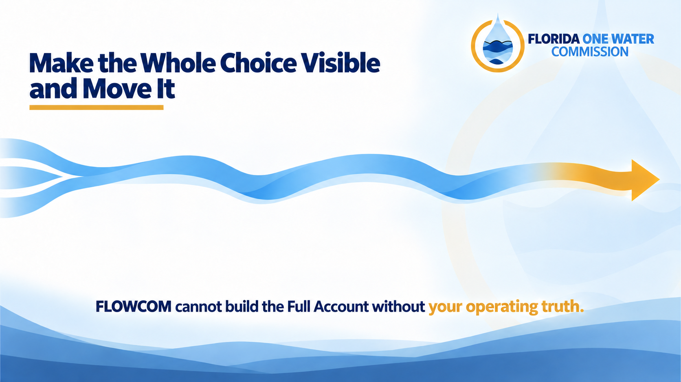
Notes:
Slide 6 — Make the Whole Choice Visible and Move It
Speaker: Chuck
Time: 3 minutes
Opening transition
“If Florida needs that capability, the next question is what it must actually do.”

Slide 7
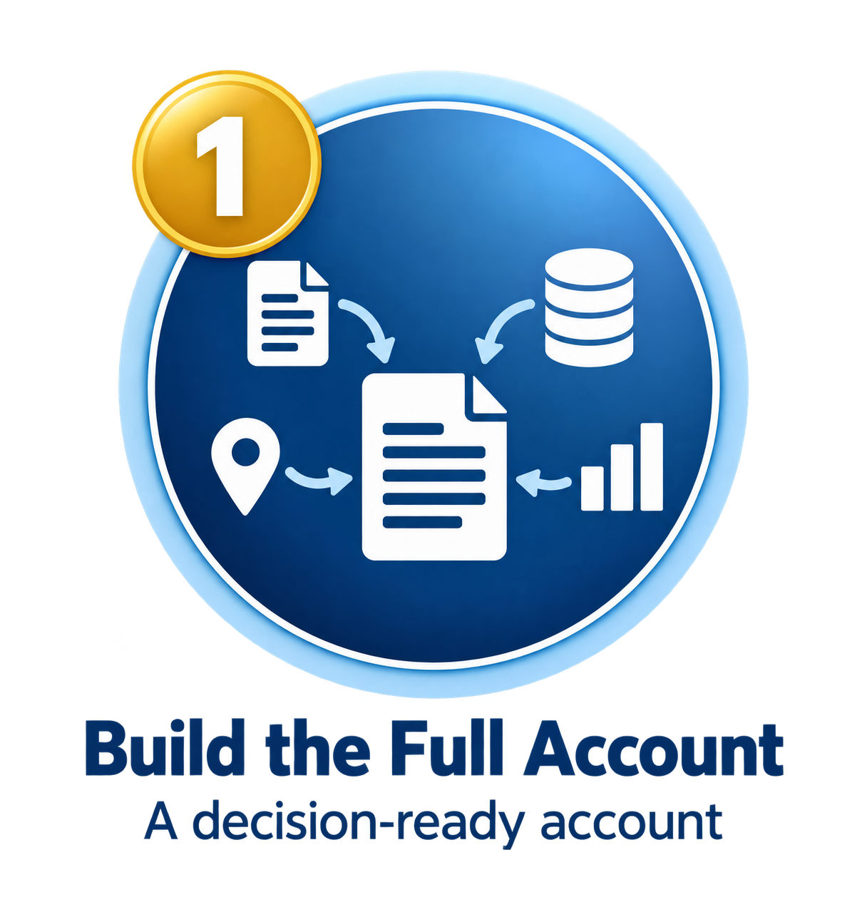
Notes:
Slide 6 — Make the Whole Choice Visible and Move It
Speaker: Chuck
Time: 3 minutes
Opening transition
1. Build the Full Account
Reveal the first stage.
“First, FLOWCOM builds the Full Account.”
“Florida rarely lacks information. The problem is that the information sits in different plans, studies, agencies, utilities, funding programs, technical disciplines, and affected communities.”
“FLOWCOM will organize that existing information around the decision that must be made. The Full Account will make the realistic options visible, along with their expected benefits, costs, burdens, risks, funding requirements, institutional responsibilities, uncertainties, and consequences of inaction.”
Emphasize the distinction:
“This is not another study. It is a decision-ready account of the complete choice.”

Slide 8
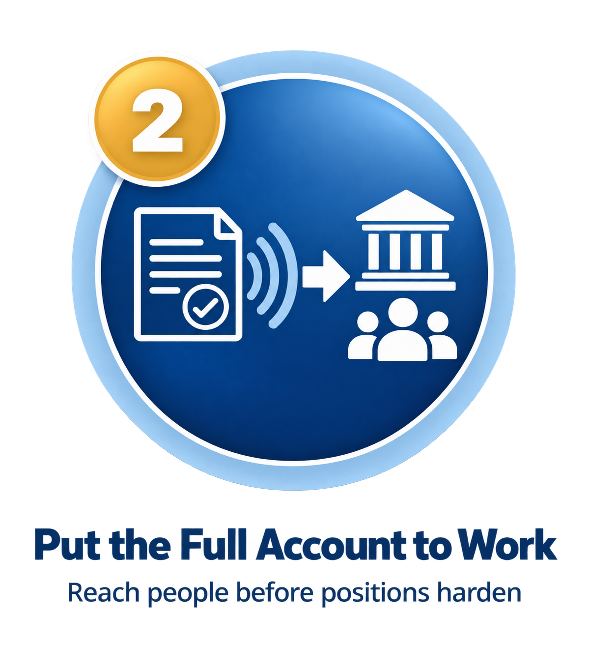
Notes:
Slide 6 — Make the Whole Choice Visible and Move It
Speaker: Chuck
Time: 3 minutes
Opening transition
2. Put the Full Account to Work
Reveal the second stage.
“Second, FLOWCOM puts that account to work.”
“Technically sound solutions can still fail when the people whose understanding and support are required never see the complete choice. Evidence may arrive too late, remain trapped in technical language, or reach formal decision-makers without reaching the communities and customers who determine whether action remains possible.”
“FLOWCOM will translate the same reviewable account for legislators, agencies, local officials, utilities, businesses, communities, customers, and voters. The objective is to enter while the decision can still be shaped, before positions harden.”

Slide 9

Notes:
Slide 6 — Make the Whole Choice Visible and Move It
Speaker: Chuck
Time: 3 minutes
Opening transition
3. Clear the Path
Reveal the third stage and gold arrow.
“Third, FLOWCOM clears the path.”
“Water solutions often stop at a missing appropriation, an outdated policy, an unclear permit sequence, a funding criterion that does not fit, an unresolved cost allocation, a public-understanding barrier, or an institutional handoff that belongs to no one.”
“FLOWCOM will identify the smallest effective change capable of unlocking the greatest achievable shared benefit. It will then connect the evidence, authority, relationships, public support, and accountability required to make that change.”
Make the utility connection
Direct attention to the concluding line:
“Utilities make this proposition real. You know whether an attractive idea can actually be permitted, financed, operated, maintained, and explained to customers.”
“FLOWCOM cannot build the Full Account without your operating truth.”
Transition to the ten-year slide
“That describes the work. The second proposition concerns the institution itself: how long should FLOWCOM have to build this capability, prove that it works, and transfer it to Florida?”
Then advance to the ten-year charter slide.

Slide 10
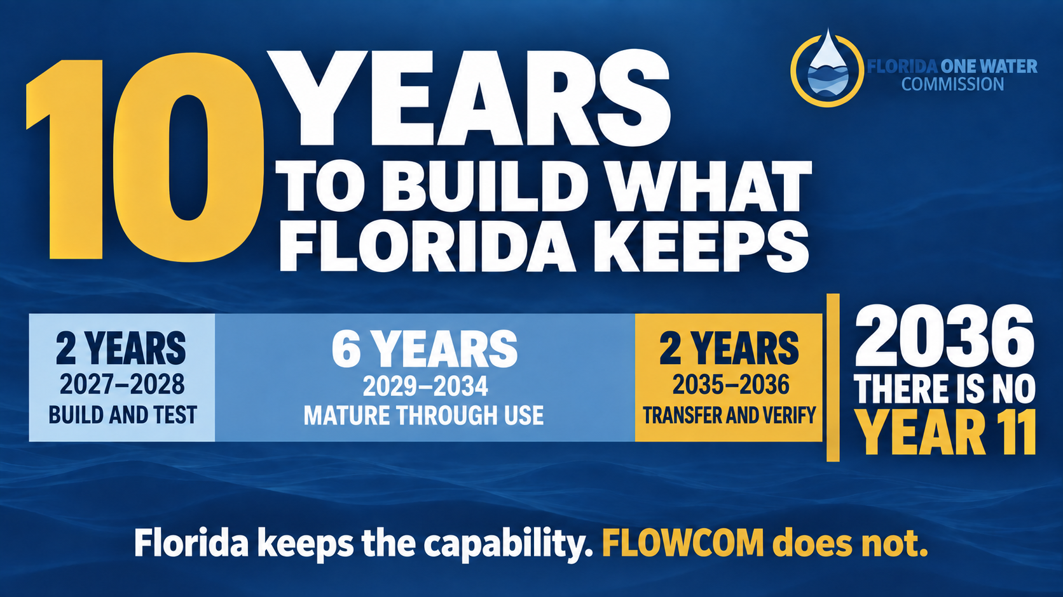
Notes:
Slide 7 — A Ten-Year Institution Built to Finish
Speaker: Chuck
Time: 45–60 seconds
Speaker notes
Advance to the slide. Pause while the audience takes it in.
“Most institutions are built to last.”
“FLOWCOM is built to finish.”
Pause.
“FLOWCOM gets ten years.”
“Two years to build and test.”
“Six years to mature the capability through use.”
“Two years to transfer it and verify that Florida can sustain it.”
“2036.”
Pause.
“There is no Year 11.”
Allow the hard stop to register.
“Florida keeps the capability. FLOWCOM does not.”
Pause.
“If you want to shape what Florida keeps, the time to enter is now.”
Transition
Advance immediately to Slide 8 — South Florida Must Be in the Room.
Delivery direction
Deliver the language slowly and without elaboration.
Do not explain the gubernatorial or legislative cycles unless someone asks during discussion.
Give the greatest weight to “There is no Year 11” and “Florida keeps the capability.”
Do not soften or fill the silence after either statement.
Move directly into the call to action while the urgency remains in the room.

Slide 11
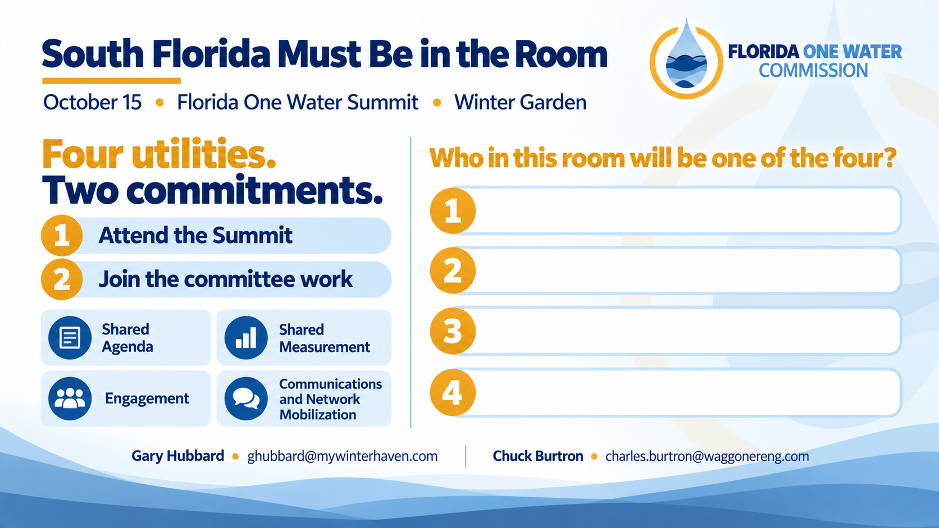
Notes:
Slide 8 — South Florida Must Be in the Room
Speaker: Chuck
Time: 2–3 minutes, followed by response and questions
Talking points
“On October 15, approximately 150 people will come together at the Florida One Water Summit in Winter Garden.”
“They will not come simply to hear presentations. They will help strengthen the issues FLOWCOM may carry into 2027, identify barriers, shape pathways, find missing partners, clarify first actions, and organize participation.”
“South Florida must be in that room—not merely represented on an attendance list, but participating in the work.”
“We are asking four South Florida utilities to make two commitments.”
“First, bring your experience and your voice to the Summit.”
“Second, place at least one representative into one of FLOWCOM’s four committees: Shared Agenda, Shared Measurement, Engagement, or Communications and Network Mobilization.”
“Collectively, we want South Florida participating across all four.”
“FLOWCOM gives an independent voice to Florida’s water—and to the future Floridians who will depend upon it. But that voice will only be credible if it carries the operating truth of the utilities responsible for delivering water every day.”
“We need four utilities willing to help build this capability.”
“Who in this room will be one of the four?”
Delivery direction
Stop speaking.
Allow the question to remain in the room.
Gary or Maria should help recognize respondents and capture the four utility names.
Do not advance to a generic “Questions?” slide.
Keep the commitment slide visible during discussion.
If commitments do not come immediately, ask:
“Who would like a direct follow-up conversation about representing South Florida at the Summit?”
“Which of these four committees most closely matches the contribution your utility could make?”

