Slide 1
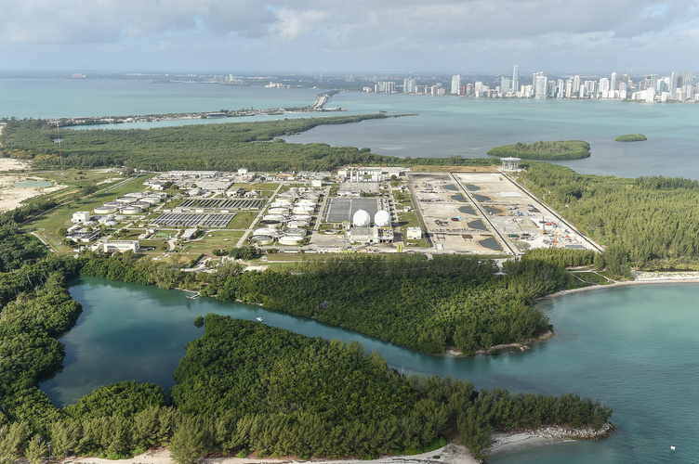
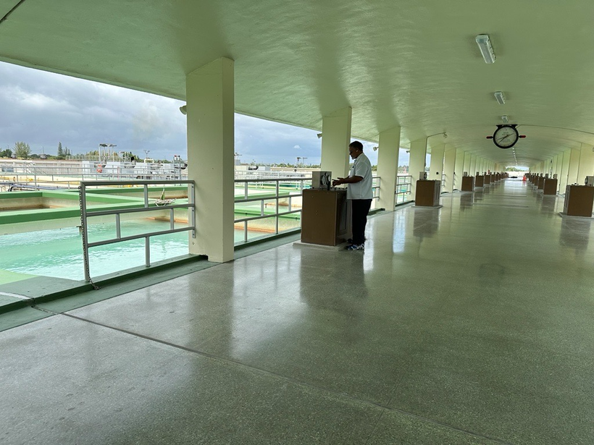
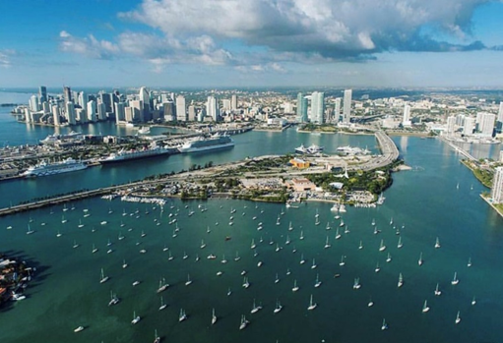

2025-2026 Year In Review
April 13th, 2026

Slide 2
SEFLUC Mission Statement
Southeast Florida Utility Council, SEFLUC, provides a communications, networking, and support structure for member utilities to continue to provide superior-quality water supply and wastewater management services to its customers in a cost-effective manner.
  Executive Board
  Chair- Jim Ferguson, Miami-Dade WASD
  Vice Chair-Maria Loucraft, Broward County WWS
  Past Chair-Poonam Kalkat, City of Boynton Beach
  Secretary-Joshua McDermott, City of Boynton Beach
  Treasurer-Kara Mills, City of Boca Raton
  Web Master-Anne Murray, Martin County

Slide 3
2026 Membership Overview
Utilities – 29 , Consultants - 11
Member Utilities:
City of Boca Raton City of Fort Lauderdale City of Plantation
City of Boynton Beach City of Hollywood Seacoast Utility
Broward County Water and Wastewater City of Margate City of Sunrise
City of Coconut Creek Martin County City of Tamarac
City of Lauderhill Miami-Dade Water and Sewer Department Town of Medley
Coral Springs Improvement District City of Miramar Village of Tequesta
City of Stuart City of Oakland Park Village of Wellington
City of West Miami Town of Jupiter Indian Trail
City of West Palm Beach Town of Jupiter Islands Town of Highland Beach
Florida Keys Aqueduct City of Pompano Beach
Member Consultants : Other Government Entities
Black & Veatch Cha Consulting South Florida Water Management District
Calvin, Giordano and Associates GMA Water Lake Worth Drainage District
Carollo Engineers
Globaltech
Hazen and Sawyer
Hotlz Consulting
Jacobs Engineering
Woolpert
Kiewit

Slide 4
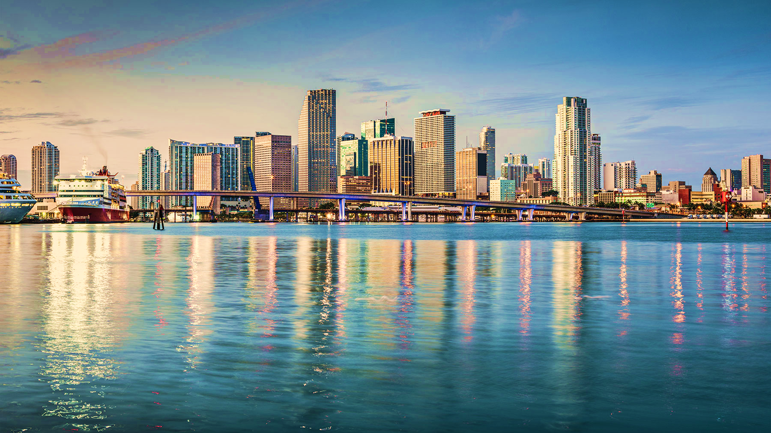




Southeast Florida
  Population of approximately 6.64 million
  Gross Domestic Product of approximately $534 billion
  Distinct Tropical Climate
  Average Annual Rainfall roughly 60 inches
  Dense urban area with unique ecosystems of the Everglades and Biscayne Bay
Common Challenges:
Climate Change and Sea Level Rise
Complying with PFAS Legislation
Biosolids Treatment and Disposal
Workforce Development And Retainage
Cost of Living and Inflation
Water and Sewer Funding and Rate Increases

Slide 5
Presentations in the Past Year
Approximately 21 Presentations of which General Topics Included:
Coastal Stormwater Resilience
Sea Level Rise Scenarios and Effects on the Biscayne Aquifer
PFAS Treatment Alternatives
Reuse and Water Loss and Water Conservation
Wastewater and Water Treatment Technologies and Projects
Biosolids Trends
Media Training
Operators without Borders
Project Delivery Methods
AI and Incorporation into Utilities Management

Slide 6
Notable Actions in the Past Year
Continued engagement with our legal team to bring up to date regulatory and legislative items to members.
Continued Discussion regarding directional drilling causing damages to underground utilities
Continued to bring relevant and applicable presentations and discussions to the members
Continued Media Relations and Communication training
Continued keeping our members informed by networking, in-person meetings, calendar of relevant conferences, workshops and events

Slide 7

SEFLUC Helping Others
Water for People
Engineers Without Borders-Florida Professional Chapter
Water Equation

Slide 8
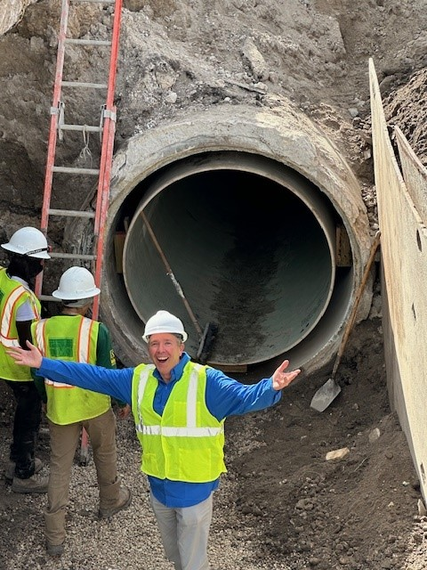
Thanks for your support and keep looking for ways to help each other.
“We can’t help everyone , but everyone can help someone” - Ronald Reagan

