Slide 1
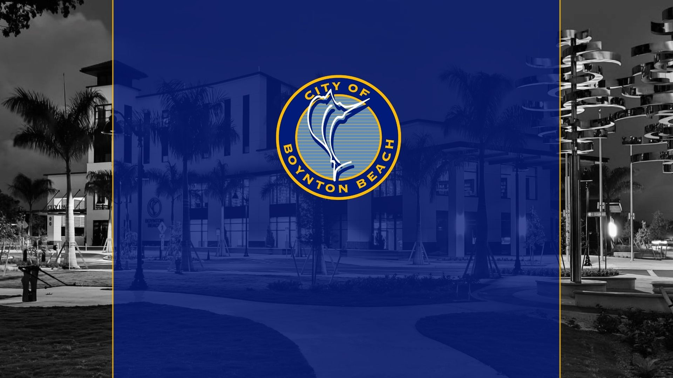
Utility Damage Prevention
&
Cost Recovery

Slide 2
Overview
Statistics/Damage Reporting – John S
Damage Prevention & Risk Reduction-Josh M
Incident Response & Documentation-Karla S
Cause Analysis & Cost Recovery-Karla S

Slide 3
Mandatory Damage Reporting
Member Operators are required to report damages to Sunshine 811
At least annually by March 31 for prior calendar year
Must describe, if known
Cause
Nature
Location

Slide 4
Damage Report Analysis
Authorizes Sunshine 811 to analyze damage data as
authorized by BOD
To support future legislation
To target public awareness campaigns
Not used for enforcement purposes
Not used to determine liability
Requires Sunshine 811 to send a summary of damages
reported to President of the Senate, Speaker of the House,
and Governor

Slide 5
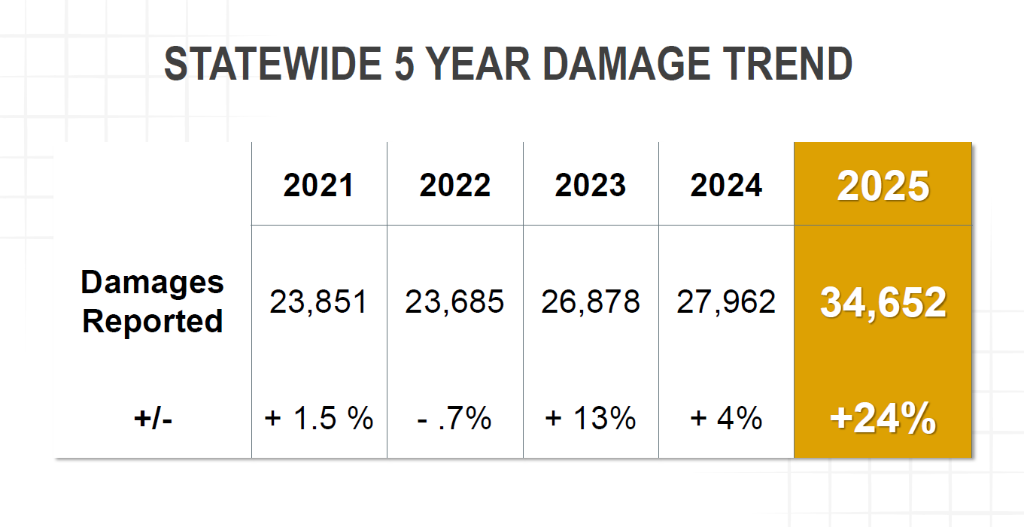

Slide 6
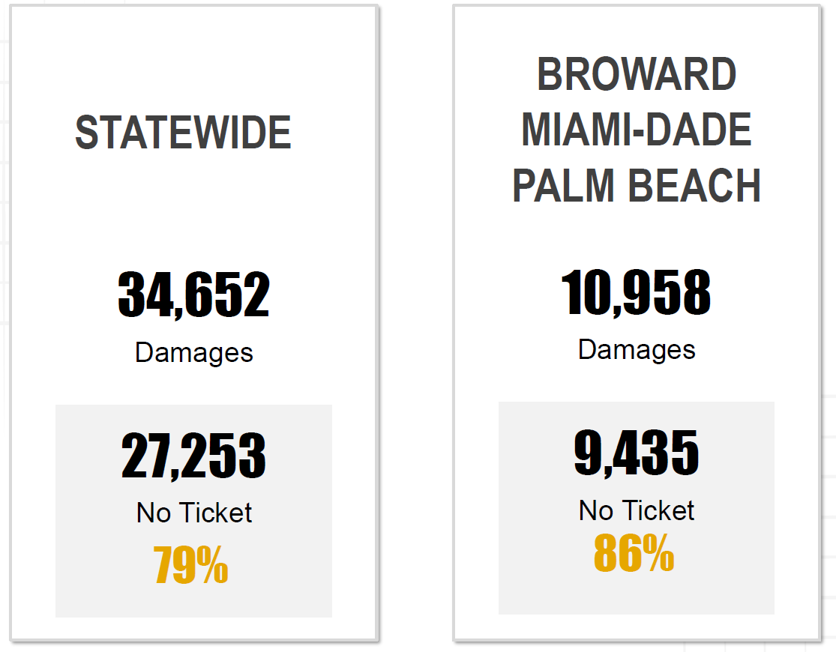

Slide 7
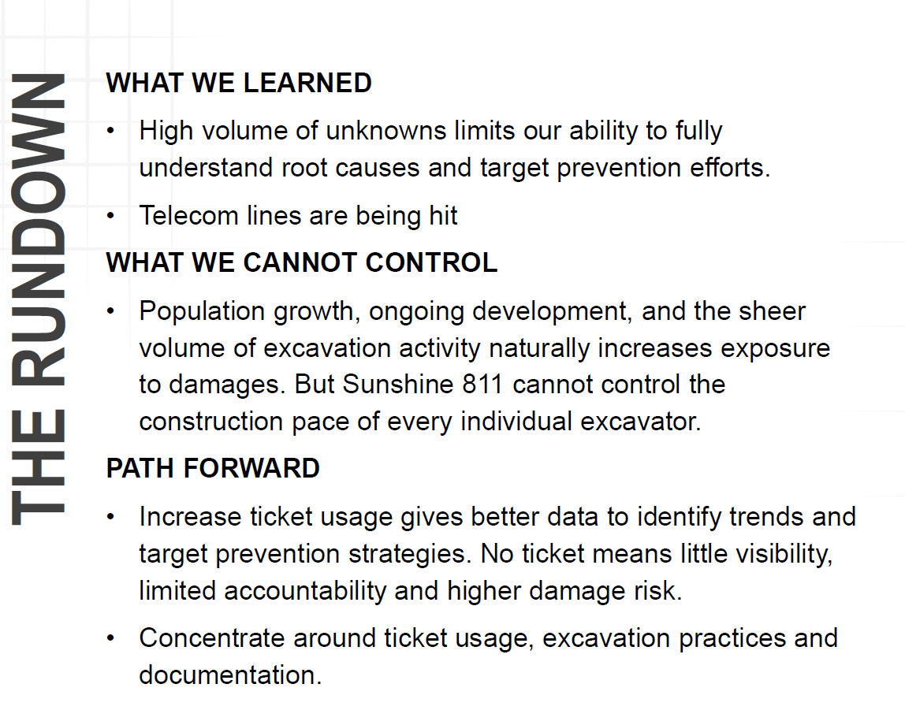

Slide 8

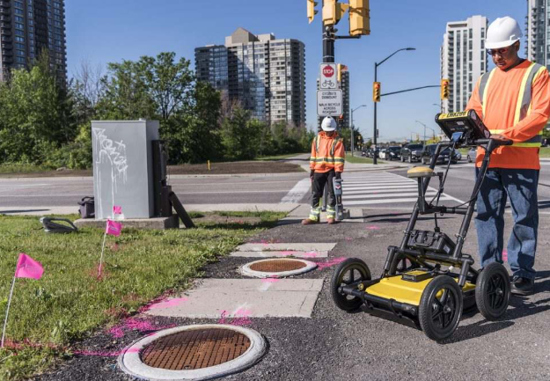
Damage Prevention & Risk Reduction
Dedicated in-house locating team
Experience + developing staff
Contractor communication & accountability
Access to reliable as-builts
👉 If the locate is wrong—
everything fails!
Notes:
Our locators are critical. Accuracy here prevents most damages. Most utility damages are preventable, and the first line of defense is accurate locating. We’ve invested in people, training, technology, and better records so our field teams and contractors are working from reliable information.
• Dedicated in‑house locator staff
• Ongoing training for locators and field crews
• New equipment (GPR)
• Critical GIS updates
• Access to accurate as‑builts
Maintaining Comms with contractors and holding them accountable

Slide 9
Incident Response & Documentation
Regular spill‑response drills
Spill kits and response trailer
Repair materials pre-staged for rapid response
📞 24/7 on‑call response coverage
• All incidents documented using Damage Information Reporting Tool (DIRT)
Notes:
On call staff for each discipline, Even with prevention efforts, incidents still happen. Our focus is rapid containment, public protection, and immediate documentation while details are fresh

Slide 10
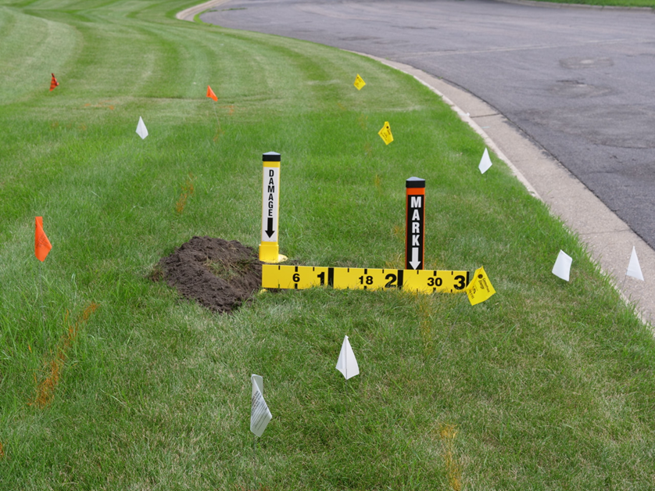
Documentation: Consistent, Clear, Defensible
Process Map
Provides a step‑by‑step workflow for incident reporting.
Standardized Approach & Training
Ensures every crew documents hits the same way.
Hit Kit
Tools and forms ready for immediate use at the scene.
Notes:
One of our biggest improvements was standardization. Before, documentation varied by crew. Now every response follows the same workflow, uses the same tools, and captures the information needed for analysis and recovery.

Slide 11
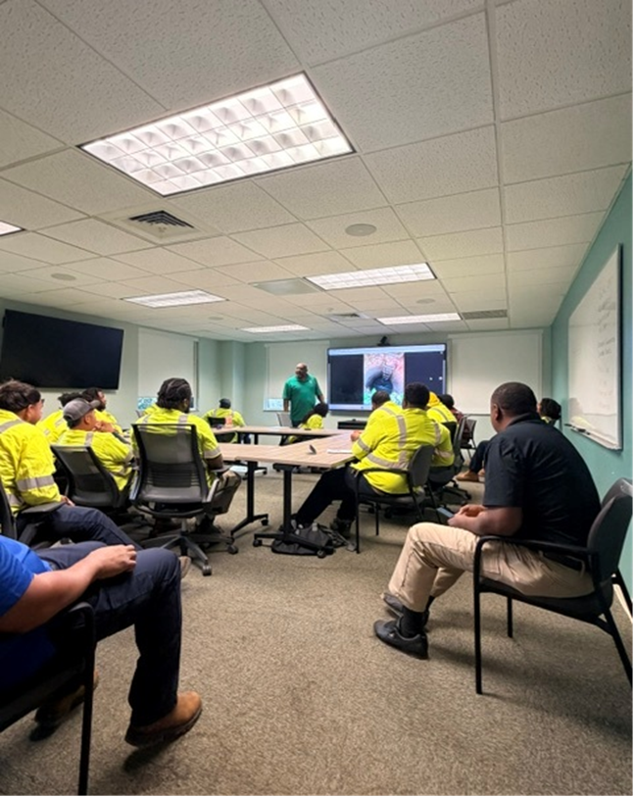
Root Cause Analysis & Cost Recovery
• Identify contributing factors
Correct repeat failure points
Support defensible reimbursement claims
Notes:
Documentation alone isn’t enough. We review each incident to understand what actually happened—locator issue, contractor error, record issue, communication breakdown—then act on that

Slide 12
Cost Recovery
• Standardized invoicing templates (include water loss)
Created reimbursement tracking tool
Ongoing coordination with Risk Management
Ongoing training with staff on documentation procedures (hit kit, photos, etc.)
GIS incident tracking
Notes:
Including insurance reimbursement-Historically, recovery was inconsistent because documentation and invoicing weren’t standardized. We built a repeatable process that supports reimbursement and gives visibility into outstanding claims.

Slide 13
Cost Recovery Results
$58,986.19 in documented damages
$6,000+ Recovered to date
Program implemented <6 months ago
Notes:
This is after implementation less than 6 months ago

Slide 14
From Reactive to Proactive
Using data to identify root causes
Tracking every incident consistently
Pursuing recovery through a repeatable claims process
Turning incidents into prevention opportunities
Notes:
We started tracking incidents more consistently—and that changed everything

Slide 15
Summary
Standardized response process
Defined roles across divisions
Enabled consistent documentation
Built the foundation for prevention & cost recovery
👉
Notes:
Our locators are critical. Accuracy here prevents most damages.

Slide 16


