Slide 1
Lower East Coast Water Supply Performance:
Is Your WUP Under Attack?
June 8, 2026

Slide 2
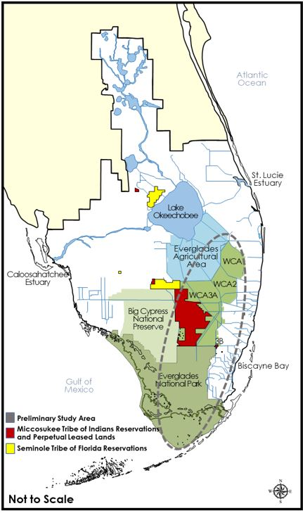
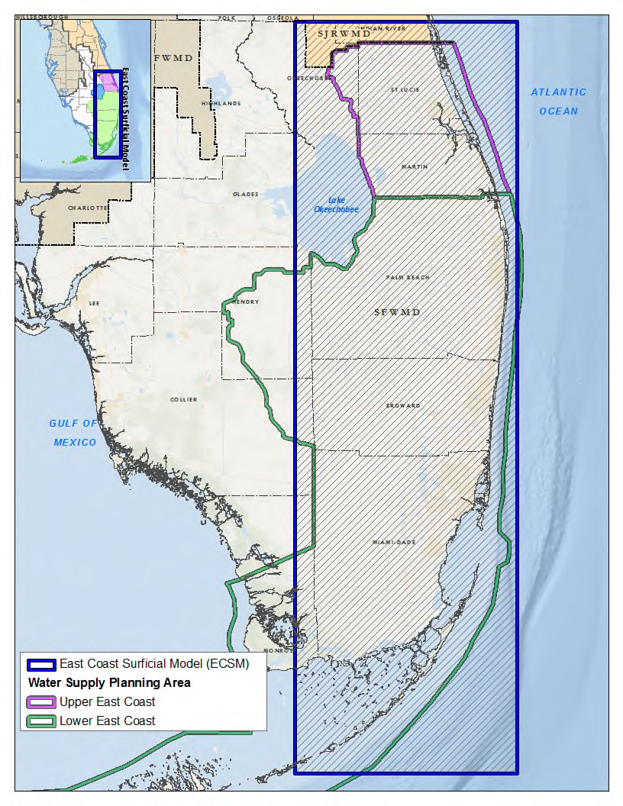
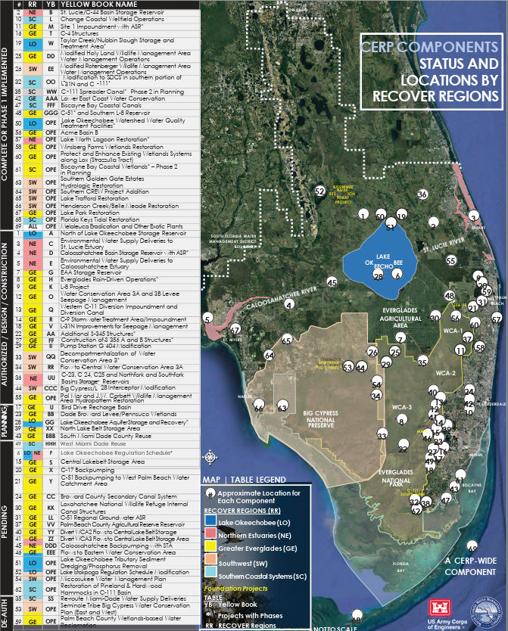
ECSM
CEPP Ops 1.0
SPCU

Slide 3
East Coast Surficial Model
Model Period of Record: 1985 – 2016
Cell size: 1,000 ft x 1,000 ft
SFWMD SEAWAT 2022
Evaluate 20-year planning demands
50-year (2075) model run also planned for Resiliency
SFWMD regional model to simulate and evaluate the effects of sea-level rise and saltwater intrusion in the surficial aquifer system

Slide 4
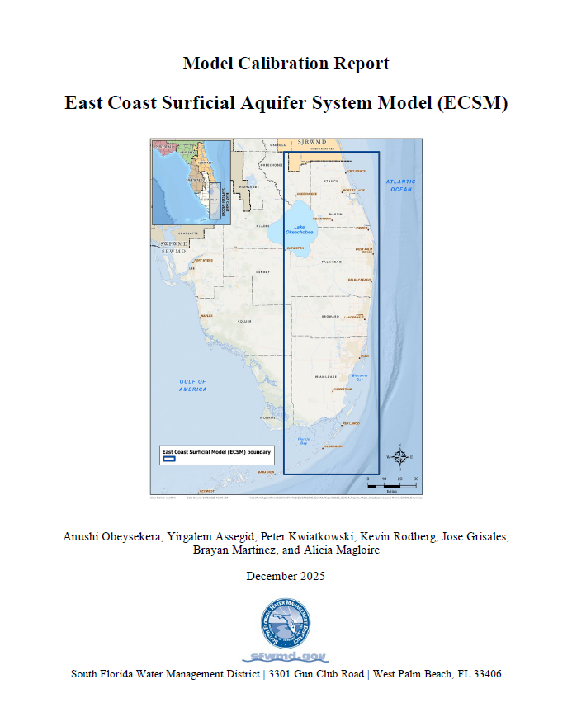
East Coast Surficial Model
“…there are significant differences between observed and simulated temporal water level response at specific wells.”
“Potential users of the ECSM should note that because of recognized data limitations, model simulation is more appropriate at sub-regional and regional scales rather than local or site-specific scales for simulation of hydrologic conditions.”

Slide 5
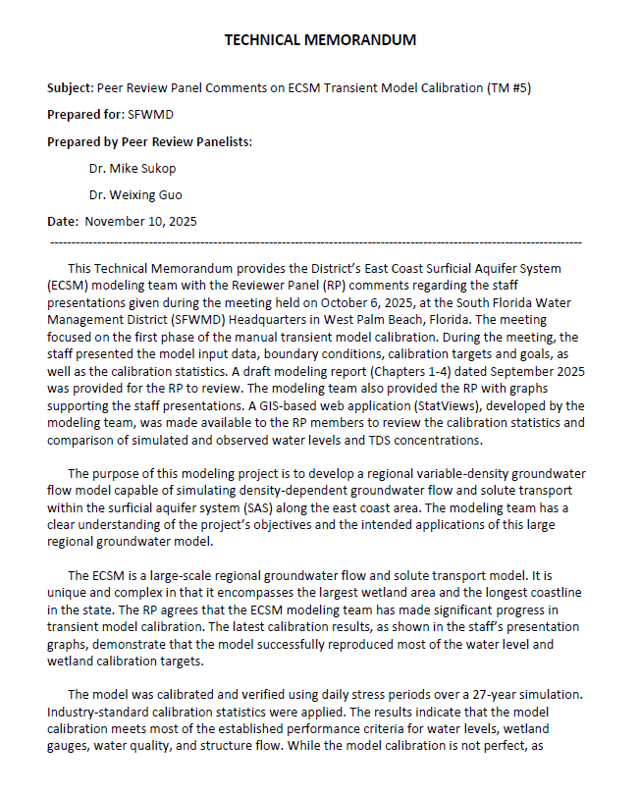
East Coast Surficial Model
Peer Review
Additional data collection
Not all calibration targets met
Needs sensitivity testing
Recommend looks at simulation differences, not direct results
SFWMD
Continuing model revisions and calibration

Slide 6
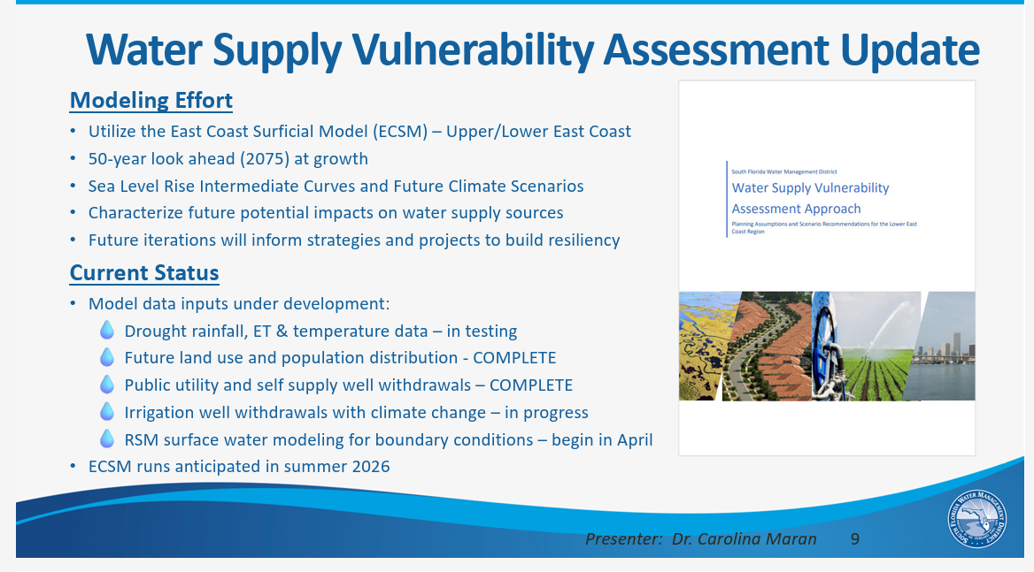

Slide 7
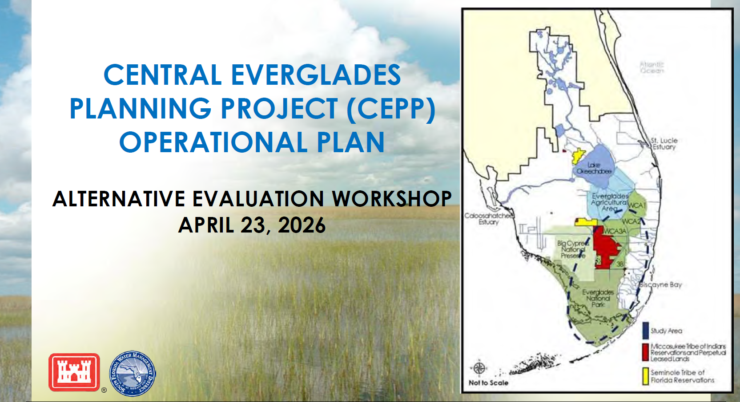
CEPP Ops 1.0

Slide 8
CEPP Ops 1.0
Goal of Central Everglades Planning Project (CEPP) Ops 1.0: maximize system-wide benefits towards incremental achievement of CEPP objectives based on consideration of year-to-year variable rainfall and hydrologic conditions

Slide 9
CEPP Ops 1.0
Plan Formulation Criteria:
Indigenous Knowledge
Ecology
Water Supply
Flood Risk Management
Recreation
Water Quality

Slide 10
CEPP Ops 1.0
Plan Formulation Criteria:
Indigenous Knowledge
Ecology
Water Supply
Flood Risk Management
Recreation
Water Quality

Slide 11
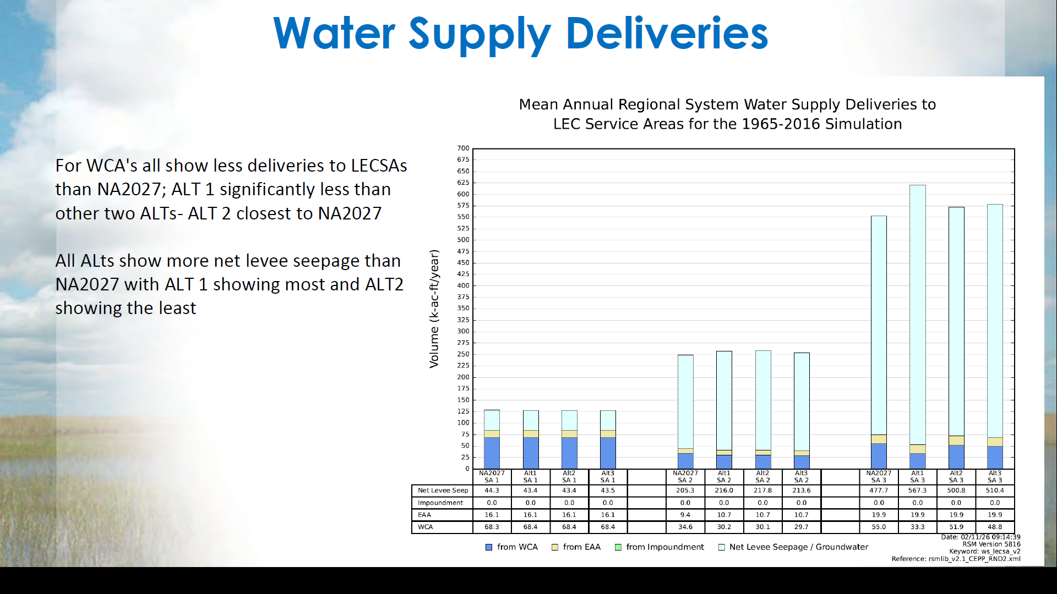

Slide 12
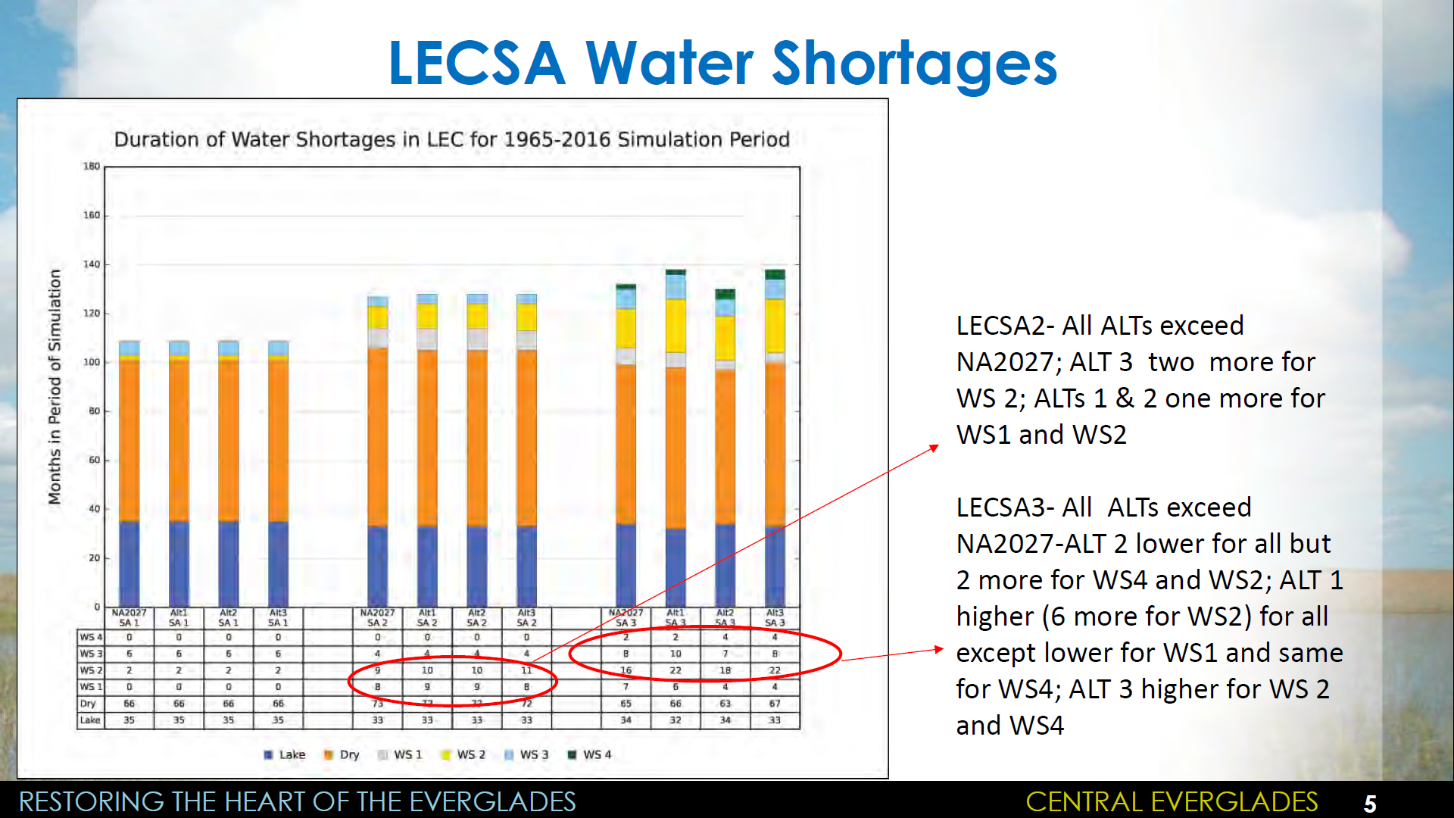

Slide 13
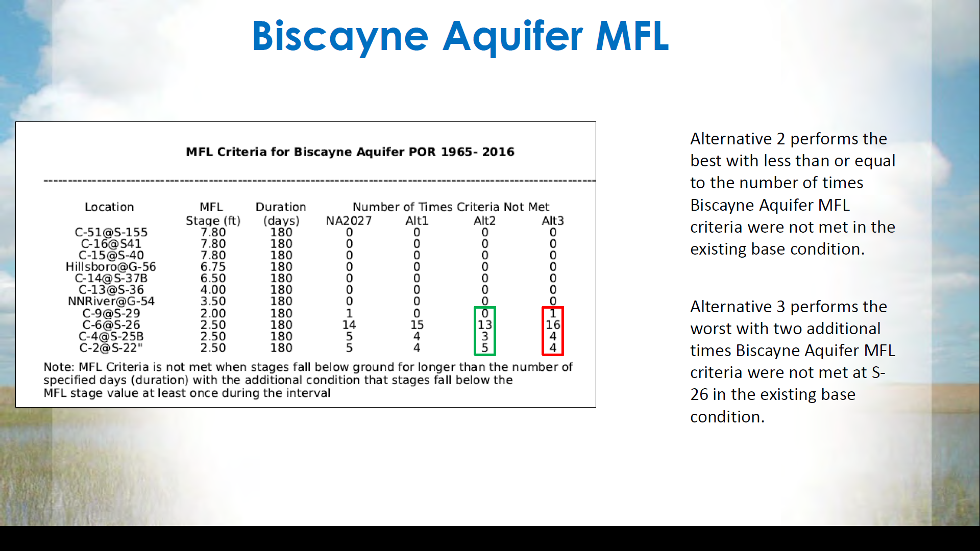

Slide 14
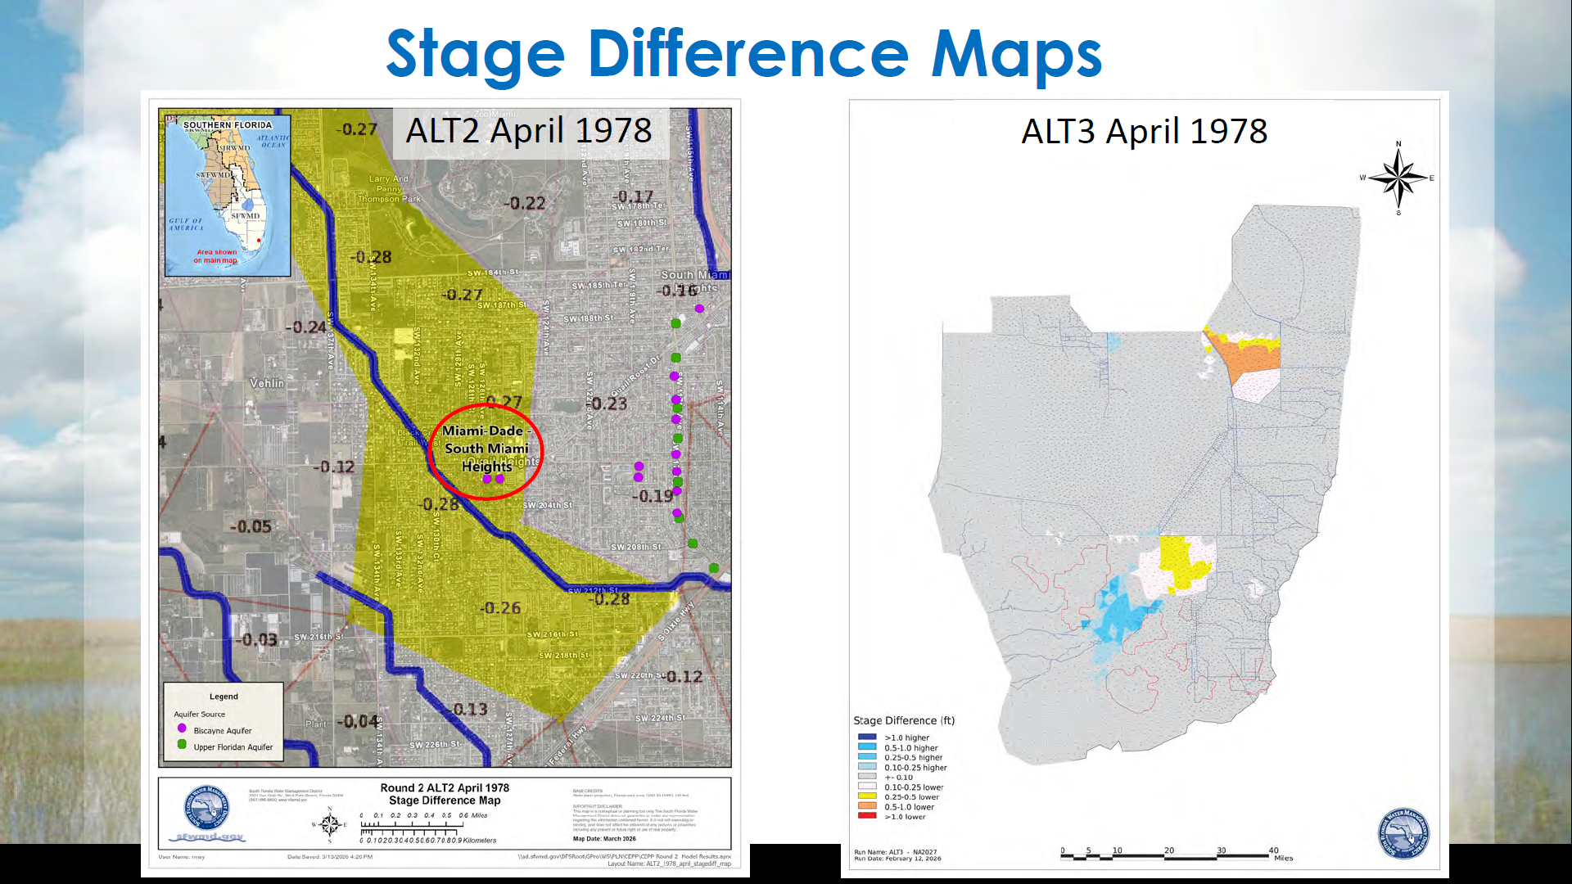

Slide 15
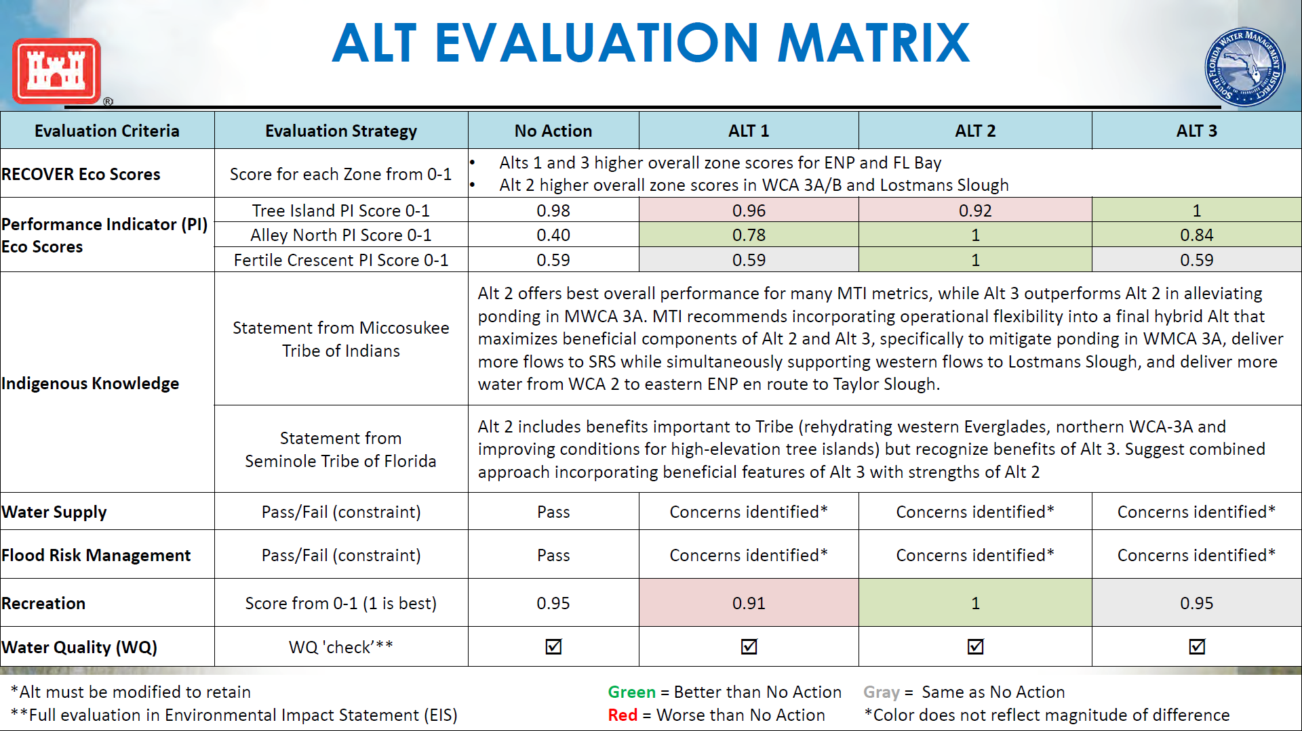

Slide 17
Second
Periodic
Comprehensive Everglades Restoration Plan
Update

Slide 18
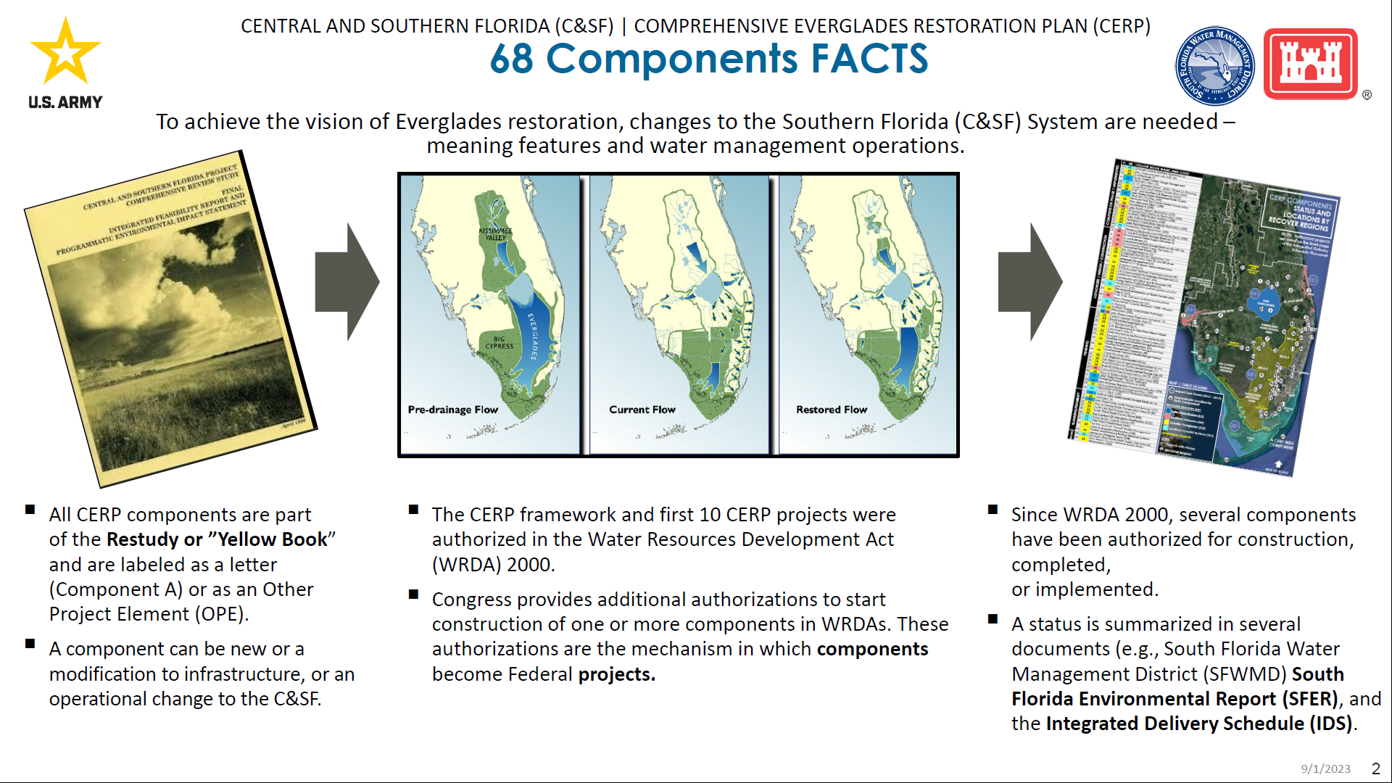

Slide 19
SPCU Model Decision Tree

Slide 20
SPCU Project Decisions
Future With Project (CERPB)

Slide 21
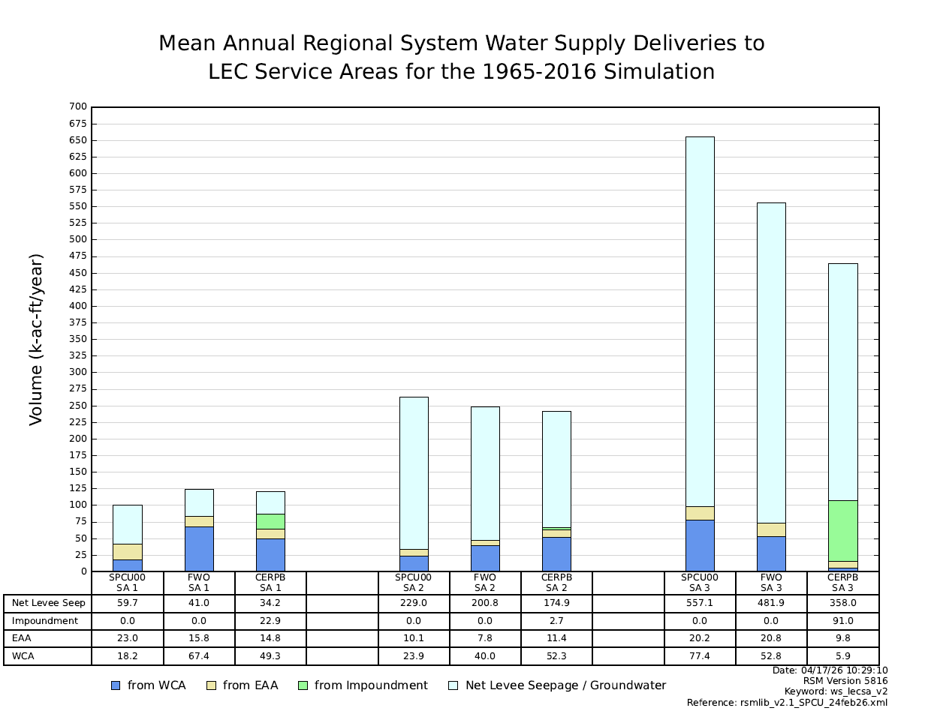
Decrease in levee seepage

Slide 22
Decrease in levee seepage
Increase in Impoundment deliveries

Slide 23
Decrease in levee seepage
Increase in Impoundment deliveries
Increased reliance on WCAs in SA1 and SA2

Slide 24
Decrease in levee seepage
Increase in Impoundment deliveries
Increased reliance on WCAs in SA1 and SA2
Sharp decrease in WCAs in SA3

Slide 25
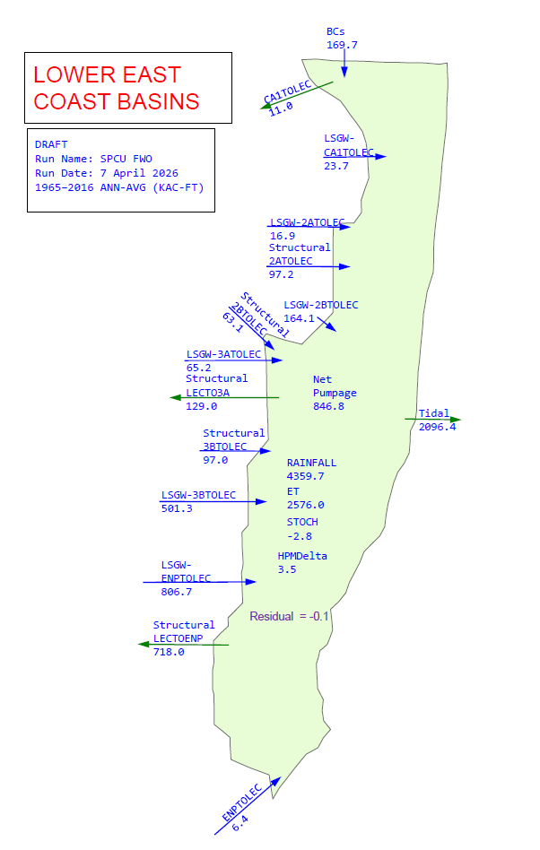
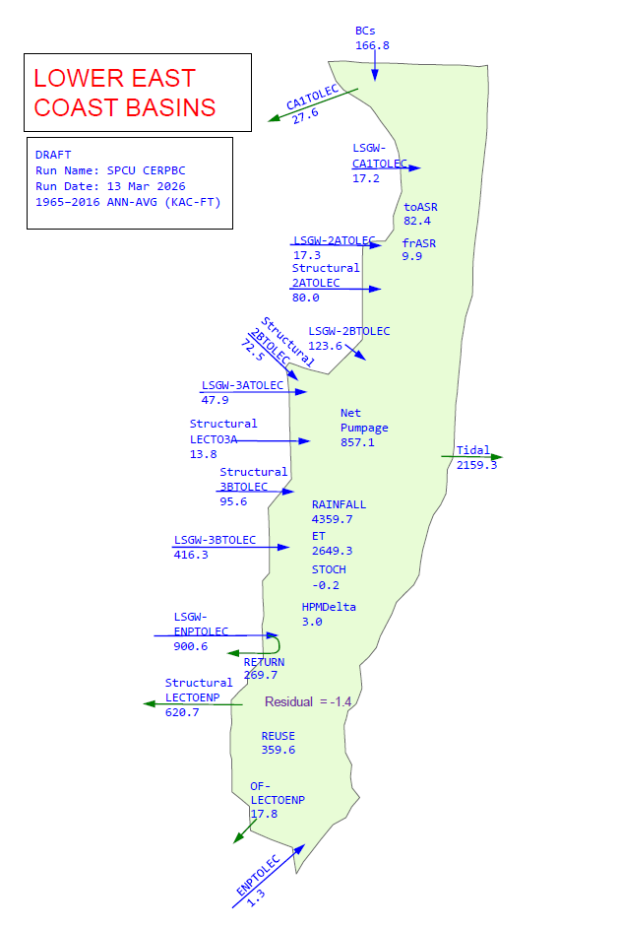
Future Without (FWO)
SPCU (CERPB)
Annual Averages
8.8 MGD from ASR
321 MGD in reuse

Slide 26
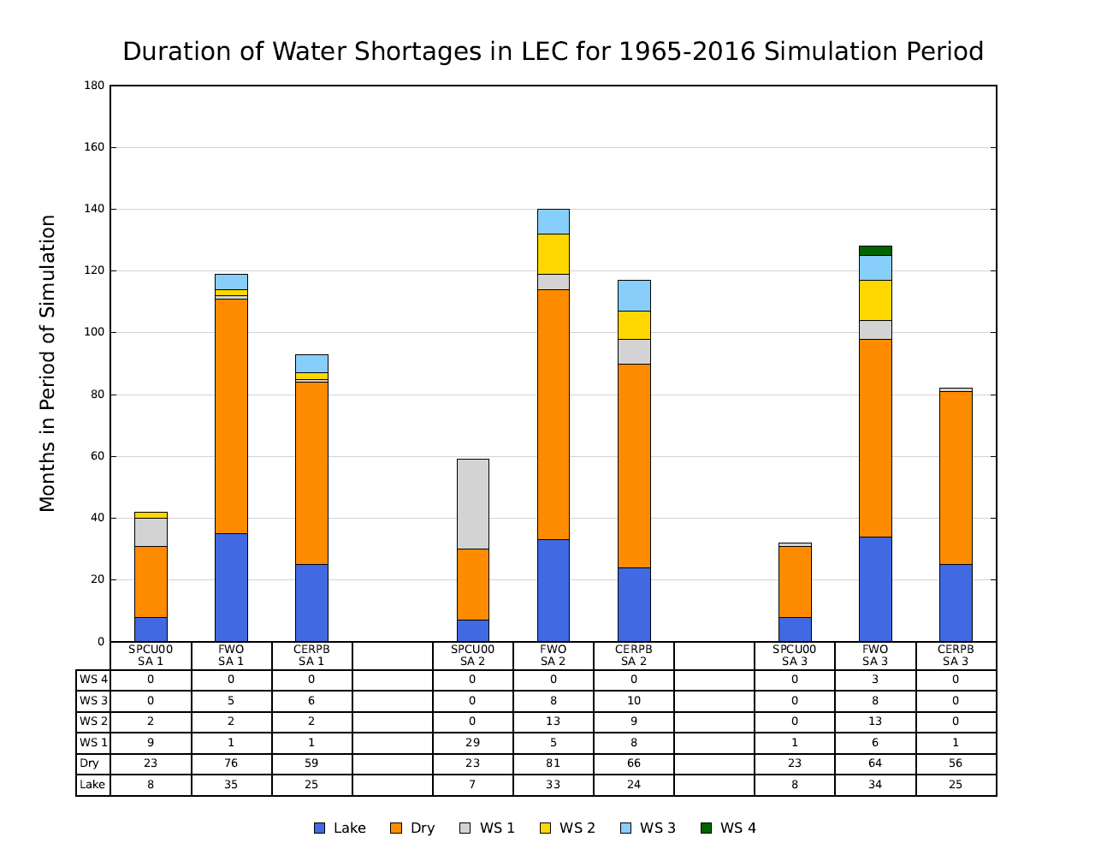
CERPB results better than FWO
CERPB results worse than 2000 baseline
Results contingent upon CERP projects

Slide 27
Savings Clause
CEPP Ops 1.0
SPCU
Water Resources Development Act (WRDA) of 2000
The “Savings Clause” does apply and an evaluation is required

Slide 28
Savings Clause
CEPP Ops 1.0
SPCU
Water Resources Development Act (WRDA) of 2000
The “Savings Clause” does apply and an evaluation is required
Exercise your Federal and State rights through participation

Slide 29
steven@gmawater.com
561-318-9532
Thank you.

