Slide 1
Focus on Change Recap based on FDEP Slides and Punta Gorda Presentation 3/25/26
Slides available at:
https://www.frwa.net/focus-on-change-presentations

Slide 2
PFAS – Drinking Water
PFAS rule (40 CFR Part 141) undergoing revision:
Rescind the MCLs for PFHxS, PFNA, GenX, and the Hazard Index
Extend the compliance date to 2031
Still under the existing rule (Compliance by April 26, 2029)
Initial Monitoring results still required by April 26, 2027 (POEs -4 quarters for most)
May use prior data (such as UCMR) with approval from FDEP
Florida still does not have primacy, so EPA Region 4 regulates directly
Compliance Monitoring begins April 26, 2027 (POEs – 4 quarterly if initial results above one half the MCL)
Annual then Triennial (similar to lead and copper)
https://floridadep.gov/water/source-drinking-water/content/and-polyfluoroalkyl-substances-pfas

Slide 3
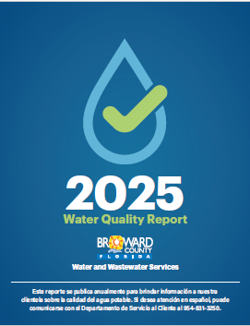
Consumer Confidence Report (CCR)
Due twice in 2027
July 1, 2027 report covers all of 2026
December 31, 2027 report covers January 1 – June 30, 2027
If you have no new data, violations, or need to report forgotten data, may distribute the same CCR
Suggestion: Sample annuals or triennials after July 1
Data to consecutive systems has a new date (April and October)
New Summary section in Front
New language for contamination sources
Posting if > 50,000
Assistance with Limited English proficiency if >100,000

Slide 4
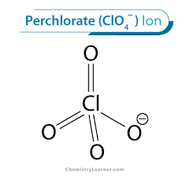
Perchlorate Rule
Rule making expected with possible MCLs of 20 ug/L or 40 ug/L or 80 ug/L
What: On January 6, 2025, the U.S. Environmental Protection Agency (EPA) proposed a National Primary Drinking Water Regulation (NPDWR) and a health-based Maximum Contaminant Level Goal (MCLG) for perchlorate under the Safe Drinking Water Act (SDWA).
Why: Perchlorate is an inorganic chemical compound that occurs naturally and can also be manufactured. It is commonly used in solid rocket propellants, munitions, fireworks, airbag initiators for vehicles, matches, signal flares, and may also be found in fertilizers and as a byproduct of improper handling of hypochlorite solutions used for drinking water treatment. Perchlorate exposure to humans occurs primarily through the ingestion of contaminated food and drinking water.

Slide 5
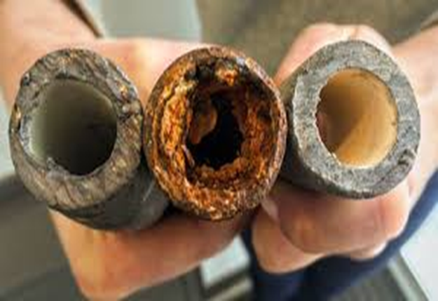
Lead and Copper Rule Improvements
Still under the LCRI
Items due on November 1, 2027
Schools & Daycares list
Junior high = high school
waivers available
Baseline Inventory
Includes addresses
Connector information
Service Line Replacement Plan
If have Lead, GRR or unknown lines
If have lead, unknown connectors
Sampling plan
Annual letters due in July 2026 and December 2027
24 hour notifications for Lead AL exceedance – issue with code red systems

Slide 6






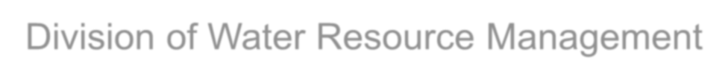

LEGISLATION AND RULES
Kristine Locke Wastewater Management Program Division of Water Resource Management
Florida Department of Environmental Protection
Focus on Change | 2026

Slide 7

HB 1379
DEFINITIONS (3)
AWT ─ defined in section 403.086(4), F.S.; treatment which will provide a
reclaimed water product that:
  Contains not more, on a permitted annual average basis, than the following
concentrations:
    5 mg/L of biochemical oxygen demand (CBOD5).
    5 mg/L of suspended solids.
    3 mg/L of total nitrogen (TN), expressed as N.
    1 mg/L of total phosphorus (TP), expressed as P.
  Has received high level disinfection, as defined by Rule 62-600.440, F.A.C.

Slide 8
HB 1379
SECTION 403.086, F.S. – ADDITIONS
In addition to the previously listed waterbodies, facilities will need to meet AWT or a more stringent treatment standard if they are discharging into the following waterbodies:
  Those not currently attaining nutrient or nutrient-related standards (WNAS).
  Those subject to a nutrient or nutrient-related BMAP.
  Those subject to an adopted RAP.
The facilities must meet this requirement by Jan. 1, 2033.
After July 1, 2023, facilities discharging into waterbodies subject to the above criteria must meet AWT within 10 years of such determination or adoption.
  Facilities that fail to meet AWT within 10 years of such determination or adoption are prohibited from disposing of any wastes into those waterbodies.

Slide 9

HB 1557
SECTION 403.064, F.S. – REVISIONS
After July 1, 2024, all applicants for permits to construct or operate a domestic wastewater treatment facility shall prepare a reuse feasibility study as part of their application for the permit.
  The revision removed the language “located within, serving a population located
within, or discharging within a water resource caution area”.
The study must evaluate different types of reuse.
After conducting the feasibility study, the facility must implement reuse
to the degree that reuse is feasible, based upon the applicant’s study.
  Gives consideration to direct ecological or public water supply benefits afforded by any disposal.
  Does not limit the use of the disposal methods for backup use only.
Section 403.064(5), F.S., lists two exemptions based on facility capacity.

Slide 10
HB 1557
SECTION 403.086, F.S. – ADDITION
By July 1, 2034, any wastewater treatment facility providing reclaimed water that will be used for commercial or residential irrigation or be otherwise land applied within a nutrient BMAP or RAP must meet the AWT standards for TN and TP …if DEP has determined in the BMAP or RAP that the use of reclaimed water as described in this subparagraph is causing or contributing to the nutrient impairment being addressed in such plan.
If DEP makes the determination after July 1, 2024, the facility has 10 years from such determination to meet the standards for TN and TP established in the BMAP.
  May require an alternative treatment standard, including a more stringent treatment standard.
  Does not apply to reclaimed water that is otherwise land applied as part of an
approved water quality restoration project or water resource development project.

Slide 11

HB 1379 AND HB 1557
UPDATED NUTRIENT BMAPS
DEP’s Division of Environmental Assessment and Restoration published 23 new
2025 updates to existing Basin Management Action Plans (BMAPs).
  An additional five BMAPs have been petitioned/have been given comment extensions
but will eventually become effective.
Primary impacts to domestic wastewater treatment facilities are the updated effluent limit tables for nutrients based on facility size and disposal method.
  Section 403.086(1)(c)1.c., F.S., requires surface water discharge within a BMAP
region to meet 3 mg/L for TN and 1 mg/L for TP by 2033.
  Section 403.086(1)(c)3., F.S., requires land application discharge to meet the BMAP effluent limitations for the impaired nutrient(s) within 10 years of BMAP adoption.
  Other disposal types must meet the BMAP effluent limitations for the impaired nutrient(s) at the time of permit renewal or no later than five years after BMAP adoption, whichever is sooner.

Slide 12
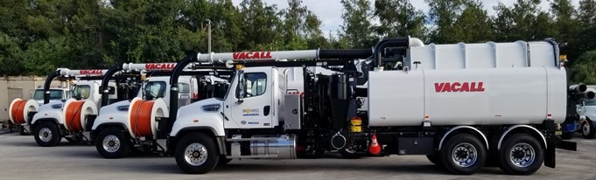
Grease Waste Removal and Disposal
The rule is now in effect
Since permitted wastewater treatment facilities, biosolids treatment facilities and septage management facilities are already approved disposal sites, an additional permit is not required.
https://FloridaDEP.gov/GreaseWaste

Slide 13
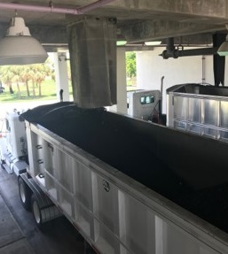
Biosolids
There are 5 bills impacting biosolids this year. FDEP is not sure how they will interpret the bills.

Slide 14
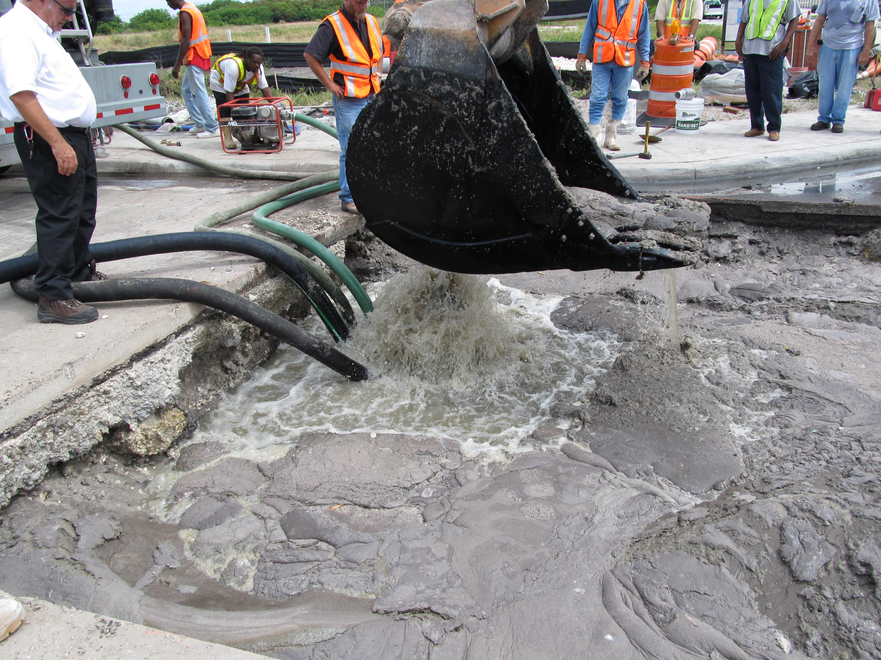
Collection System Rule Revisions
Collection System rule revision is expected soon.
Notice of proposed rule for FAC 62-604 is currently being prepared and include:
Clarifying the provisions for minimizing inflow, infiltration and leakages
Clarifying the provisions for preventing SSOs
Requiring the Power Outage Contingency Plans address upgrading older pump stations to meet the rule’s current emergency pumping capability requirements
Clarifying that surface water monitoring is required when SSOs impact surface waters

Slide 15
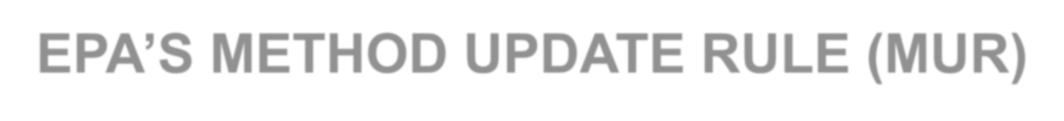
EPA’S METHOD UPDATE RULE (MUR)
Chapter 62-620, F.A.C., was amended to incorporate revisions to 40 Code of Federal Regulation (C.F.R.), Part 136, which establishes guidelines for monitoring and testing methods for wastewater permits.
  Located at: https://www.ecfr.gov/current/title-40/chapter-I/subchapter-D/part-136.
Updates to 40 C.F.R., Part 136 include:
  Clarifications to existing methods.
  Clarifications to sampling and preservation procedures methods.
Requirements of the MUR are presently effective and must be utilized by labs and/or samplers.
Effective date of Sept. 8, 2025.

Slide 16

FORM UPDATES
Updating forms adopted in Chapter 62-620, F.A.C.
  To include all information fields from EPA’s National Pollutant Discharge Elimination System (NPDES) forms, including eReporting.
  To be consistent with revisions made in past years to DEP rules and F.S.
  Notice of Rule Development (NORD) has been published and Notice of Proposed Rule (NOPR) is expected to be published soon.
Updated forms adopted in Chapter 62-621, F.A.C. on May 7, 2025.
  To include all information fields from EPA’s NPDES forms, including eReporting.
  Fast-track rule adoption due to federal regulation.

Slide 17

Questions
Maria Loucraft
SEFLUC Chair
mloucraft@broward.org
(954) 831 -0776
Information compiled from the Florida Water Rural Focus on Change Presentation Slides and the in-person presentations provided in Punta Gorda on March 25, 2026.
Some slides have been taken directly from the FDEP presentations and are identified by the FDEP logo.

