Slide 1

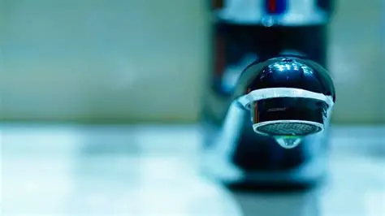
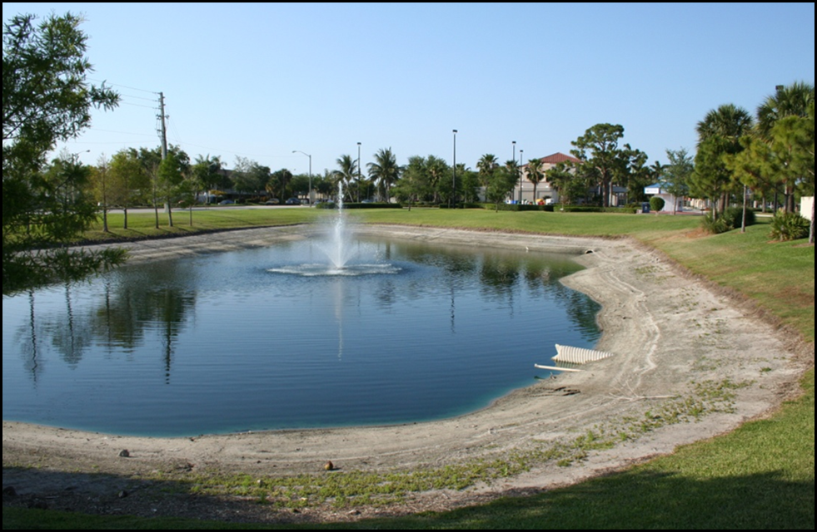
Water Supply Conditions and Water Conservation
PRESENTED BY:
Tom Colios
South Florida Water Management District
SEFLUC
April 13, 2026

Slide 2

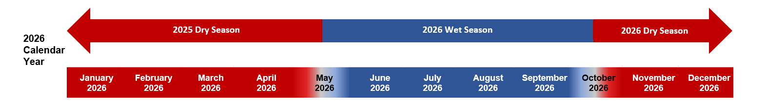
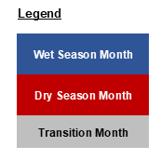

Approaching the Dry Season Ending
We are here
Dynamic Wet Season start date is around May 22.
Dynamic Wet Season end date is around October 12.
Presenter: Tom Colios
2
Notes:
So here we are now: Middle of the 2025 Water Year Dry Season, which started in October and will last until May 2026; so a few more months… and already looking forward to 2026 Wet Season, right?! (this is now where I thought I would be last year)

Slide 3
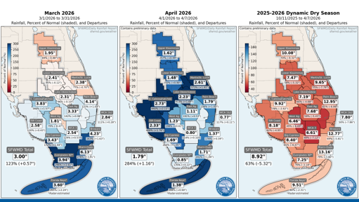
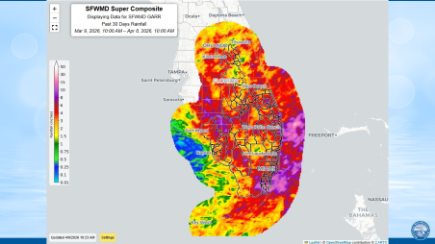
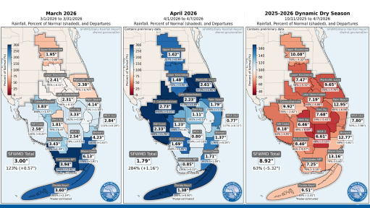

Status of Rainfall
Drier-than-Normal Dry Season
Total area-averaged rainfall has ranged between roughly 50% to 80% of normal for the dry season to date
March and early April rainfall ranged between 70% to 400% of the normal
Overall improved water levels conditions due to recent rainfall events
Presenter: Tom Colios
3
Notes:
With regards to the status of Rainfall, we are in a drier than normal dry season

Slide 4
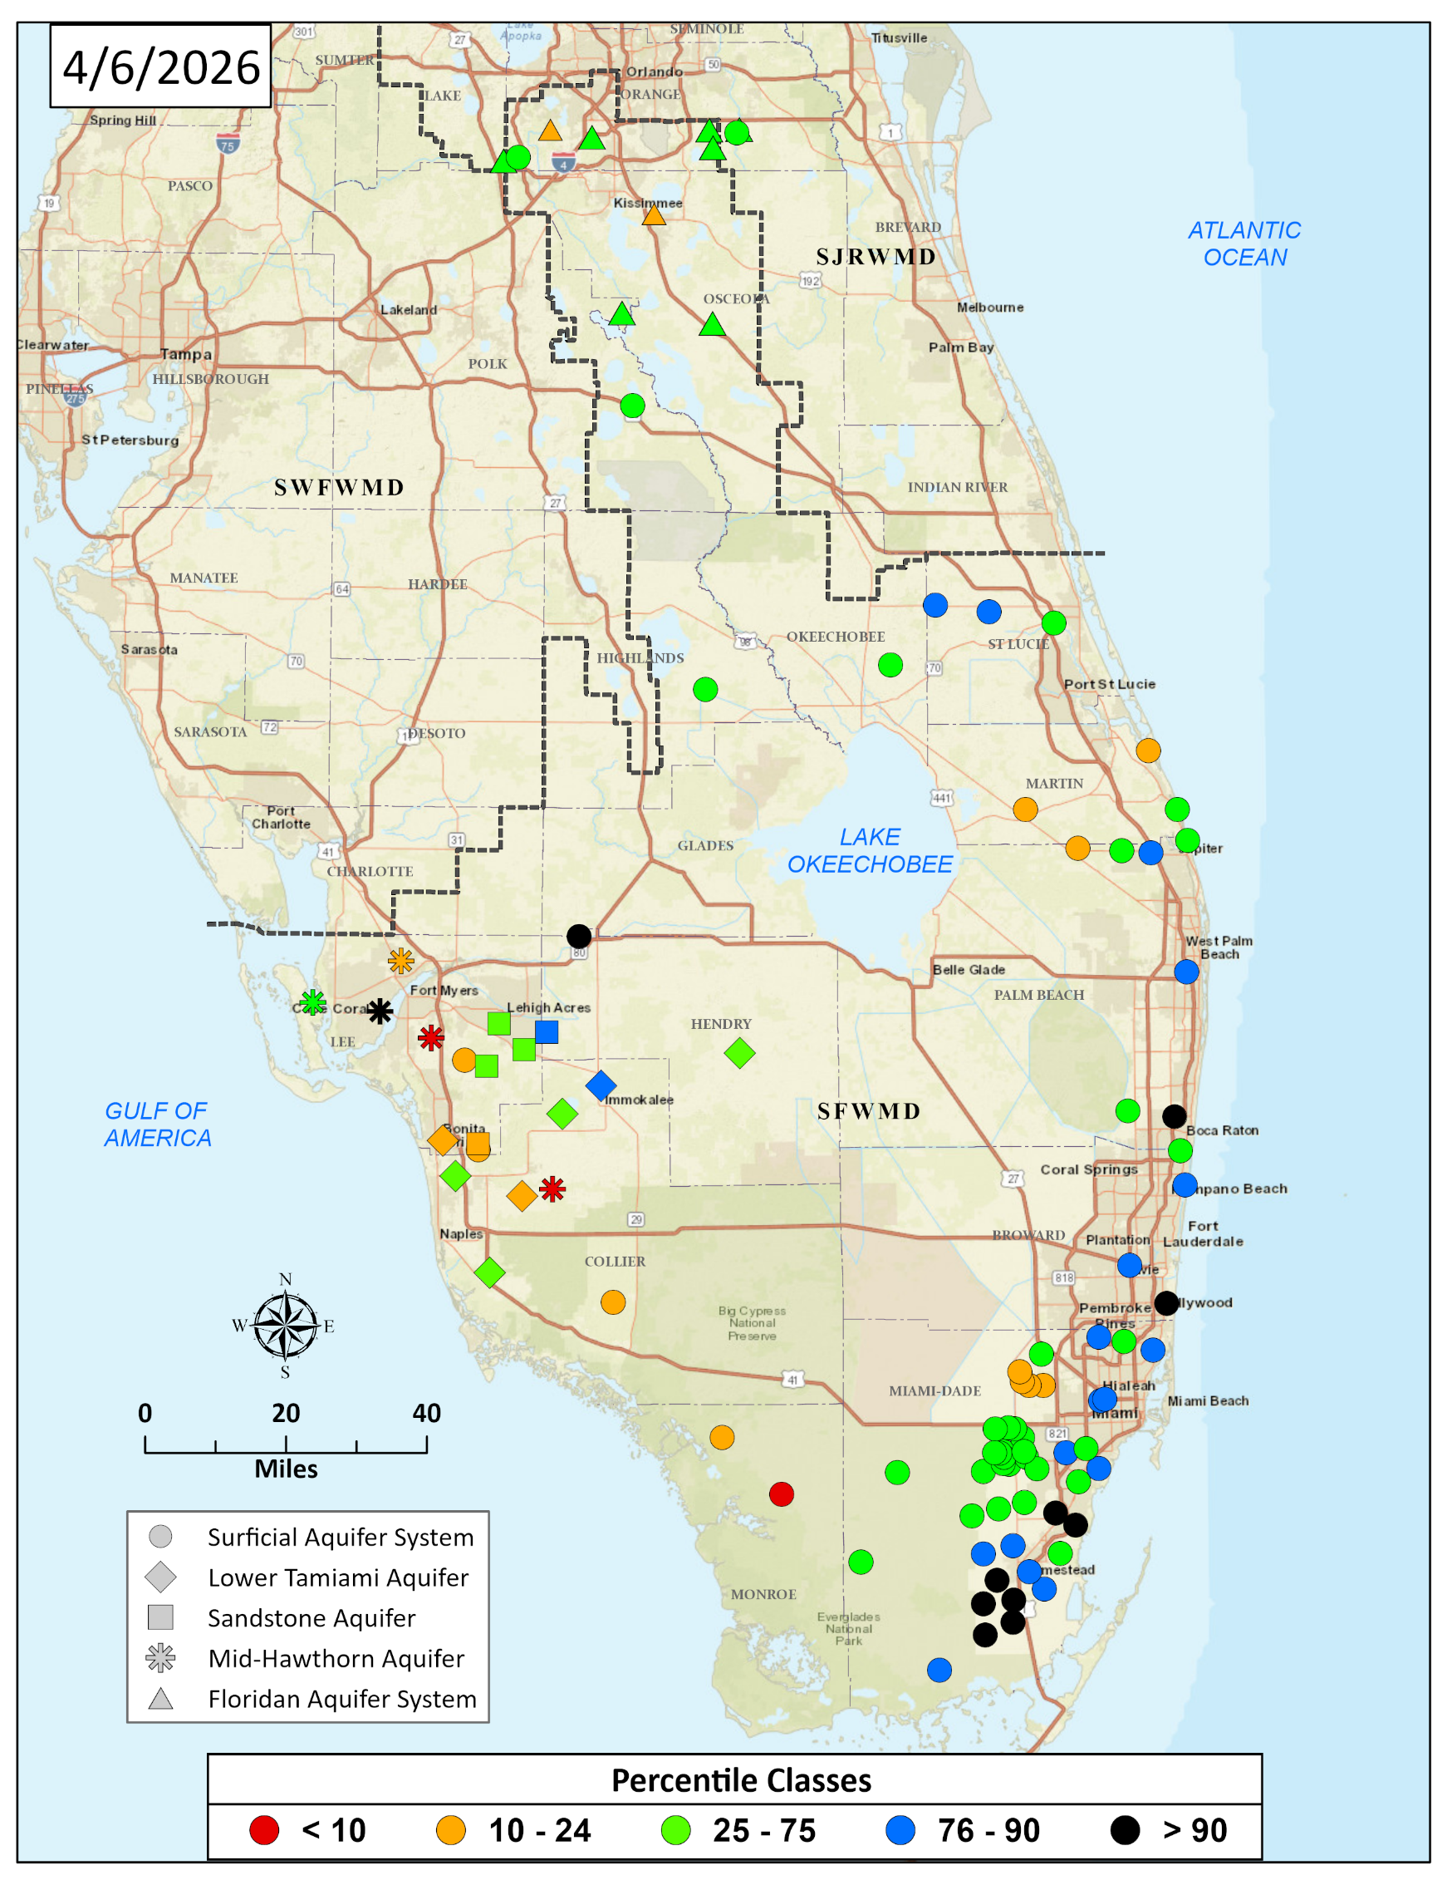
Status of Groundwater Levels
  Continuously monitoring groundwater levels (monitor wells locations)
  Statistical comparison of current water levels compared to historical for this time of year
  95% of Public Water Supply comes from groundwater
Presenter: Tom Colios
4
Notes:
With regards to GW Levels, noticing that 95% of our public water supply comes from groundwater – here is a map showing the location of our sentinel wells where we continuously monitor water levels.
Similarly to rainfall, this map shows a statistical comparison of current water levels compared to historical for this time of the year and wells in orange and red are in more critical conditions with levels below 25% and 10% of the time respectively, and declining, as expected for this time of the year.

Slide 5
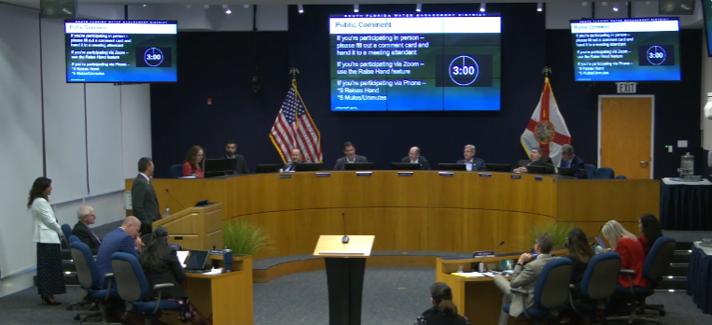
Ongoing Dry Season
February 5, 2026: Water Shortage Warning was issued for the Biscayne Aquifer and its recharge areas in Miami-Dade and Monroe Counties, the Lower Tamiami Aquifer in Lee and Collier Counties, and the Indian Prairie Basin in Glades and Highlands Counties.
February 12, 2026: SFWMD Governing Board approves Resolution 2026/0213 delegating to the Executive Director the authority to issue an order declaring a water shortage and imposing appropriate water use restrictions when certain hydrological conditions are present.
March 30, 2026: The District rescinded the Water Shortage Warning for the Biscayne Aquifer in Miami-Dade and Monroe Counties, as a result of recent rainfall in that area coupled with conservation efforts.
5
Notes:
We continue to look at LWC and Istokpoga regions for condition updates and also assessing the forecast conditions – which will be covered by Todd next

Slide 6
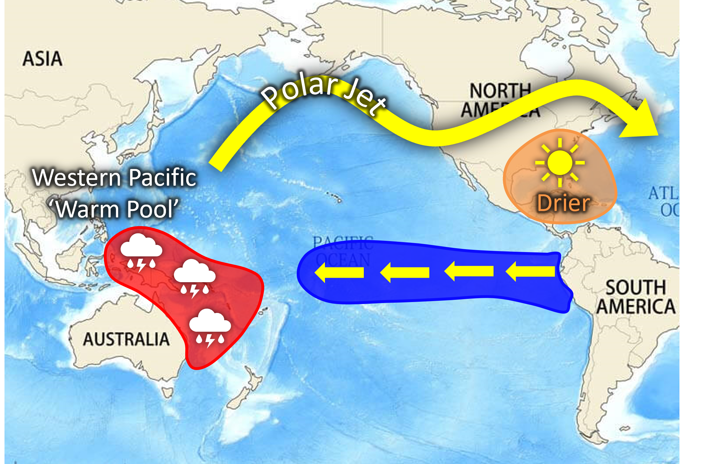
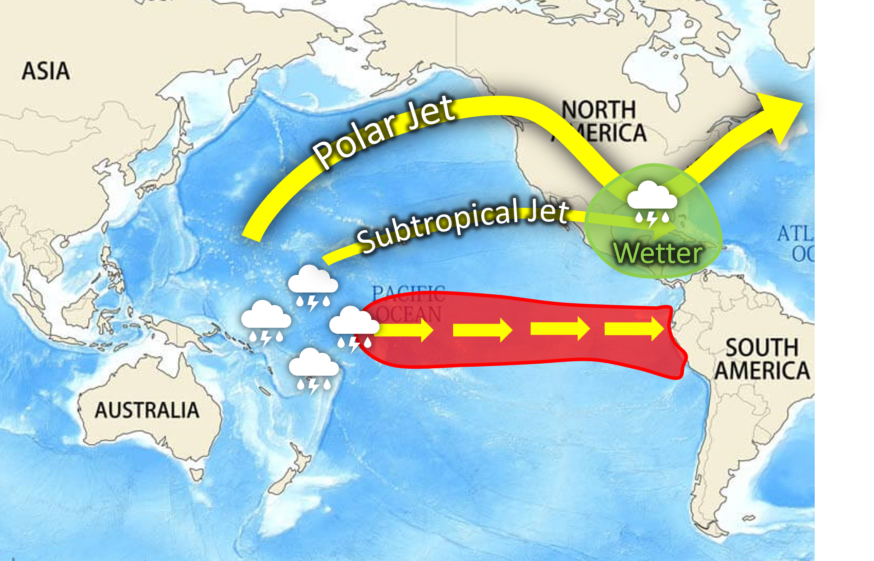
Rainfall Outlook Through End of Dry Season
  Early dry season was extremely dry (~20th percentile)
  Dry season normally ends in late May (median end date 22 May)
  Atmosphere has recently oribited through an El Niño-like state
  Has led to an unprecedented wet regime since late February
  Rainfall forecast confidence remains low during ENSO transition
La Niña Pattern
El Niño Pattern
6

Slide 7
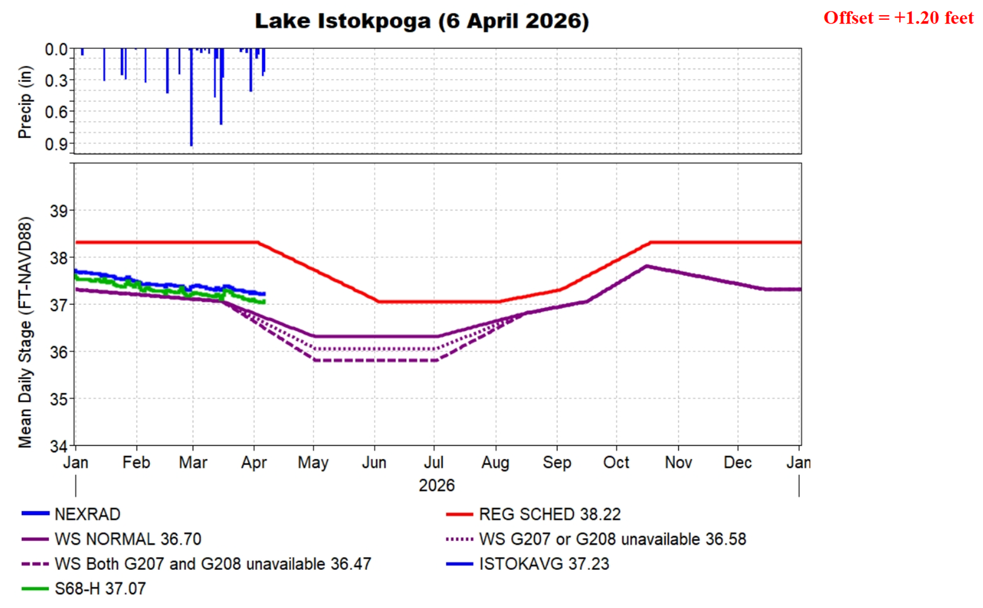
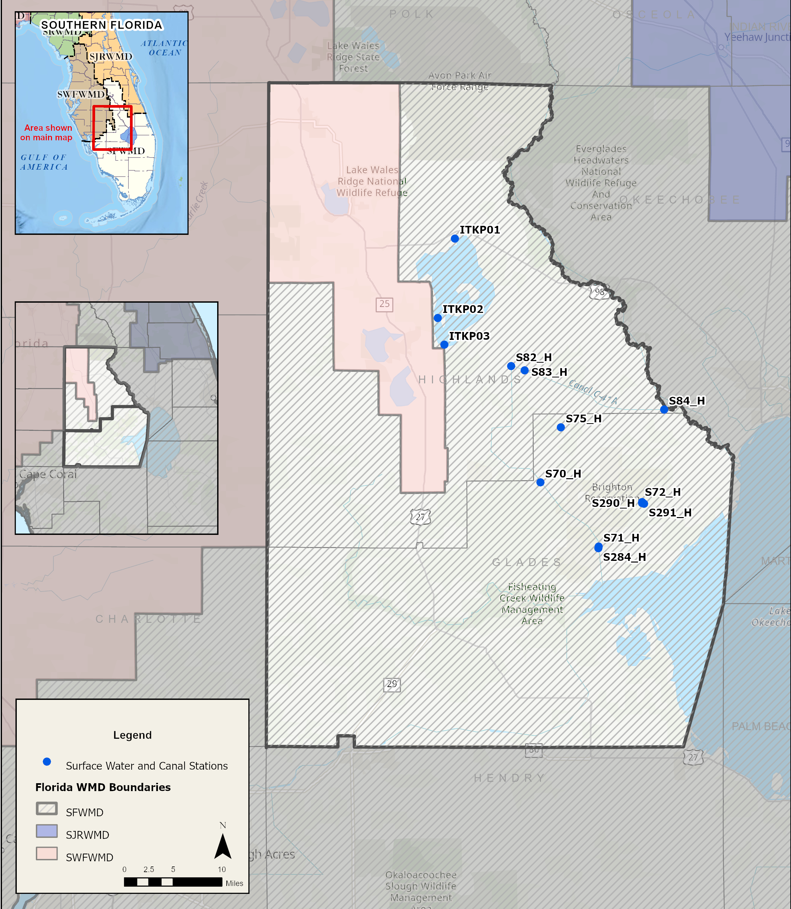
Indian Prairie Basin Glades and Highlands Counties
Deviation Request was approved by USACE to continue to allow deliveries from Lake Istokpoga to meet water supply demands in the Indian Prairie Basin when lake stage drops below solid line.
Presenter: Tom Colios
7
Notes:
2 years DEVIATION
Initiated Coordination with Seminole Tribe

Slide 8
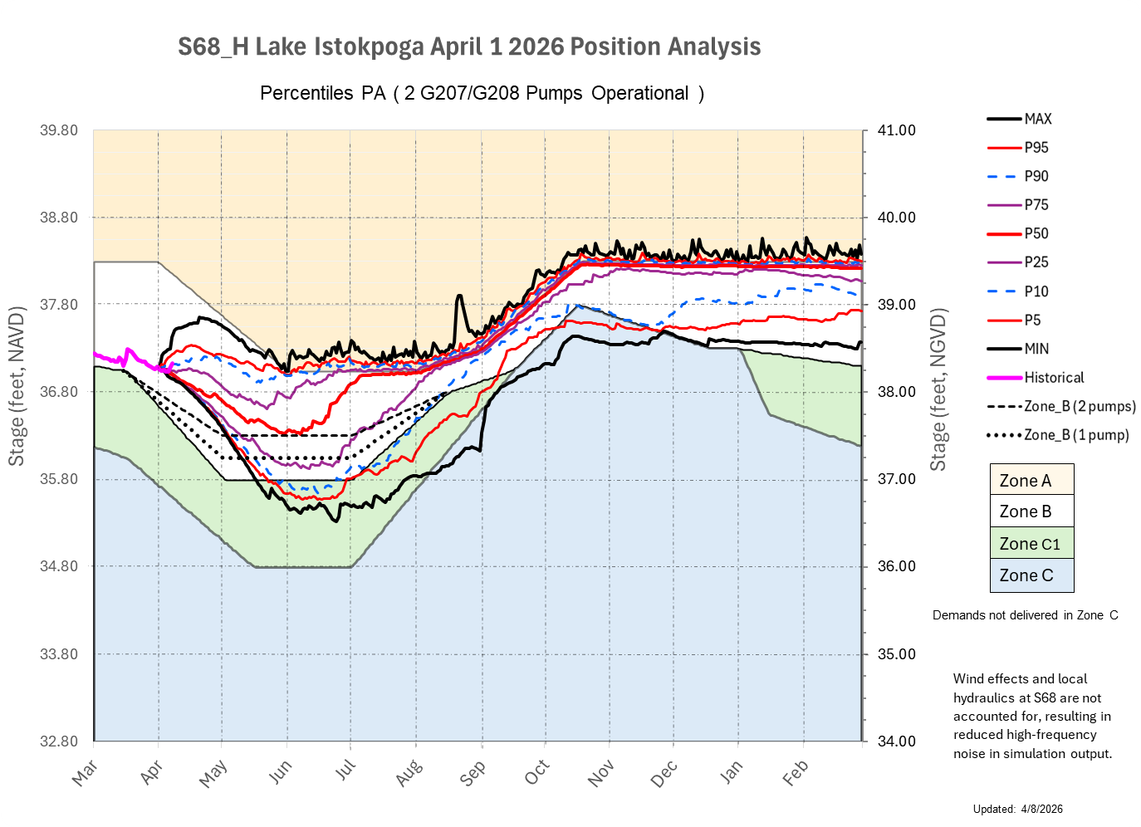
8
Notes:
S68 Headwater – base of the position analysis
Heading for the - a little lower than the lake –(current conditions) – if we open the structure, we would see local drawdown…. If we look at only one structure, you could get different rating.

Slide 9
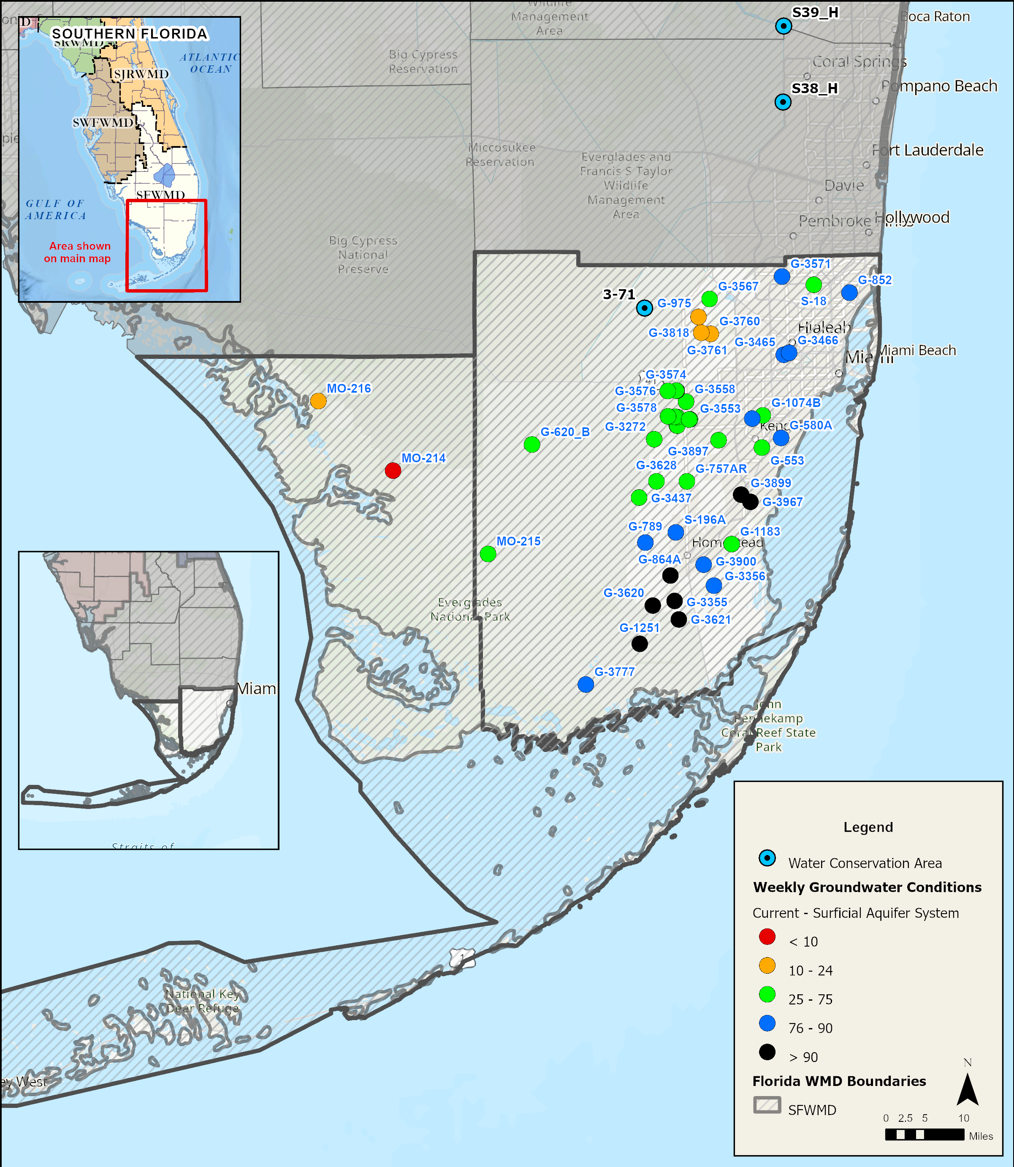
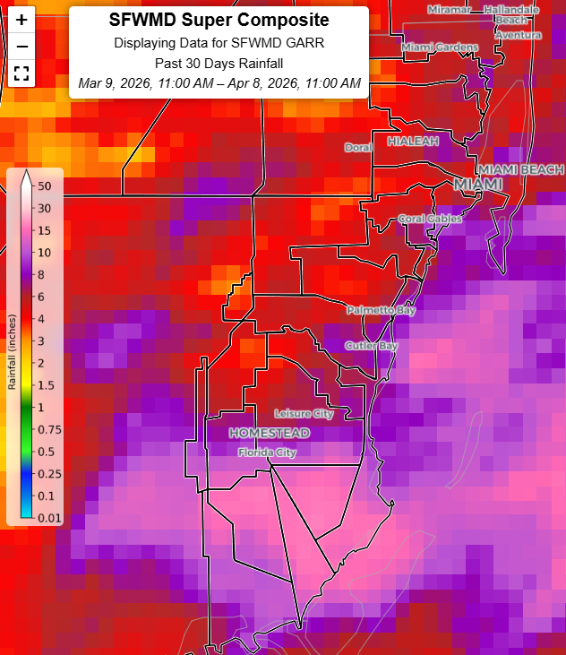
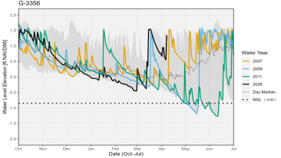
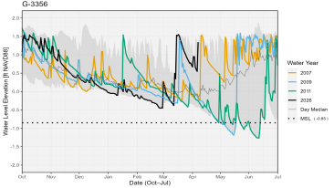
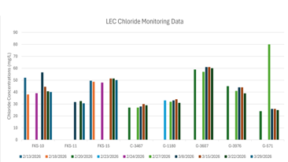

Biscayne Aquifer, South Miami-Dade County
Presenter: Tom Colios
9

Slide 10
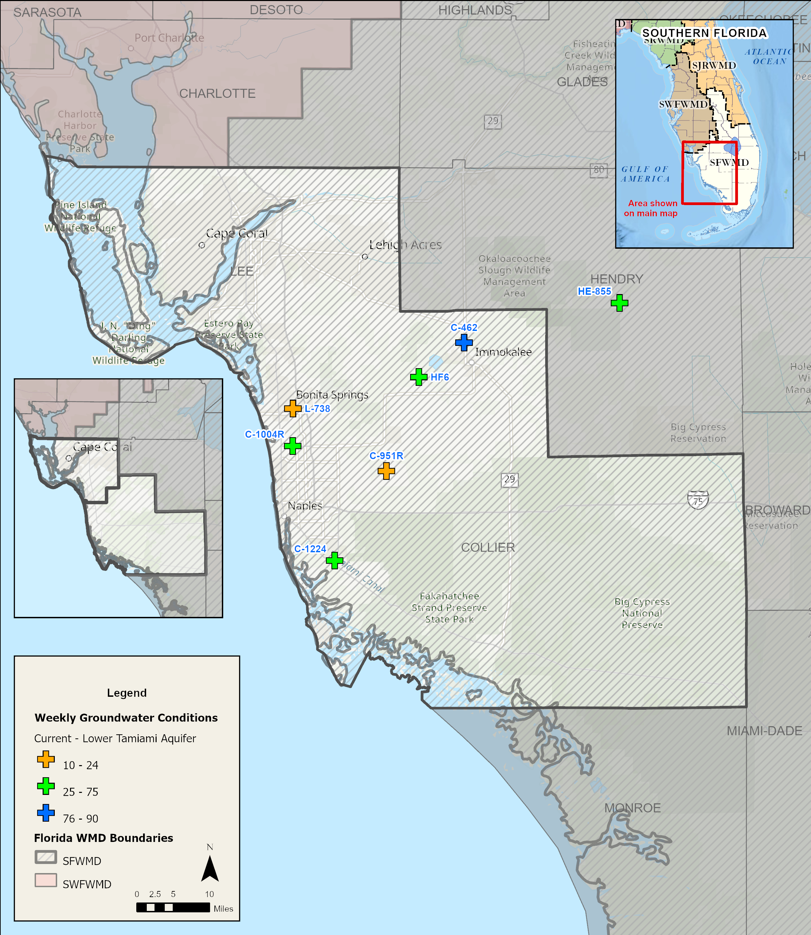
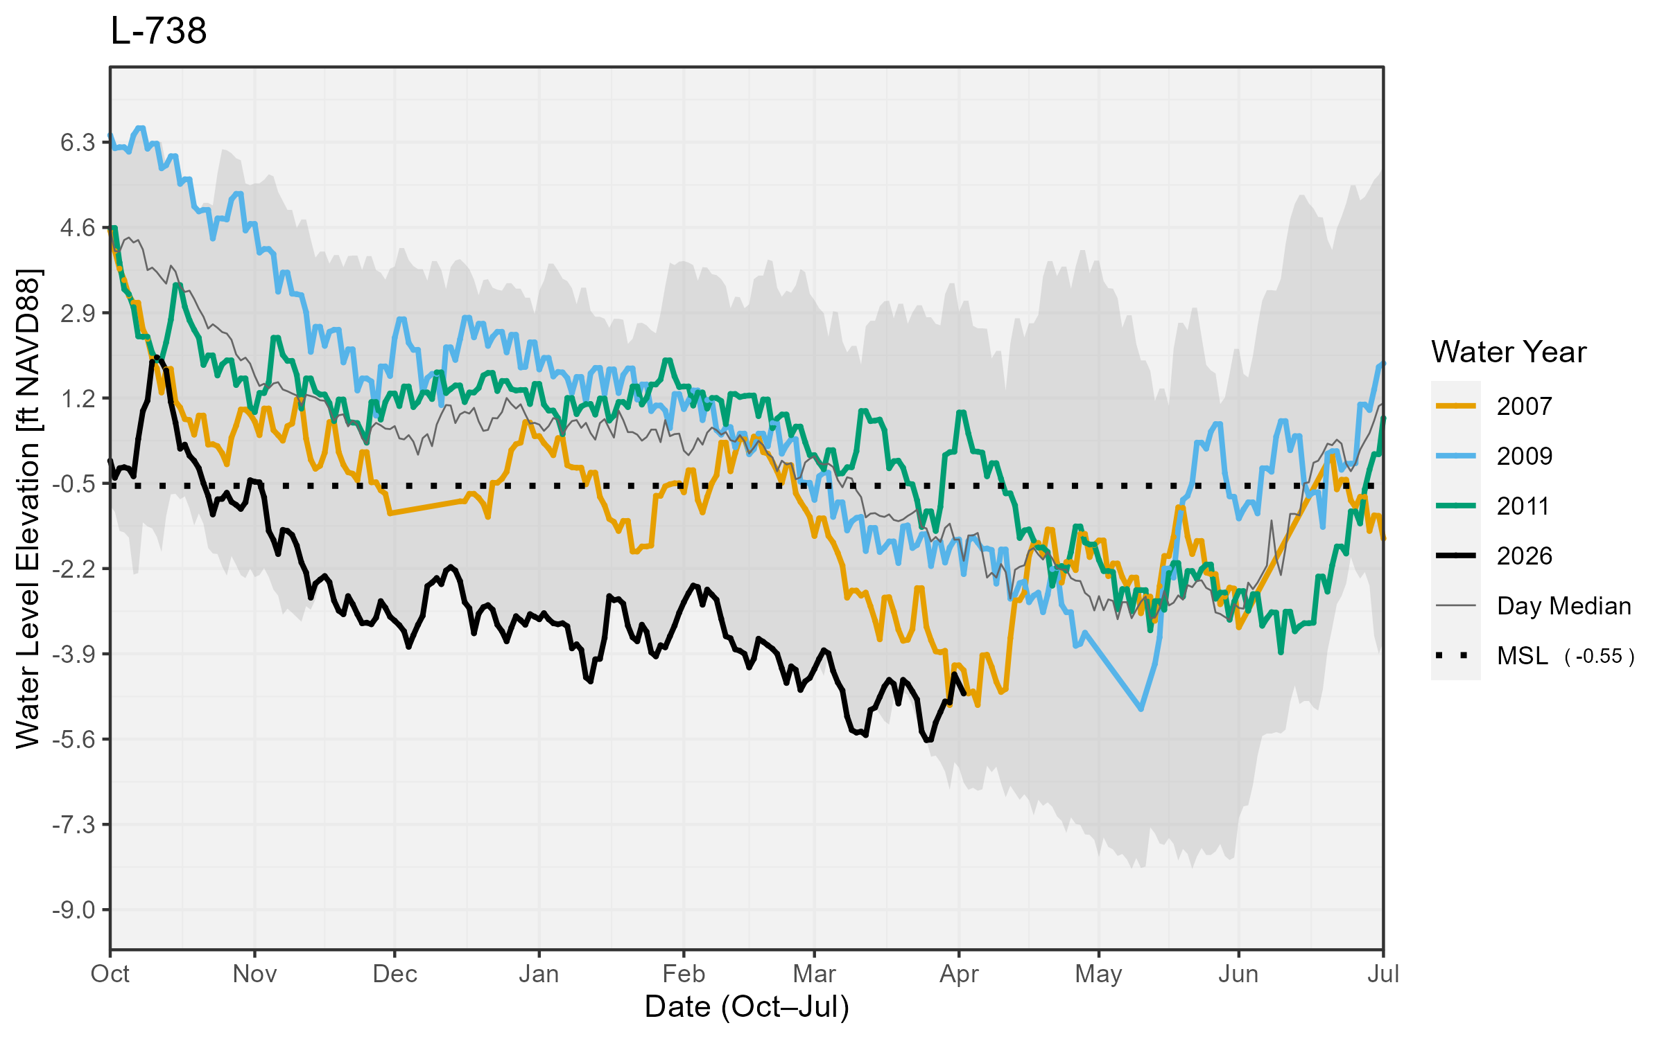
Lower Tamiami Aquifer, Lee and Collier Counties
Presenter: Tom Colios
10
Notes:
I just wanted to let you know that we had a very productive meeting with the Bonita Springs Utility Executive Director Andy Koebel and his Director of Operations Don Woodruff. They are very understanding of our concerns regarding the water levels of the Lower Tamiami Aquifer and have agreed to shift some of their water production away from their coastal wells and to rely more on their alternative water sources.
I also wanted to make you aware that effective February 1, Lee County’s dry season irrigation rule went into effect that reduces irrigation to 1-day a week in unincorporated Lee County. Hopefully we will see that reduction in demand, along with the changes in operations by the Utility help to stabilize the aquifer water levels in south Lee County.
And it might be nice when discussing the water shortage at the GB meeting to acknowledge the efforts of the County and Utility in addressing the current conditions.

Slide 11
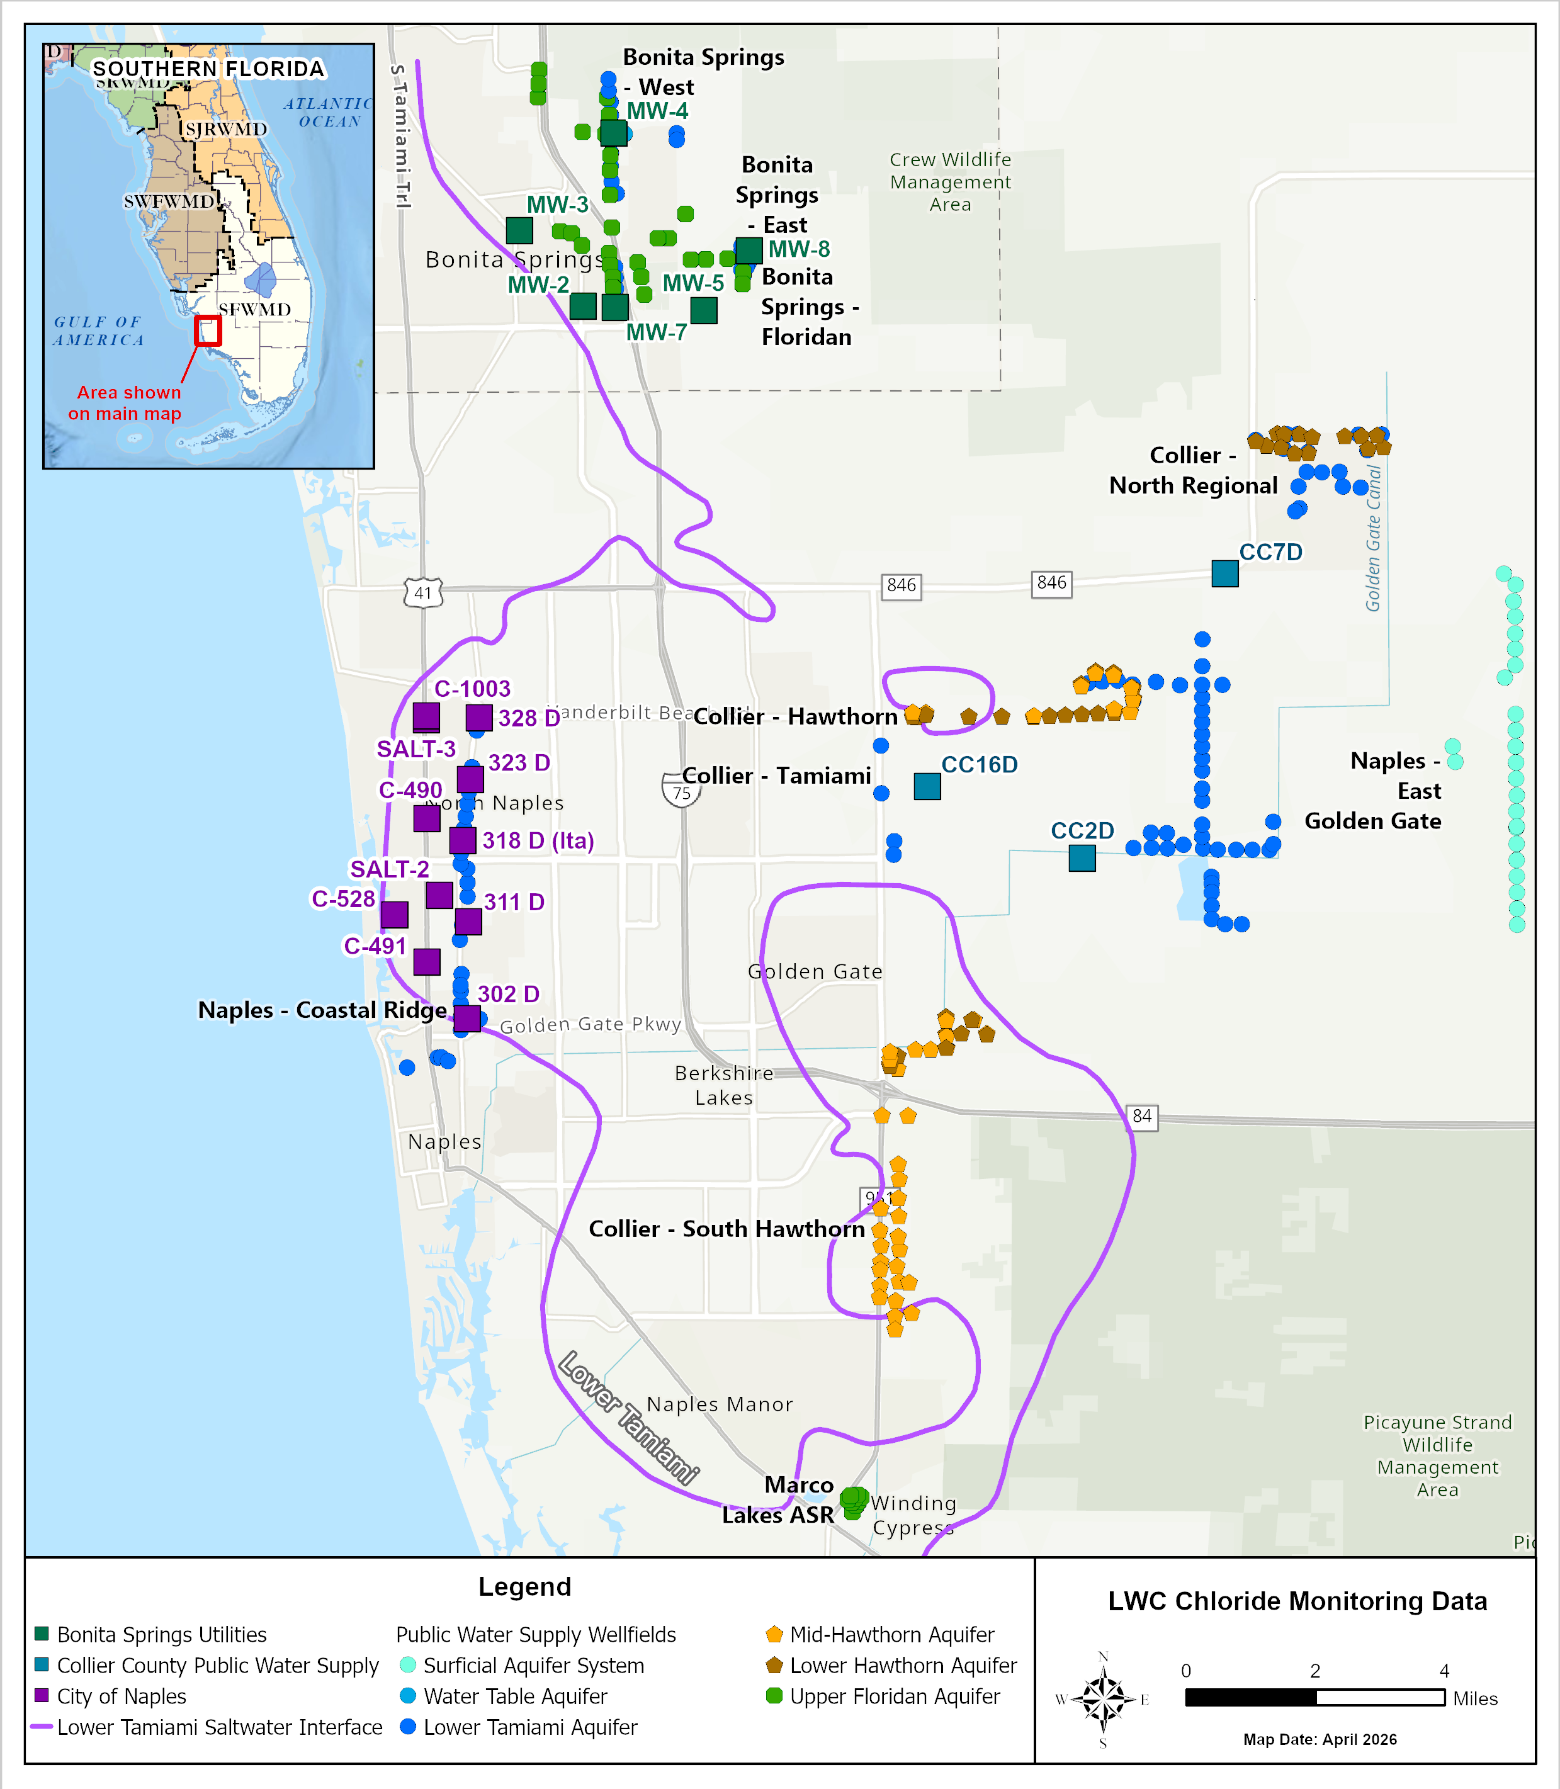
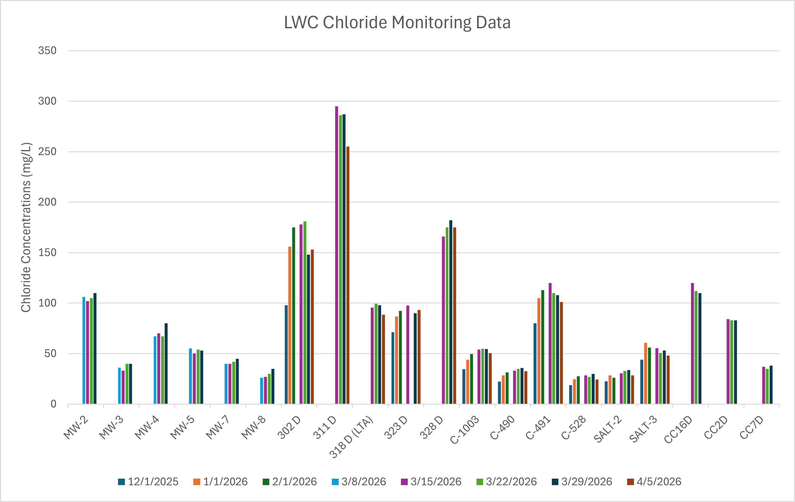
Lower Tamiami Aquifer, Lee and Collier Counties
Presenter: Tom Colios
11

Slide 12
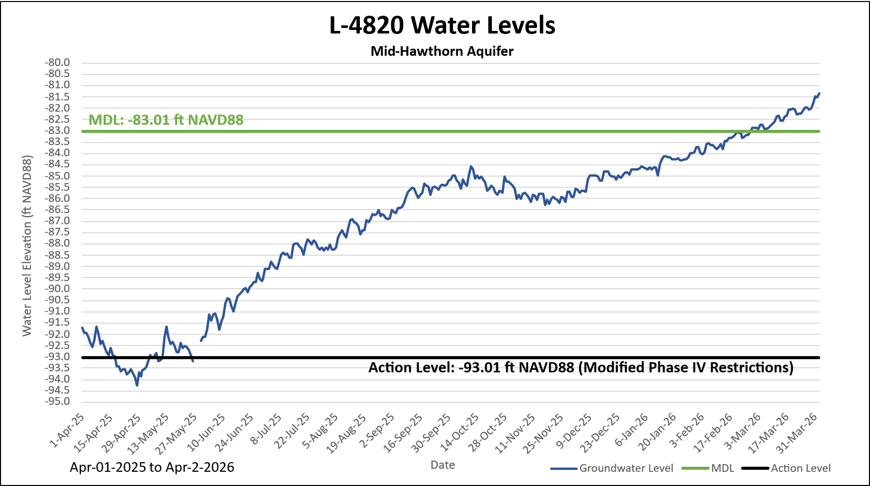
Status of Water Restrictions in Cape Coral and Lehigh Acres
Phase III Restrictions Since November 2023
Phase IV Restrictions Since May 2025
Aquifer Levels at Mid-Hawthorn reached back above MDL on Feb 28
Upcoming Rule Making Public Workshop for Mid-Hawthorn and Sandstone Aquifers
Above MDL since Feb 28
Presenter: Tom Colios
12
Notes:
Considering Reducing Restrictions: 40th day above MDL, 20 days remaining to reduce restrictions
One example and somehow a good news story: levels reapproaching the maximum development line and protecting the mid-hawthorn aquifer

Slide 13
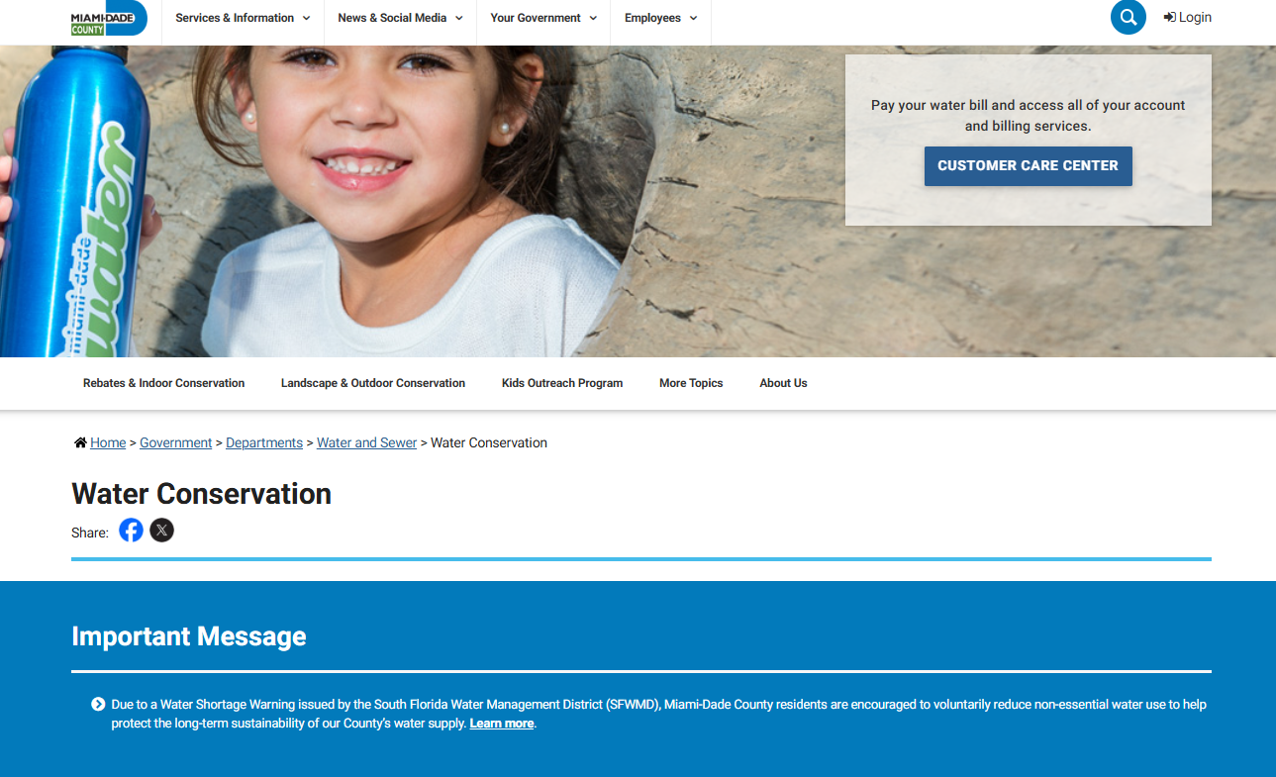
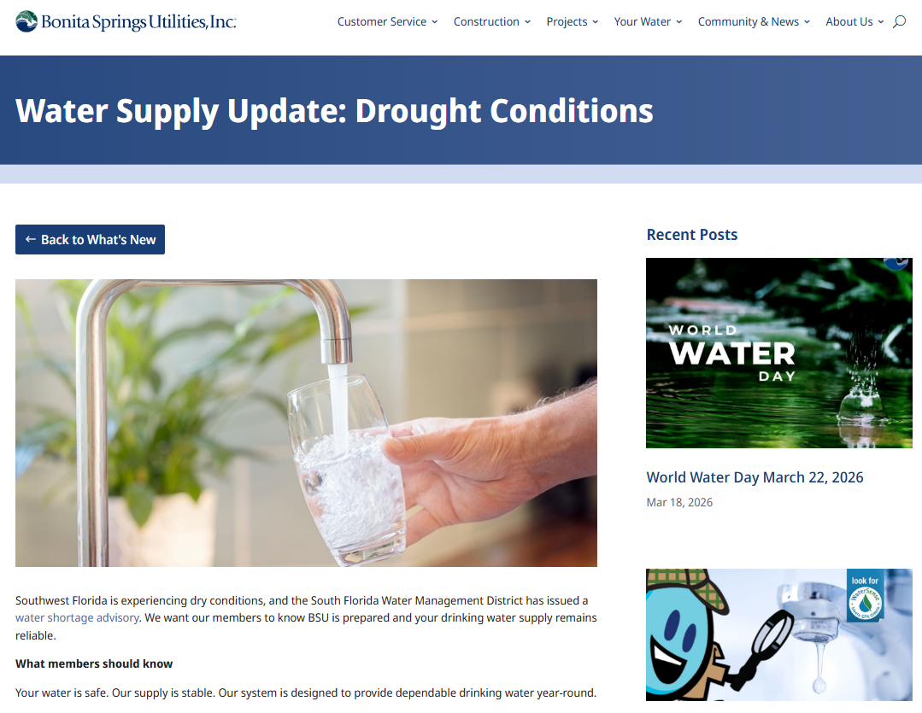
Joint Action: Enhanced Monitoring and Water Conservation Outreach
Bi-weekly calls hosted by SFWMD with Water Users and Water Utilities within Warning Areas
Optimization of Wellfield Operations
Weekly water level and Chloride concentration data being shared by Water Utilities and main Water Users
Water Conservation Messaging and Public Outreach
Thanks to Miami-Dade Water and Sewer Department, FPL, City of Homestead Utilities, Florida Keys Aqueduct Authority, Florida City, FDACS, Bonita Springs Utilities, Lee County, Collier County, City of Naples, Florida Utility Solutions, Resource Conservation Systems, City of Marco Island, City of Everglades, City of Okeechobee, Okeechobee County, Glades County, Highlands County, Spring Lake Improvement District and Friends of Lake Istokpoga.
13
Notes:
The City of Naples – Terry Savage’s response on 3/26/26
“Under normal operating conditions, we maintain an approximate 80/20 split between the wellfields to meet desired flow—80% from the eastern wellfield and 20% from the western. Over the past six weeks, we have adjusted this distribution to approximately 95/5.
For example, today’s [3/26/26] influent flow is 19 MGD, with approximately 18 MGD coming from the eastern wellfield and 1 MGD from the western.
This operational adjustment appears to be having a positive effect, as chloride levels have remained stable and NGVD elevations continue to keep us in a favorable position.”
Bonita Springs Utilities – Don Woodruff’s response on 3/27/26
“We implemented the shift on 2/5/26 resulting in reduced LTA usage to the lowest practical level, approx. 2200-2500 gal/min. In alignment with our WUP, which allocates 25% withdrawal from the west wellfield and 75% from the east, we have limited all LTA withdrawal to the furthest East wells. To meet overall system demand, we are utilizing our UF wells to supplement treatment capacity.
OpThis shift results in a finished water blend of approximately 25% lime-softened water supported by LTA and 75% RO water supported by UF.”

Slide 14
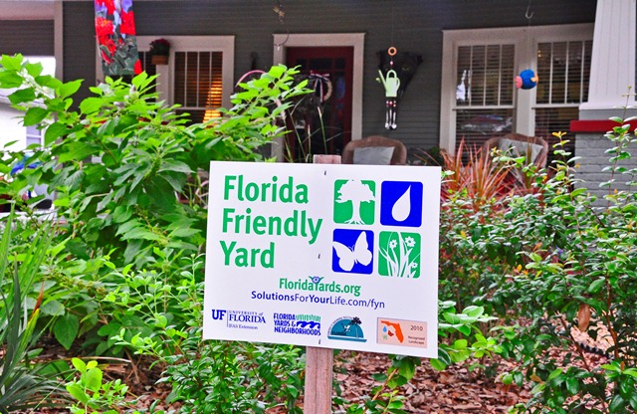
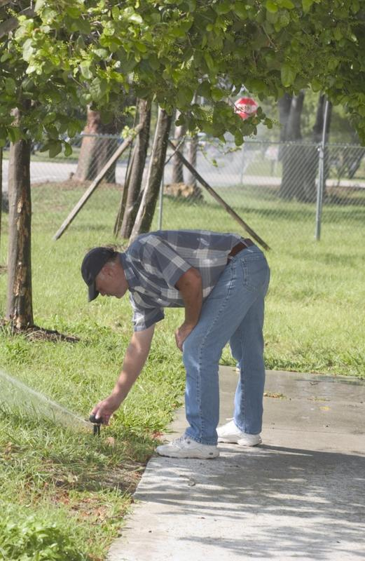
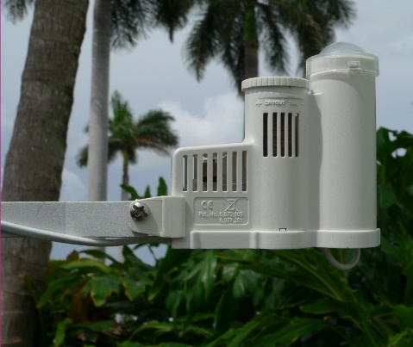
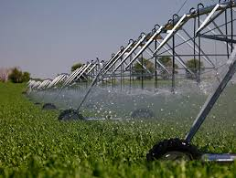
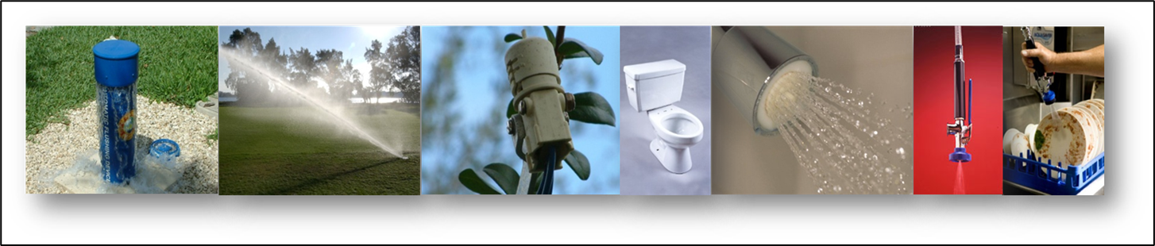
Encouraging Water Conservation
Presenter: Tom Colios
14
Notes:
Continue to remind water users to comply with year-round landscape irrigation rule
Request users implement additional voluntary water conservation measures
Increased communication with water users, local government & public
Provide advance notice that worsening water shortage conditions may result in mandated cutbacks
Encourage utilities with alternative water supply sources to use these sources to the maximum extent practicable

Slide 15

April is Water Conservation Month
Established in 1998, Statewide
Collaboration between American Water Works Association, Water Management District,
and the Florida Department
of Environmental Protection
Intended to raise public awareness about water conservation
Presenter: Tom Colios
15
Notes:
Be aware of your water use… Use it wisely
Support the Florida Section of the American Water Works Association by proclaiming April as Water Conservation Month
Local governments and other organizations issuing proclamations
April has been proclaimed Water conservation month for 24 years in our state.
The first time was 1998. This in a combined effort between FSAWWA, water management districts, and FDEP and is aimed primarily at residential and other utility customers. Municipalities are encouraged to pass similar resolutions to raise awareness.

Slide 16
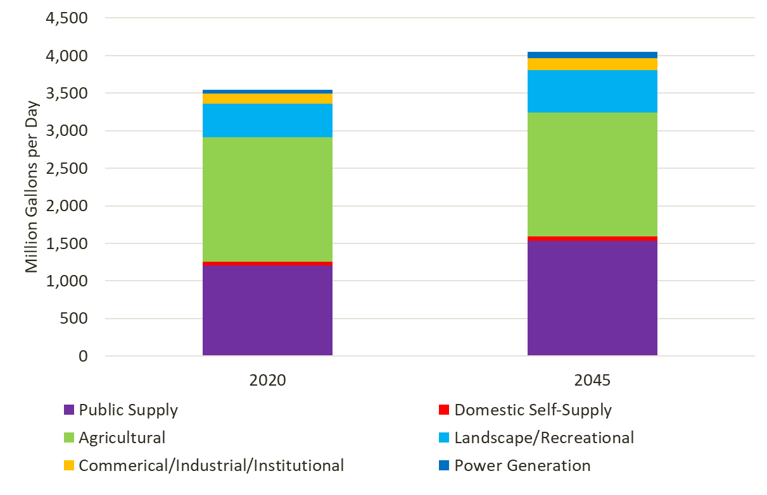
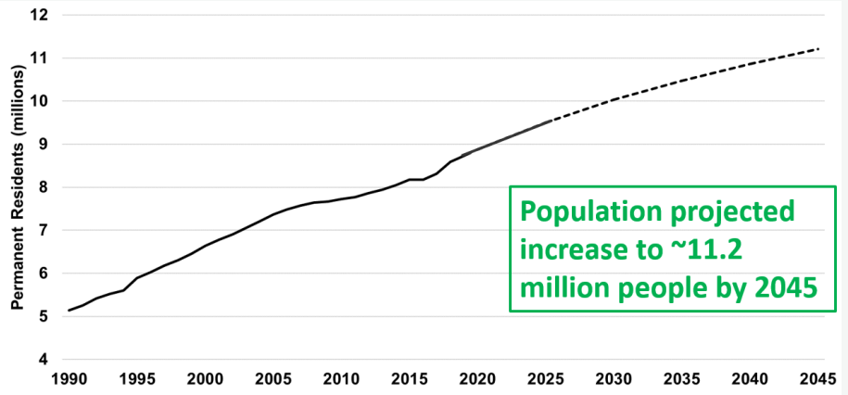
Districtwide Population Growth and Demands
Data obtained form the University of Florida
Bureau of Economic and Business Research (BEBR)
Water supply demands are projected to increase by 500 million gallons per day from 2020 to 2045
Presenter: Tom Colios
16

Slide 17
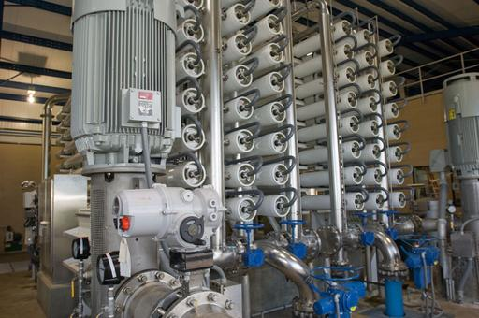
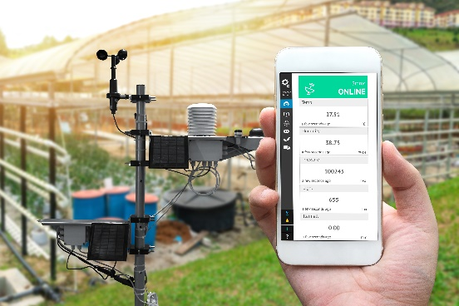
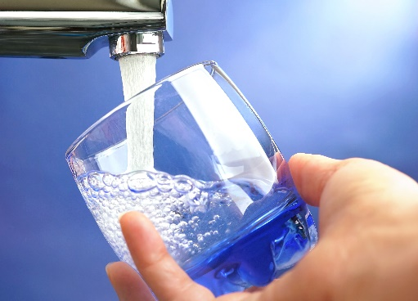
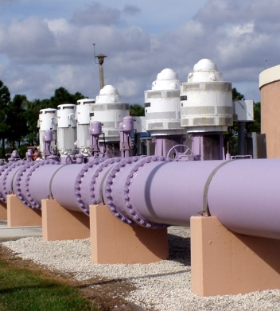
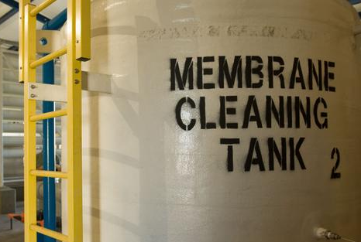
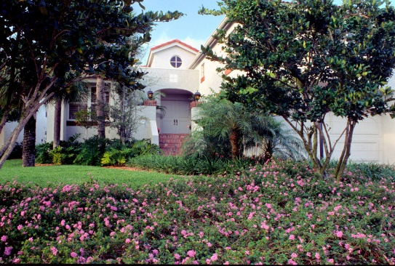
Water Conservation Role in Meeting Future Demands Public, Local Governments and District Partnership
Expand or add new alternative supply sources (increasing capacity)
Decrease demands through water conservation
AND
Presenter: Tom Colios
17
Notes:
We have two options to meet the increasing demands.
We can develop new supply sources, which is very costly and can take considerable time. or we can decrease demands through water conservation which is cheaper and easier to implement. By water conservation we mean using less water for a specific task, increasing water use efficiency, and/or reducing wasteful use.
Although we may not be able to decrease demands by conservation alone in some areas, conservation should always be included in the planning process
But, How do we get people to conserve water?

Slide 18

Simple Steps to Save Water
Indoor
Repair leaks (e.g. running toilet, dripping faucet)
Replace older, inefficient fixtures and appliances
Run only full loads of dishes and clothes
Outdoor Water Conservation
Florida-Friendly LandscapingTM
Rain shutoff device – required on all irrigation systems
Set timer to run only 2 or 3 days per week pursuant to local irrigation ordinance
No irrigation between 10 am and 4 pm
Repair leaks and do not irrigate sidewalks or driveways
Presenter: Tom Colios
18

Slide 19
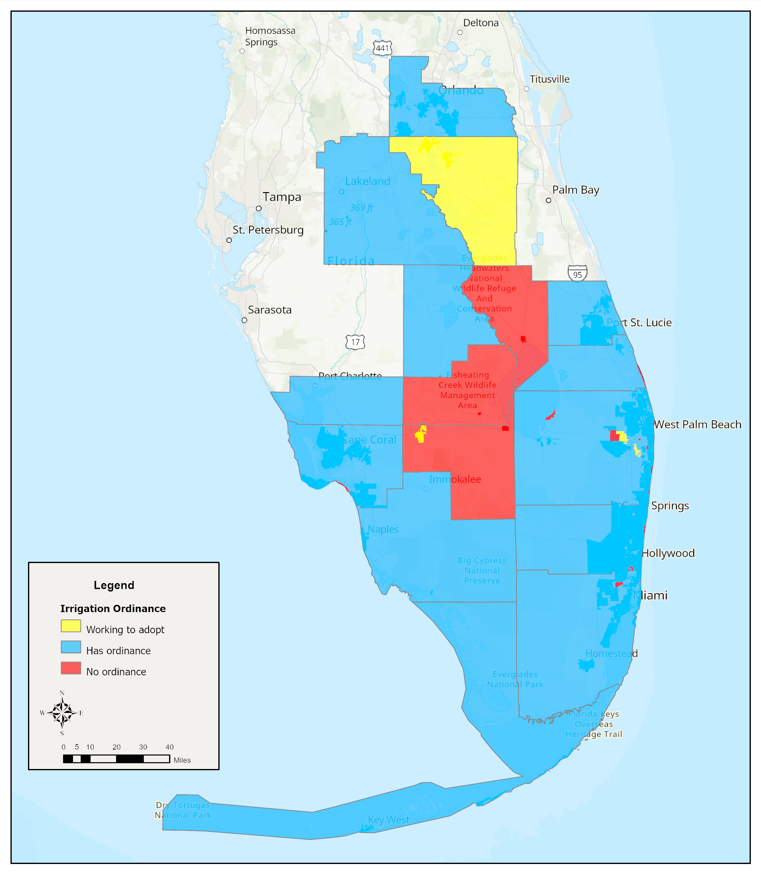
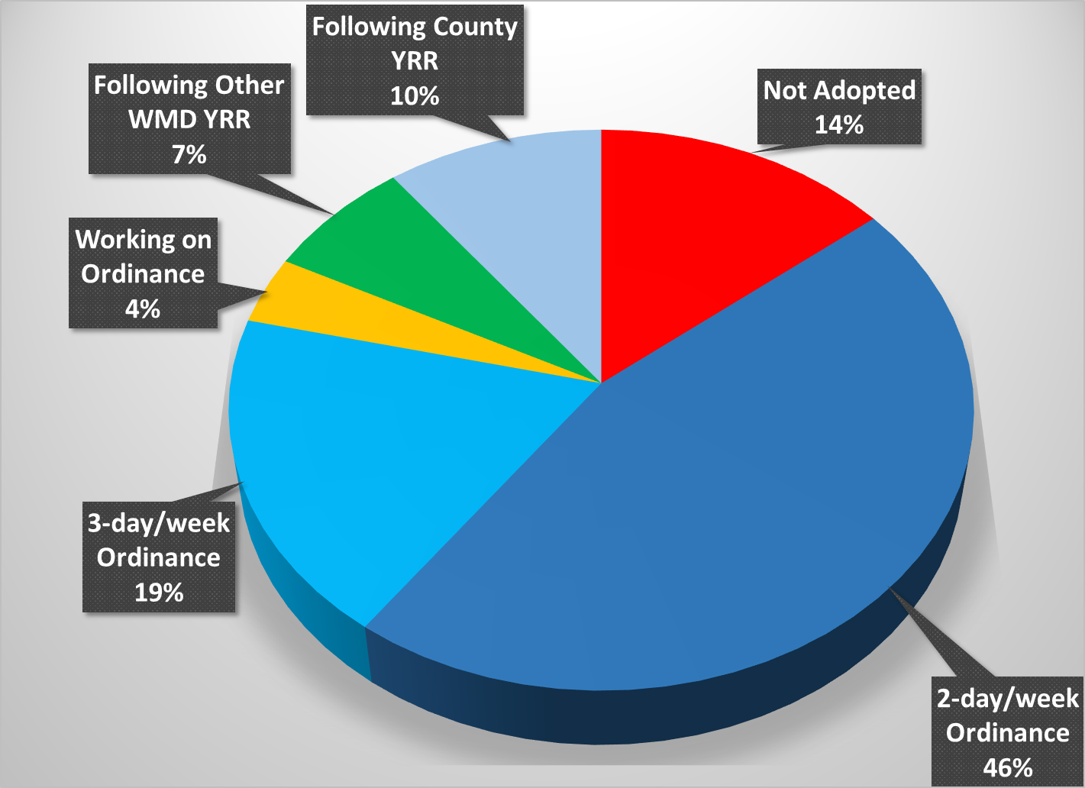
Year-Round Irrigation Ordinances*
Adoption Status
Local governments covered by an ordinance | 127
Working on adoption | 6
No ordinance | 22
Grand Total | 155
*Chapter 40E-24, F.A.C, restricts irrigation to 2 or 3 days per week and prohibits irrigation between 10 AM and 4 PM
Presenter: Tom Colios
19
Notes:
In 2019, District staff were instructed by the Governing Board to engage in an effort to have all local governments adopt ordinances and as of April of 2022, a total of 97 governments have an ordinance that comports with Rule 40E-24. This covers around 93% of the District’s population.

Slide 20
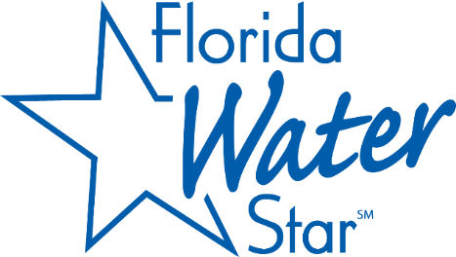

District Endorsed and Partnership Programs
Recognition Program
    LEED
    Green Globes
    Water Sense
    Florida Water CHAMP
    Florida Friendly Landscaping, Florida Water StarSM
Cooperative Funding Program
  Local implementation of water-saving technology
  FY25 and FY26 Water Conservation Projects
    11 projects with ~ $500,000 in funding approved
    Estimated 127 million gallons per year saved
  Total: 71 conservation projects since 2020; $3.6M in funds allocation and 4.1MGD saved
Presenter: Tom Colios
20
Notes:
Florida Water StarSM
Statewide voluntary certification program
Increased water efficiency for new homes, commercial properties, and communities
Landscape – right plants and reduced percent turf
Irrigation – micro‐irrigation and reduced high volume
Indoor fixtures – water efficient
20% indoor and 40% outdoor water savings over traditional construction
Florida Water CHAMPSM
Water Conservation Hotel and Motel Program (CHAMP)
Voluntary recognition program for hotel and lodging facilities
Saves water through education, changes in laundry operations and conservation devices (aerators)
Savings up to 20 gallons of water/room/night
There are some programs that the District supports, and you may be familiar with some of these: we already talked about FFL,
We also support Florida Water Star, a water conservation voluntary certification program for new and existing homes and commercial developments.. The Florida Water Star Program was developed by the St. Johns River Water Management District in 2006 and became a statewide program in 2012.
It provides Standards and guidelines for water efficiency in categories like:
Indoor fixtures and appliances
Landscape design
Irrigation systems
They have a team of independent inspectors who inspect each project prior to certification
The main component of being a Water CHAMP property is implementing a towel and linen reuse program.

Slide 21
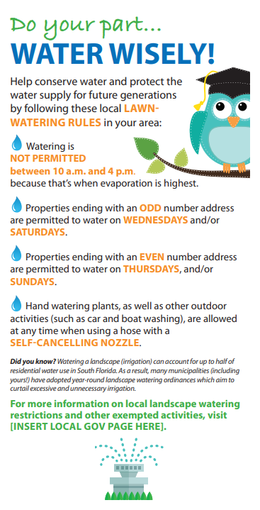
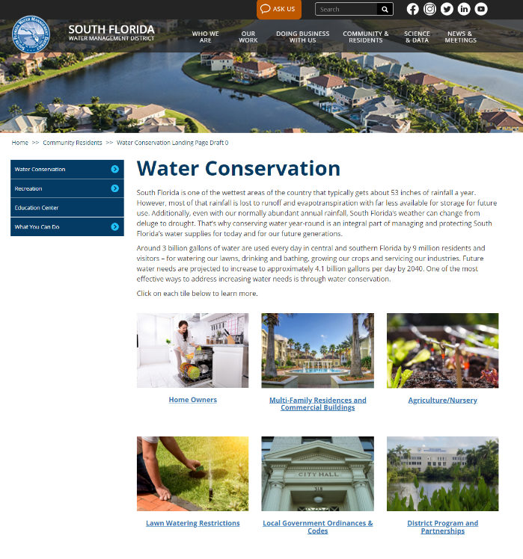
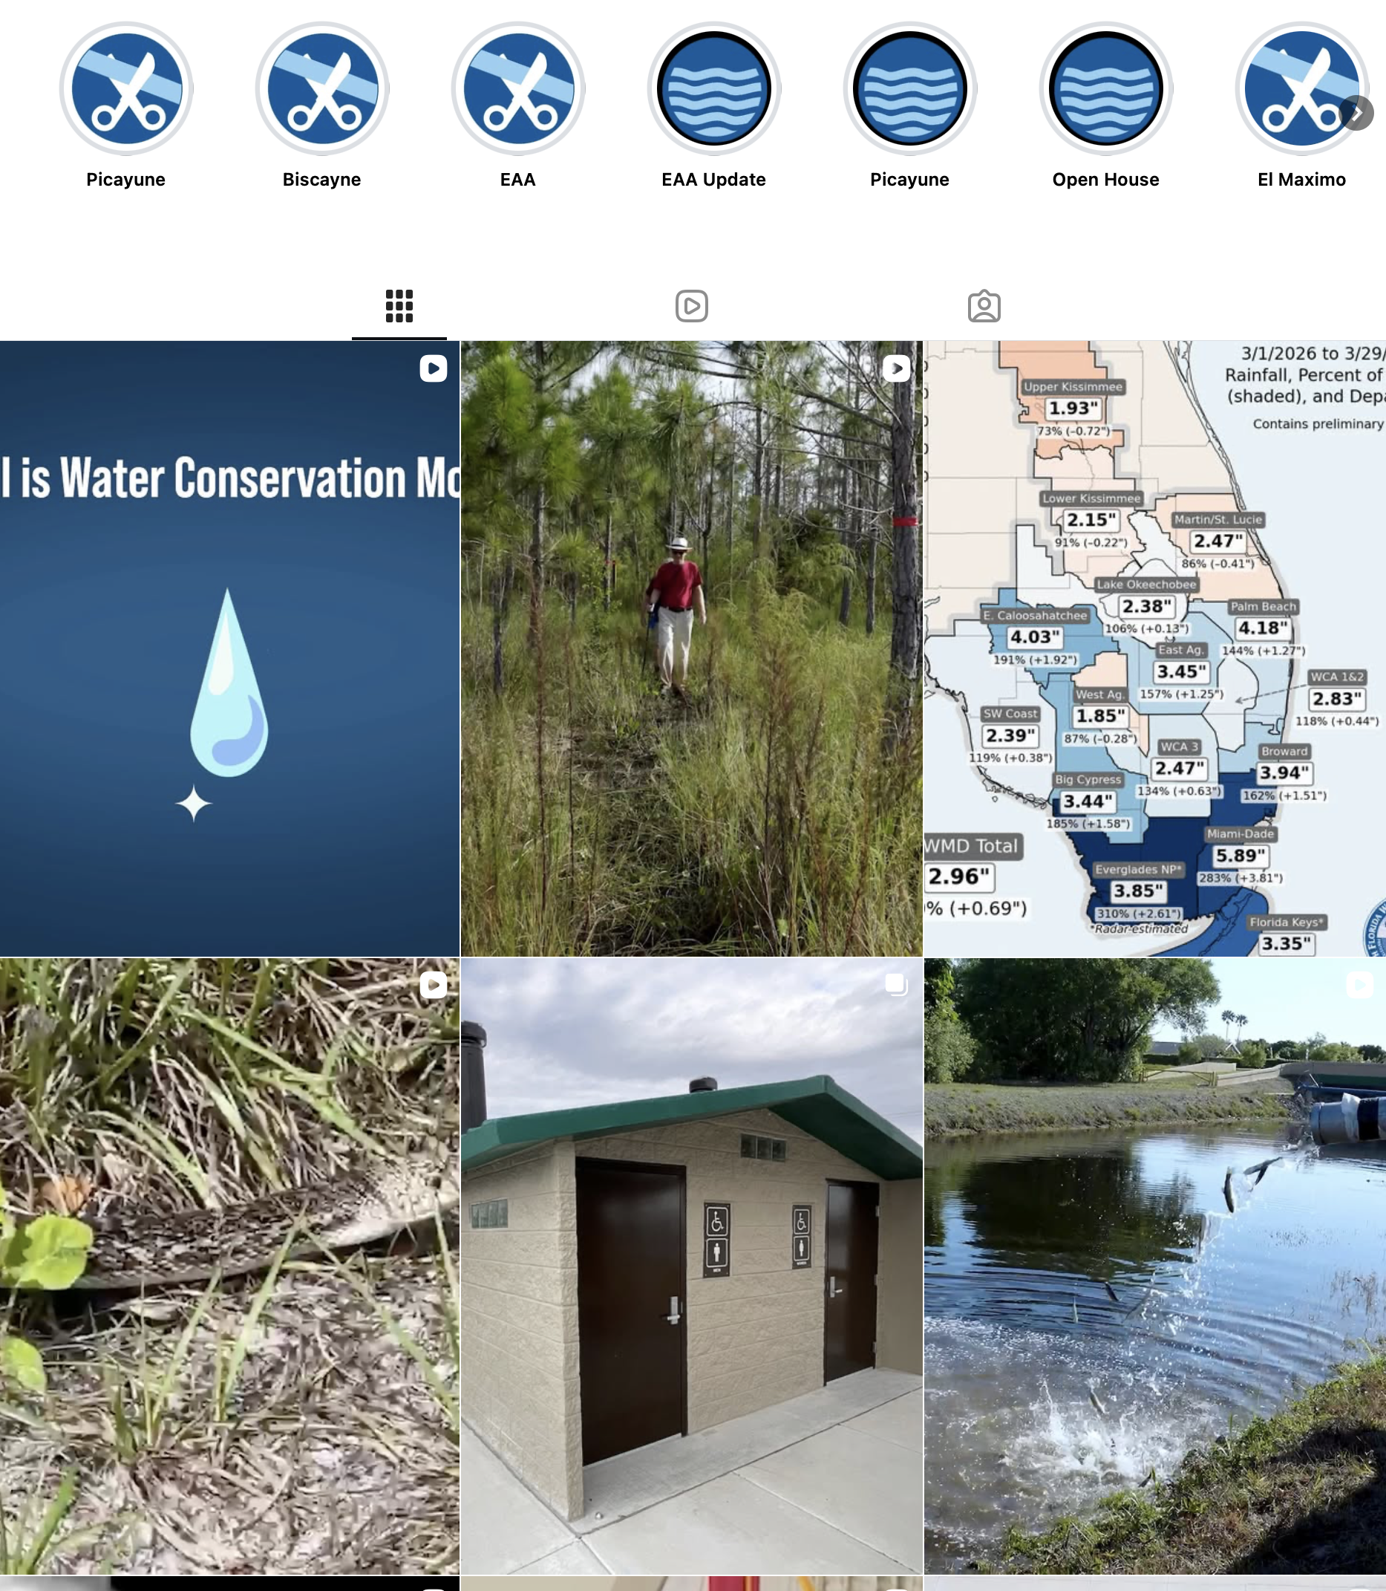
Public Communications and Outreach
Social media posts pertaining to water shortage warnings, navigation and rain reached over 283,400 people.
280,000 website visitors.
Quarterly conservation
coordinator meetings.
Presenter: Tom Colios
21
Notes:
The District also engages with the community through our social media platforms which have more than 47k followers and the distribution of educational materials
Recently, we worked with the communications group to update our conservation webpage.
Our quarterly Conservation Coordinators Meetings provide the opportunity for conservation officers across the district to share knowledge and advances in water conservation.
The main component of being a Water CHAMP property is implementing a towel and linen reuse program.

Slide 22
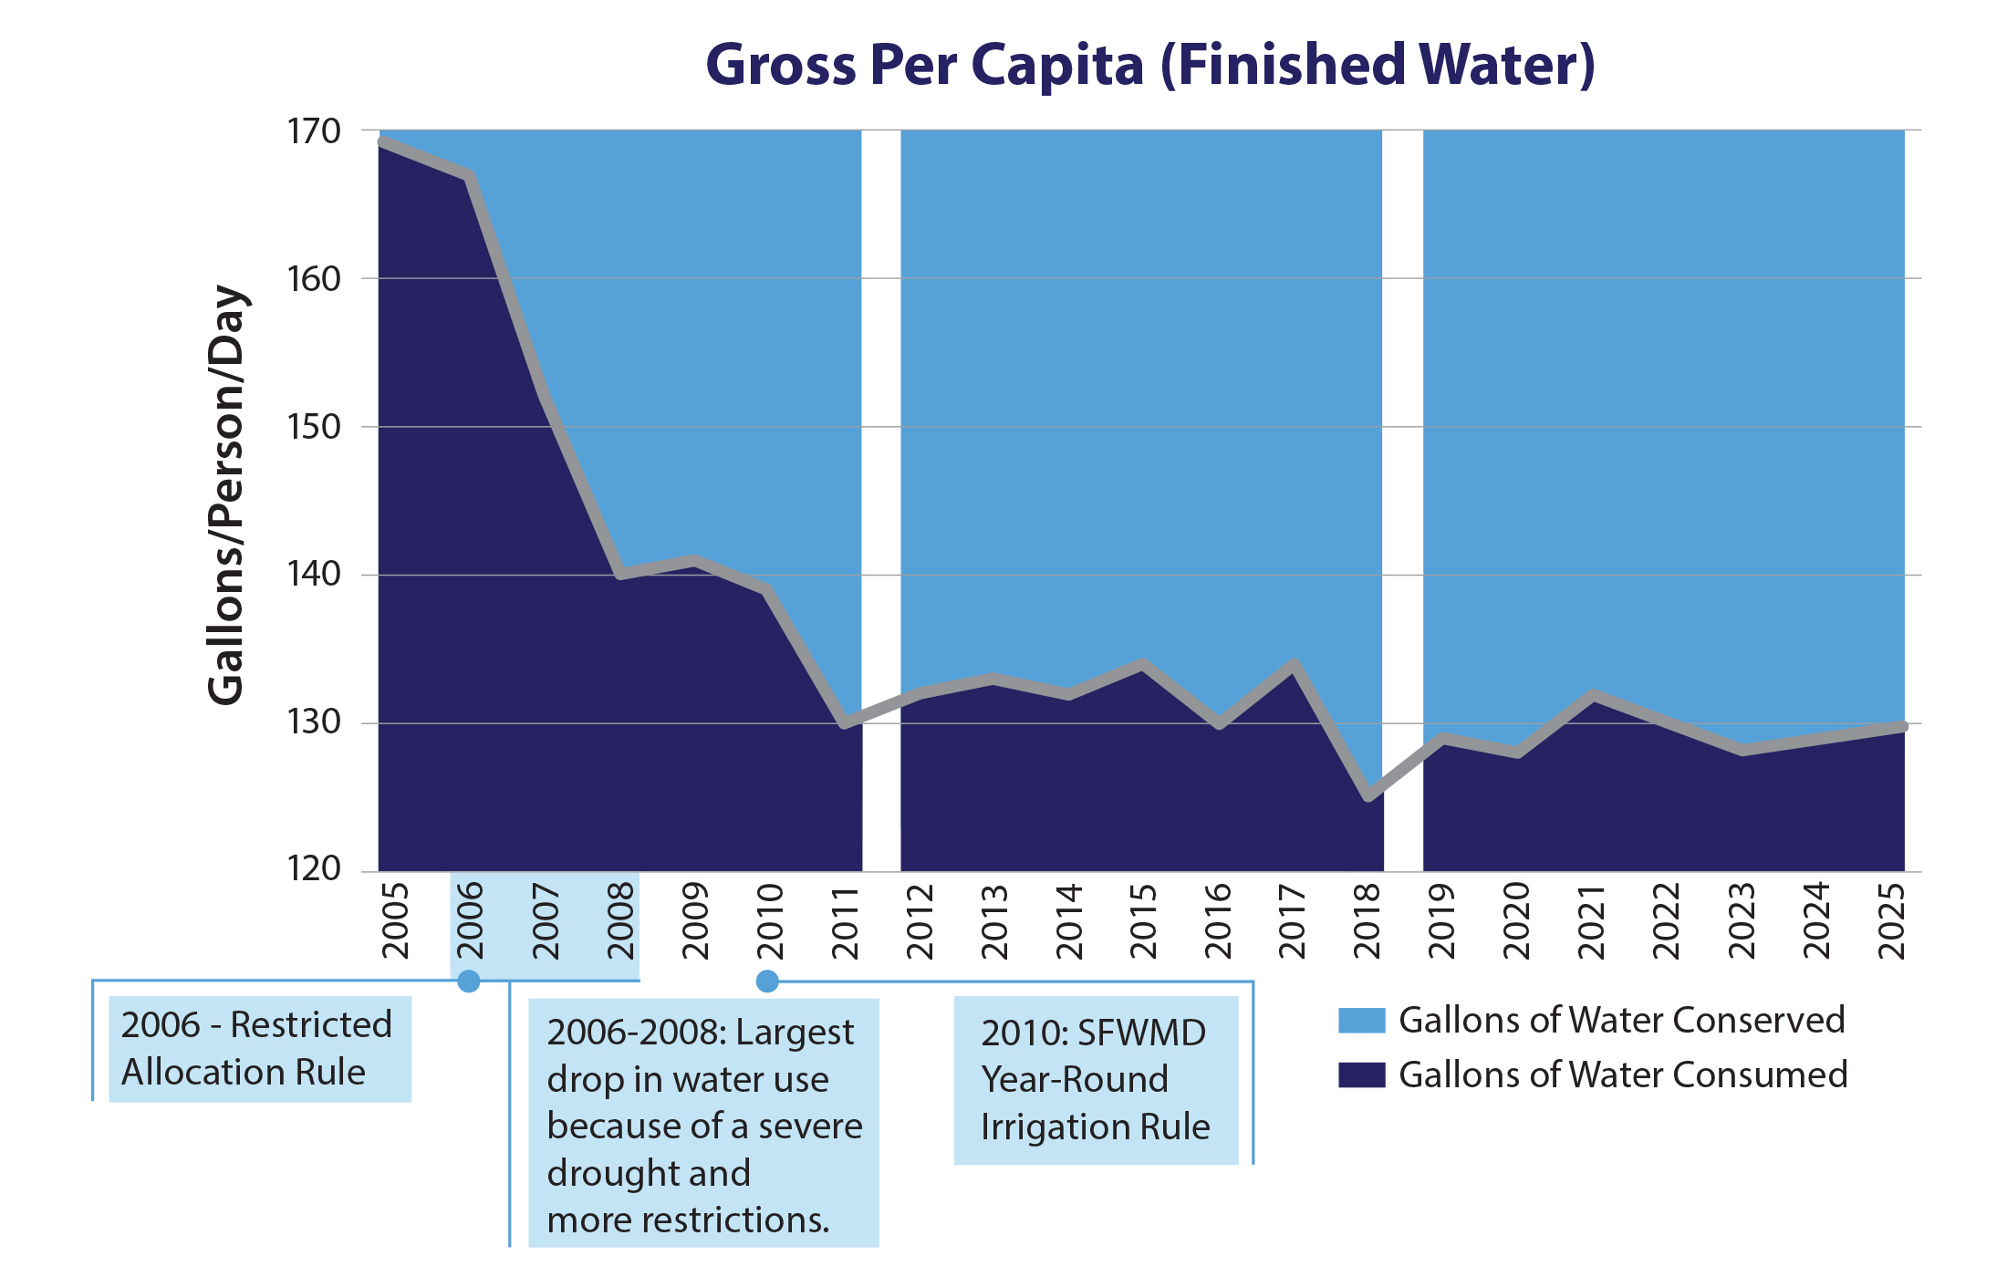
Water Conservation Works
Since 2020: Over $3.6M to support a total of 72 Water Conservation Projects, with an estimated savings of 4.27 MGD.
Presenter: Tom Colios
22

Slide 23

Presenter: Tom Colios
23

Slide 24
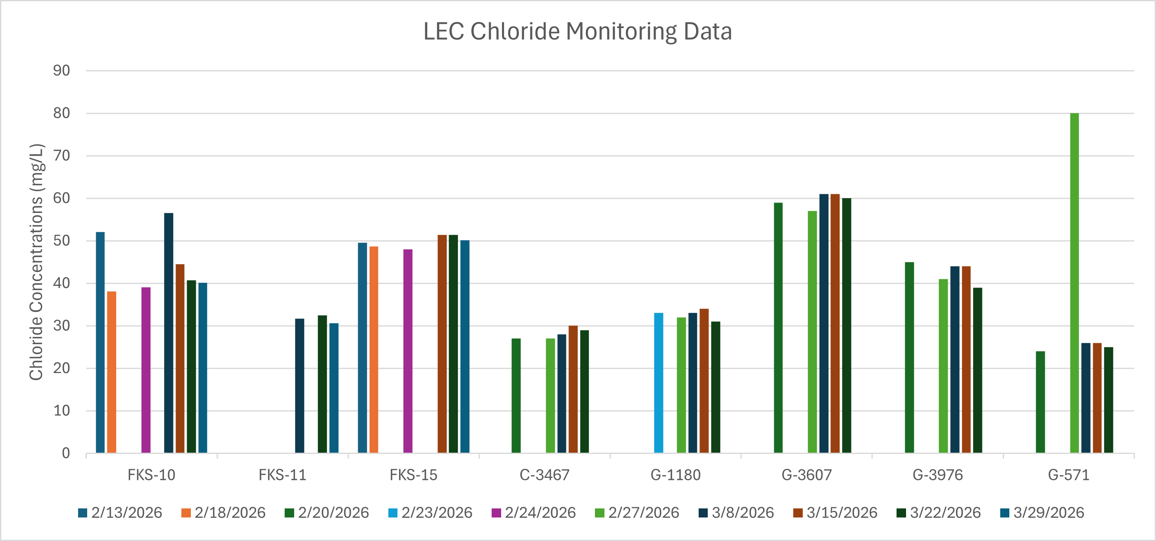
Presenter: Tom Colios
24

Slide 25
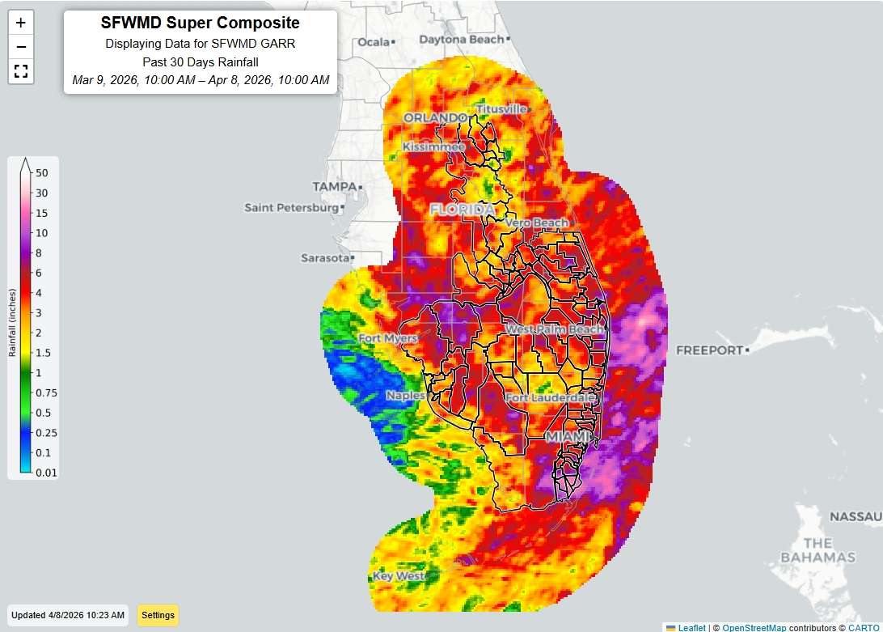

Slide 26
