Slide 1

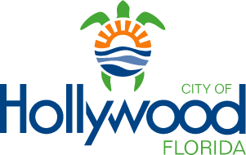
Forced Rank Methodologies to More Efficiently Perform Asset Criticality Analysis
Ameer Khan, BSc, Mauricio Lara, PE
Presentation Co-Authors: Kathryn Benson, PE and Jim Oldach, CRL
April 13, 2026
Southeast Florida Utility Council (SEFLUC) – Monthly Meeting

Slide 2
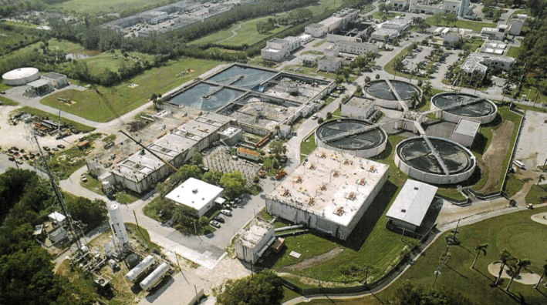
Agenda
Introduction to Asset Management
Background of City of Hollywood
Criticality Determination Process
  Asset Registry
  Asset Hierarchy
  Criticality Subsystem
  Criticality of Assets
Benefits
  Condition Assessment
  Financial Planning
Collaboration and Innovation Conclusions

Slide 3
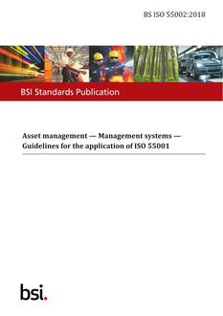
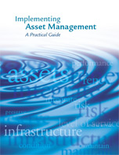
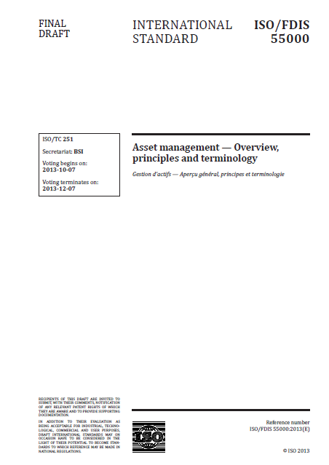

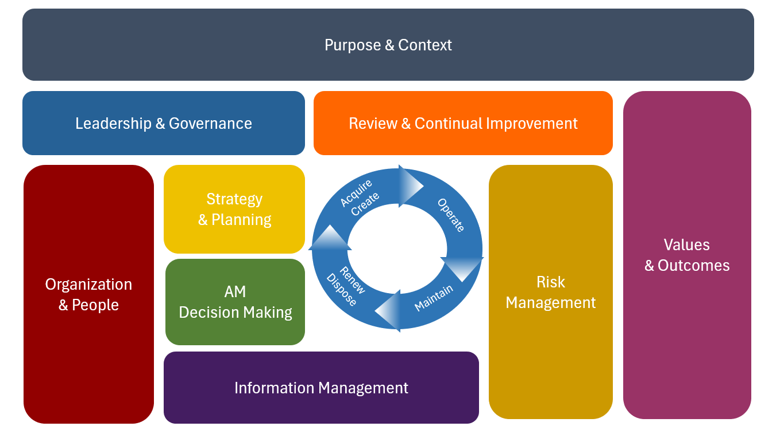
What is Asset Management?
Coordinated activity of an organization to realize value from assets. (ISO 55000)
  Realization of value will normally involve balancing of costs, risks, opportunity and performance benefits.
Asset Management is an integrated set of processes to minimize the life cycle costs of infrastructure, at an acceptable level of risk, while continuously delivering established levels of service. (AWWA)
  It is essentially effective infrastructure management; it is designed to minimize costs, protect infrastructure, and maximize resource effectiveness.

Slide 4
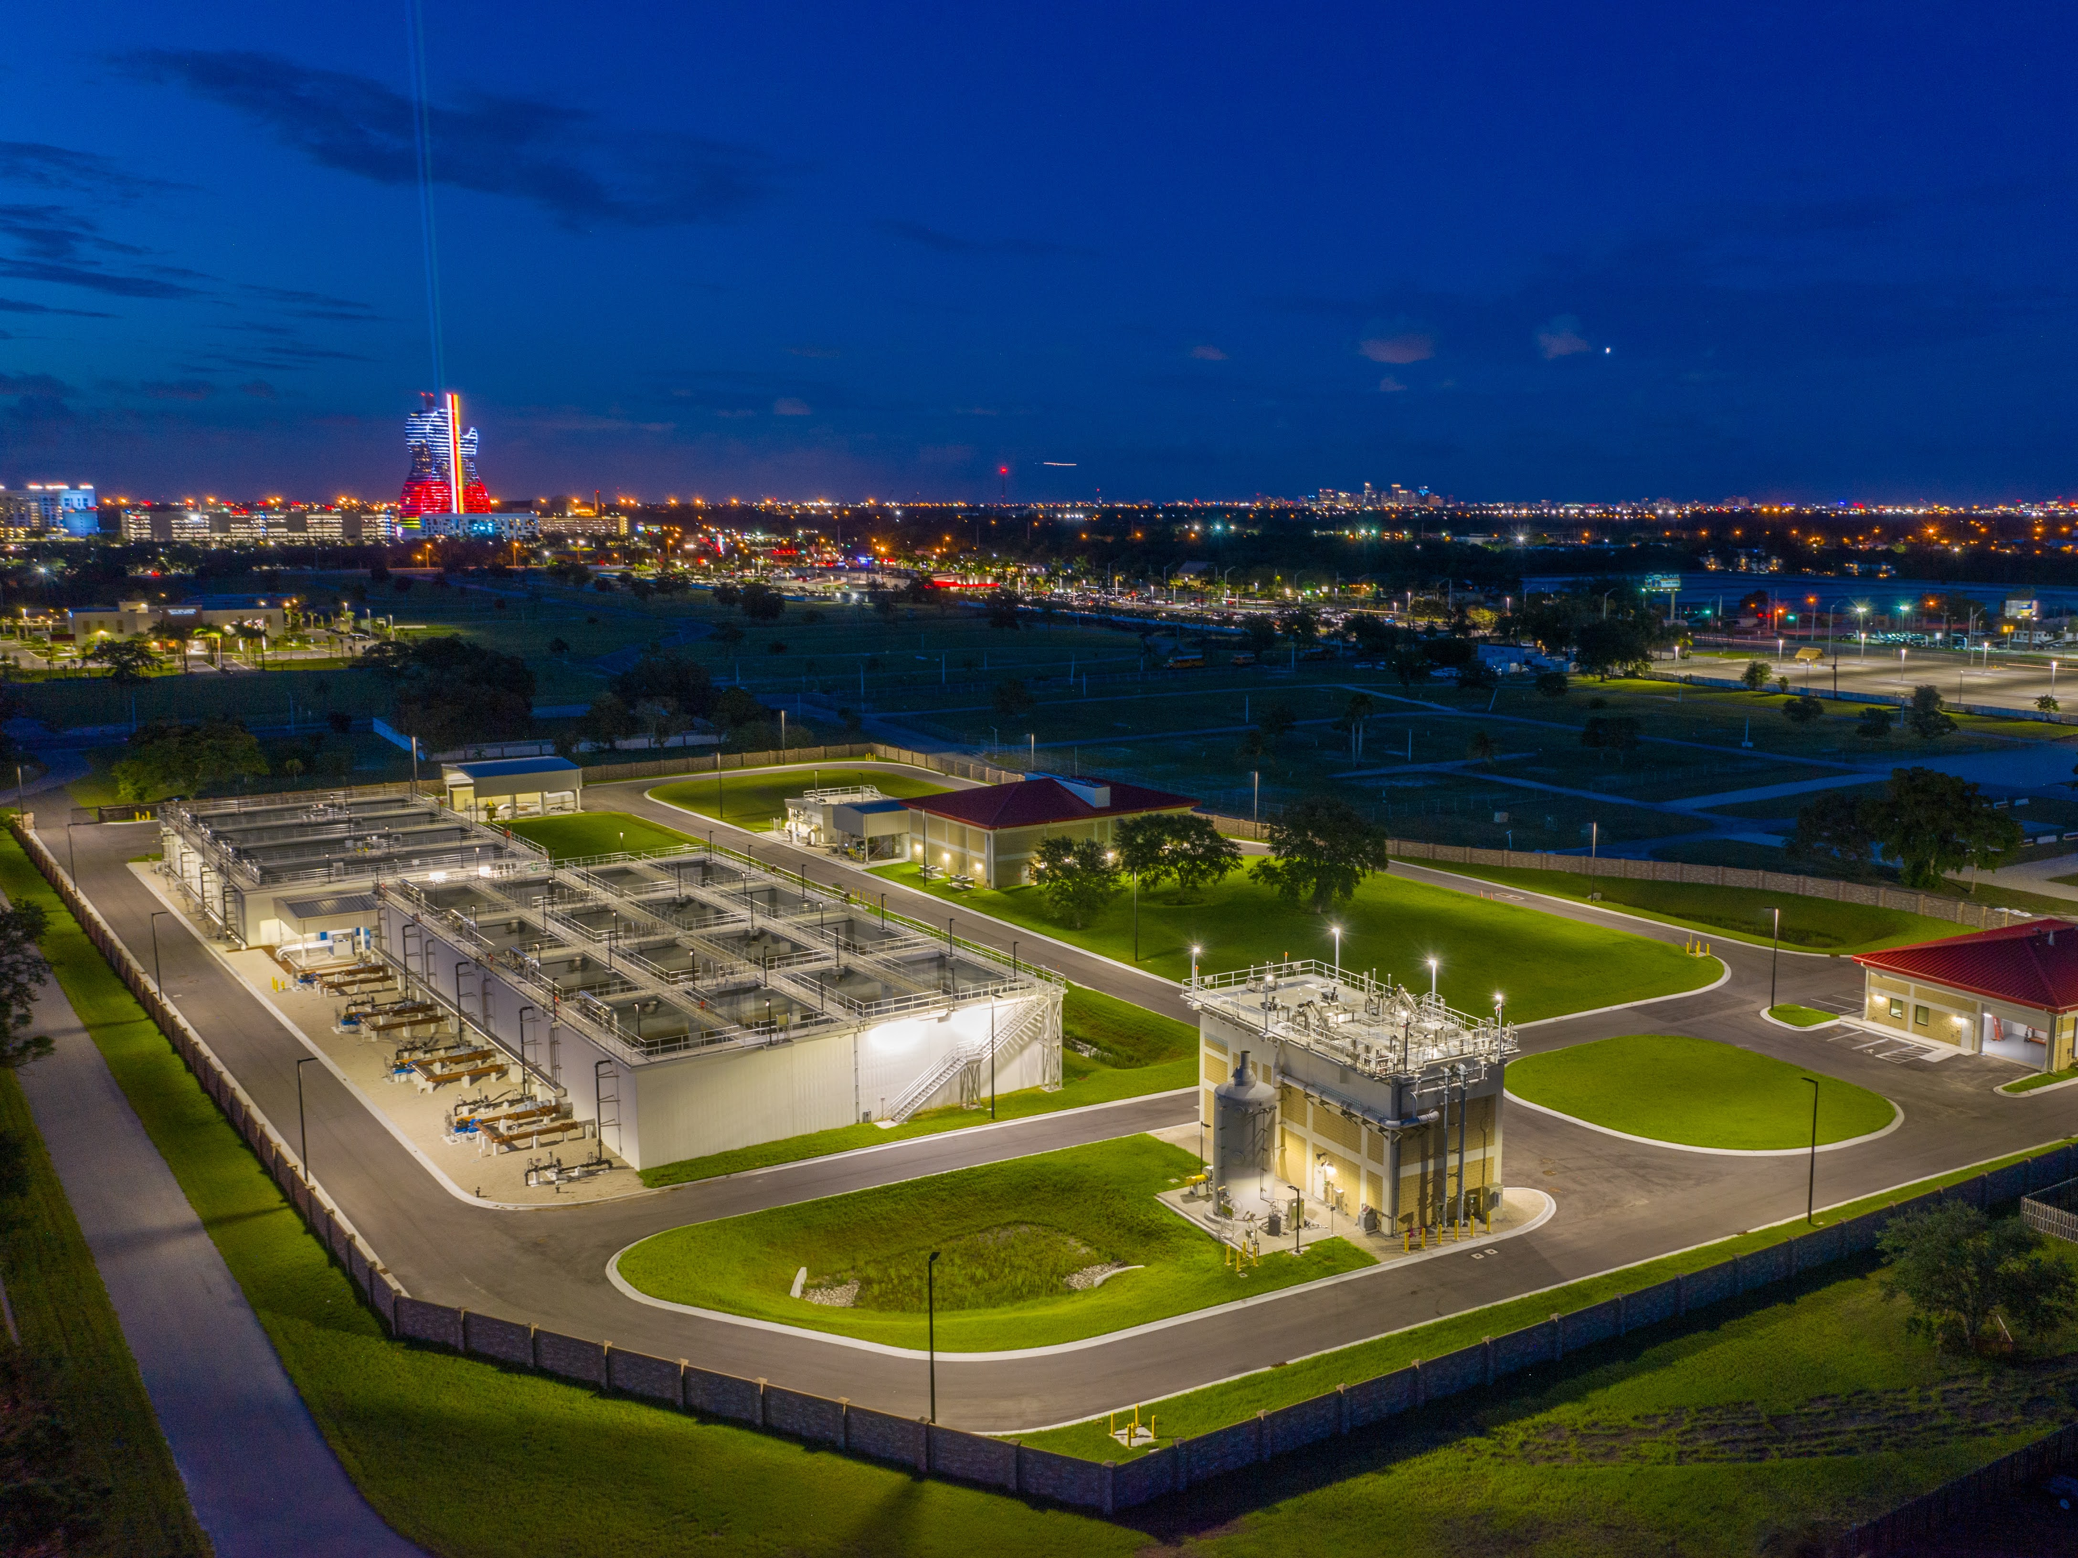



What are our assets?
Physical (Facilities)
Fiscal (Funding)
Human Resources
Information Resources

Slide 5
What are some key elements of Asset Management?
  Strategic Plan
  Service Levels
  Risk Management
  Life Cycle Analysis
  Triple Bottom Line
  Data and Data Systems
  Role Clarification
  Succession Planning
  Training and Retention
  Business Cases
  Decision Making
  Performance Measurement
  Benchmarking
Levels of Service
Customers & Other Stakeholders
Assure Alignment
Organizational
Goals
Organizational
Mission & Vision

Slide 6
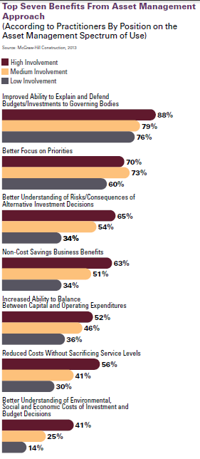
What drives asset management?
  Capital and O&M budgeting meet funding limits rather than true assessment of system needs
  Lack of integration of tools and methods
  Decentralized data management
  Decisions based on perception (and sometimes passion) rather than fact and analysis
  Focus on first costs rather than life cycle
  Lack of planning for Operations and Maintenance
  Lack of effective Capital and O&M forecasting
  Lack of focus on customer levels of service
  Lack of understanding of risk

Slide 7
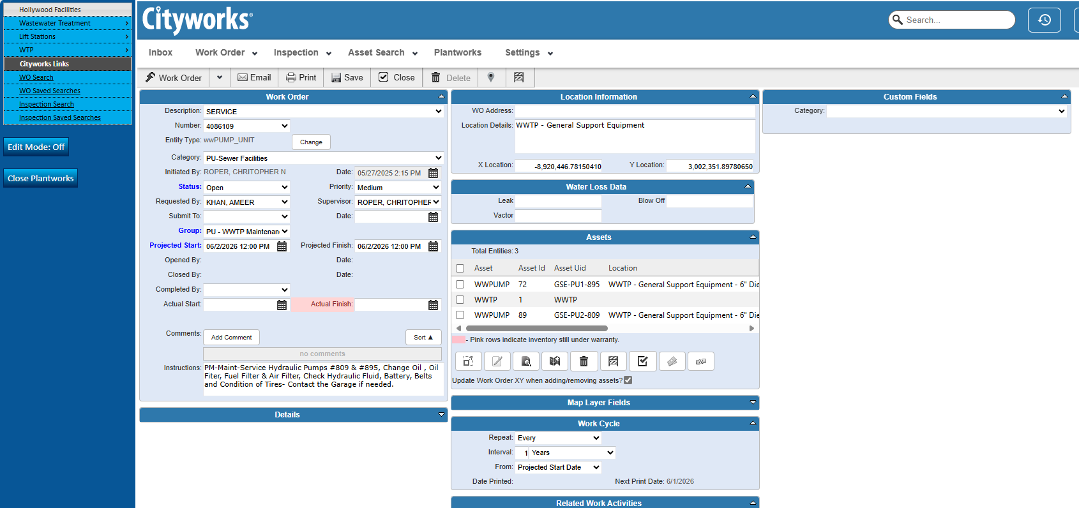
What is CMMS or EAM? How does it integrate or overlap with asset management?
A Computerized Maintenance Management System (CMMS) or Enterprise Asset Management System (EAM) is just one software tool in the asset management tool box.
The CMMS system is only as good as the data, maintenance strategies, work processes, and standards that go into it and accompany its output.

Slide 8
Serving a Region, Investing in Resilience
A Regional Commitment to Reliable Wastewater Service
  The Southern Regional Wastewater Treatment Plant (SRWWTP) serves
    Hollywood
    Pembroke Pines
    Dania Beach
    Hallandale Beach
    Miramar
    Pembroke Park
    Southern Broward County
Over 25,000 customers rely on this facility daily.
The City has committed $280 million in water and sewer infrastructure improvements (FY 2025–2029 CIP).
This project is a cornerstone of that investment -ensuring long-term reliability and service quality.

Slide 9
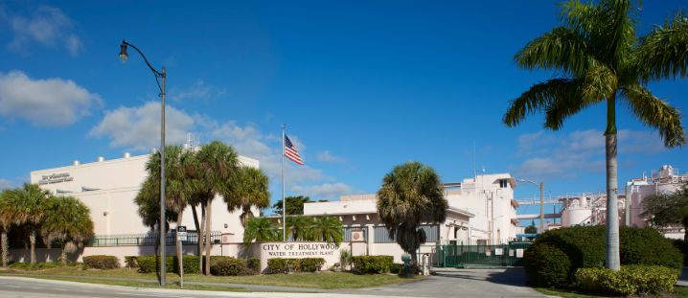
From Reactive to Proactive
Modernizing Asset Management at the SRWWTP
Implementation of Cityworks® Enterprise Asset Management to:
    Track performance and maintenance costs
    Prioritize repairs and replacements
    Support capital planning
Key project components:
    Asset Registry Development: ~1500 assets cataloged
    Criticality & Risk Ranking: Using SOAP methodology
    Condition Assessment: Field evaluations and strategic recommendations
Outcome:
    Outcome: A smarter, data-driven approach to maintaining essential infrastructure.

Slide 10
Criticality Process
Criticality Analysis
Data Collection (Asset Registry), System Review (Asset Hierarchy) & Development of Function(s) Statements
Criticality – A relative measure of the impact of failure on the mission objective (function)…a relative measure of consequences.
    Critical: Prevents continued ability to safely fulfill function(s).
    Essential: Reduces continued ability to safely fulfill function(s).
    Non-essential: Could not prevent or reduce ability to safely fulfil function(s).
Data Collection & Systems - Development of Asset Registry & Asset Hierarchy
  Process and Instrumentation diagrams (P&IDs)
  Geospatial configuration or aerial photographs
  Most recent preliminary engineering report (PER)
  Regulatory permits
  Summary of production/quality reports
  Summary of regulatory compliance data for past 3 years
  Maintenance histories
STEP
1
Establishment of Cross-Functional Team
STEP
2
Criticality Workshop at System Level
STEP
3
Post-Processing of the Workshop Results
STEP
4
Relative Criticality Ranking at the Asset Level
STEP
5
Final Review with Cross-Functional Team
STEP6

Slide 11
Criticality Process
Criticality Analysis
Data Collection (Asset Registry), System Review (Asset Hierarchy) & Development of Function(s) Statements
Cross-Functional Team
  Operations, Maintenance, Engineering, Finance, Safety, Compliance, and Management
Develop Function Statements
  Function statements should start with the word "To....", and usually contain a verb, an object and at least one performance standard
    To pump water at a minimum rate of 300 gallons/minute
  A function can have more than one desired standard of performance, such as:
    “To heat up to 500 lbs of product X from ambient temperature to boiling point (212°F) in one hour.”
    Here the desired performance standards relate to weight, temperature and time
STEP
1
Establishment of Cross-Functional Team
STEP
2
Criticality Workshop at System Level
STEP
3
Post-Processing of the Workshop Results
STEP
4
Relative Criticality Ranking at the Asset Level
STEP
5
Final Review with Cross-Functional Team
STEP6

Slide 12
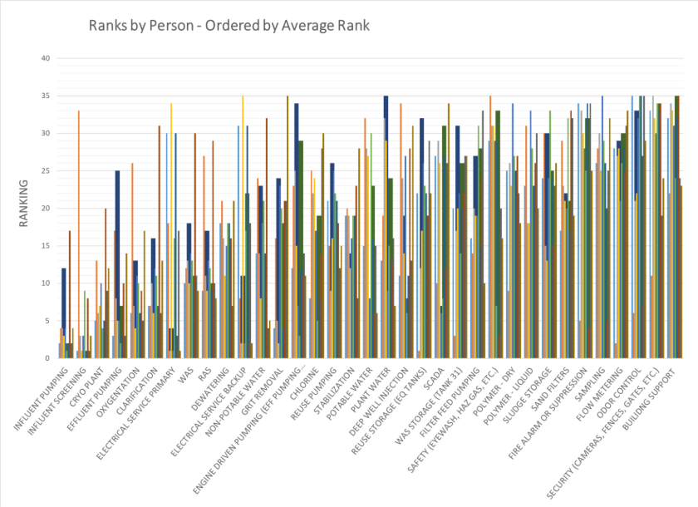
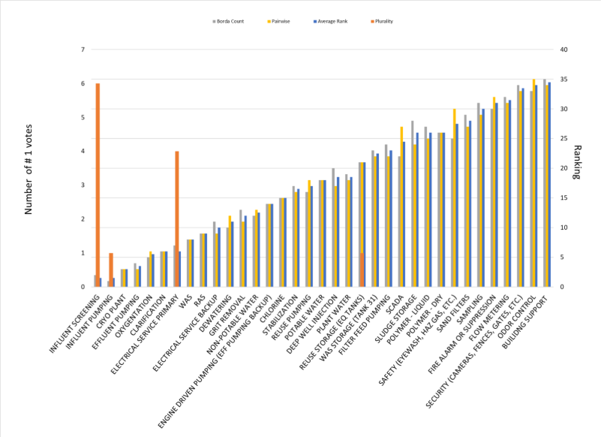
Criticality Process
Criticality Analysis
Data Collection (Asset Registry), System Review (Asset Hierarchy) & Development of Function(s) Statements
STEP
1
Preference (Forced Rank) Ballot for System
  Ballots are entered into spreadsheet tool
  Combination of Plurality, Borda Count, and Pairwise Comparison
Graphical presentation of input and output data
Final ranking (1 to 5) based on calculations and graphical review
Establishment of Cross-Functional Team
STEP
2
Criticality Workshop at System Level
STEP
3
Post-Processing of the Workshop Results
STEP
4
Relative Criticality Ranking at the Asset Level
STEP
5
Final Review with Cross-Functional Team
STEP6

Slide 13
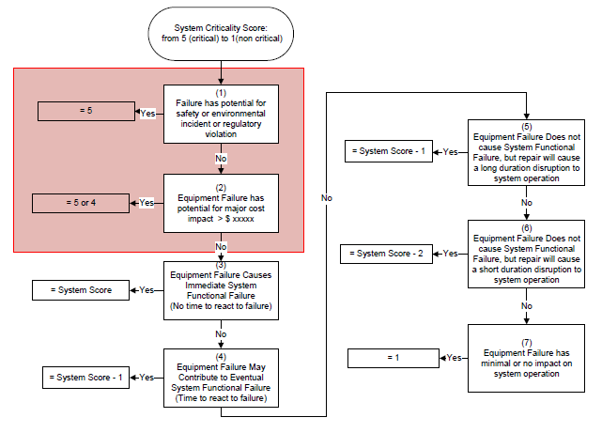
Criticality Process
Criticality Analysis
Function-based scoring system at the asset level
  Reliability Centered Maintenance (RCM) theory
        Process Pumps = system value
        Chemical tanks = 5
        Protective devices on chemical systems (e.g. level transmitter on tank) = 5
        Flow meter (causes failure to meet reporting standards) = 5
        Flow meter (causes ops to rely on other monitoring method but easy to replace (system – 2)
        Flow meter (causes ops to rely on other monitoring method but difficult to replace (system – 1)
        Large check valve on process pump (system – 1)
Data Collection (Asset Registry), System Review (Asset Hierarchy) & Development of Function(s) Statements
STEP
1
Establishment of Cross-Functional Team
STEP
2
Criticality Workshop at System Level
STEP
3
Post-Processing of the Workshop Results
STEP
4
Relative Criticality Ranking at the Asset Level
STEP
5
Final Review with Cross-Functional Team
STEP6

Slide 14

How to utilize the results?
Condition Assessments
Preventative Maintenance Program Improvement
Work Prioritization
Inventory Management and Critical Spares
Predictive Maintenance Programs
Health and Safety Improvements
Design and/or Re-designs
O&M Budget Development
CIP Prioritization
Communications

Slide 15
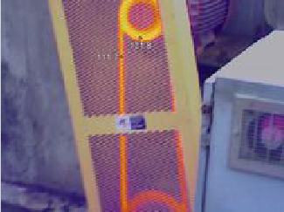
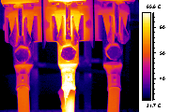
Condition Assessment
Utilized Jacobs ACES program
Method should be repeatable, sustainable and easily represented in Cityworks
  Vibration Monitoring
  Ultrasonic
  Thermography
  Megohmmeter (electric insulation testing)
  Motor Current Signature Analysis
Focus Condition Assessment on highly critical assets from SOAP
Asset Inventory Review
Table Top Assessment & Data Review
Field Assessment 1:
MOST CRITICAL ASSETS
Field Assessment 2:
Less Critical Assets
Mesh into maintenance program
Asset Values & Total Useful Life
Develop R&R Schedule
Refine R&R Schedule
Refine R&R Schedule

Slide 16
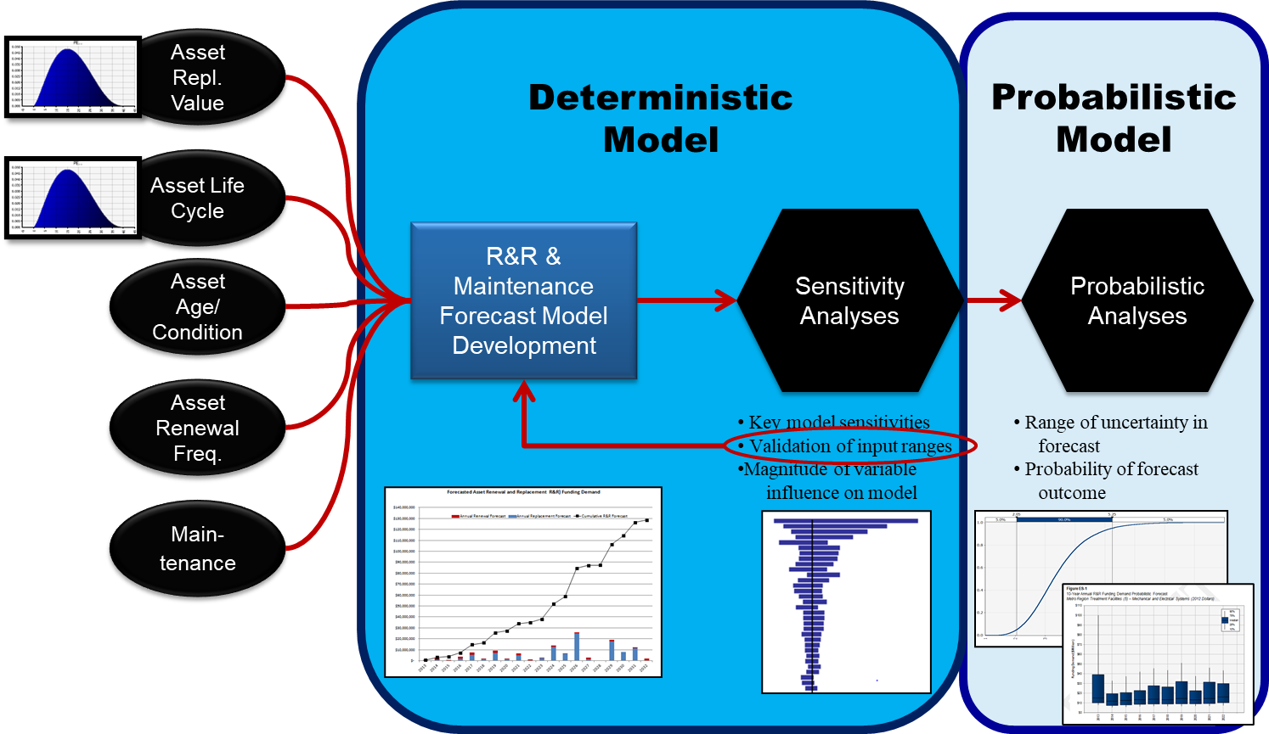
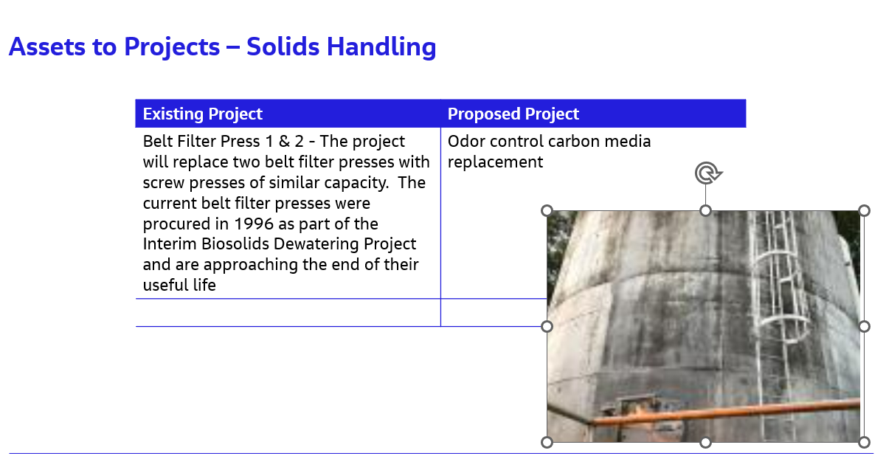
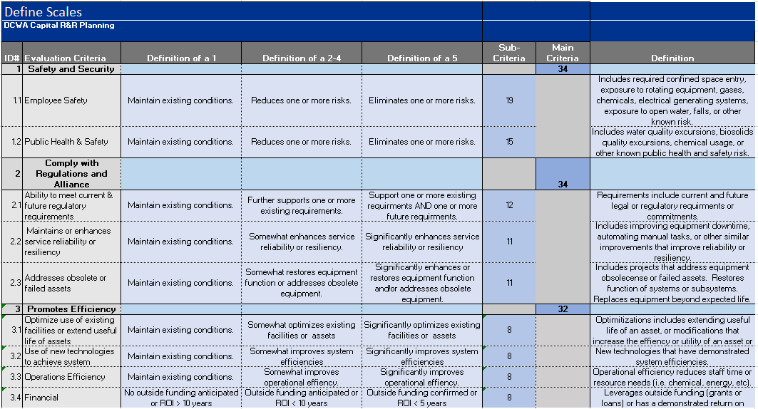
Financial Planning
Capital Planning
Assets to Projects
Prioritization Tool

Slide 17



Approach for Criticality Assessments - Most applicable times to perform:
When struggling to prioritize your maintenance program and related resources
When facing a major capital investment
When you need a structured, new way of evaluating old problems
When there is a change in leadership and a quick confirmation of the existing system is desired
When you simply do not have enough data to support anything beyond a subjective approximation

Slide 18
Collaboration & Innovation Conclusions
Partnering for Efficiency and Impact
The City partnered with Jacobs Engineering to apply the SOAP (Solomon-Oldach Asset Prioritization) method:
    Saves up to 70% staff time
    Delivers 80–95% accuracy compared to traditional methods
    Prioritizes assets based on function and failure impact
City staff played a key role in:
    Workshops and system reviews
    Validating asset data and rankings
    Guiding field assessments
Result a replicable model for other utilities and assets:
    Efficient
    Transparent
    Community-focused

Slide 19
Thank You - Questions?
Contact: Mauricio Lara, PE mauricio.lara@jacobs.com

