Slide 1

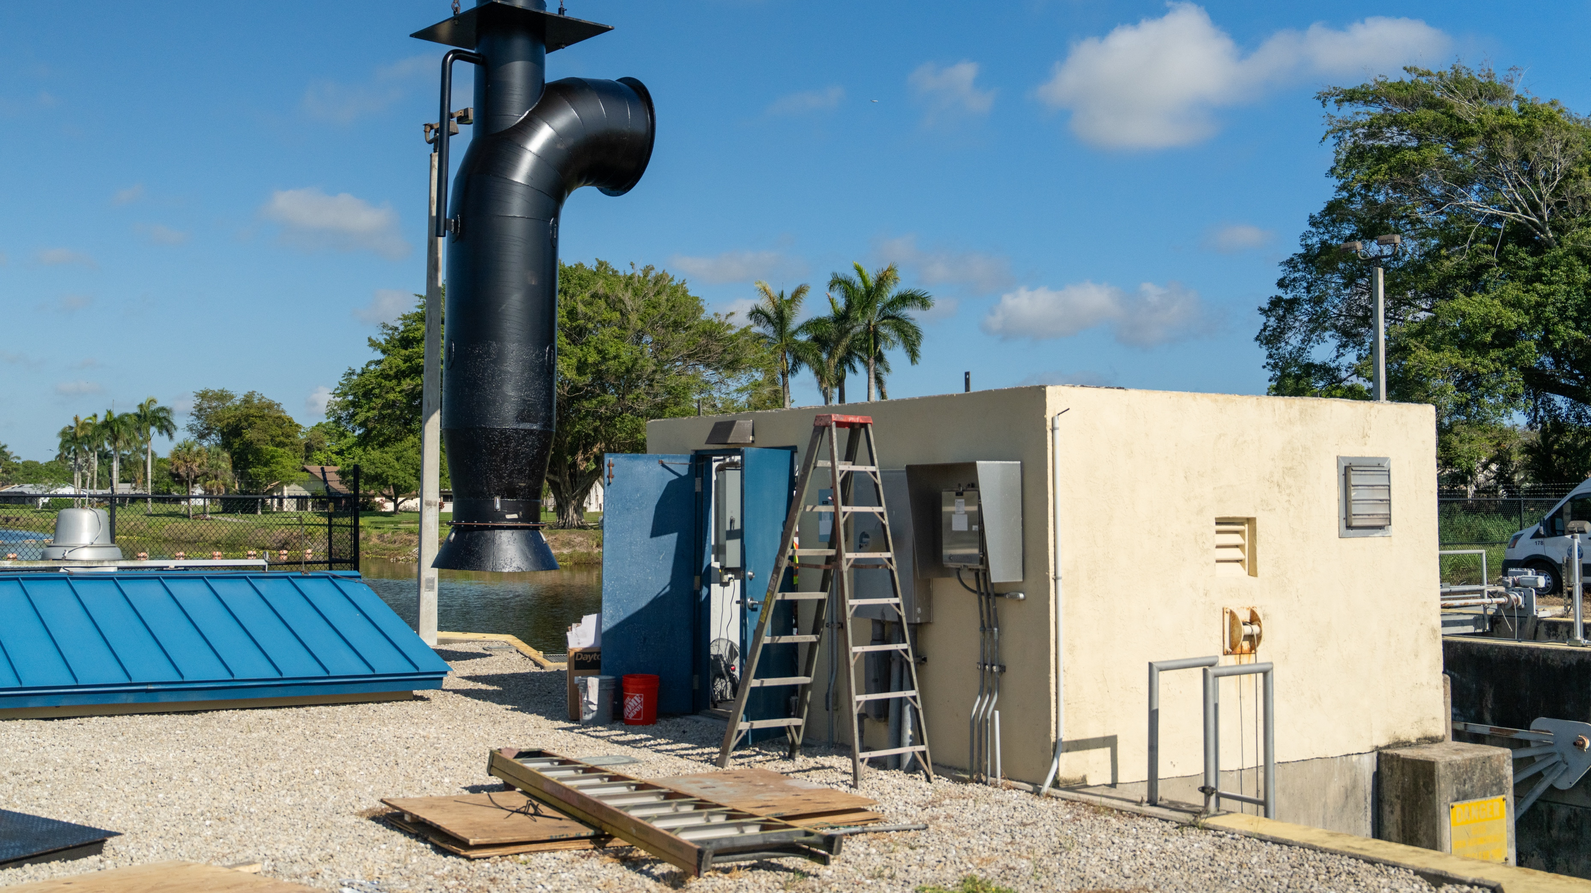
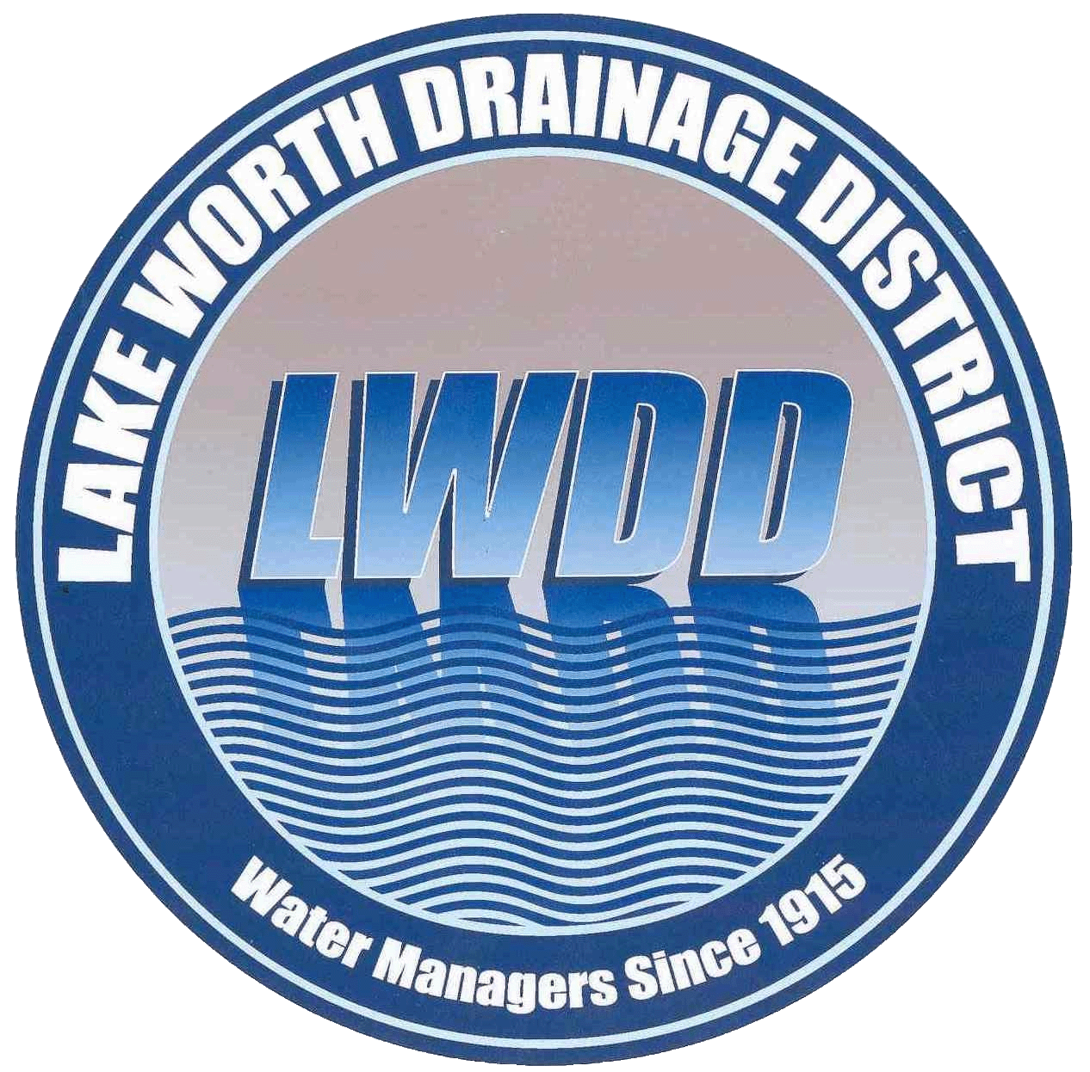
Greetings SEFLUC
Who We Are:
The Lake Worth Drainage District
Tommy Strowd, P.E., LWDD Executive Director, District Engineer

Slide 2
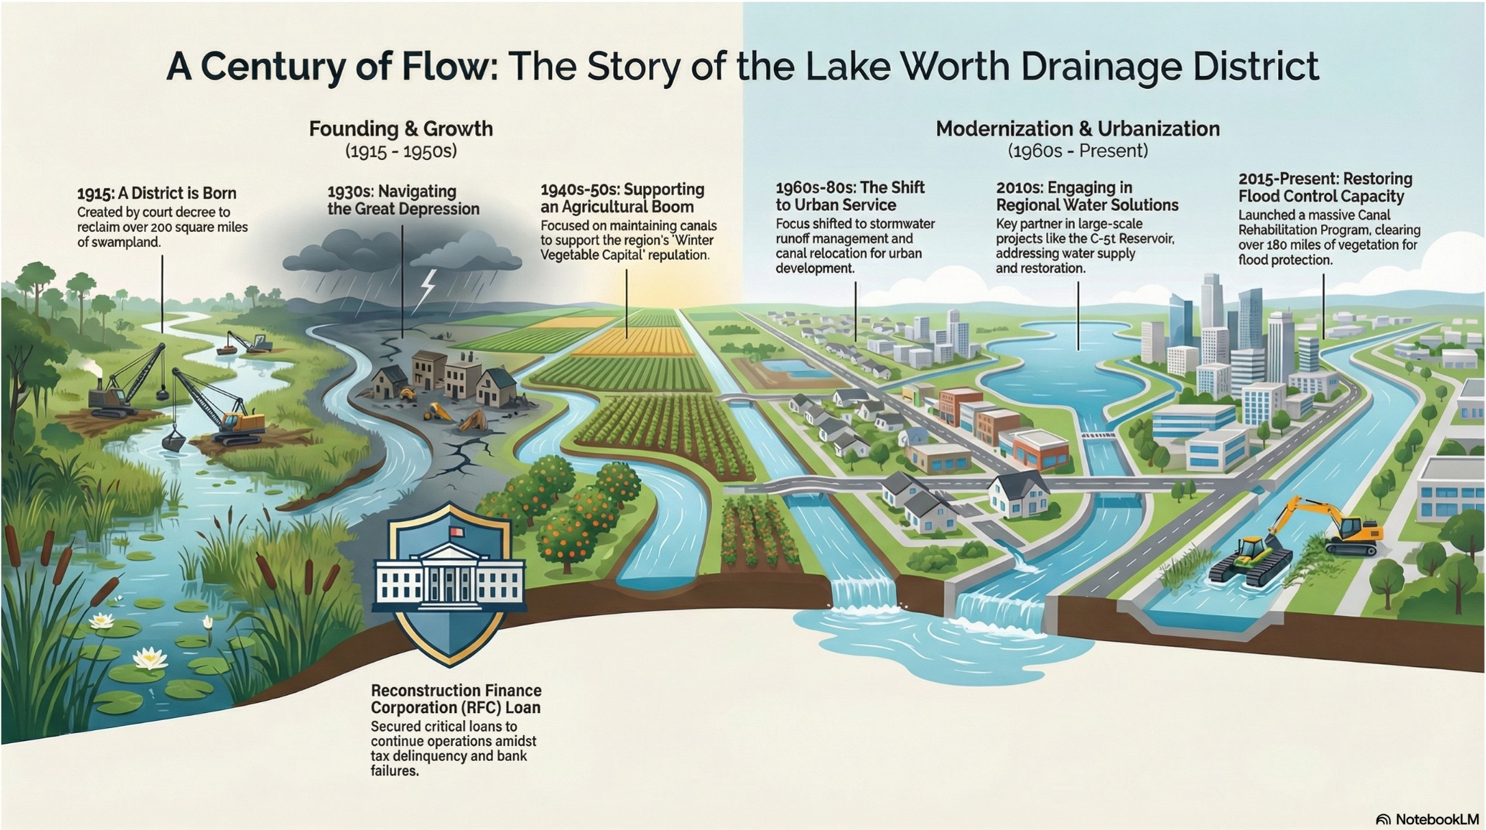
Introduction to the LWDD
Notes:
Municipalities:
Atlantis
Boca Raton
Boynton Beach
Delray Beach
Greenacres
Village of Golf
Haverhill
Lake Clarke Shores
Lake Worth
Palm Springs
Royal Palm Beach
Wellington
West Palm Beach

Slide 3
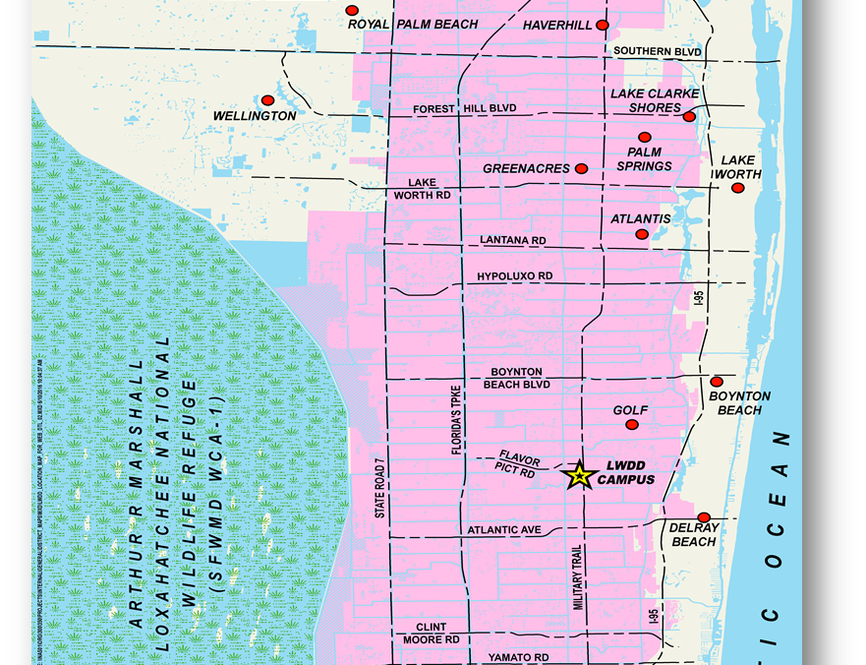
Who We Are
Independent special taxing district established in 1915 by the Florida Legislature for the purpose of settlement and development of agriculture
‘Single Purpose’ drainage district
Responsible for providing flood control and water supply for approximately half of Palm Beach County
Encompasses approximately 200 square miles in southeastern Palm Beach County; all or part of 13 municipalities
Serving ~800,000 residents and more than 10,000 agricultural acres
Notes:
Municipalities:
Atlantis
Boca Raton
Boynton Beach
Delray Beach
Greenacres
Village of Golf
Haverhill
Lake Clarke Shores
Lake Worth
Palm Springs
Royal Palm Beach
Wellington
West Palm Beach

Slide 4
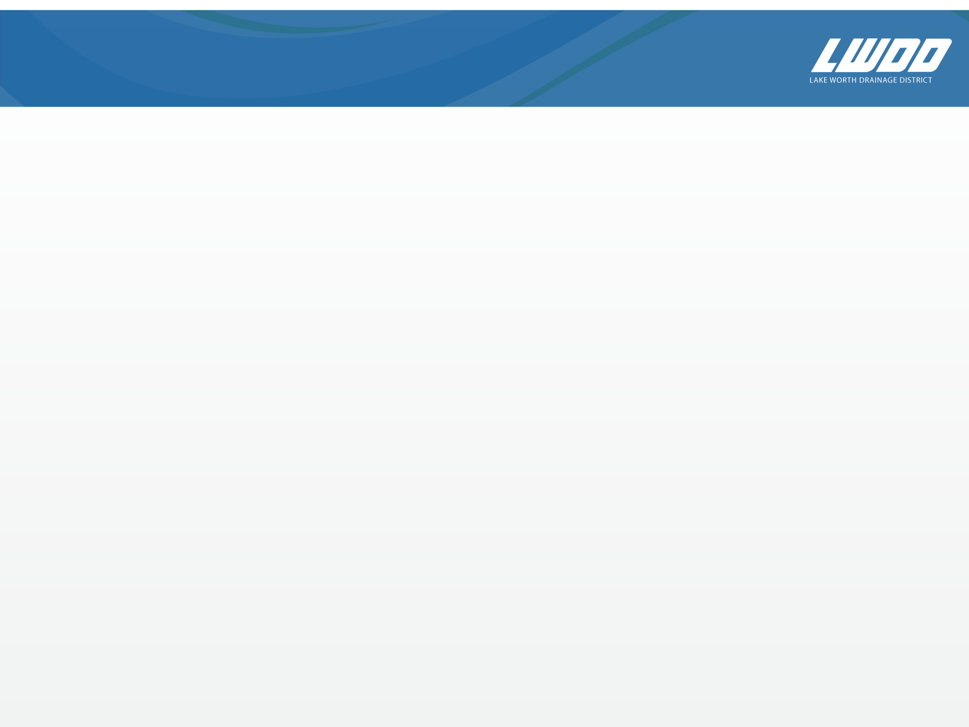
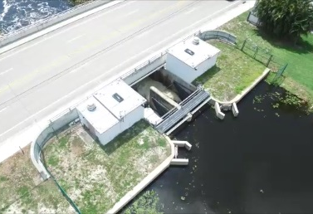
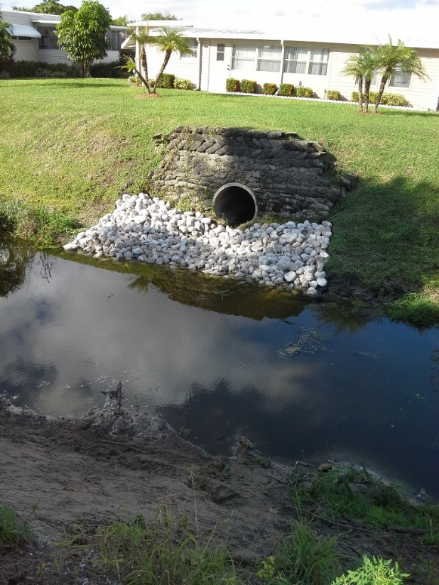
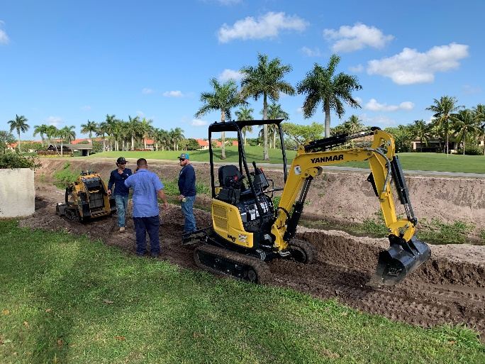
What We Do
Operate and maintain approximately 500 miles of canals and 1,000 miles of rights-of-way
  50 Lateral canals run west to east every half mile
  5 Equalizer canals run north to south along State Road 7, Florida Turnpike, West of Military Trail and East of Congress Avenue
  20 major control structures and numerous minor structures
Regulation of drainage
connections and use of the canal right-of-way

Slide 5
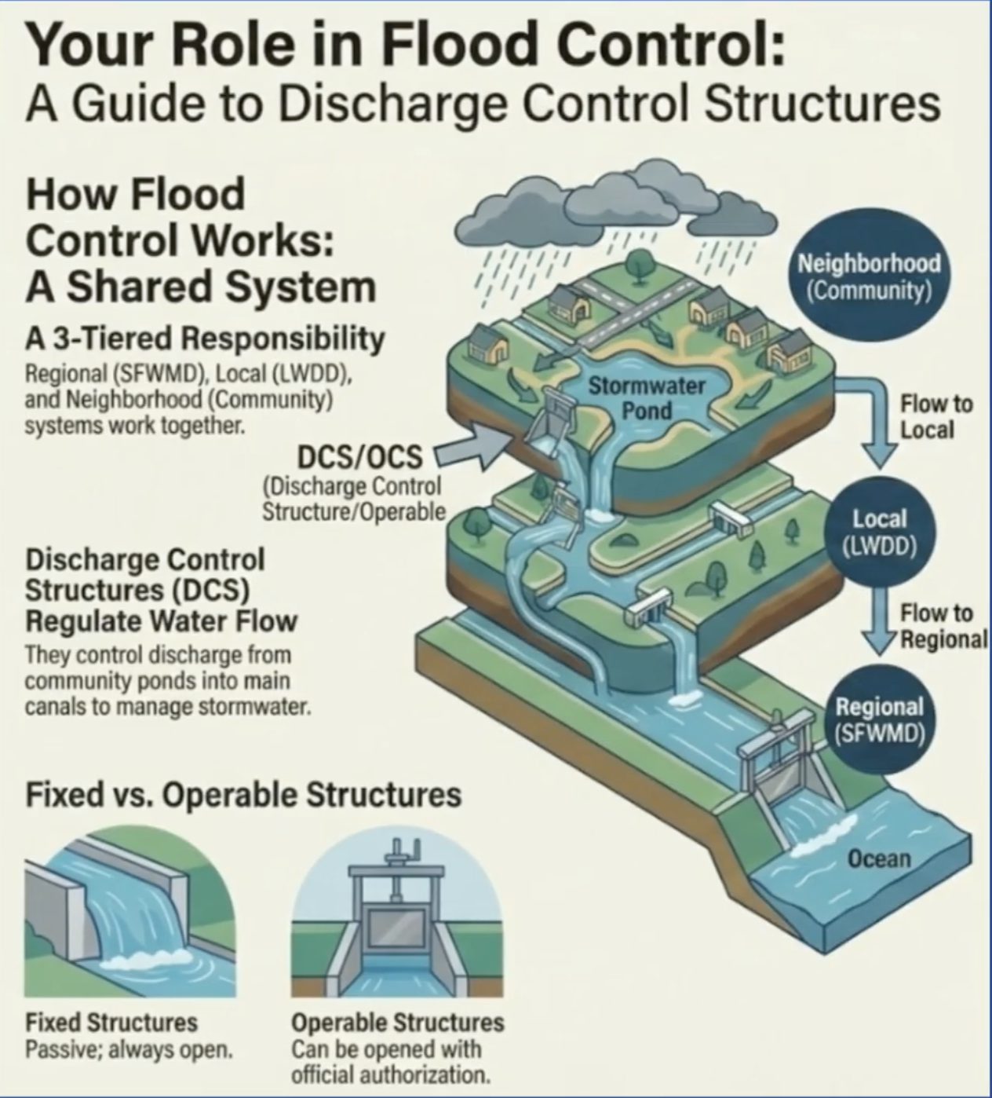
Shared Flood Control
Flood control relies on three connected levels:
SFWMD: Manages regional canals and water releases
LWDD: Maintains local canals and infrastructure
Communities: Manage neighborhood stormwater systems

Slide 6
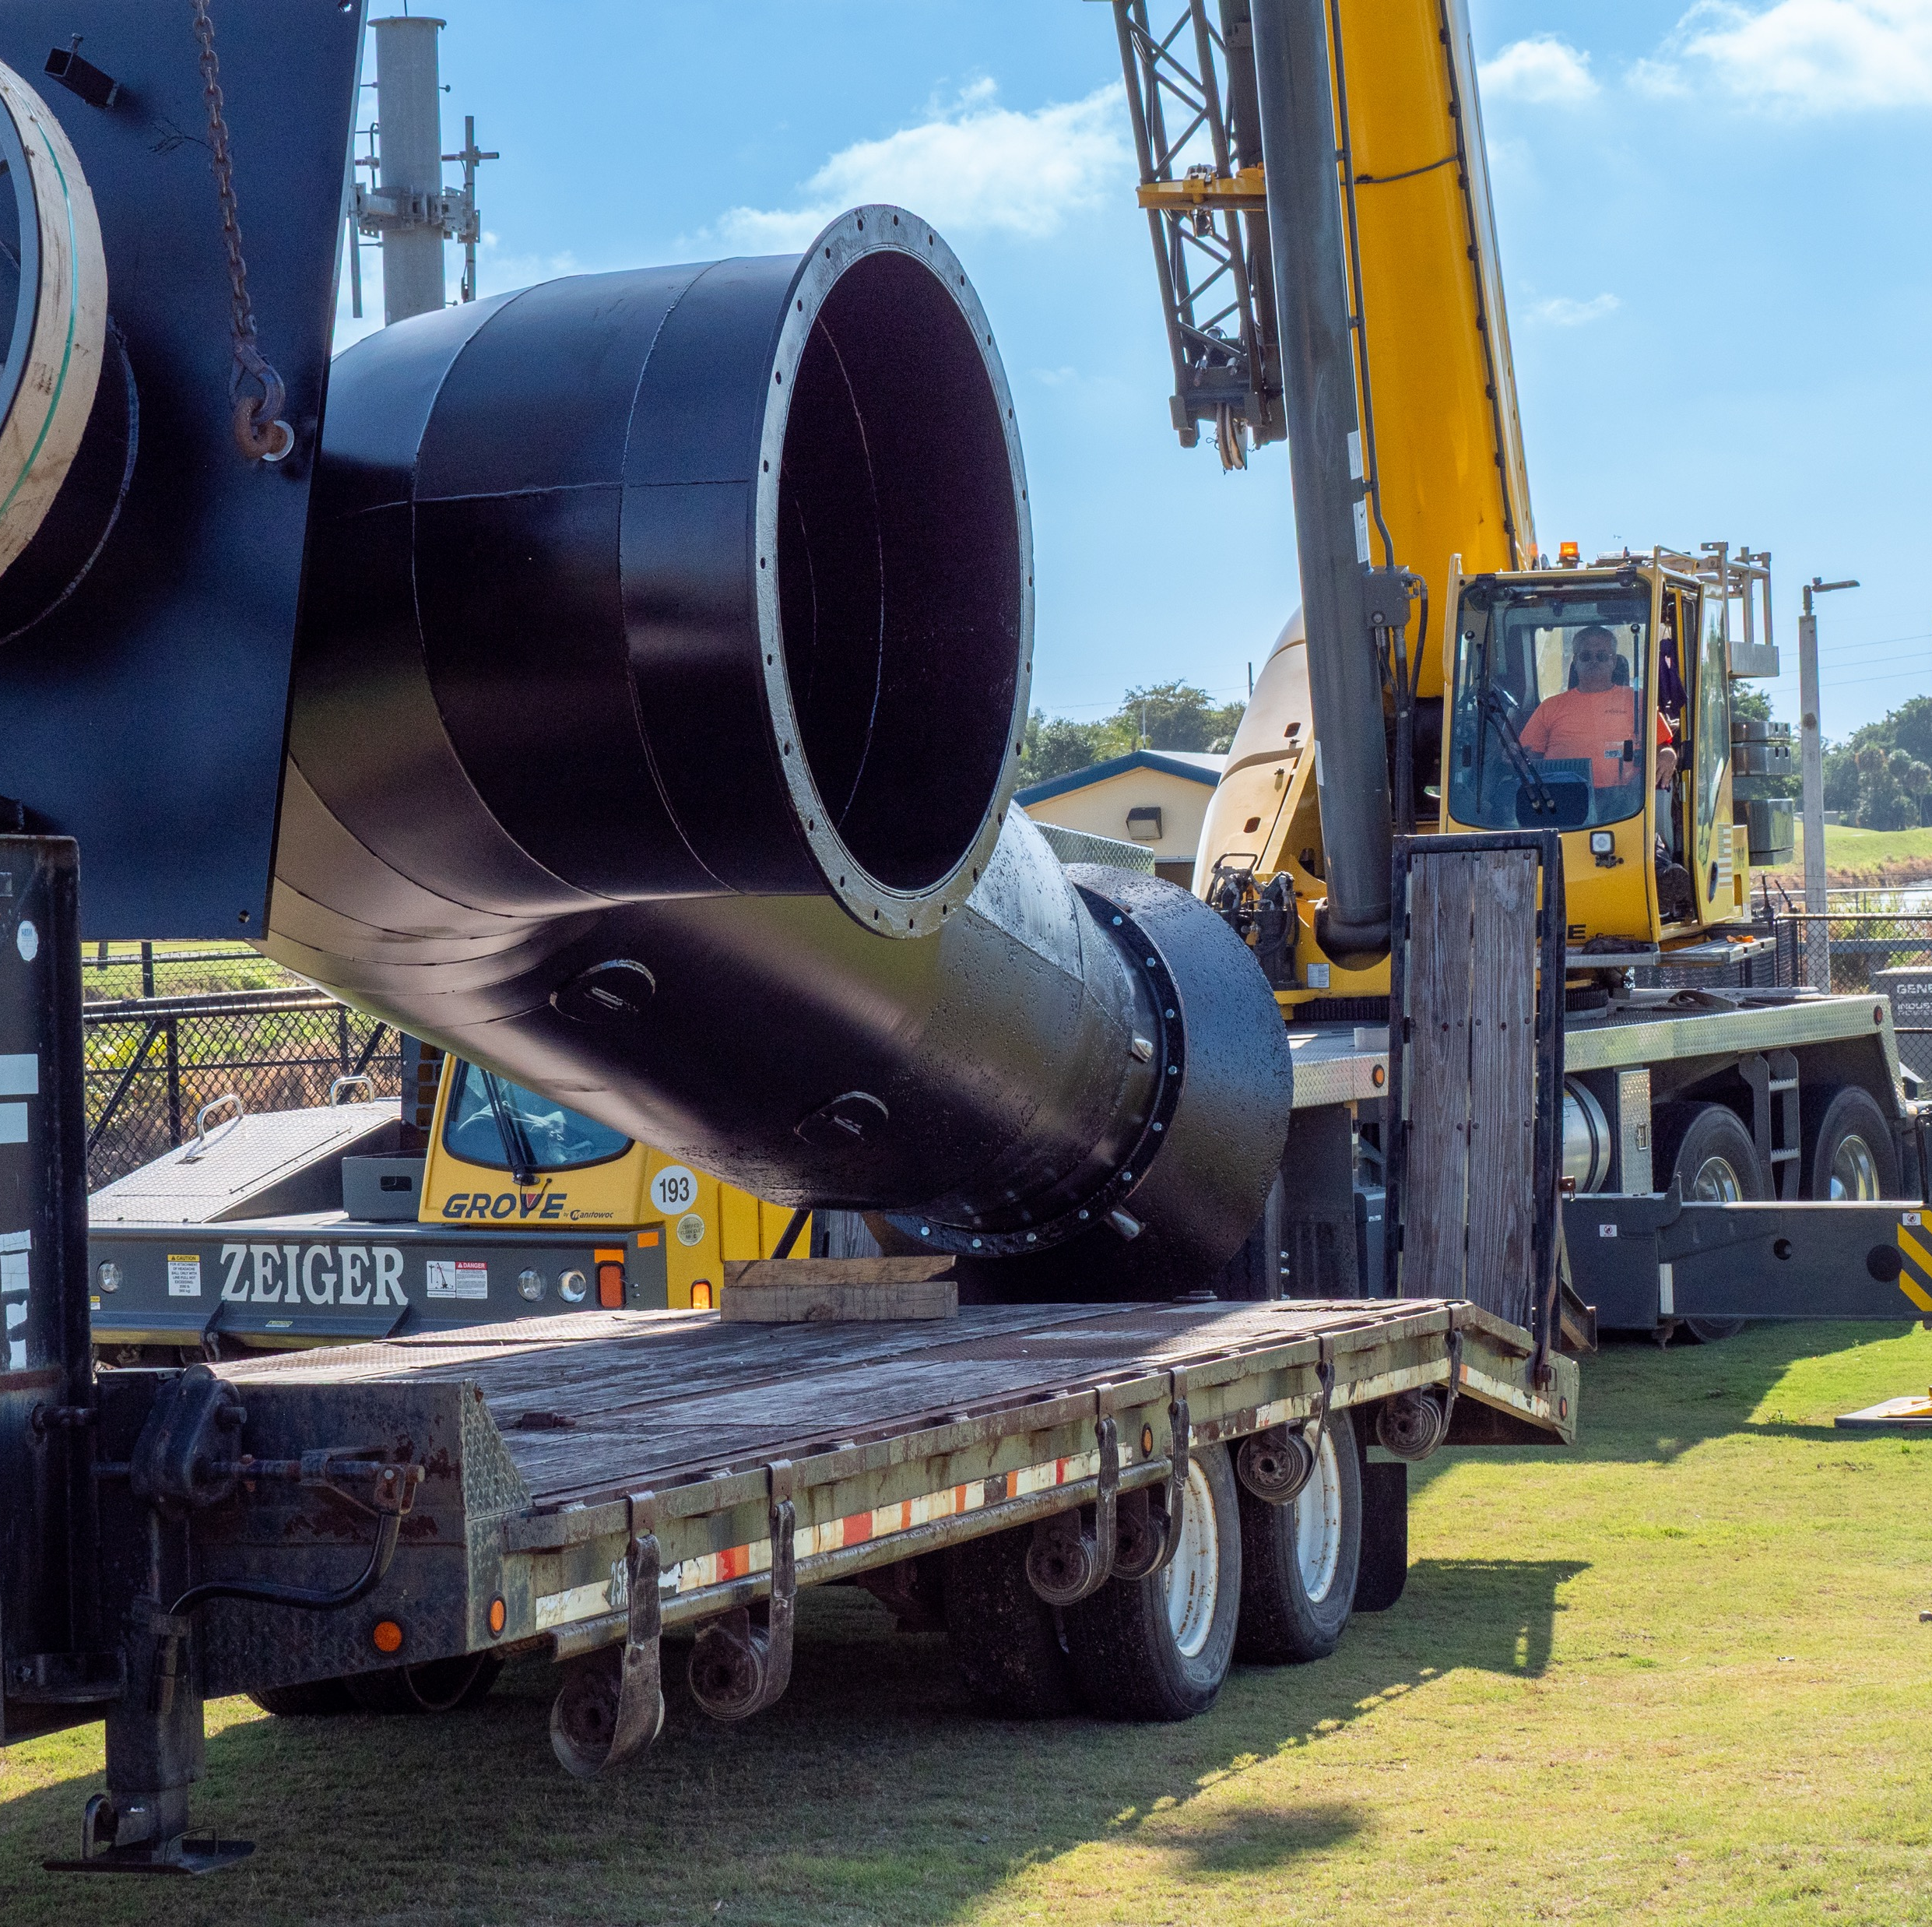
LWDD’s Water Supply Role
LWDD plays key role in balancing water supply needs in southeastern Palm Beach County
LWDD not a water consumer
  “Diversion & Impoundment”…
LWDD manages water levels to make it available for urban and agricultural needs
Sources of water supply…
  Rainfall
  Water Conservation Area 1 (Primary)
  Lake Okeechobee (Secondary)

Slide 7
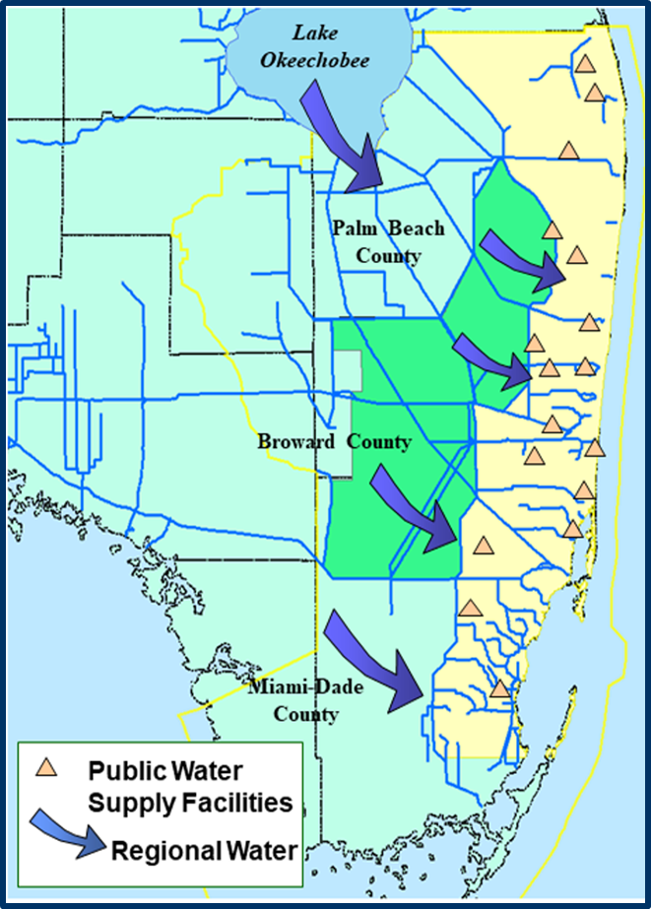
Lake Okeechobee and LEC Water Supply
Everyone in South Florida relies on Lake Okeechobee and the Water Conservation Areas to:
Replenish and recharge coastal aquifers
Maintain ground water levels
Protect against saltwater intrusion that could contaminate wellfields

Slide 8
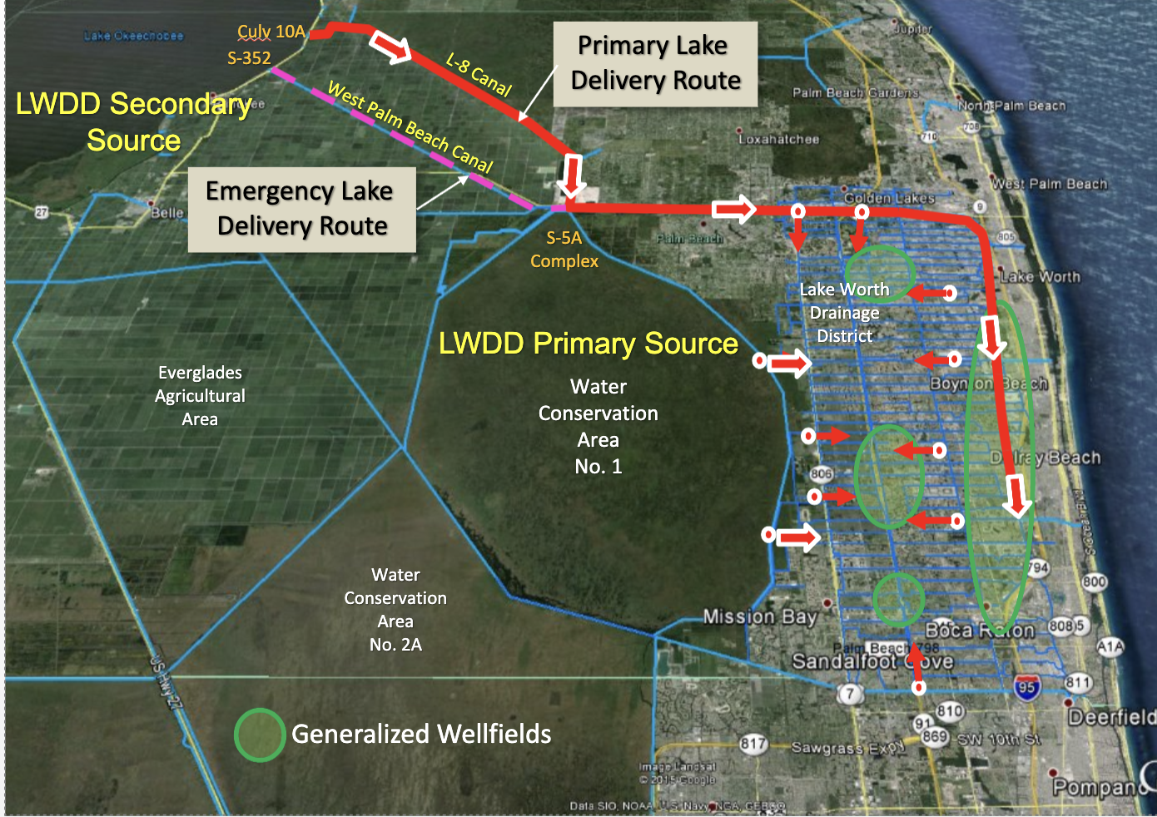
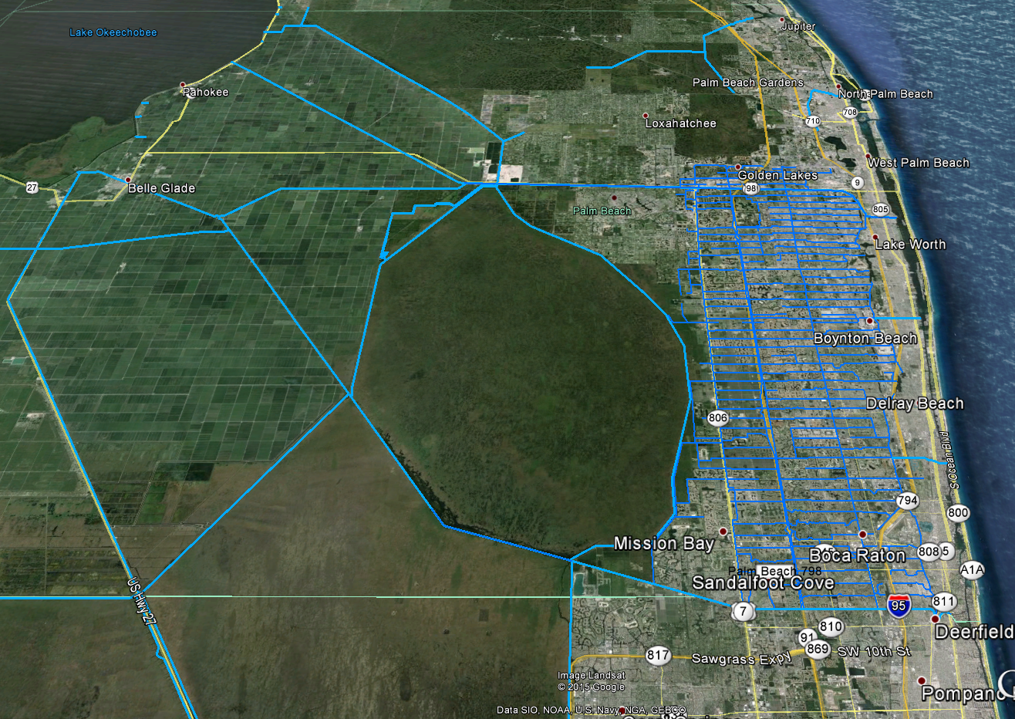
LWDD Water Supply
Culv 10A
Primary Lake
Delivery Route
S-352
L-8 Canal
LWDD Secondary
Source
West Palm Beach Canal
Emergency Lake
Delivery Route
S-5A
Complex
Lake Worth
Drainage
District
LWDD Primary Source
Everglades
Agricultural
Area
Water
Conservation
Area
No. 1
Water
Conservation
Area
No. 2A
Generalized Wellfields

Slide 9
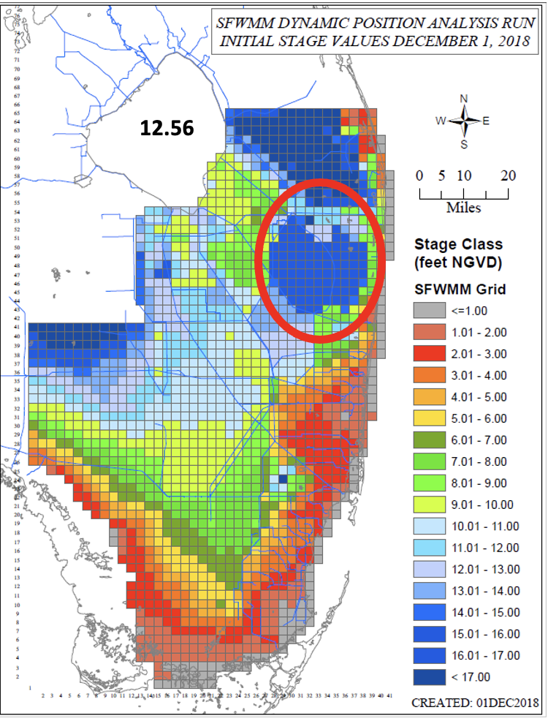
Groundwater Levels

Slide 10
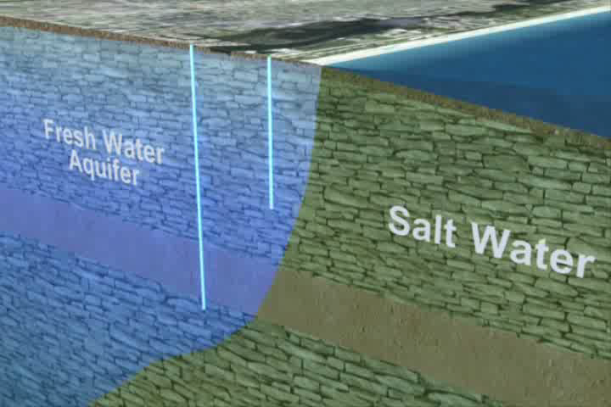
Water Supply: Saltwater Intrusion
Recharge

Slide 11
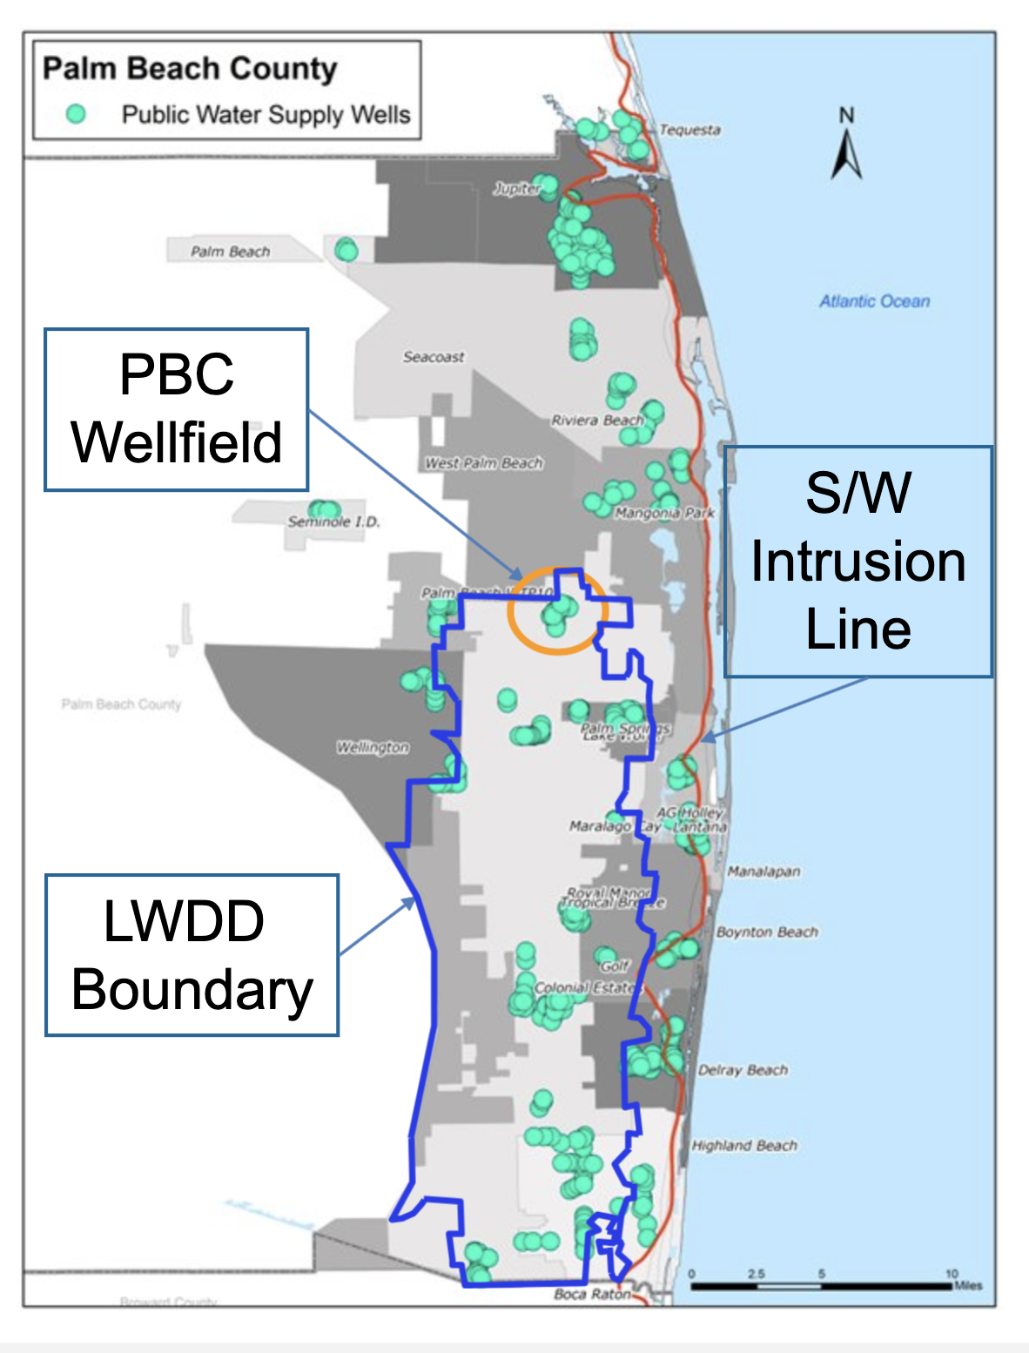
Water Supply: Saltwater Intrusion
S/W
Intrusion
Line

Slide 12
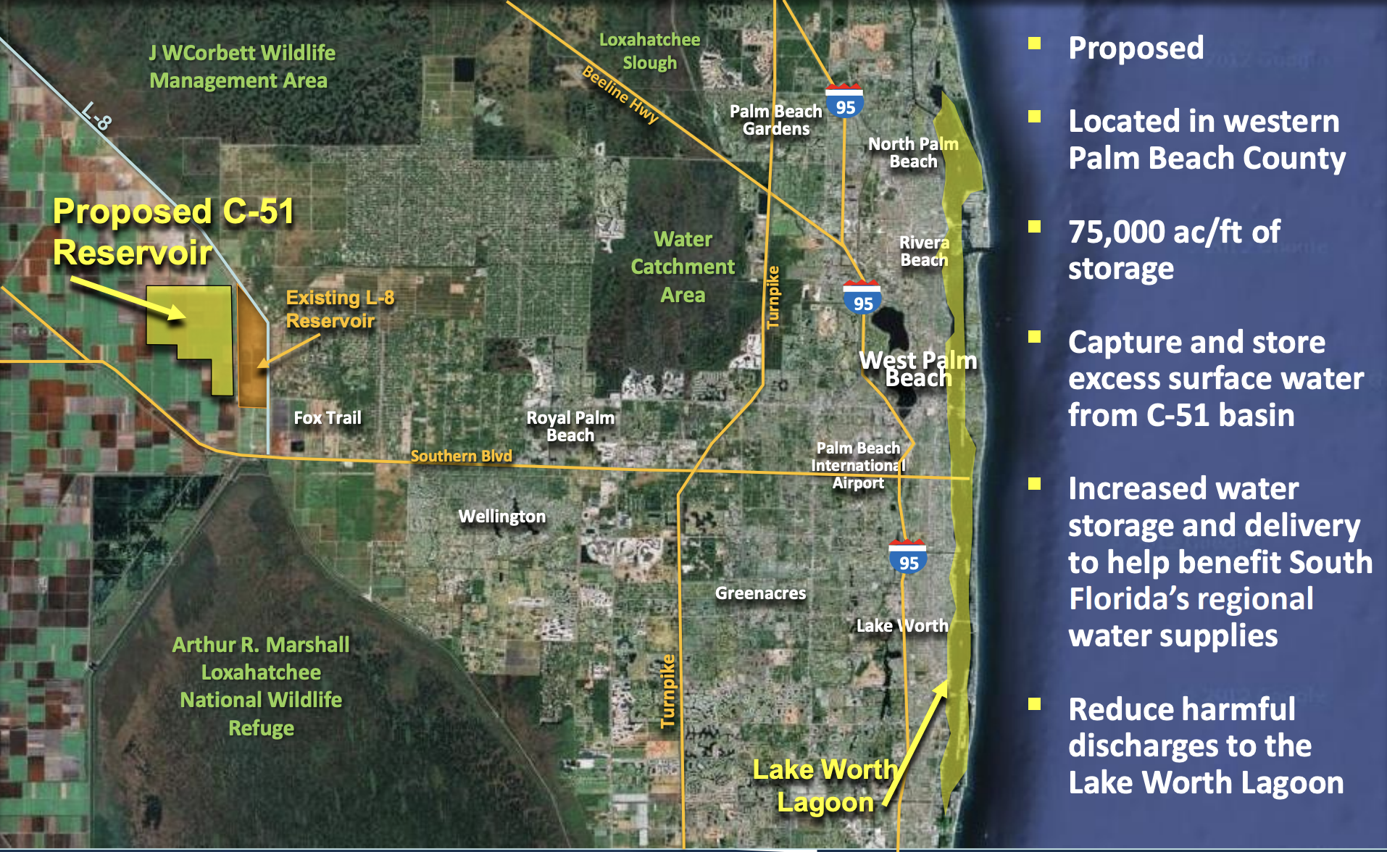
C-51 Reservoir
C-51 Reservoir

Slide 13
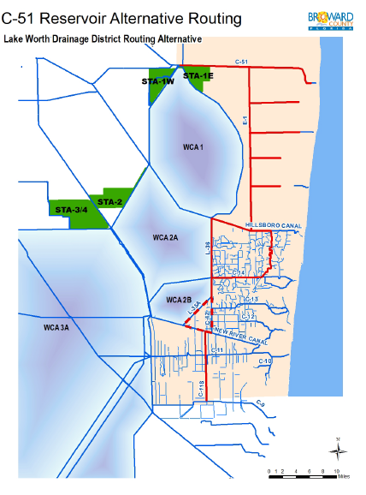
C-51 Reservoir
Divert water from Reservoir Storage
Pass through LWDD Canal Network
  C-51 Canal
  Hillsboro Canal
Pumped from Hillsboro Canal into N. Broward County

Slide 14
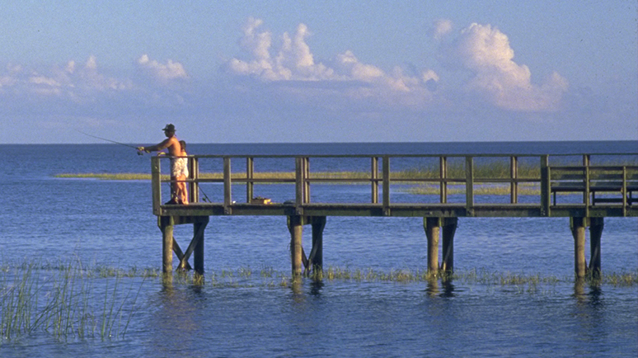
Management of Lake Okeechobee
With current regional infrastructure, it is impossible to satisfy all competing needs
CERP is ultimately the best solution
USACE should be commended for their efforts to develop a new comprehensive regulation schedule for the lake because of the completion of the Herbert Hoover Dike refurbishment
However, there are some water supply concerns specific to southeastern Palm Beach County associated with drought conditions

Slide 15
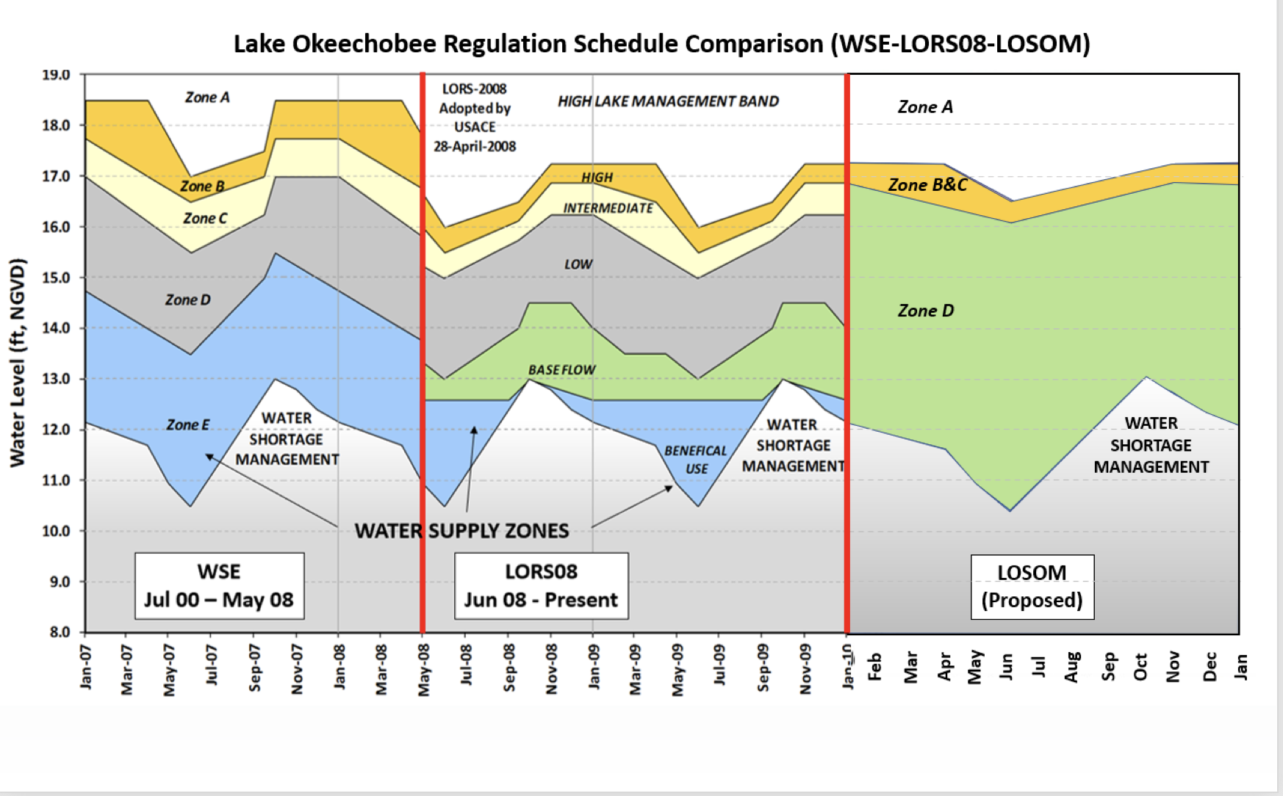
Recent Lake Schedules Compared to LOSOM

Slide 16
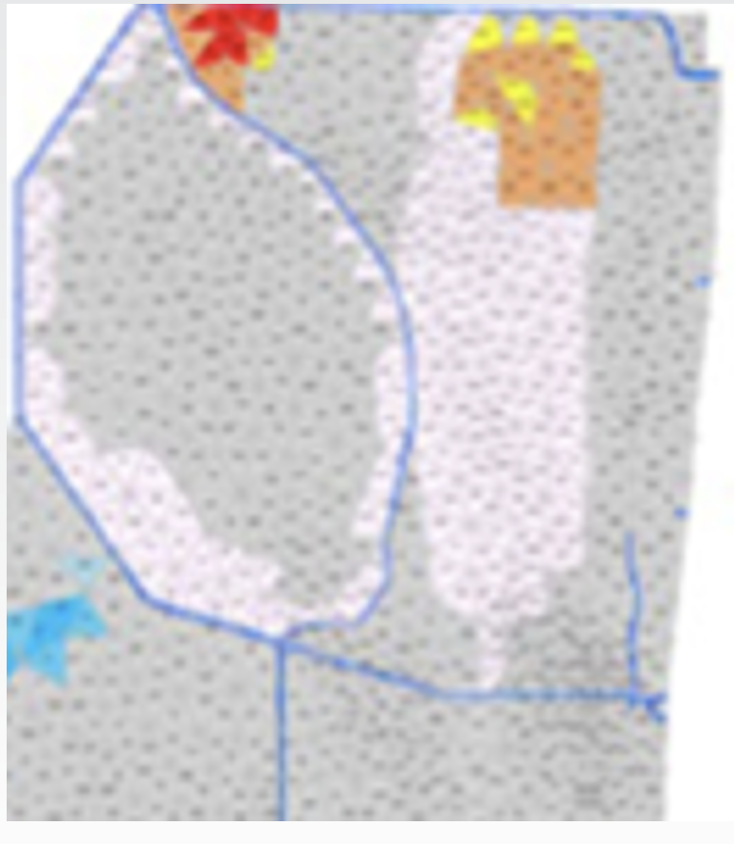
LOSOM Effects on LECSA-1
No regulatory releases to Lake Worth Lagoon
Lower canal stages during dry periods
Reduced pumping from East into LWDD
Shifts reliance to WCA-1 for water supply
Increased withdrawal from WCA-1 lowers perimeter stages and impacts hydroperiods
Less water in WCA-1 coupled with drier antecedent conditions results in lower levels in LWDD, with increased risk for saltwater intrusion

Slide 17
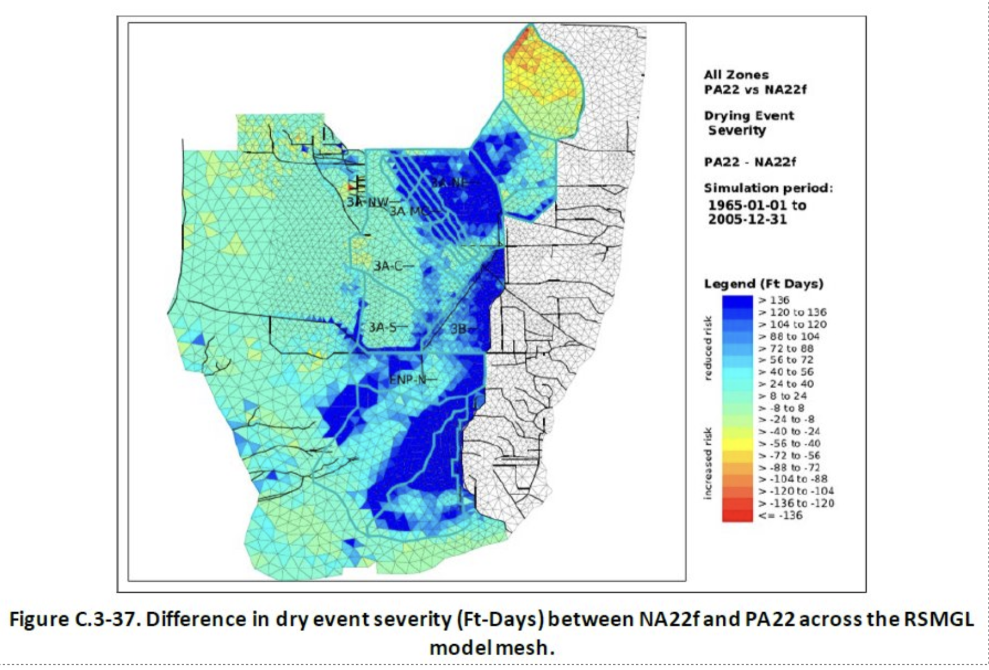
LOSOM Effects on LECSA-1

Slide 18
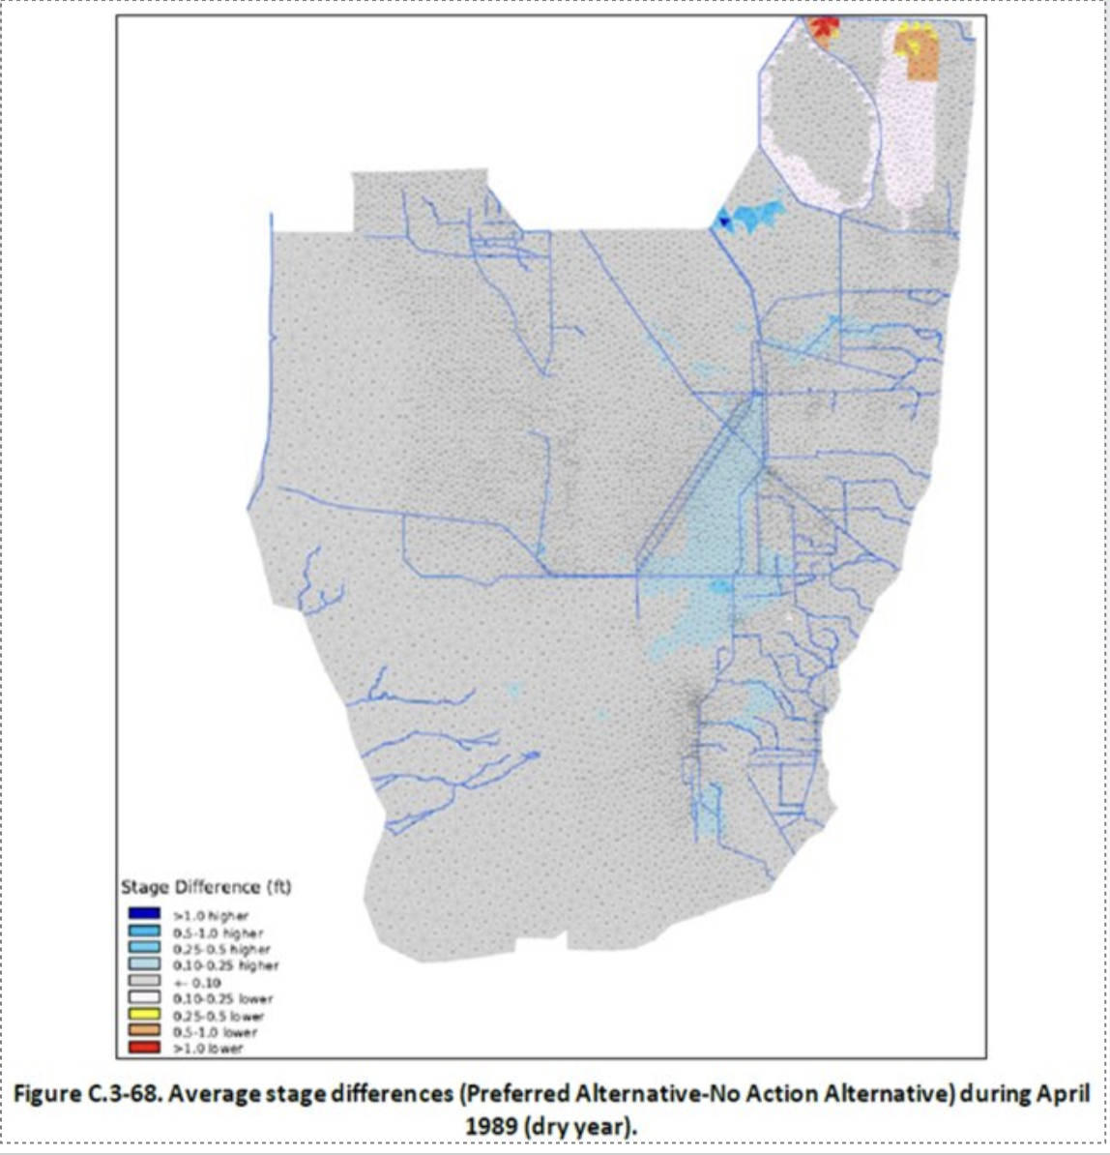
Average Stage Difference – Dry Month / Dry Year​

Slide 19
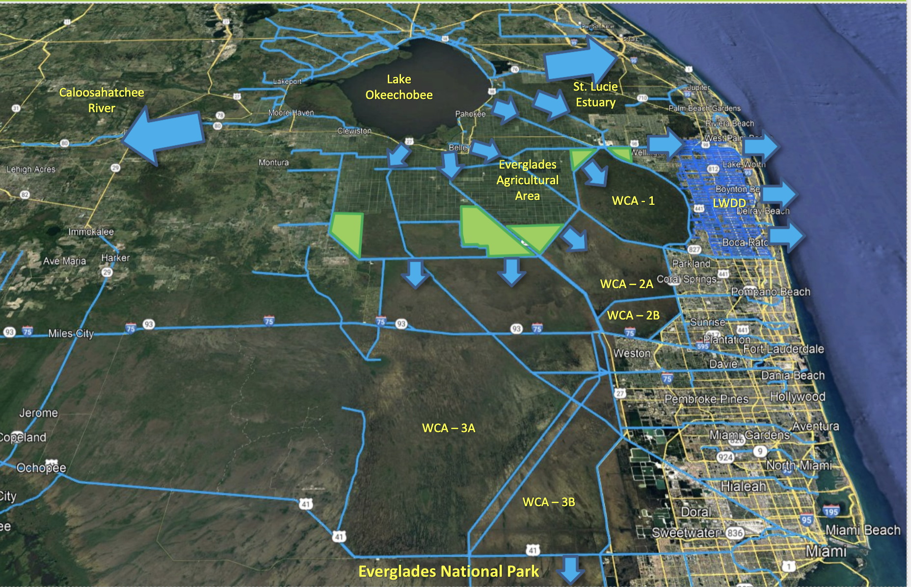
LORS08 Operations – ‘Regulatory Releases to the Estuaries’

Slide 20
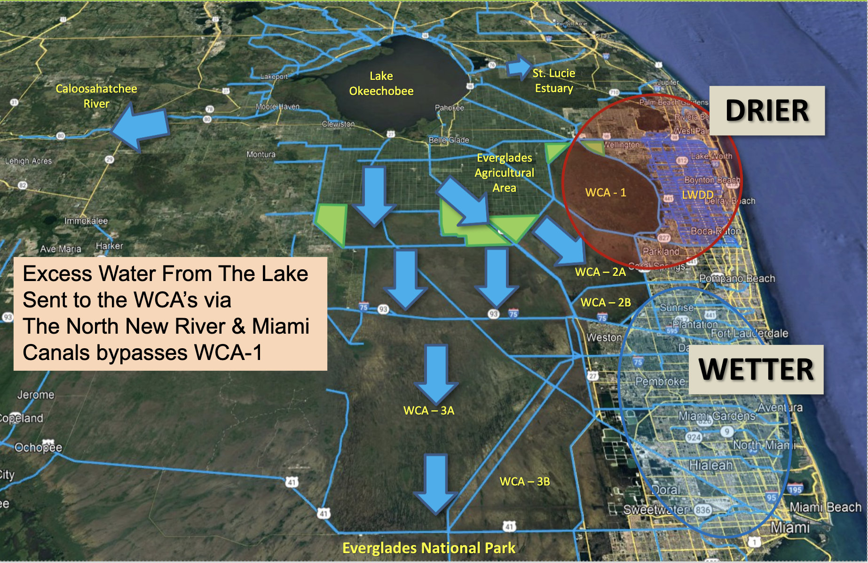
LOSOM Operations – ‘Sending Water South’

Slide 21
Solutions?
Storage, Storage, Storage…​
A number of storage projects were identified in CERP which could play a significant role in resolving these issues in southeastern PBC​
        Site I Reservoir ​
            1,600 acres – 4 ft. deep​
          ASR Wells​
        C-51 ASR​
        Others…

Slide 22
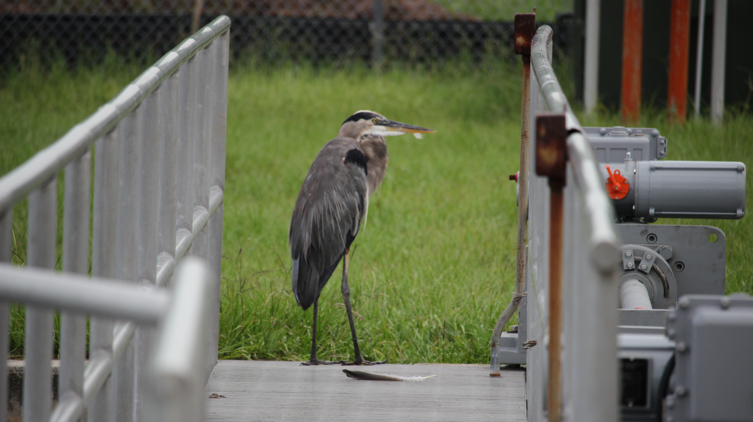
Questions?

