Slide 1
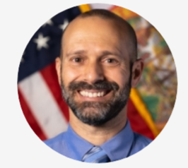
SFWMD Annual Reclaimed Water Status Report
Presentation to Southeast Florida Utility Council
September 8, 2025
Robert Wanvestraut
AWS-Reuse Coordinator
South Florida Water Management District
1

Slide 2
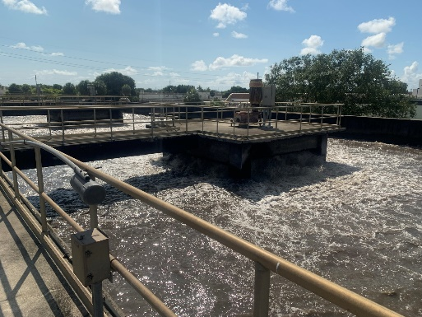
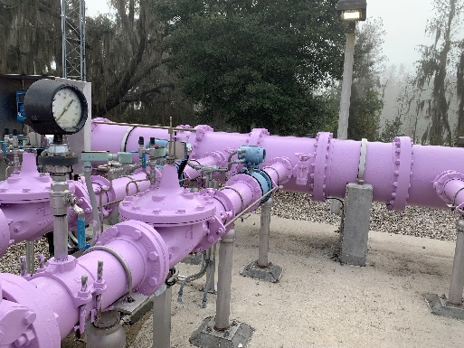
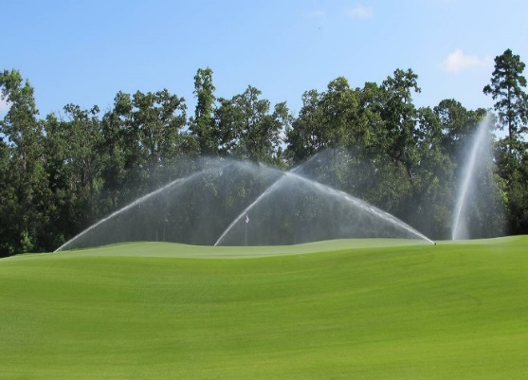
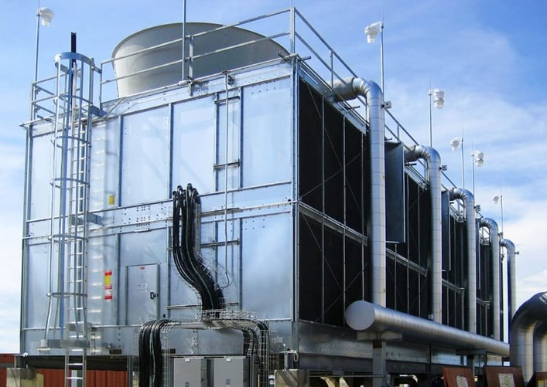
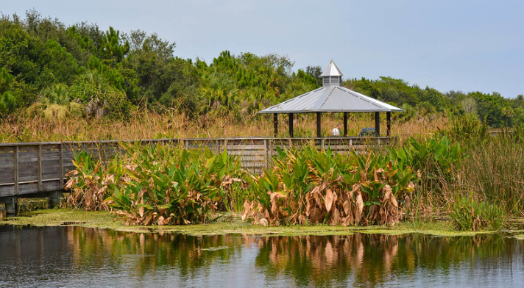
What Is Reclaimed Water?
Domestic wastewater that has received at least secondary treatment and basic disinfection and is reused for a beneficial purpose.
Reclaimed water is recognized by the State of Florida as an Alternative Water Supply.
Presenter: Robert Wanvestraut
2
Notes:
What is reclaimed water?
It’s the water that goes down the drain at our homes and businesses, for most of us that water flows to a central wastewater treatment facility where the reclaimed water receives additional filtration and high-level disinfection commensurate with its end use. The closer the reclaimed water could get to the public, the higher the level of treatment.

Slide 3
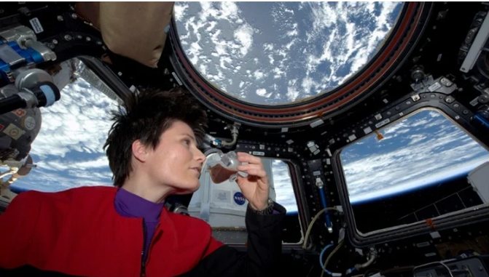
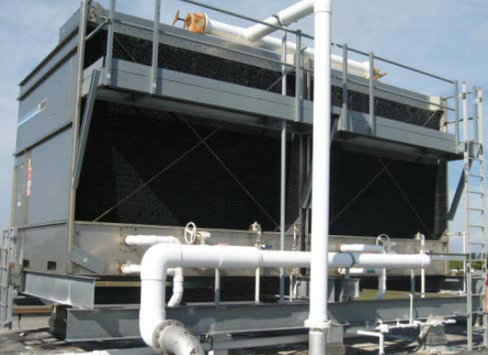
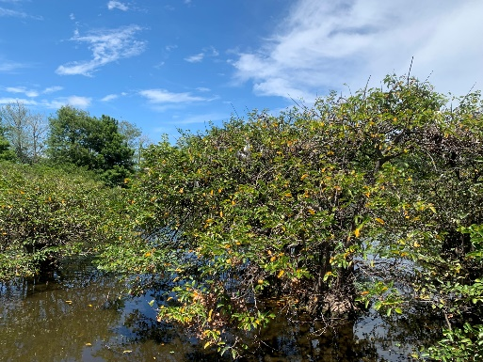
Uses of Reclaimed Water
Uses of Reclaimed Water include:
  Landscape Irrigation
  Agricultural Irrigation
  Groundwater Recharge
  Industrial Processes
  Environmental Enhancement
  Direct and Indirect Potable Water Supply
Photo: NASA
Astronaut Samantha Cristoforetti enjoys a cup of espresso made from recycled water on the International Space Station.
  Approximately 300 mgd of reclaimed water is produced and applied in the SFWMD.
Presenter: Robert Wanvestraut
3
Notes:
WW Treated 950
Supplemental Flow 36
Total Disposal 700
Reuse Minus Supplements 266
Reclaimed Water can be applied in a variety of ways which would otherwise be done using potable water.
Direct and indirect potable reuse is not common in Florida, yet, but it is already implemented elsewhere in the United States and other countries… and on the International Space Station (ISS)!
The water recovery system (WRS) installed on the ISS achieves a recovery rate of approximately 93%, however the origin of this water can be from urine, ambient air, moisture from the astronaut crew’s sweat and breath, as well as even from their laboratory animals.

Slide 4
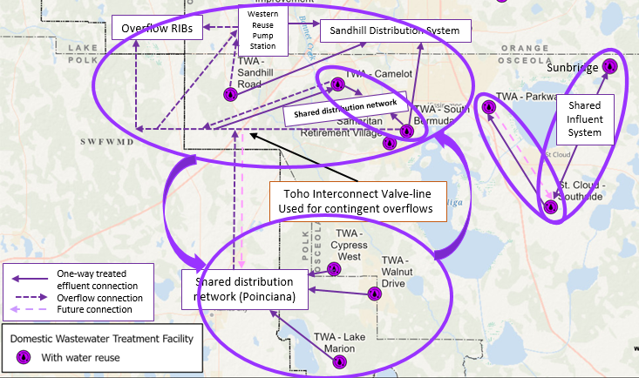
Reclaimed Water Considerations of the SFWMD
The District considers reclaimed water use in:
  Regional water supply planning
  Groundwater modeling
  Water Use Permitting
FDEP’s perspective and scope on reuse of reclaimed water is statewide, which is not appropriate for water supply planning or hydrogeologic modeling.
Toho Water Authority: Reclaimed water facility connections and system and interconnections
Presenter: Robert Wanvestraut
4

Slide 5
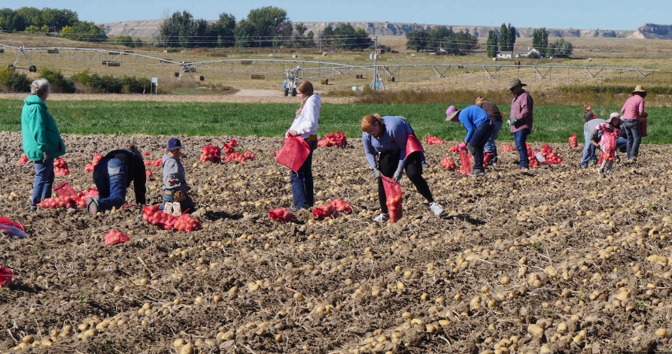
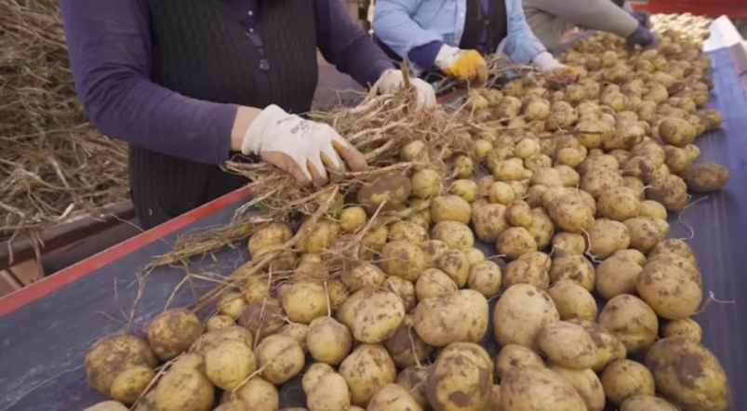

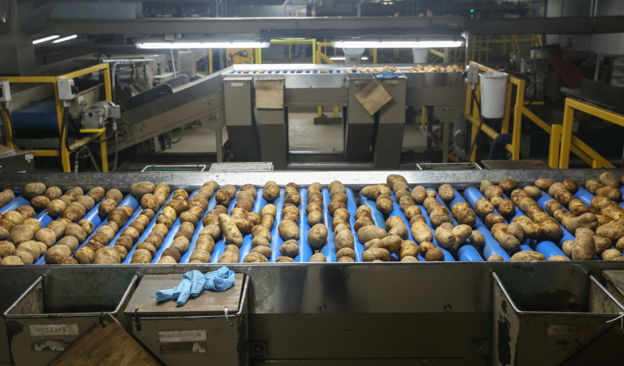
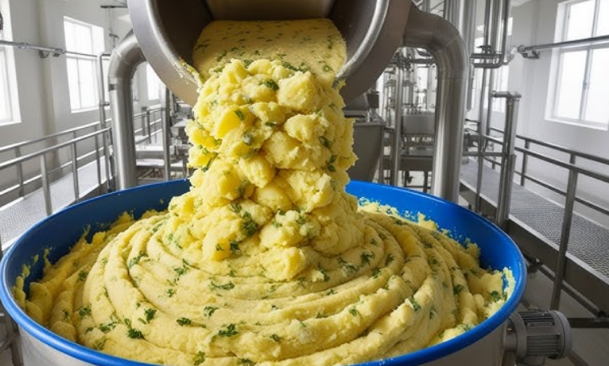
Data Collection and Preparation
Presenter: Robert Wanvestraut
5

Slide 6
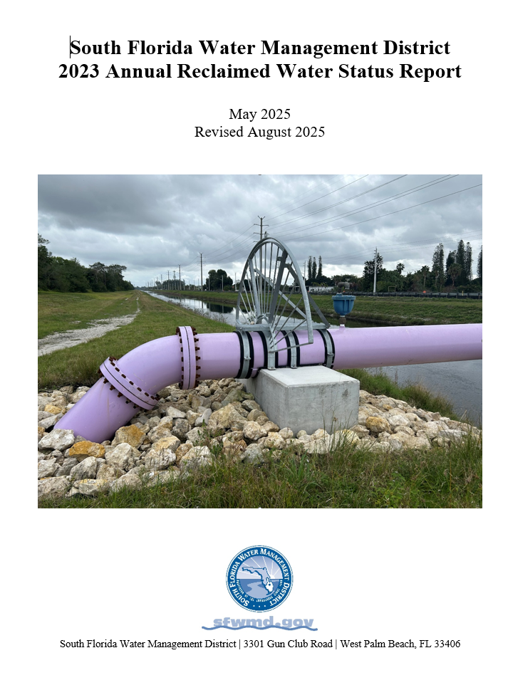
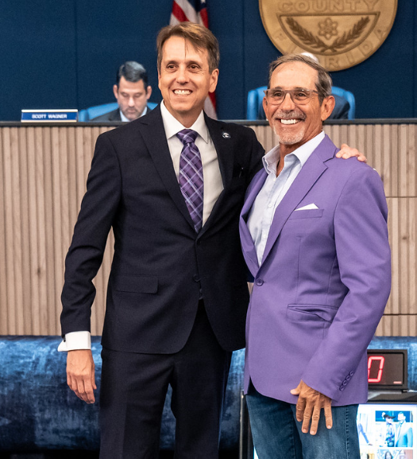
SFWMD Annual Reclaimed Water Status Report
Goal to publish annually in May to coincide with Water Reuse Week as an informative piece on ‘All things Reclaimed’ for the Purple Jacket recipient.
Provides background on state reuse activities and requirements as well as implementation status in the SFWMD.
Summarizes reclaimed water and other associated flow data by planning area and across the District’s 16 counties.
Presenter: Robert Wanvestraut
6

Slide 7
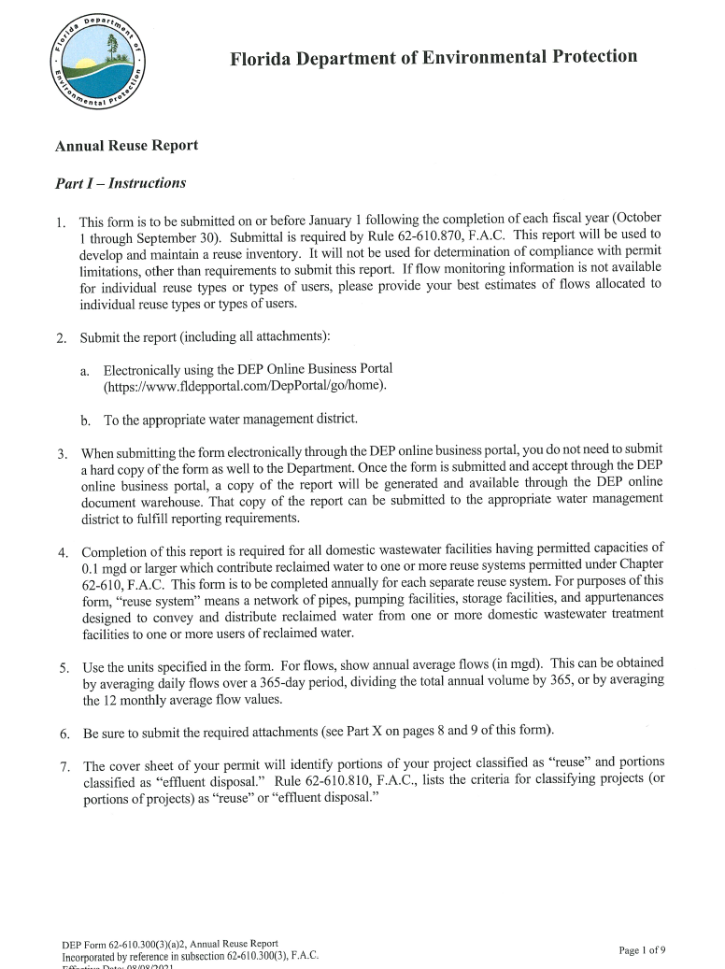

Data & Metrics
Report covers:
124 facilities with wastewater treatment capacities 1.0 mgd
  With exception of the Sebring Airport (Highlands County)
Flow data obtained:
107 facilities permitted to produce reclaimed water
  FDEP Reuse Inventory Reports (reuse facilities)
17 facilities permitted to treat wastewater only (non-reuse)
  Data obtained via communications with FDEP and utility staff
Notes:
With exception of the Sebring Airport (Highlands County), permitted at 0.09 mgd, is included in the report.

Slide 8
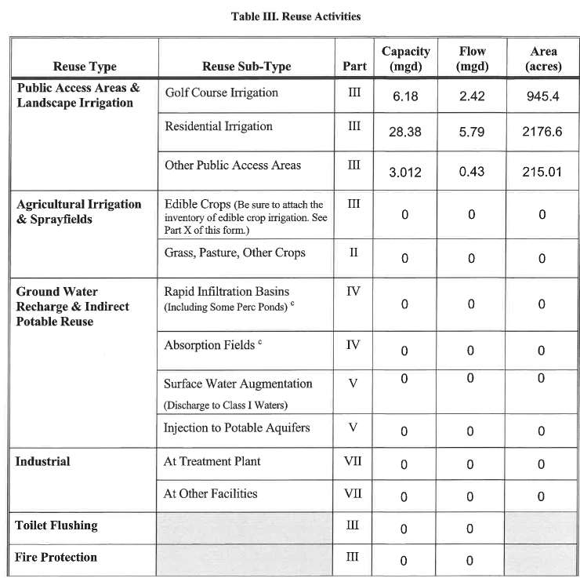
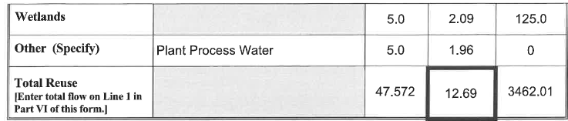
Data & Metrics
Primary Metrics (all in mgd except percentages):
Treated wastewater
Supplemental water
Tota Reuse (inclusive of supplemental water)
Disposal
Reused Wastewater (Reuse – Supplemental)
% Reused Wastewater
  (Reuse – Supplemental/Treated Wastewater)
  Secondary Metrics:
  Sub/Categories of 2-4 above
Notes:
With exception of the Sebring Airport (Highlands County), permitted at 0.09 mgd, is included in the report.

Slide 9
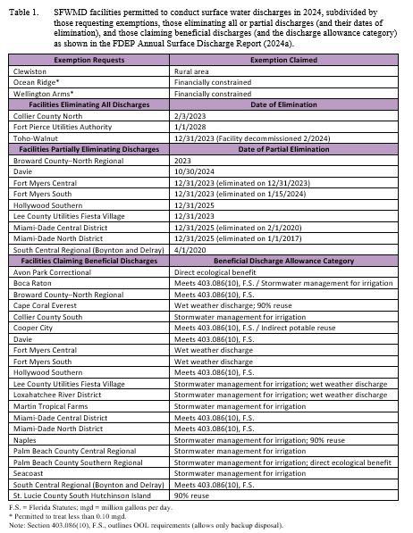
Background Sections in the Report
Background Discussion Sections Include:
Increasing demands and limitations on traditional water sources
Leah Schad Memorial Ocean Outfall Program
Surface Water Discharges, Chapter 2021-168, Laws of Florida (a.k.a SB64).

Slide 10
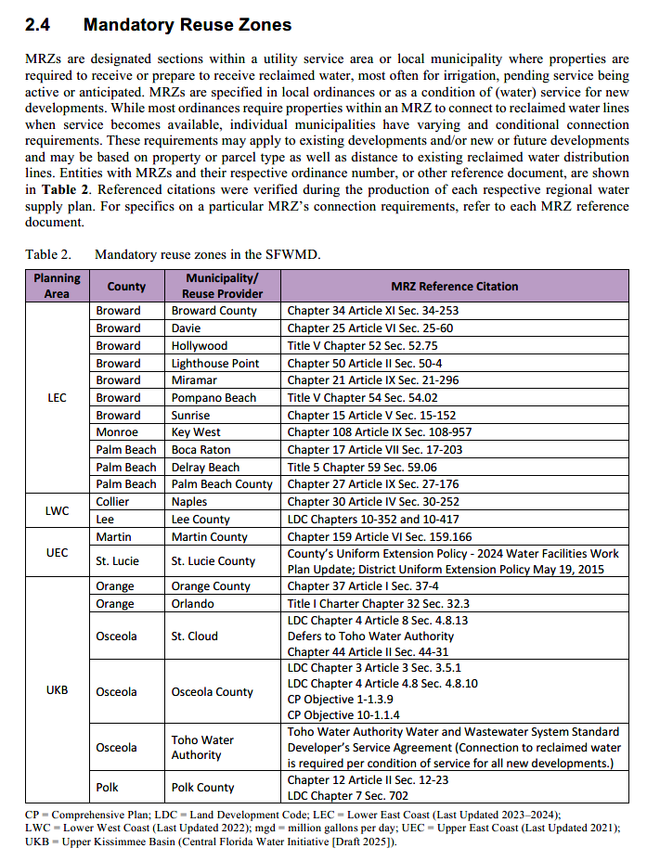
Factors Relevant to Water Reuse Implementation
Background Discussion Sections Include (Con’t):
Mandatory Reuse Zones
Levels of reclaimed water treatment and disinfection
The Florida Potable Reuse Commission and rules governing potable reuse
Reclaimed water in SFWMD Water Use Permitting

Slide 11
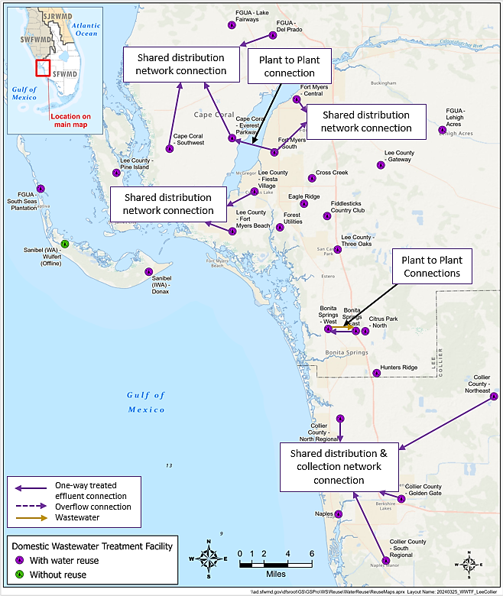
Factors Relevant to Water Reuse Implementation
Background Discussion Sections Include (Con’t):
Facility Interconnections
Reuse Treatment & Disinfection levels

Slide 12
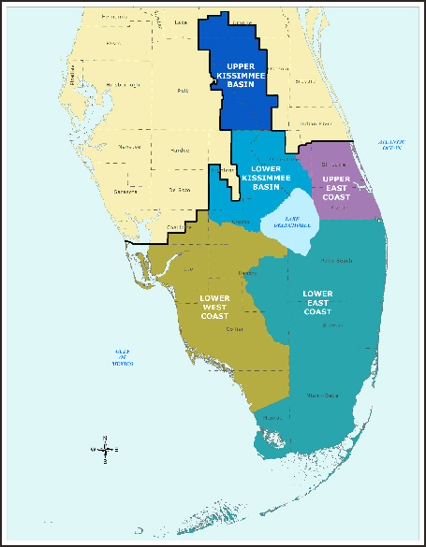
Summarization of Flow and Project Data
Flow data presented for the 16-Counties of the SFWMD as a whole.
Flow data and project information presented by Planning Area and constituent counties.

Slide 13
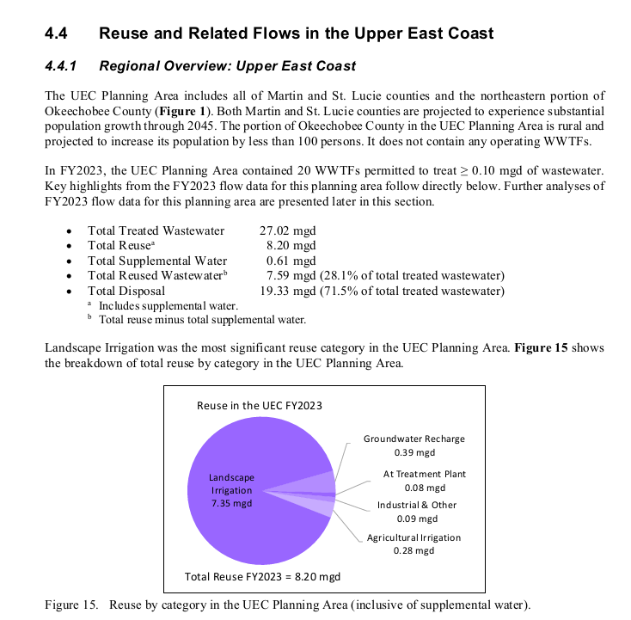
Reuse in Each Planning Area
Short narrative on the Planning Area
High-level primary data
Reuse categories (pie chart)

Slide 14
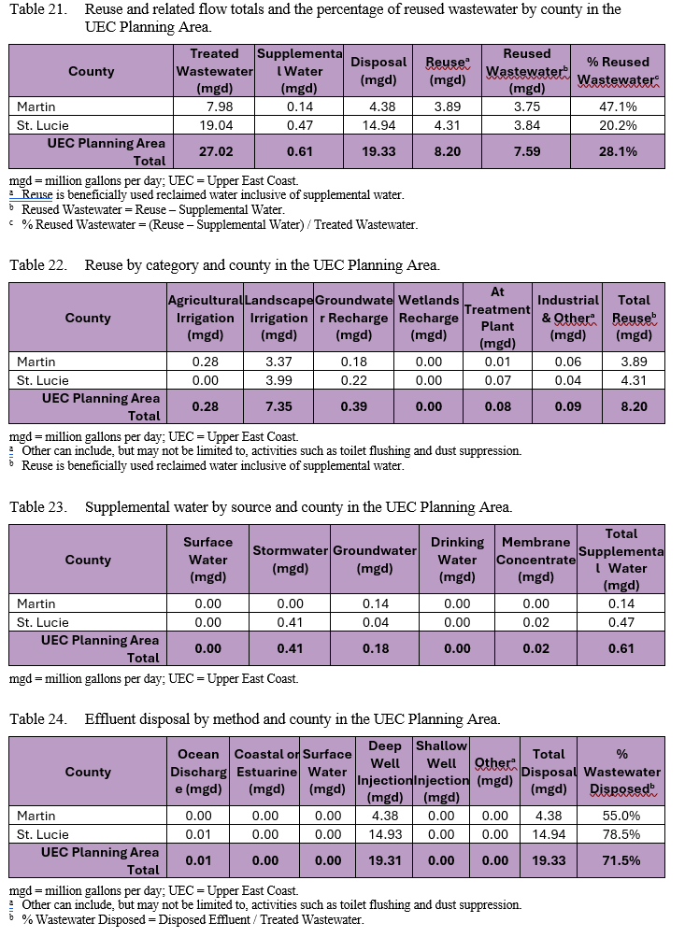
Reuse in Each Planning Area
Flow tables:
1- Primary metrics
Treated wastewater
Tota Reuse
Supplemental water
Disposal
Reused Wastewater
% Reused Wastewater
2- Reuse (by category)
3- Supplemental water (by source)
4 -Effluent disposal (by method)

Slide 15
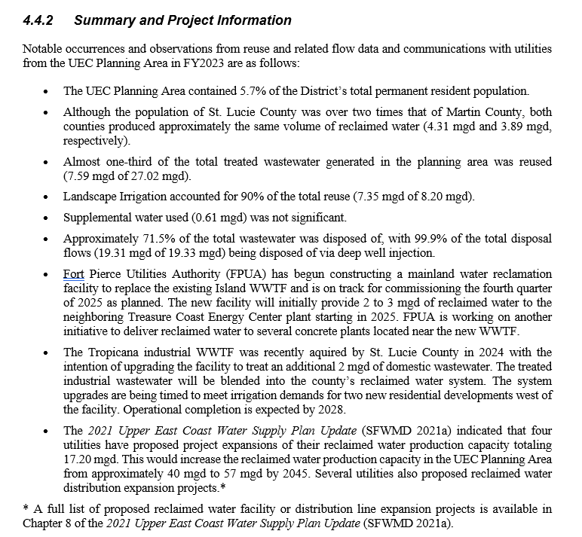
Reuse in Each Planning Area
Planning Area Summary & Project Info:
Notable occurrences & observations from data
Upcoming reuse project information
  Significant plant/network expansions

Slide 16
Let’s Look at Some Fun Figures
High-level districtwide data
SEFLUC counties’ flow data

Slide 17
Reuse In the SFWMD

Slide 18
Reuse and Related Flows in the SFWMD
Planning Area | Treated Wastewater (mgd) | Supplemental Water (mgd) | Disposal (mgd) | Reuseª (mgd) | Reused Wastewater^{b} (mgd) | % Reused Wastewater^{c}
LEC | 720.60 | 5.05 | 639.45 | 97.53 | 92.47 | 12.8%
LKB | 1.34 | 0.00 | 0.47 | 0.86 | 0.86 | 64.6%
LWC | 89.15 | 31.81 | 28.12 | 91.61 | 59.80 | 67.1%
UEC | 27.02 | 0.61 | 19.33 | 8.20 | 7.59 | 28.1%
UKB | 102.26 | 1.29 | 0.64 | 95.95 | 94.65 | 92.6%
Grand Total | 940.37 | 38.76 | 688.00 | 294.15 | 255.38 | 27.2%
ª Includes supplemental water.
^{b} Total reuse minus total supplemental water.
^{c} % Reuse wastewater = Reused Wastewater/Treated Wastewater

Slide 19
Districtwide Reuse Flows for Categories for 2023
*Inclusive of Supplemental Flows

Slide 20
Reuse and Related Flows SEFLUC Counties
County | Treated Wastewater (mgd) | Supplemental Water (mgd) | Disposal (mgd) | Reuseª (mgd) | Reused Wastewater^{b} (mgd) | % Reused Wastewater^{c}
Broward | 237.99 | 0.17 | 224.64 | 18.07 | 17.90 | 7.5%
Martin | 7.98 | 0.14 | 4.38 | 3.89 | 3.75 | 47.1%
Miami-Dade | 353.35 | 0.00 | 340.62 | 18.67 | 18.67 | 5.3%
Monroe | 8.52 | 0.07 | 8.21 | 0.38 | 0.31 | 3.6%
Palm Beach | 120.75 | 4.82 | 65.98 | 60.41 | 55.59 | 46.0%
Grand Total | 728.58 | 5.19 | 643.83 | 101.42 | 96.23 | 13.2%
ª Reuse is beneficially used reclaimed water inclusive of supplemental water.
^{b} Reused Wastewater = Reuse – Supplemental Water.
^{c} % Reused Wastewater = (Reuse – Supplemental Water) / Treated Wastewater.

Slide 21
Reuseª in the SEFLUC Counties 2023
ª Reuse is beneficially used reclaimed water inclusive of supplemental water.
^{b} Other can include, but may not be limited to, activities such as toilet flushing and dust suppression.

Slide 22
Effluent disposal in the SEFLUC Counties
County | Ocean Discharge (mgd) | Deep Well Injection (mgd) | Shallow Well Injection (mgd) | Otherª (mgd) | Total Disposal (mgd) | % Wastewater Disposed^{b}
Broward | 63.16 | 160.99 | 0.00 | 0.49 | 224.64 | 35%
Martin | 0.00 | 4.38 | 0.00 | 0.00 | 4.38 | 1%
Miami-Dade | 122.91 | 217.71 | 0.00 | 0.00 | 340.62 | 53%
Monroe | 0.00 | 6.21 | 1.57 | 0.43 | 8.21 | 1%
Palm Beach | 5.93 | 59.53 | 0.00 | 0.52 | 65.98 | 10%
Grand Total | 192.00 | 448.83 | 1.57 | 1.43 | 643.83 | 100.0%
a Other can include, but may not be limited to, activities such as toilet flushing and dust suppression.
b % Wastewater Disposed = Disposed Effluent / Treated Wastewater.

Slide 23
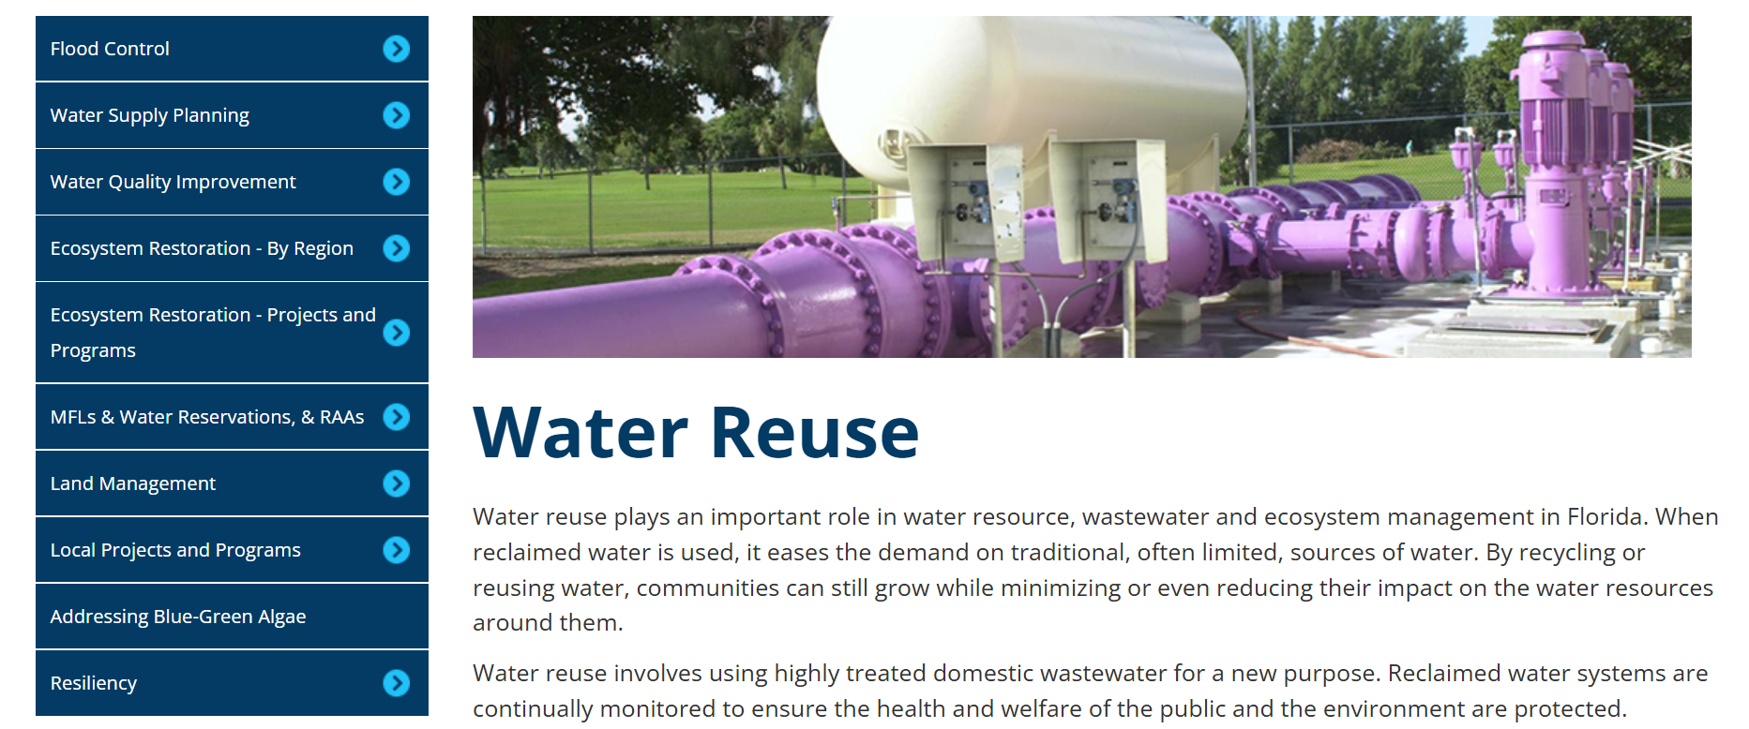
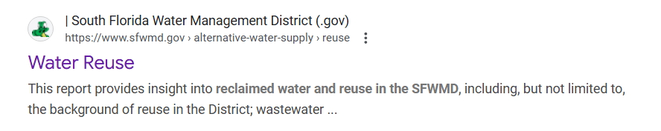
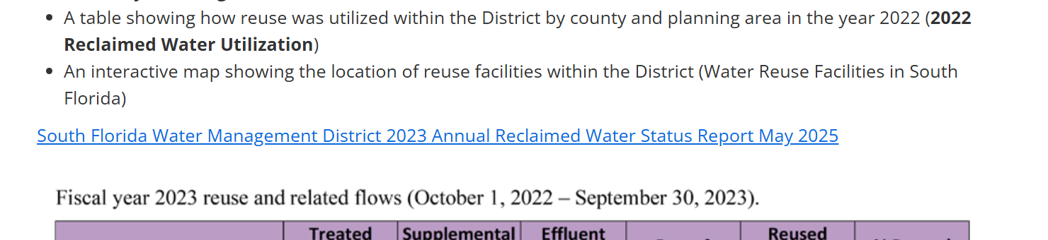
Where to find the report
District’s Reuse Page
Google: “SFWMD annual reuse report”
Click on SFWMD Water Reuse (first result)
Scroll down to South Florida Water Management District 2023 Annual Reclaimed Water Status Report May 2025
1.
2.
3.

Slide 24
Thank You!!
Robert Wanvestraut
AWS-Reuse Coordinator
South Florida Water Management District
rowanves@sfwmd.gov
561-682-6615

