Slide 1
This is Water’s Moment
A Candid Discussion on Funding your Water Infrastructure
May 9, 2022
By Stacy Barna, Funding Discipline Leader

Slide 2







Bipartisan Infrastructure Law (BIL)
Historic Investments Across Every Core Infrastructure Sector
$1.2T for the nation’s core infrastructure…
Almost two-thirds is devoted to transportation
Takes a long view of our assets and a holistic approach to mobility and congestion
Boosts annual revenues of public sector clients an average of $60B annually
Contains an estimated $550 billion in new spending above baseline levels
Every state will see tangible benefits from the BIL. Recent AASHTO BIL Analysis

Slide 3
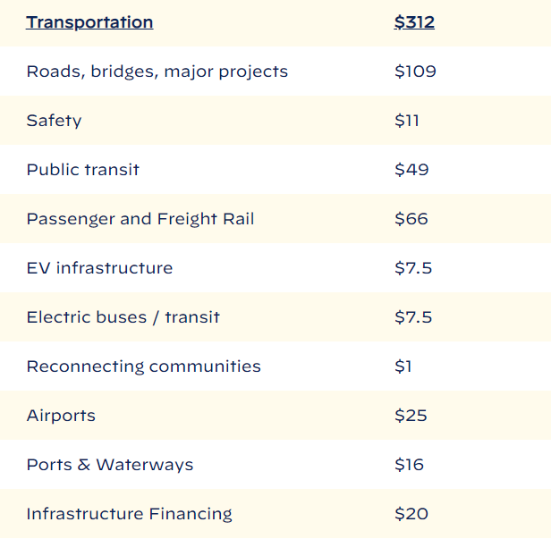
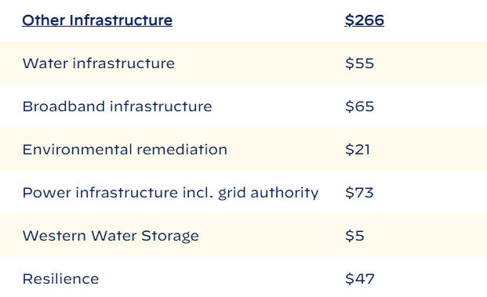

Breakdown of >$550B in New Investment Spending

Slide 4
Bipartisan Infrastructure Law At-A-Glance
Key Water Features
$11.7B to DWSRF
$15B to DWSRF for
Lead Service Line Replacement
$4B to DWSRF for
Emerging Contaminants
$5B to Water Infrastructure Improvements through the Nation (WIINS) for Emerging Contaminants
$11.7B to CWSRF
$1B to CWSRF for
Emerging Contaminants
Chart Breakdown from ARTBA
Notes:
IIJA Overview
What’s part of IIJA? (impacts to all markets)
How is CDM Smith tracking/leveraging

Slide 5

BIL Implementation Timeframe - SRF
Eligible candidates submit a
pre-application for SRF funds, are ranked on Project Priority List, apply if ranked high enough, and receive funds. Summer-Fall 2022
EPA prepared guidance distributed on March 8, 2022
Law effective November 15, 2021
1
2
3
4
EPA finalizes BIL funding formula distribution by state and share with
State SRF agencies.
States apply for SRF capitalization grant and update Intended Use Plans with funds and requirements. Spring-Summer 2022
Notes:
The timing is now to work with clients on starting process

Slide 6
Current Intel from CIFA for SRF (EPA/State Org)
States can apply for capitalization grants but will not receive the grant until they have an Intended Use Plan and projects to support receiving the grant.
  Likely not an issue with SRF supplemental funds
  Will be an issue for Emerging Contaminant and Lead Service Line Replacement funds
  Chicken or egg- May use set-asides for LSL inventories (check with state)
Many states are reviewing their disadvantaged community/affordability definitions for potential changes
  Environmental Justice 40 Initiative
  Concerns about pockets of disadvantaged in larger communities
  Emphasis on disadvantaged communities receiving forgiveness so may need to change to allocate all of the required funds
  Examples

Slide 7
New: Build America, Buy America (BABA)
Made in America Office at OMB published BABA guidance on April 18, 2022; EPA Guidance expected soon but EPA webinar is optimistic for equivalency.
Build America, Buy America (BABA) Sourcing Requirements
BABA requires the following conditions apply to federal financial assistance obligations for infrastructure made after May 14, 2022:
Iron and steel: all manufacturing processes must occur in the United States
Manufactured products: final manufacturing process must occur in the US and the cost of components mined, produced, or manufactured in the US must <55%
Construction materials: all manufacturing processes must occur in the US- OMB has preliminary guidance
Waivers from these requirements must be in writing, published for public comments, and approved judiciously

Slide 8
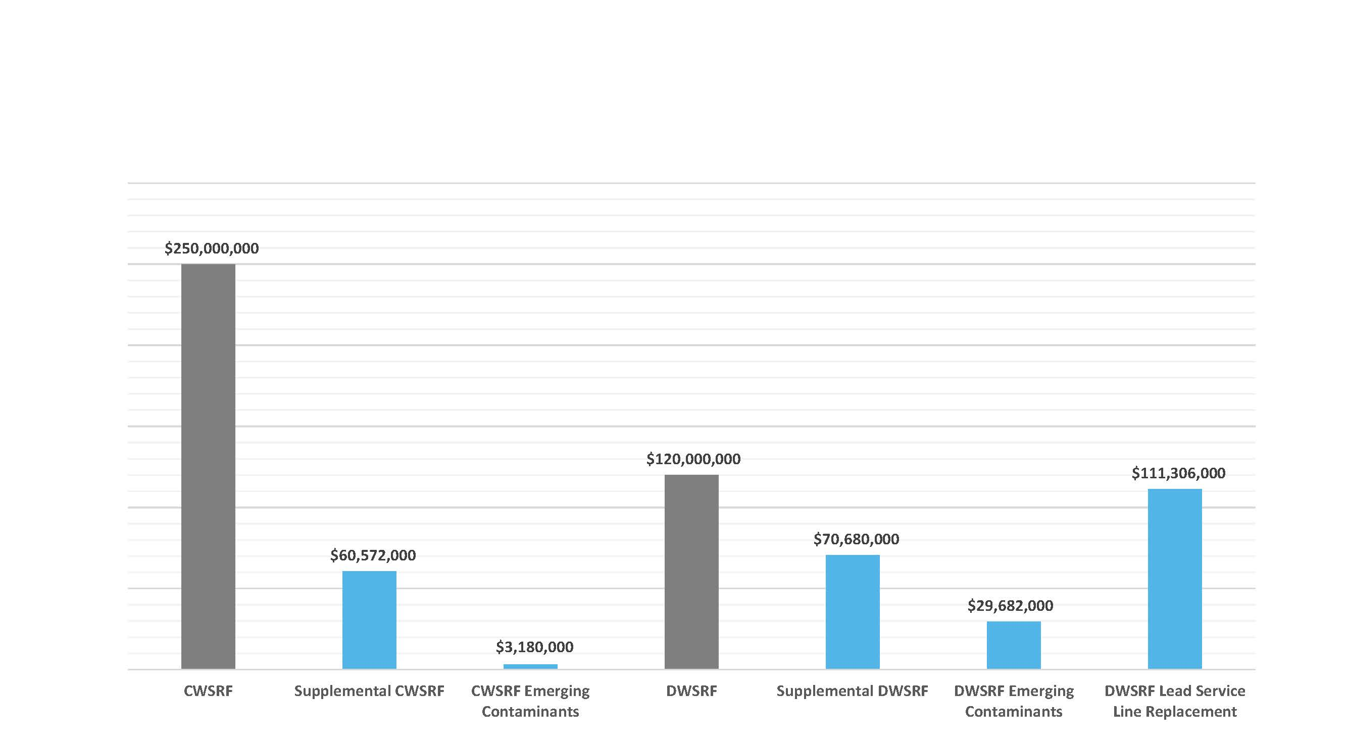
Florida BIL Breakdown for 2022

Slide 9
Florida BIL Supplemental and LSL
Supplemental SRF
  Same requirements as CWSRF and DWSRF
  Increase Investment in Disadvantaged Communities
  49% Principal Forgiveness
  BABA applies
Lead Service Line
  Funneled through DWSRF
  49% Principal Forgiveness
    Disadvantaged communities only (Sponsors 20-90% PF)
  Must replace entire LSL
  LSL Inventories- Required for all

Slide 10
Florida BIL Emerging Contaminants
DWSRF Emerging Contaminants
  Must be DWSRF eligible and primary purpose to address emerging contaminants in DW
  100% Principal Forgiveness
  25% must go to disadvantaged communities or those serving less than 25K
CWSRF Emerging Contaminants
  Abatement of Emerging Contaminants in Wastewater or Stormwater
  100% Principal Forgiveness
  By rule, only small disadvantaged communities to receive PF

Slide 11
But there’s More: American Rescue Plan Act (ARPA) and 2022 Appropriations
USES: Recovery & investment
TWO Disbursements:
First in 2021, second in 2022
$1.9T bill finalized in March 2021
$350 billion
in emergency funding:
  $195B for states
  $130B for local governments
  $20B for tribal governments
  $4.5B for territories
Annual Appropriations for 2022 similar to 2021 but include earmarks
TIME SENSITIVE!
Spend by
end of 2026
Every state managing differently
NC: 2022, $1.6B
via SRF agency
Notes:
Mention: Build Back Better Bill in development

Slide 12
How Water Funding Flows
FEDERAL
STATE
LOCAL
$130 B Grants
COVID Relief
(ARPA)
$350 B
Treasury
$220 B Grants
State Gov.
$55 B
$55 B
State SRF
Programs
$55 B
Bipartisan Infrastructure Law
EPA
Loans & Grants
$8.3 B
Bureau of
Rec
$8.3 B
DOI
Grants
$2.7 B
$2.7 B
$2.7 B
Loans & Grants
FY22 Approval Appropriations
Act
EPA
$444M Congressional
Directed Spending

Slide 13
This is Water’s Moment
A Candid Discussion on Funding your Water Infrastructure
May 9, 2022
Stacy Barna
barnasl@cdmsmith.com
512-652-5303
QUESTIONS?

