Slide 1

Keeping Pace with PFAS
Pending Regulations & Solutions
Southeast Florida Utility Council
February 14, 2022
Notes:
Thank you, Kay, and thank you for the opportunity to participate in today’s webinar. Much of my time over the last 3 years has been focused on this issue, specifically as it relates to drinking water. So I wanted to share with you all what I’ve learned and just what are the risks to the public and utilities, what considerations should be made in approaching treatment, and finally what are the available solutions that can be applied for treatment.

Slide 2
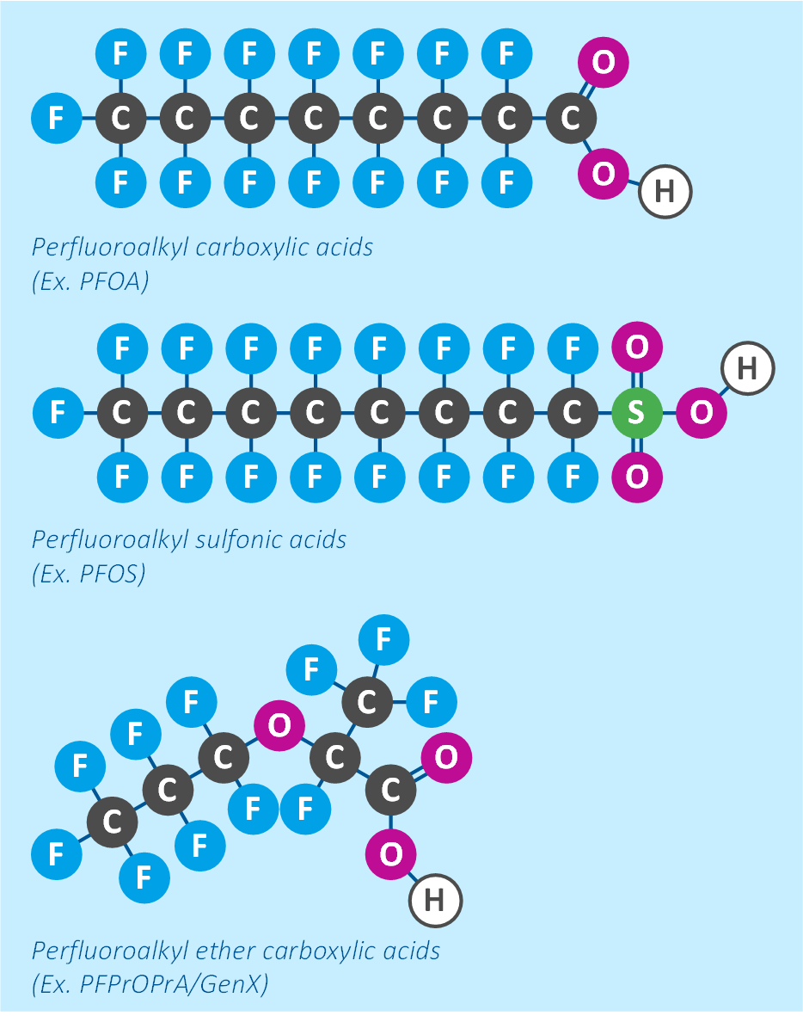
What are PFAS?
Thousands of chemicals
Strong, stable, persistent
Bio-accumulative
Pervasive
Ubiquitous
Largely unregulated
PFAS properties benefit a wide range of applications but promote migration through the environment.
Notes:
So let’s start off with a short primer on “What is PFAS”. PFAS are a class of synthetic, highly fluorinated chemicals developed for the highly stable properties that are associated with carbon-fluorine bonds.
I’m going to try and quickly decrypt some of the terms here and explain some of the chemistry because I think it helps to understand the issue. PFAS stands for per- and poly-fluoroalkyl substances. “Alkyl” meaning a single bonded carbon chain, which can vary widely in length. “Fluoro” meaning it has fluorine atoms attached to the carbon chain instead of hydrogen atoms. Per- and poly- refer to the extent that the carbon atoms are saturated with fluorine atoms – use “per-” if all the hydrogens have been replaced with fluorine atoms, and “poly” if only some have been replaced with fluorine atoms.
Generally, when naming individual compounds, the “A” is replaced with a letter abbreviation for the number of carbon atoms and the “S” is replaced with a letter abbreviation for the terminal functional group, such as a carboxylic acid group or a sulfonate group.
So generally, a single PFAS molecule has two essential parts: the fluorinated carbon chain (alkyl group) and a functional group. The fluorinated carbon chain is what gives these molecules their stability, heat resistance, oil and water resistance, and persistence, since natural biological processes cannot break them down. The attached functional group is the wildcard and is the part that is “engineered” to make the molecule useful for different applications.
You can quickly see that when you start considering the variations in length and the different functional groups, you end up with thousands of these chemicals. What started in the late 1940’s with PFOA has now evolved into the thousands of PFAS chemicals. While these chemicals have been around for while, many of them are proprietarily developed and so it remains an evolving science, but the science we have is concerning. The biological stability and persistence of these chemicals in the environment and human body means very small amounts will accumulate and some are shown to be toxic.
They migrate easily through the environment and are now considered ubiquitous - or found everywhere and in the blood of the majority of humans.

Slide 3


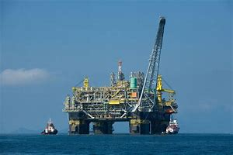





Applications
Firefighting Foams
Non-stick Cookware
Oil Recovery
Food Packaging
Cosmetics
Paints and Inks
Coatings and Textiles
Medical Devices
Numerous pathways for contamination and human exposure.
Notes:
PFAS are found in what seems like just about everything today. This is a sampling of their many different applications…
With all the applications of these chemicals, there are numerous pathways for both contamination of water sources and food supplies and human exposure through direct contact with chemically treated products.

Slide 4
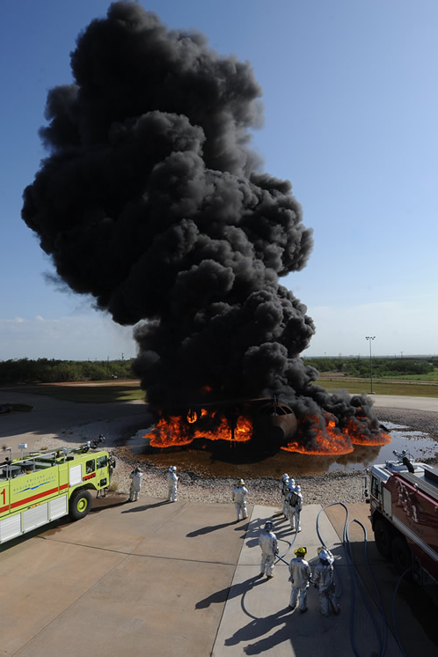
Common Contamination Routes
Airports, Military Bases & Fire-Fighting Schools
  Use of Aqueous Fire-Fighting Foams (AFFF)
Waste Disposal
  Stormwater Runoff
  Landfill Leachate
Manufacturing
  Air Emissions
  Industrial Wastewater Discharges
Consumer Products
Preventing contamination at the source is key.
Notes:
Drinking water is obviously an important pathway and so protection of our water resources is key. The most common, or major, contamination routes are through use of firefighting foams, especially at airports and military air fields.

Slide 5

Health Effects
Readily adsorbed through ingestion
Not metabolized (long half-lives)
Crosses placenta and into breast milk
Known adverse effects:
  Liver damage
  Thyroid interferences
  Increases in cholesterol (total, LDL)
PFOA – Likely carcinogen
PFOS – Potential carcinogen
Health effects studies are still lagging
Notes:
These are some of the known health effects from exposure to PFAS.

Slide 6
Evolving Science of PFAS
Data from Black & Veatch
pilot study:
PFAS are often present in groups – some cannot be measured.
Notes:
A major problem in dealing with PFAS is the number of unknowns – it’s still so much an evolving science. There’s just so much we don’t know. A huge unknown that impacts utilities is the sheer number of PFAS we cannot measure. How can you fully define the problem if you can’t accurately measure the scope of the contamination? A couple of years ago, we could only measure a handful of these compounds today we can measure 21 or more.
So, consider that you don’t know what you don’t know. What is considered “total” amount of PFAS today, might not be the same “total” tomorrow because of advancements in analytical techniques.

Slide 7
Testing Methods
Method | Media | # of Targeted Analytes
537.1 | Drinking Water | 18
533 | Drinking Water | 25 | Short-Chain PFAS
8327 | Non-Potable Water | 24 | GW, SW, WW
1633 (Draft) | Non-Potable Water | 40 | GW, SW, WW, Soils, Biosolids
Total Organic Precursors |  | All PFAS | Under development
Notes:
A major problem in dealing with PFAS is the number of unknowns – it’s still so much an evolving science. There’s just so much we don’t know. A huge unknown that impacts utilities is the sheer number of PFAS we cannot measure. How can you fully define the problem if you can’t accurately measure the scope of the contamination? A couple of years ago, we could only measure a handful of these compounds today we can measure 21 or more.
So, consider that you don’t know what you don’t know. What is considered “total” amount of PFAS today, might not be the same “total” tomorrow because of advancements in analytical techniques.

Slide 8
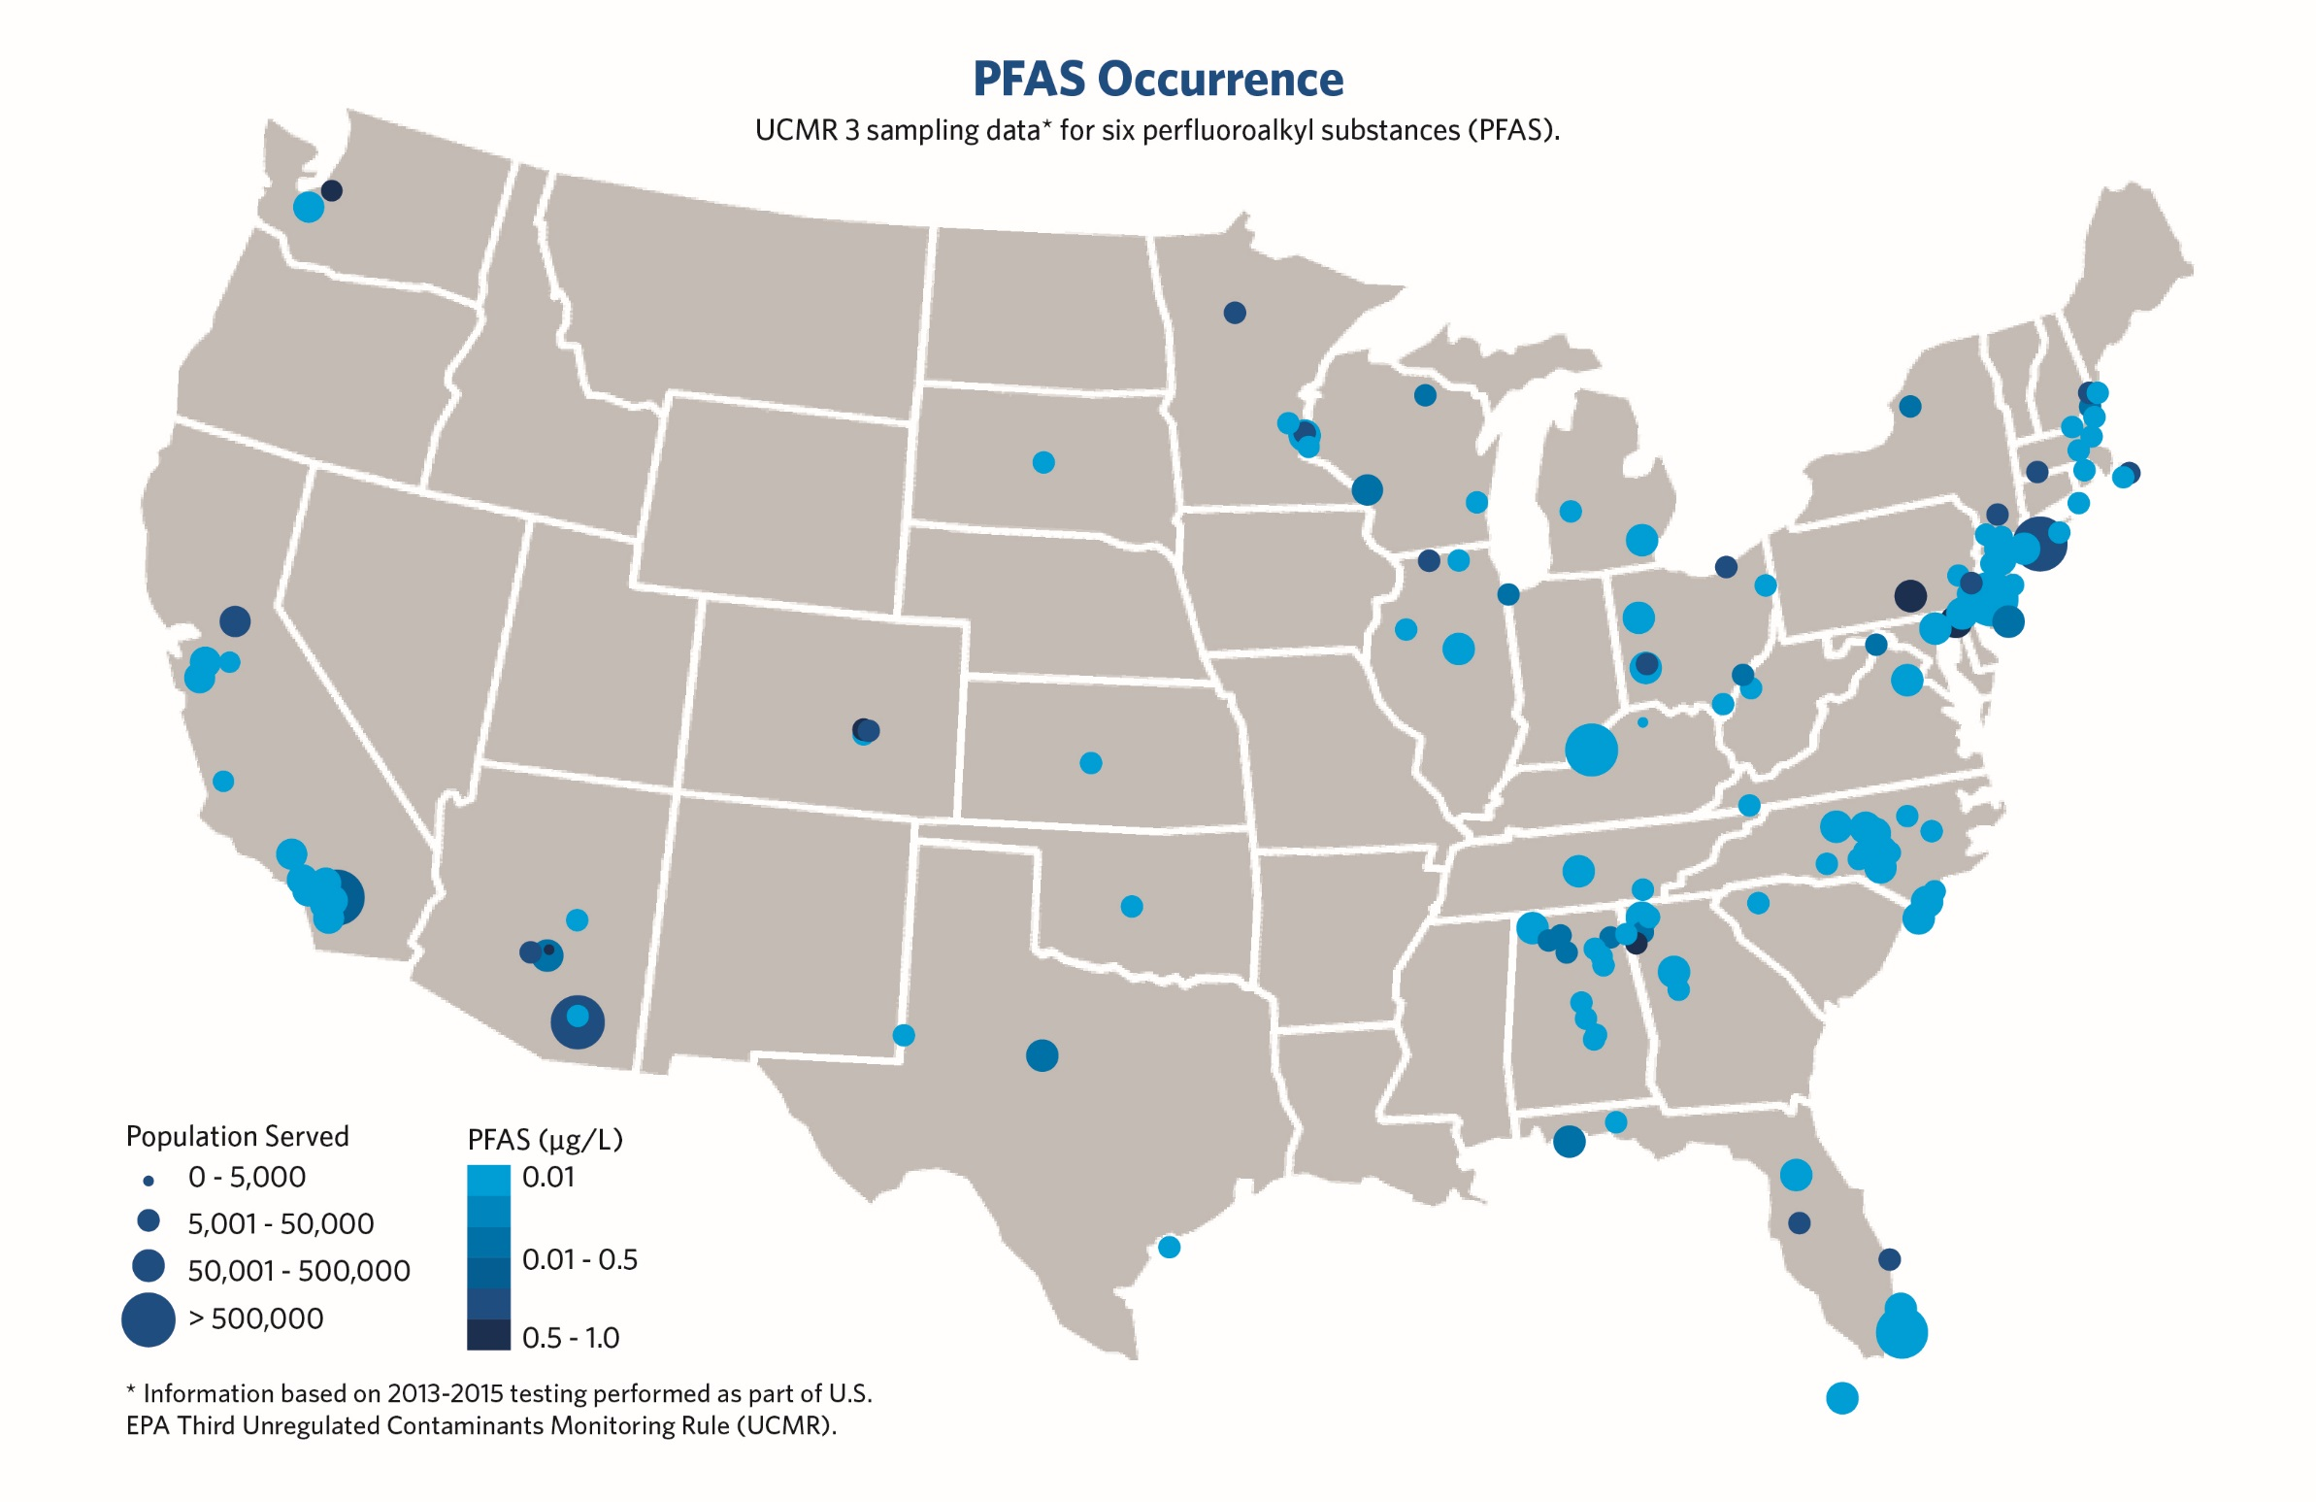
Actual PFAS detections in drinking water are likely higher.
Notes:
This is a map of the occurrence of PFAS in public drinking water systems nationally. The data depicted is from UCMR 3.

Slide 9

UCMR 5
Sampling in 2023 through 2025
29 PFAS Compounds
MDLs range from 2 to 5 ng/L
All systems serving >3,300 people;
800 systems serving fewer

Slide 10
Evolving PFAS Regulations
New Hampshire
PFOA
12 ppt (MCL)
PFNA
11 ppt (MCL)
US EPA Lifetime Health Advisory
PFHxS
18 ppt (MCL)
PFOA
70 ppt
PFOS
15 ppt (MCL)
PFOS
70 ppt
New York
Michigan
PFOA
10 ppt (MCL)(P)
PFOA
8 ppt (MCL)
PFOS
10 ppt (MCL)(P)
PFOS
16 ppt (MCL)
PFNA
6 ppt (MCL)
New Jersey
PFHxS
51 ppt (MCL)
PFOA
14 ppt (MCL)
PFBS
420 ppt (MCL)
PFOS
13 ppt (MCL)
PFNA
14 ppt (MCL)
California
PFOA
10 ppt (AL)
North Carolina
PFOS
40 ppt (AL)
GenX
140 ppt
Key:
PFAS Guidance
PFAS MCL
Landscape is beginning to change as states implement enforceable drinking water MCLs.
10

Slide 11
Federal Drinking Water MCL Timeline
Spring 2021 - Final Regulatory Determination
  Will regulate PFOA and PFOS
  Possibly PFBS and GenX
Fall 2022 – Proposed MCLs (Expected)
Fall 2023 – Final MCLs (Expected)
Fall 2026 – Compliance Required

Slide 12
SAB Review Documents
PFOA is likely carcinogen = MCLG of zero
PFOA and PFOS are harmful at much lower levels than previously thought
  RfDs several orders of magnitude lower than current LHAs.
EPA evaluating approaches to regulating PFAS
  Individually
  Group/Class
  Potency factor
Signs point to limits significantly lower than current LHAs.

Slide 13
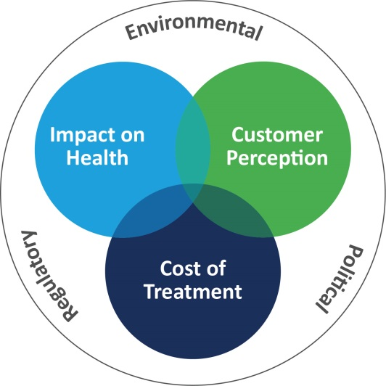
Universe of PFAS Solutions
Treatment (individual vs. regionalized)
  Granular Activated Carbon
  Ion Exchange
  Reverse Osmosis
Purchase treated water
New water supplies
Blending
No one-size-fits-all solution for treatment of PFAS.
Notes:
Finally, recognize there is no one-size-fits-all solution for treating PFAS. Every situation is different (extent of contamination, types of PFAS, size of system, regulations).

Slide 14
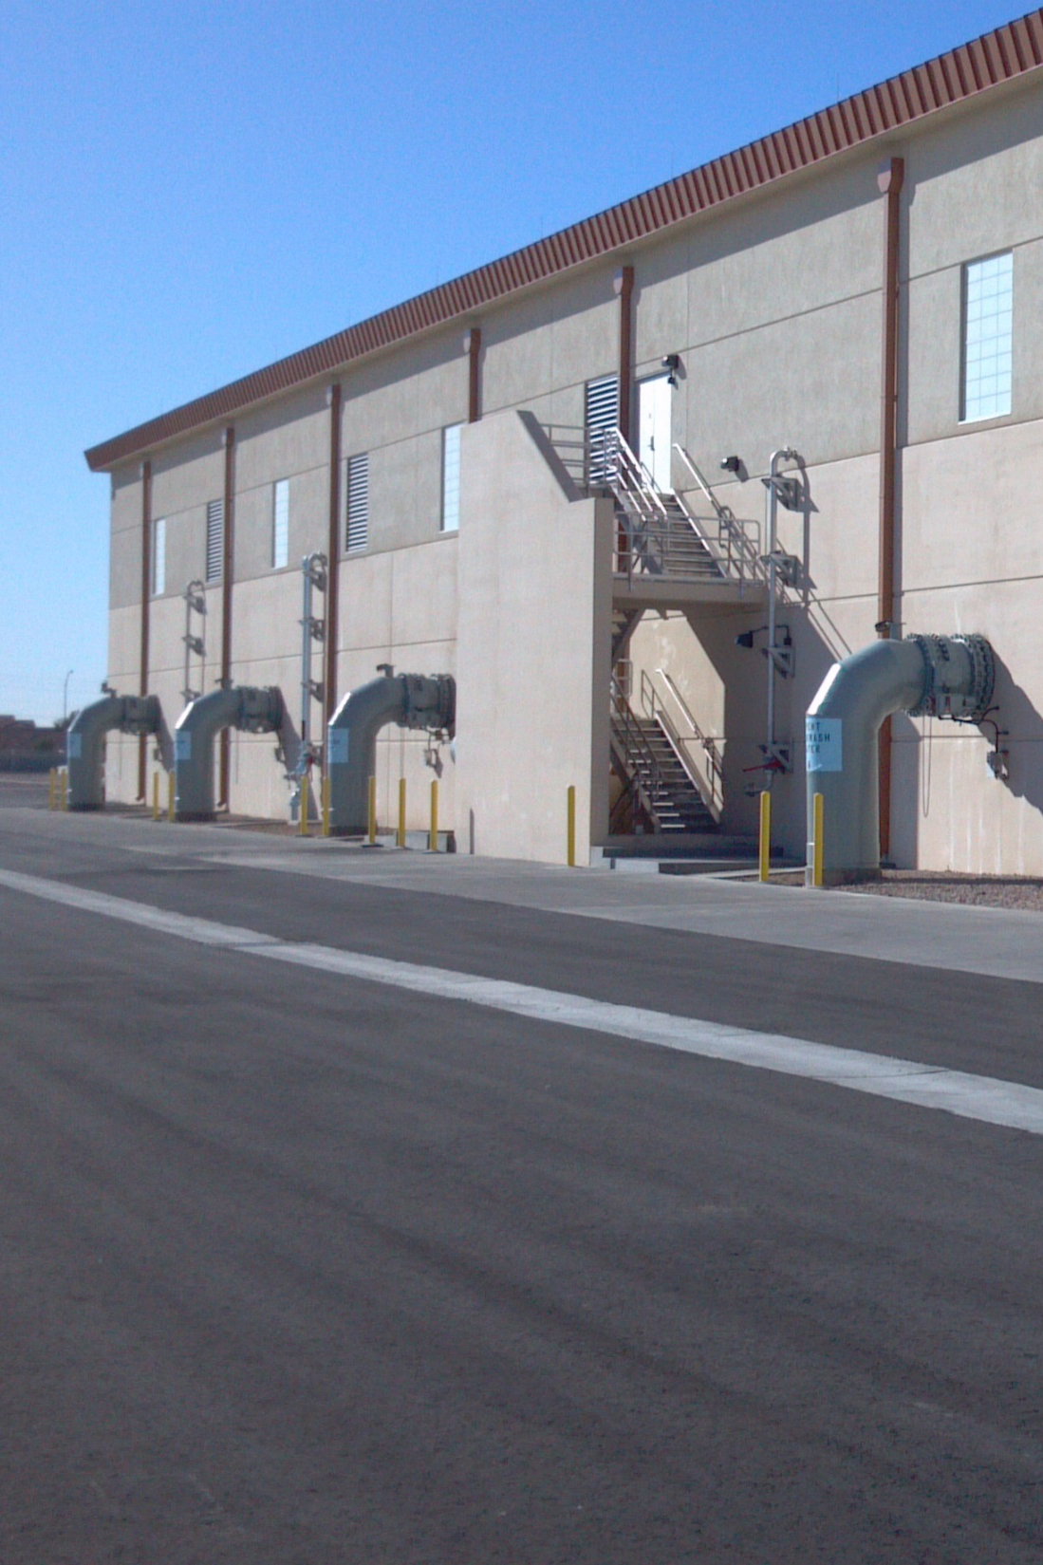
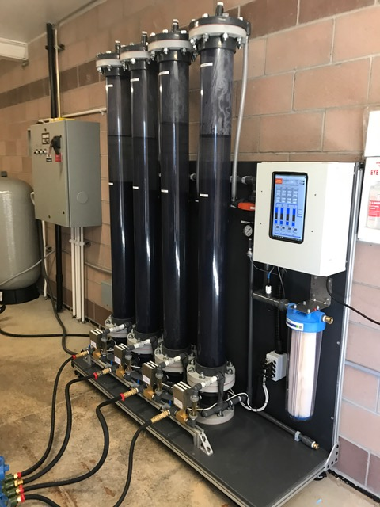
Best Available Technology – GAC/IX
Limited capacity for adsorption
GAC – Removes broad organics; reactivate
IX – Targeted removal of PFAS; single-use
Replacement frequency impacts costs
Piloting recommended to determine:
  Media selection
  Expected PFAS removal
  Lifecycle cost evaluation
Media replacement can impact operations
GAC/IX provide flexibility to adapt.
Notes:
Both GAC and IX are adsorbents, where contaminants are attracted to the surface of the media where they bond. They have a limited capacity for adsorption – they can only adsorb so many organics before they become saturated. GAC adsorbs a broad range of organics, while ion exchange resins are very targeted.

Slide 15
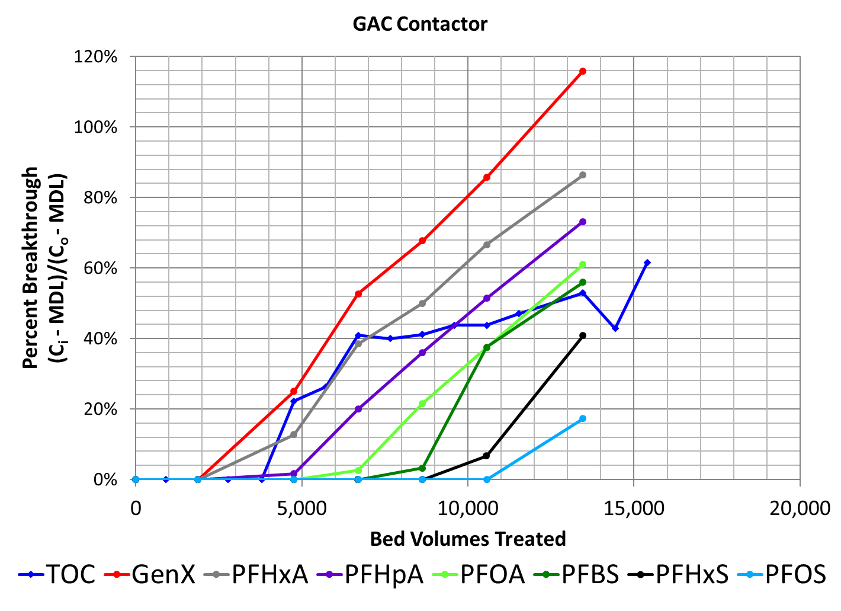
The Importance of Piloting
Breakthrough order based on
  Straight carbon length
  Sulfate or acid functional group
Treatment validation/optimization
  Doubling the EBCT resulted in 70% improvement in GAC replacement
Adjusting replacement provides flexibility in uncertain regulatory environment
Piloting provides certainty in the selected treatment method.

Slide 16
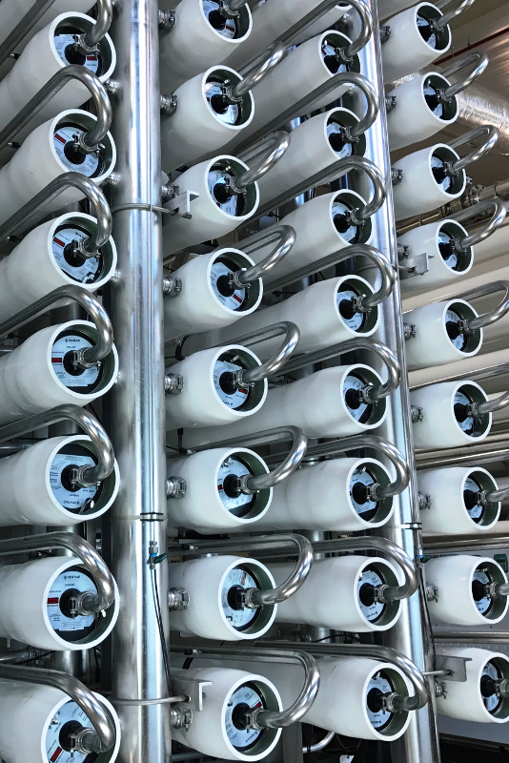
Membrane Processes
Applicable to NF and RO
Near complete removal of all PFAS (>95%)
Can be combined with GAC or IX for greater removal
Requires ~15% more raw water
High levels of PFAS in concentrate stream
Inland desalination very costly
Need for pre- and post-treatment
RO becomes more favorable with high concentrations of PFAS.

Slide 17
Available Treatment Technologies
Technology | CAPEX | OPEX | Pros | Cons
GAC | $$ | $ - $$ Varies with replacement | Removes wide range of organics Removes from environment Re-useable media | More frequency replacement Low adsorption capacity Early breakthrough of short chain PFASs
IX | $$ | $ - $$ Varies with replacement | Targeted removal of PFAS Higher adsorption capacity Removes from environment Less frequent replacement | Single use media Removal of short chain PFASs Removes few other contaminants
RO | $$$ | $$ - $$$ Varies with effluent goal | High level of PFAS removal Indiscriminately removes all contaminants | Concentrated waste stream Requires pre-treatment Requires post-treatment stabilization
Notes:
Talk about factors that influence selection that are not related to PFAS (EDCs/PPCPs, ocean outfall, etc.)

Slide 18
Funding Opportunities
Infrastructure Investment and Jobs Act
  Commits $11.7 billion to DWSRF General Fund
    Can be used for Emerging Contaminants (PFAS)
    $70.7 million allotted to Florida annually for 2022-2026
  Commits $4 billion to DWSRF designated for Emerging Contaminants
    $29.7 million allotted to Florida annually for 2022-2026
  Commits $5 billion for emerging contaminants in economically distressed communities

Slide 19
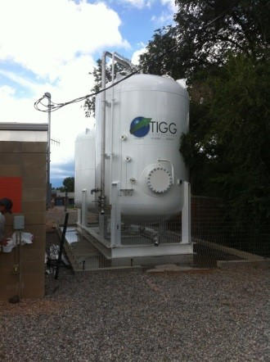
Keys to Dealing with PFAS
Eyes on the horizon
Know your PFAS profile
Plan ahead
  Develop reliable cost models
  Evaluate various solutions
    Cost impact to consumer
    Flexibility if regulations change
Proactively communicate with stakeholders
Notes:
As a utility, the most important aspects of dealing with PFAS contamination of your drinking water involve gathering the right information and proactively communicating that knowledge to your customers – your stakeholder.

Slide 20
Helpful Resources
EPA PFAS Action Plan (Feb 2019) and Update (Feb 2020)
American Water Works Association (PFAS Page)
Association of State Drinking Water Administrators (ASDWA) (PFAS Page)
Environmental Council of the States (ECOS) (PFAS Page)
Interstate Technology & Regulatory Council (ITRC) (PFAS Page)
EPA Methods & Guidance for PFAS Sampling & Analysis

Slide 21
Thank you!
Dustin Mobley
MobleyDR@bv.com
913-458-9927

