Slide 1
EPA/FDEP Updates on LCRR
and Funding Update*
SEFLUC
Lead Service Line Inventory Working Group
06/29/2022
Kevin Carter
Broward County
Water and Wastewater Services
kcarter@broward.org
954-831-0718 (office)
954-856-3879 (mobile)
  * Most Funding Update Slides from FDEP’s Shanin Speas-Frost, State Revolving Fund Administrator – Drinking Water

Slide 2
Florida Section of AWWA Water Utility Council:
Tracking Federal Legislation and Rulemaking
Our mission is to “develop action programs to initiate, evaluate, respond, and comment on legislative, regulatory, and other matters directly affecting water utilities in Florida.”
For Federal Legislation and Rulemaking, we rely and coordinate frequently with AWWA’s Government Affairs (GA) office in D.C. as well as the AWWA’s Water Utility Council.
For LCRR, the WUC submitted comments on EPA’s proposed rule in 2020 to support GA’s comprehensive comment letter.
Coordinating with GA on how other states implementing LCRR and GA assisted with our dialogue with FDEP.
  WUC dialogue with FDEP stalled as they await EPA guidance document.

Slide 3

EPA’s Lead Service Line Inventories Guidance Status
When LCRR decision made on Dec. 16, 2021 EPA stated*:
  “To assist local water systems, state primacy agencies, and other partners, EPA is committed to issuing new guidance for the LCRR.”
  “EPA will issue guidance on developing lead service line inventories, including best practices, case studies, and templates.”
  “EPA is also updating the Safe Drinking Water Information System to support state and Tribal data management needs for inventories.”
February/March, EPA released a draft guidance intended for a closed review by organizations such as AWWA.
June 7th, EPA sent Guidance document to the White House Office of Management and Budget for their review.
  Review timeline unknown.
  * https://www.epa.gov/system/files/documents/2021-12/lcrr-review-fact-sheet_0.pdf

Slide 4
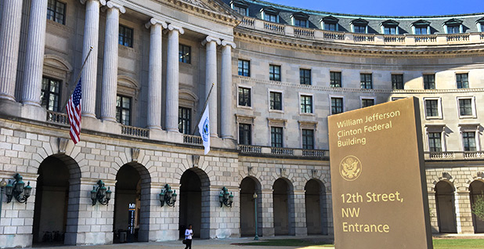
EPA’s LCRR Funding
*EPA lists 4 major federal funding pools for lead service line replacement:
  Drinking Water State Revolving Fund (DWSRF)
  Water Infrastructure Improvements for the Nation Act (WIIN) Grants
  Water Infrastructure Finance and Innovation Act (WIFIA)**
  HUD Development Community Block Grant program.
The federal Bipartisan Infrastructure Law (BIL)/DWRSF passed in Nov. 2021 provides major increase for DWRSF (and Clean Water State Revolving Fund, CWSRF as well).
Both the DWRSF and CWSRF are administered by FDEP.
https://ca.dep.state.fl.us/mapdirect/?focus=staterevolvingfund
*https://www.epa.gov/ground-water-and-drinking-water/lead-service-line-replacement
**https://www.epa.gov/wifia
The USEPA Main Headquarters - William Jefferson Clinton Federal Building - in Washington D.C.

Slide 5
BIPARTISAN INFRASTRUCTURE LAW
Bipartisan Infrastructure Law (BIL)/Infrastructure Investment and Jobs Act (IIJA)
On November 21, 2021, the IIJA was signed into law – also known as BIL
$43 billion to EPA for Water and Wastewater Infrastructure through SRF
  $275,420,000 Florida’s Total Allotment
  1st Year Allotment – 5 Years
Prioritize disadvantaged communities (Environmental Justice)
CWSRF & DWSRF rules and eligibilities apply
Projects will have to meet Build America, Buy America (BABA)
  Applies to Iron and Steel, all manufactured projects, all construction material
  Similar to the existing AIS process, including waivers
  Slide from FDEP’s Shanin Speas-Frost, State Revolving Fund Administrator – Drinking Water
epa.gov/infrastructure

Slide 6
BIPARTISAN INFRASTRUCTURE LAW
Mike Chase, P.E.
Program Administrator (CWSRF)
(850) 245-2969
Michael.Chase@floridadep.gov
floridadep.gov/wra/srf/content/cwsrf-program
  Slide from FDEP’s Shanin Speas-Frost, State Revolving Fund Administrator – Drinking Water
Notes:
Here is the contact information for both of our SRF programs. Are there any questions? Now I’ll turn it over to Dyana Stewart with the Florida Rural Water Association for a quick demonstration of DiamondMaps and RevPlan.

Slide 7
State Revolving Fund Supplemental Funding
In addition to the regular Capacity Grant….
Increase investment in Disadvantaged Communities – Environmental Justice
At least 49% in Principal Forgiveness
Will have to meet Build America, Buy America (BABA)
Same requirements of current CWSRF and DWSRF laws and rules for Florida. Not planning on expanding disadvantaged definition for first couple years of BIL spending. DWSRF is already flexible in its definition.
  Slide from FDEP’s Shanin Speas-Frost, State Revolving Fund Administrator – Drinking Water
Notes:
These public meetings adopting the priority lists are held at regularly scheduled intervals – quarterly – until the funds are exhausted. To provide the project managers sufficient time to review all of the information, we have a requirement that all projects have everything ready for the type of loan requested, 45 days prior to the meeting.

Slide 8
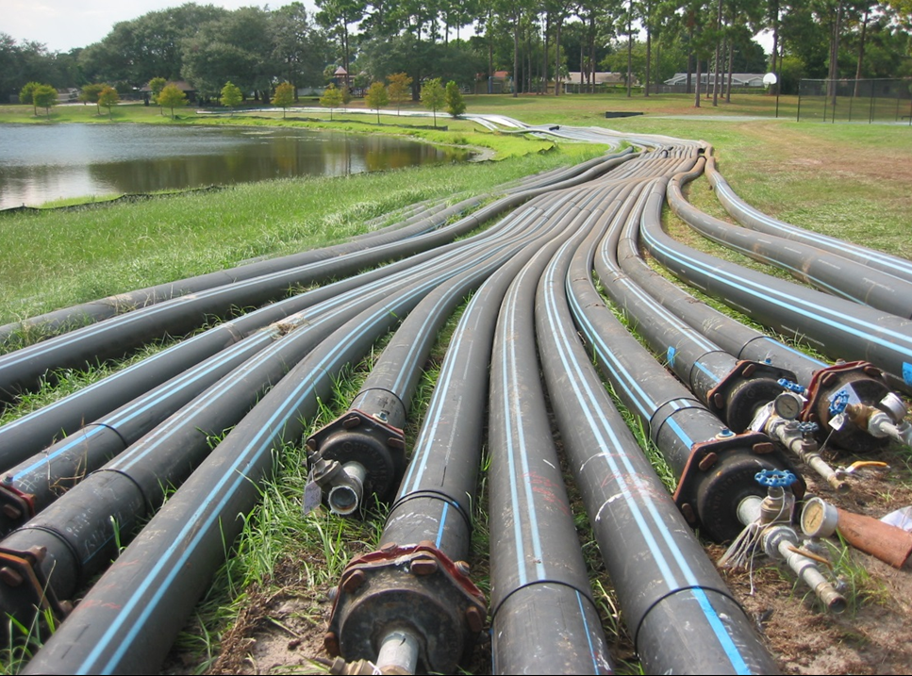
DWSRF LEAD SERVICE LINE REPLACEMENT
Must replace entire LSL not just a portion
Galvanized Pipe and Goosenecks??
LSL Inventories – Help Meet LCR Rule
Public water lines, not inside building structure piping and fixtures
Florida will struggle to spend all of its money!
49% Principal Forgiveness for disadvantaged communities
  Slide from FDEP’s Shanin Speas-Frost, State Revolving Fund Administrator – Drinking Water

Slide 9

BUILD AMERICA, BUY AMERICAN (BABA)
Effective May 14, 2022
Equivalency Projects – All Federal $$$
New Awards and Increases
Buy American Preference
All Iron and Steel (AIS)
All Manufactured Products
All Construction Material
Waivers
Public Interest Waiver
Nonavailability Waiver
Unreasonable Cost Waiver
www.epa.gov/grants/united-states-environmental-protection-agency-implementation-buy-american-provisions
  Slide from FDEP’s Shanin Speas-Frost, State Revolving Fund Administrator – Drinking Water

Slide 10


THE FLORIDA DEPARTMENT OF ENVIRONMENTAL PROTECTION
Shanin’s contact info
SHANIN T. SPEAS-FROST, P.E., MBA
Division of Water Restoration Assistance
Florida Department of Environmental Protection
CONTACT INFORMATION:
850-245-2991
Shanin.Speasfrost@floridadep.gov

Slide 11
Some Future Events
EPA Bipartisan Infrastructure Law Webinar – July 13th.
https://files.constantcontact.com/07edc34a601/26fbd0df-8e9e-4c36-8eed-12fd2dfe6da9.pdf
FSAWWA Water Bugs Luncheon on LCRR – Aug 3rd.
https://www.fsawwa.org/events/event_list.asp
August 31st Important FDEP DWRSF and CWSRF Meeting:
  This is the First Priority List (FPL) meeting of the year and they have full amount of funds to obligate for the year.
  DEP workshop Intended Use Plans for the fiscal year before the August priority list meeting officially starts.
  The 45-day deadline to submit a Request For Inclusion (RFI) is July 18th for Planning/Design Loan.
  For construction projects they should basically already have a RFI and a Facility Plan. But if interested contact her (no promises).
  For the next FPL in February 2023, the deadline is Jan 8th but they need the Facility Plan and RFI around the end of November/early December.
*https://www.fsawwa.org/events/event_list.asp

Slide 12


Conversations lead to solutions, let’s talk
Questions/Discussion Time
Kevin Carter
Broward County Water and Wastewater Services kcarter@broward.org
954-831-0718 (office)
954-856-3879 (mobile)

