Slide 1
SEFLUC – LEAD SERVICE LINE INVENTORY WORKING GROUP
March 30, 2022

Slide 2

Introductions

Slide 3
Group Purpose - Background
Lead and Copper Rule Revisions (LCRR)
Rule Effective Date: December 16, 2021
Rule Compliance Date: October 16, 2024 (2.5 years)
More changes - Lead and Copper Rule Improvements (LCRI) – Before October 16, 2024
States have until October 2023 to set up their rules

Slide 4

Group Purpose
Share the most recent information
Share information resources
Share Strategies/Difficulties
Begin with LSL Inventory
If works, continue with other rule elements

Slide 5
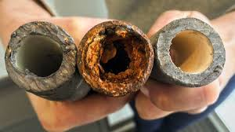
Slides (below and in blue) from the EPA Website:
https://www.epa.gov/dwreginfo/lead-and-copper-rule

Slide 6
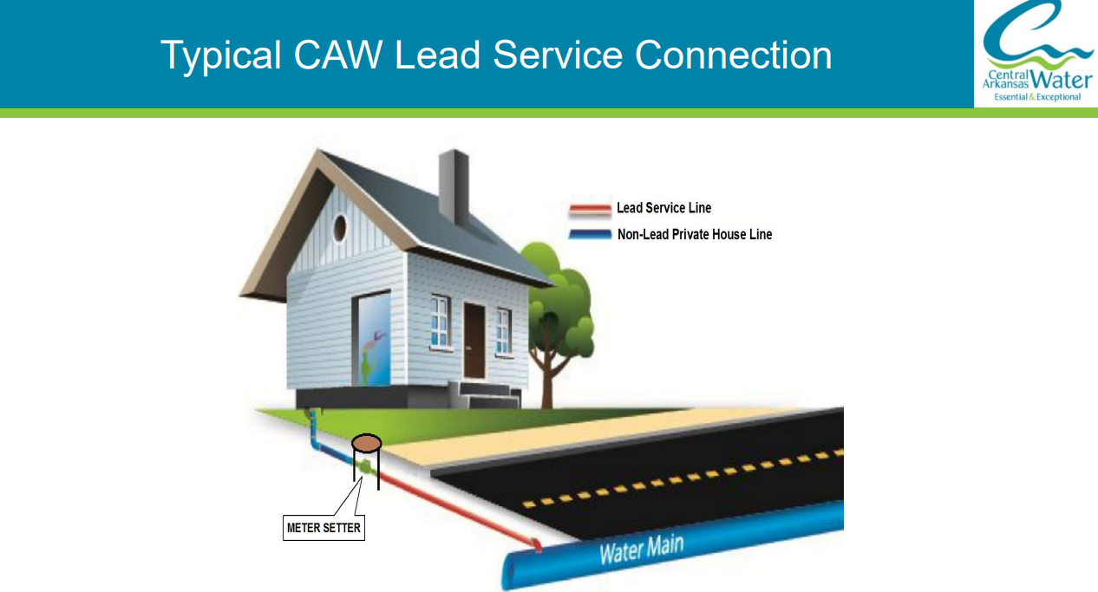

Slide 7
LCRR Requirements
Lead Service Line Inventory (Utility and Customer Sides) – Oct 2024
Lead Service Line Replacement Plan (Utility and Customer Sides) – Oct 2024
Tap Sampling Plan – Oct 2024 (more changes expected to rule)
Customer Notifications – Nov 16, 2024 (30 days after inventory done) and Annually – specific type of line; after TL or AL exceeded
Find and Fix – Customer (Notify 3 days, re-collect 30 days), FDEP (when) and Local and State Health Agencies Annual by July 1 (results, addresses, outreach materials, corrosion)
Water Quality Sampling upon tap sample >15 ppb sample – within 5 days, FDEP and Report with find and fix above
New Customer Tap result notifications timelines (3 days if > 15 ppb, 30 days if </= 15 ppb) & resamples within 30 days
School and Day Care Testing (<2014) – Compile list, sampling schedule (contact facilities) due Oct 2024
Filter Pitchers, POU filters, educational material & flushing info, analytical testing & reporting when disturb line (LSL, GRR, Unknown) – communication between field/compliance or lab
New limits (Action Level and Trigger Level)
Lead Service Line Replacements based on TL or AL exceedance (track in Inventory with dates, Report # and Analytical results) – communication between field/compliance or lab/ inventory data entry
Corrosion Plans (Optimize upon TL exceedance or make adjustments based on Find and Fix Water Quality, new test procedures)

Slide 8
LSL Inventory Requirements per the Rule
Identify customer & utility SLs
  Lead
  Galvanized requiring replacement*
  non-lead
  Lead Status Unknown (unknown)
Inventory on-line if serve> 50,000
Submit to FDEP/DOH along with numbers
(unknowns = lead)
Annual letters to customers with line identified & replacement information (and 30 days after inventory complete, TL or AL ex)
Update Inventory during normal course of operations; update numbers annually based on inspections
Must be able to identify actual LSL or GRR replacements compared to identification as non-lead
Systems with only non-lead not required to update Inventory, unless find a LSL (30 days to report)
* Galvanize Requiring Replacement (GRR) – where a galvanized service line is or was at any time downstream of a lead service line or is currently downstream of a “Lead Status Unknown” service line. If the water system is unable to demonstrate that the galvanized service line was never downstream of a lead service line, it must presume there was an upstream lead service line.

Slide 9
LSL Inventory – What We Know
EPA is preparing a guidance document and template for Inventory
See 40 CFR, Subpart I, Part 141
May use the records or methods for line identification in the rule, or a State of Florida approved method
Location Identifier – address, block, intersection associated with each SL
Composition – Lead, Non-lead, Galvanized Requiring Replacement, Unknown, or may provide exact material of line
Data Source, date confirmed, who
As move forward: date changed out, document change as physical changeout and not identification of the line

Slide 10
LSL Replacement Plan
Replacement of X% of Lead + GRR + unknown
Replacement of both Utility side and Customer = 1
Replacement of Utility side only = 0 ?
Replacement of Customer side only = 0 ?
Since replacement is based on the full line only, may want to quantify based on full line.
Each Service line with have A and B portion
Required Oct 2024 (submitted to FDEP or DOH)
Will include a replacement goal should the tap sampling 90th percent > TL (10 ppb) and 3% if > AL (15ppb)
Will include:
replacement SOPs
Customer notification SOPs – specific timelines
Reporting SOPs
Testing SOPs
Outreach
Educational materials (info, flushing instructions)
Distribution of Filters/pitchers/replacement cartridges
Financing options

Slide 11
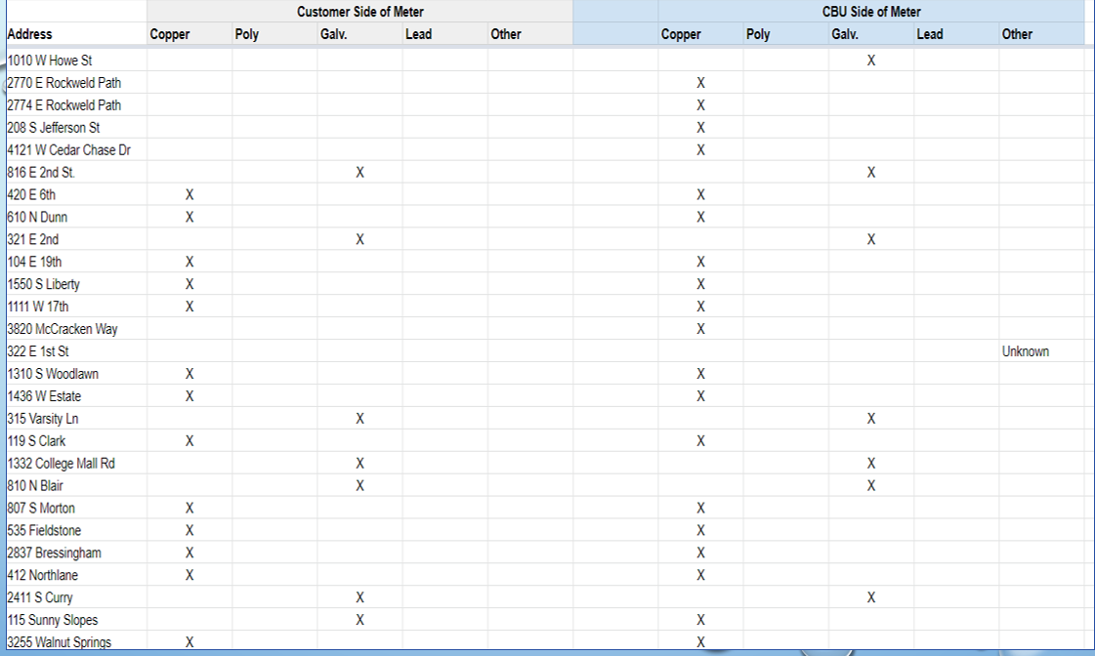

STEP 1 – Develop LSL Inventory Template

Slide 12
Data Sources (Per the Rule)
All Construction and Plumbing Codes
Permits
Existing records and documentation which indicates the service line materials
All water system records (distribution system maps and drawings)
Historical records on service connections, meter installations
Capital Improvement or Master Plans, and Standard Operating Procedures
Inspection and records of the distribution system
Any resource, information, or identification method provided or required by the State to assess service line material
Other as approved by the State

Slide 13
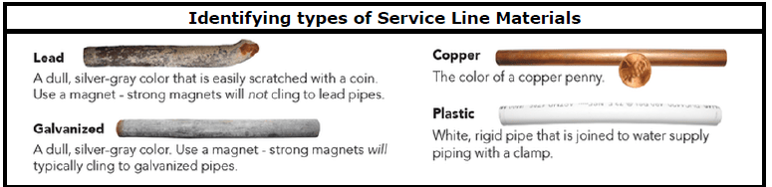
Possible Methods for Finding SL Composition - Inspection
Scratch Test
Strong Magnet

Slide 14
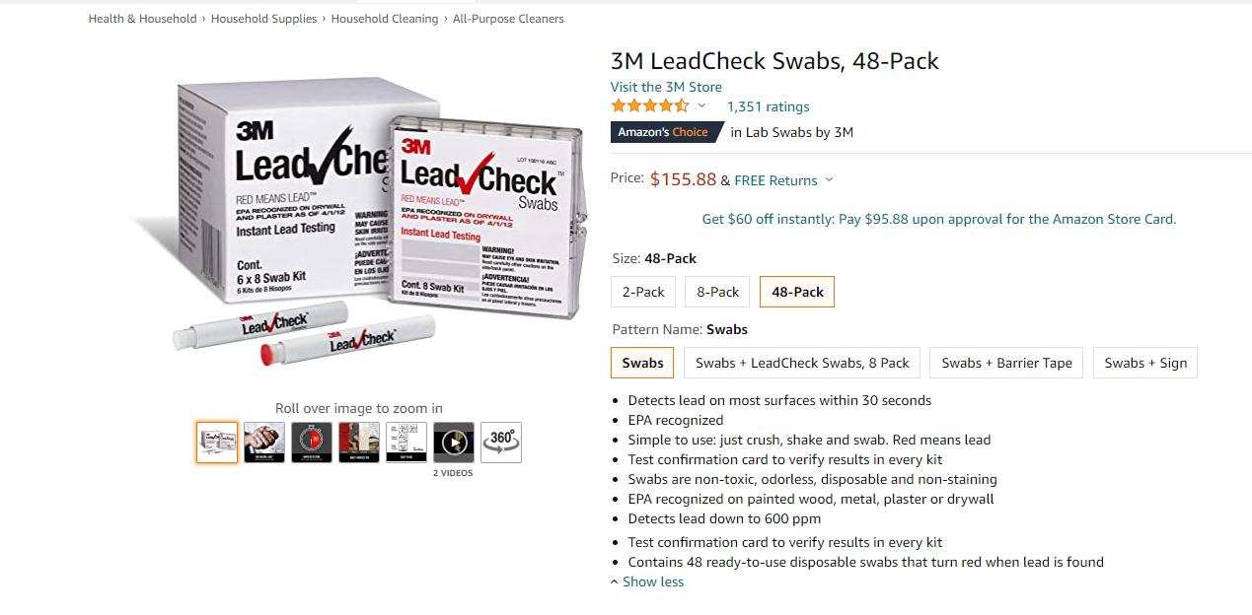
Possible Methods for finding SL Composition
GIS/Maps/Utility Records
Building Dept Records (Year?)
Speak to Building Officials
Speak to Distribution Staff (?)
Evaluate during meter reading/changeouts
Evaluate during SL replacements/normal work
In-home checks
Customer surveys (?)
Test Pits/Potholing
Model (?)
Verification for some of these (?)

Slide 15
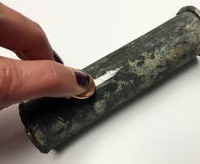
STEP 2 – Develop Data Collection Plan
Methods (Start with what you already have)
Timelines
Inhouse/Contractor
How Data will be entered into LSL Inventory & by Whom
How progress will be evaluated
Funding Plan (funding may be available)

Slide 16
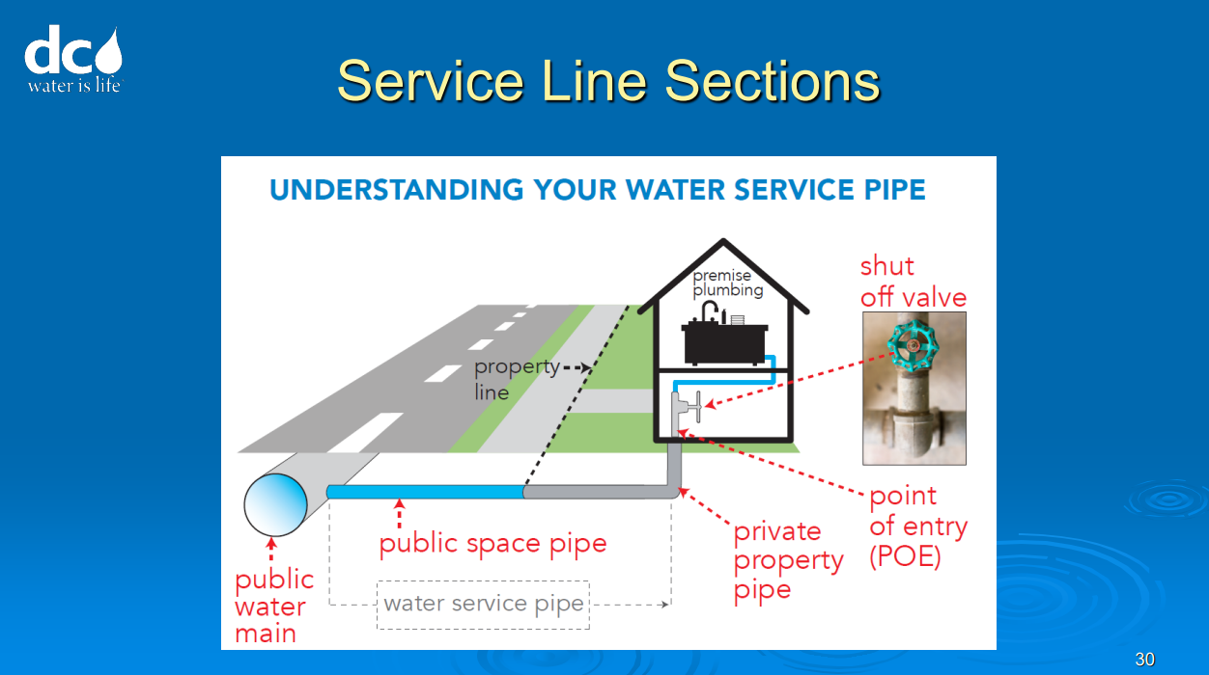

Slide 17
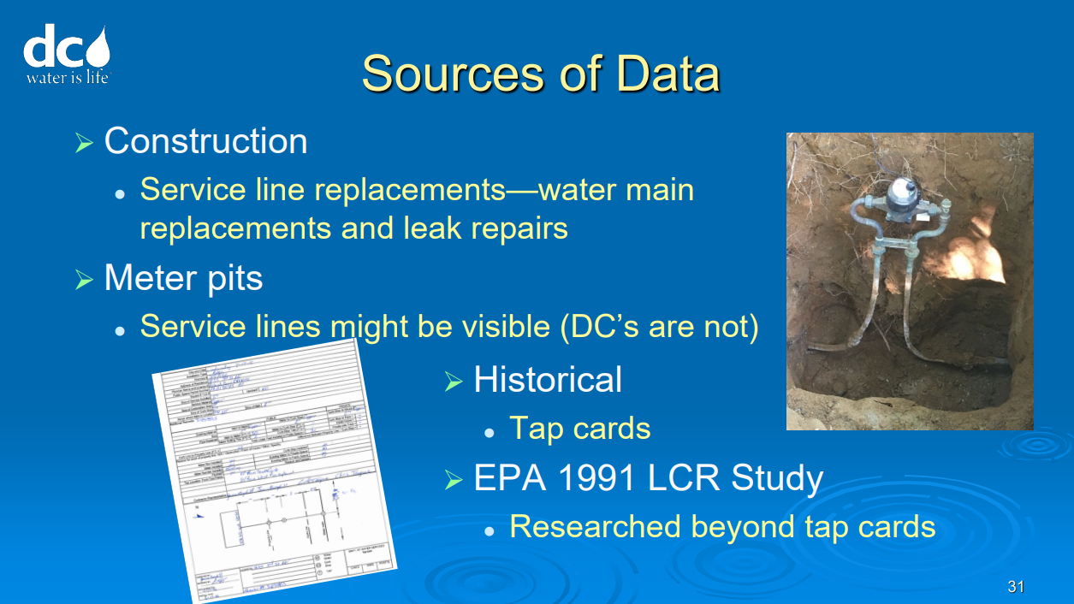

Slide 18
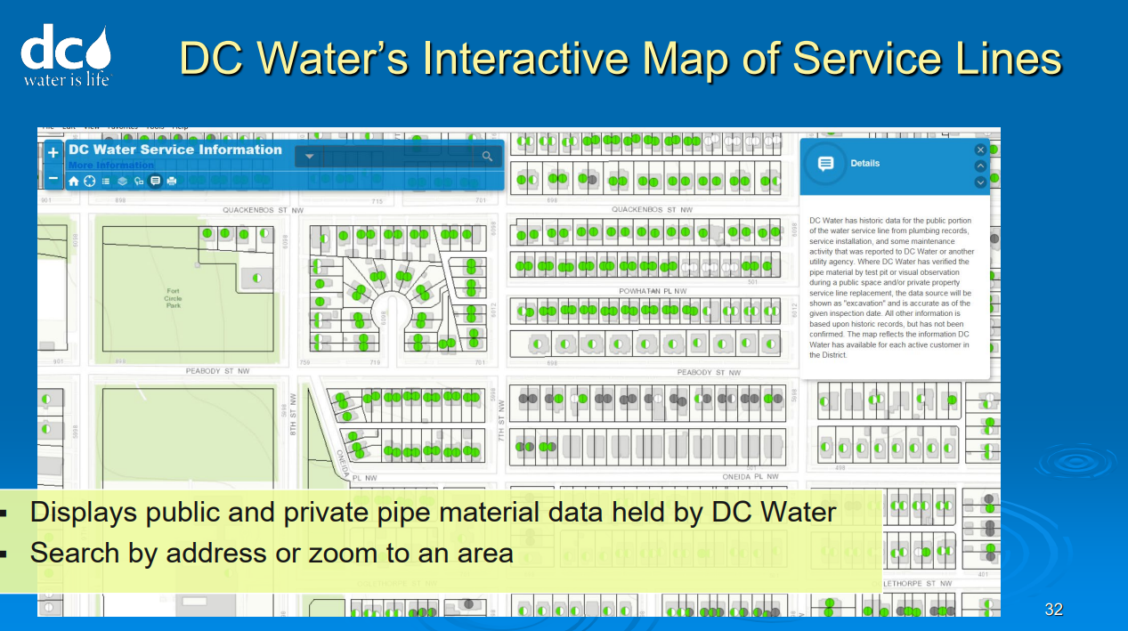

Slide 19
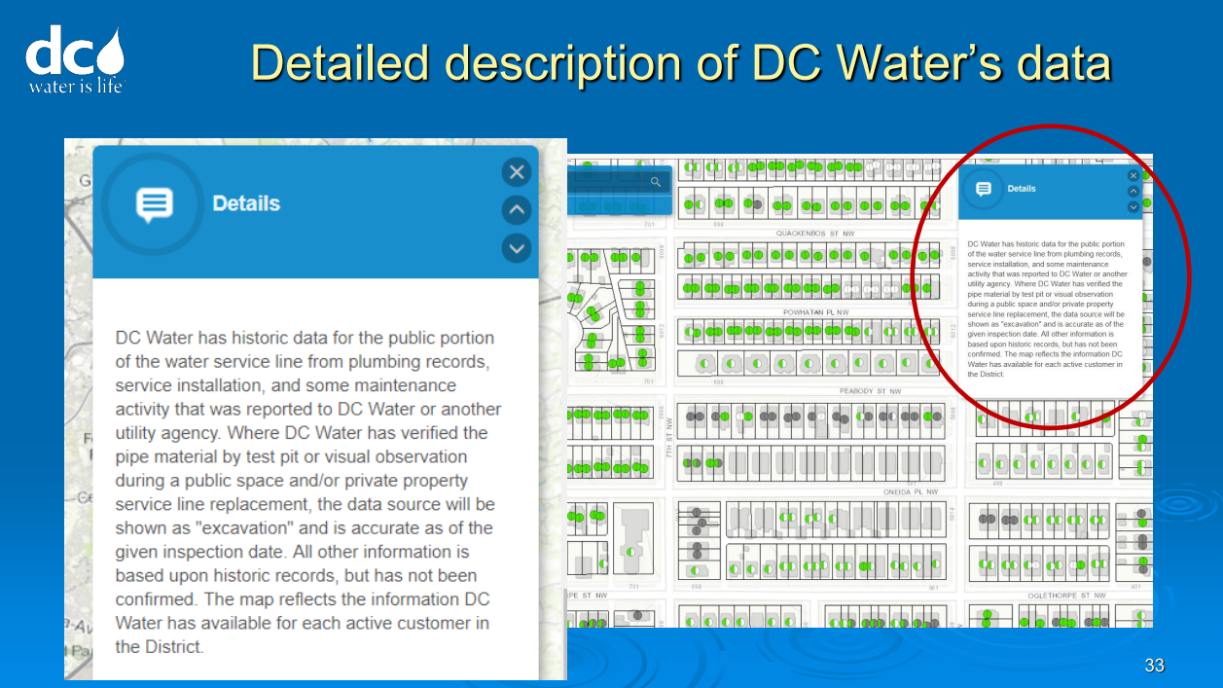

Slide 20
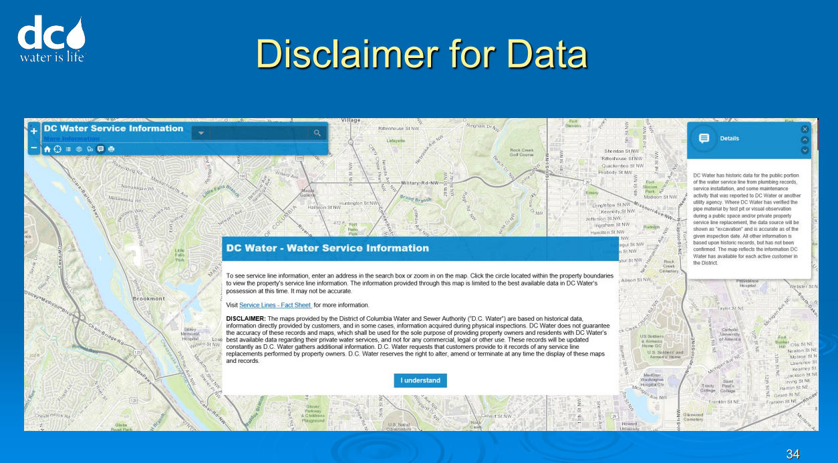

Slide 21
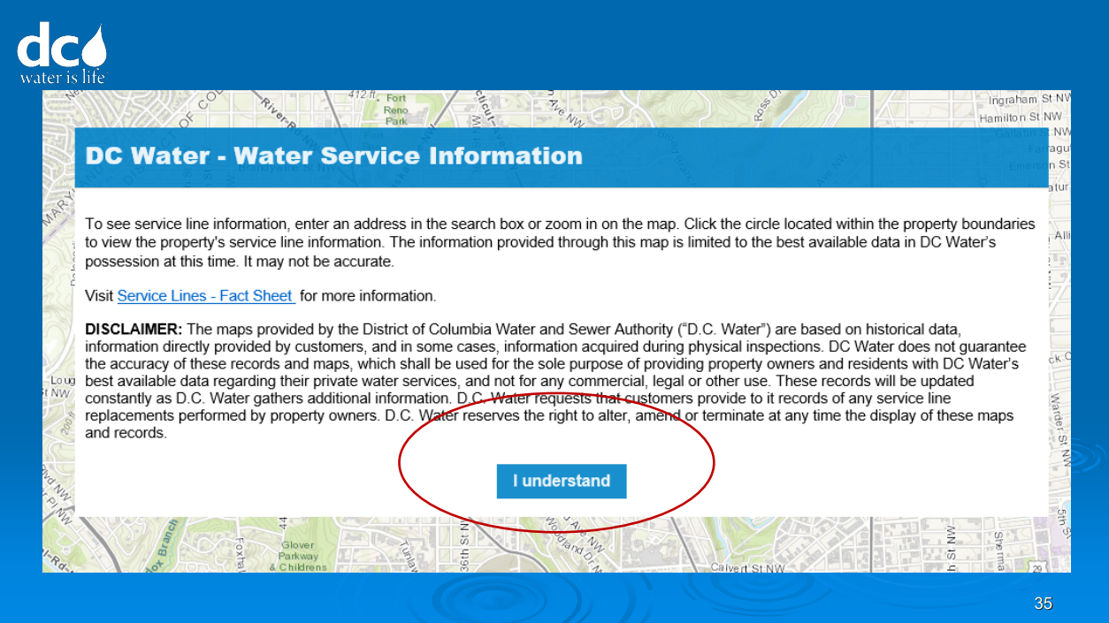

Slide 22
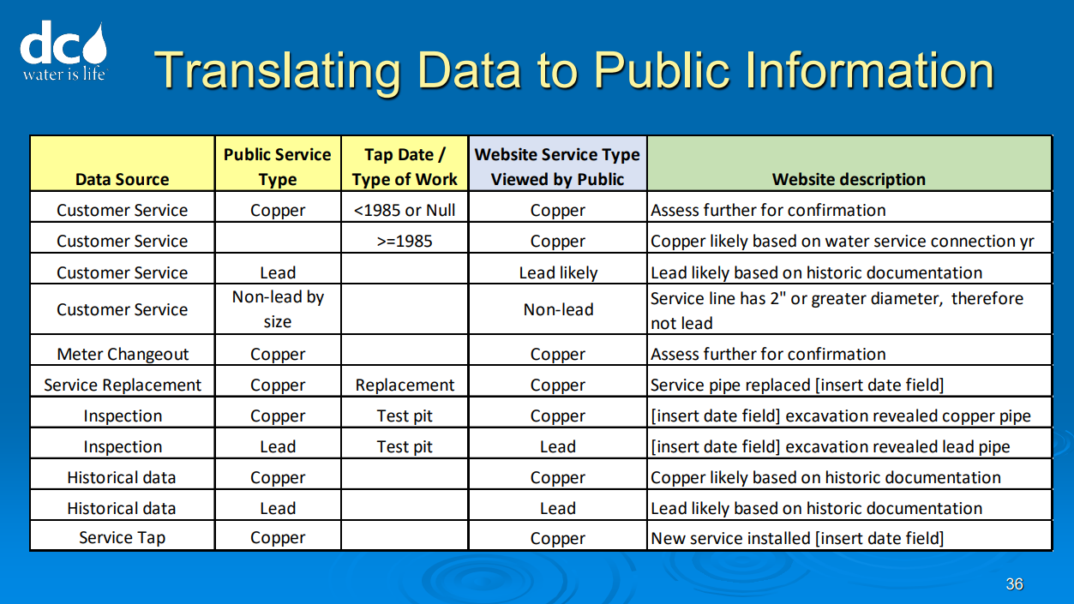

Slide 23
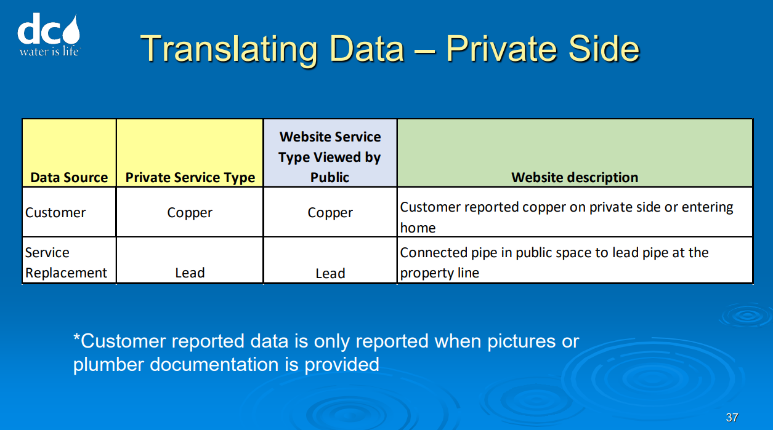

Slide 24
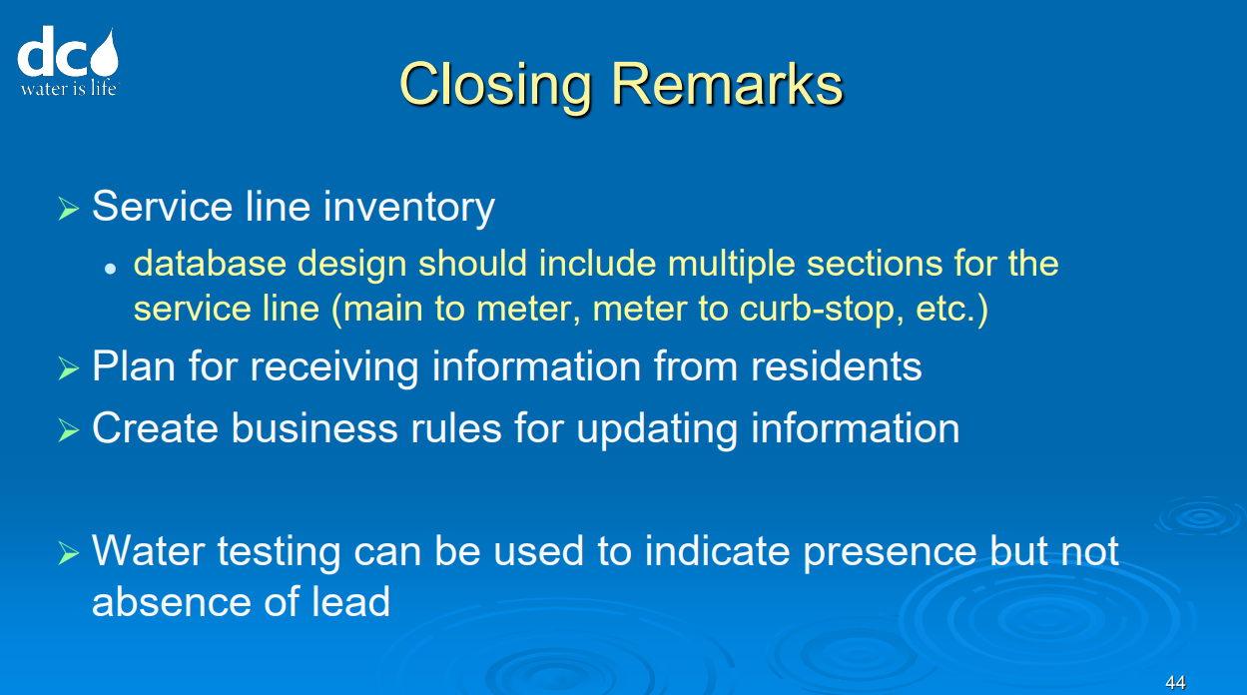

Slide 25
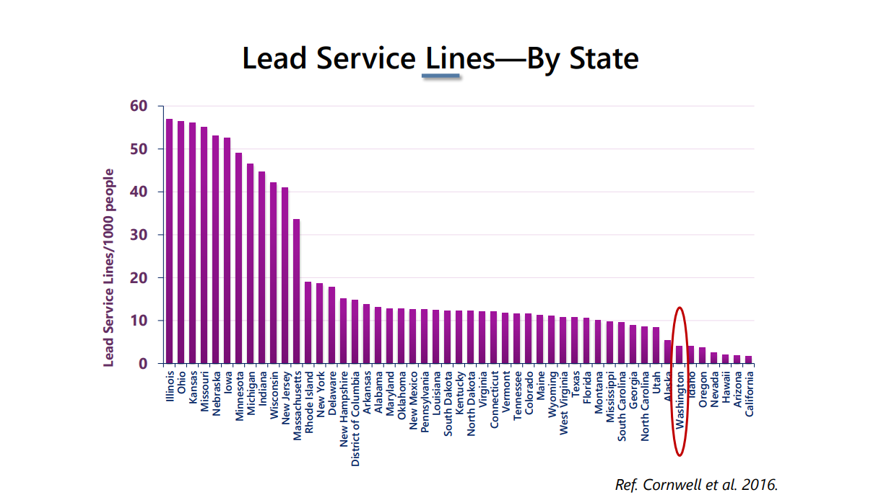

Slide 26
LSLs in Florida?
(The Natural Resources Defense Council has estimated there are 200,000 lead service lines in Florida. The Florida Department of Environmental Protection and Department of Health oversee monitoring of lead levels in drinking water.)
Florida Today Article (Google)
Plumbers favored lead piping and plumbing until 1930, when copper replaced it for service lines. Galvanized pipes were used for interior plumbing between 1920 and 1950. And copper pipe used between 1970 and 1986 used lead solder until it was banned in 1986

Slide 27
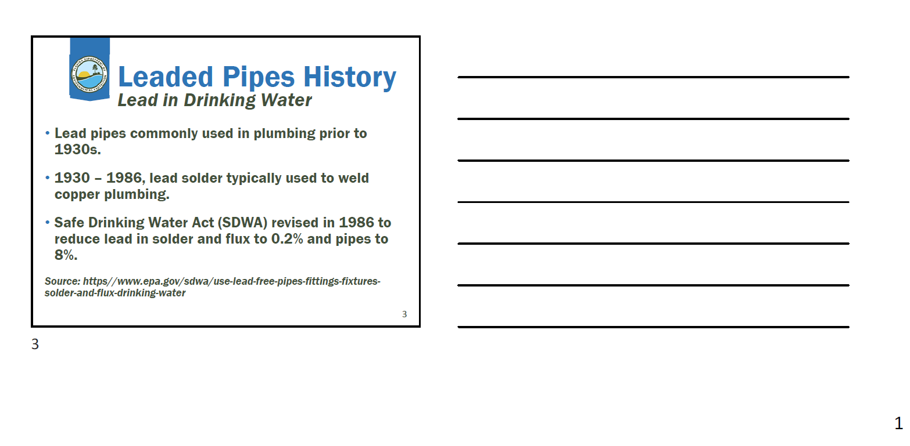
DEP Presentation 2022 Focus on Change

Slide 28
Available Resources
Requirements for Lead Service Line Inventory from ASDWA
https://www.asdwa.org/event/lead-service-line-inventory-symposium/
Examples of interactive maps
https://www.denverwater.org/your-water/water-quality/lead/lead-service-lines
https://lead.pgh2o.com/your-water-service-line/planned-water-service-line-replacement-map/

Slide 29

Sharing

Slide 30

Next Meeting
Frequency -
Date –
Time-
Location-
Staff Needed –
What do we want to accomplish next time?
Include info on SEFLUC webpage?

