Slide 1

Water and WASTEWATER Workforce Development PROGRAM
Our program is a US Department of Labor and FL Department of Education approved program that results in a nationally recognized Certificate of Completion.

Slide 2
FRWA Apprenticeship
Program History and current status
National Rural Water Association has 34 states participating in this program
2019: Program standards were written and submitted to FDOE – FDOE Approved
2019: first WW Apprenticeship class was held in Tallahassee – graduated fall 2021
2021: Second Graduating class (DW & WW) begun – graduates fall 2022
2023: FRWA is seeking to continue the success of this program in the NE and SE while continuing classes in SW

Slide 3
Apprenticeship Info
Accredited Apprenticeship Program by Florida Department of Education
Approximately two-year program commitment (may finish early with past work experience)
Apprentices must complete:
  288 hours of Related Technical Instruction (RTI) by meeting in class twice/month
  4,000 hours of on-the-job Training within a Water/Wastewater position

Slide 4
Apprenticeship offers benefits to both operators and systems
The system gains access to a vetted pool of applicants that will receive technical training in addition to their on-the-job training.
The apprentice becomes a valuable employee as they learn first-hand essential skills on-the-job and learn about the system’s assets from a mentor. This mentor is a licensed operator who already works for the system.
Apprentices receive technical instruction in addition to their on-the-job learning. This instruction helps to strengthen and round out the knowledge base of the apprentice, making them a more valuable employee.
This training includes the coursework required to receive a Class C operator’s license for water or wastewater, hands on demos and presentations of pumps and motors, emergency response, lab testing, basics of utility management and more.

Slide 5
Apprentices 2021-23 received:
Related Technical Instruction (RTI – 288 hours):
  Sacramento State coursework to fulfill the class c operator’s licensure (dw/ww)
  Plant safety
  Demonstration of pump and motor breakdown
  Dosing equipment troubleshooting & maintenance
  Presentations on lab ethics and SOP of lab procedures & testing
  New technology presentations: polymers, Chemical, lab instrumentation, field and plant instrumentation, Plant equipment
  Process control trouble shooting
  Emergency response training and presentations
  Stand-by generator/pump presentations
  Mixing 101 Presentations
  Dot flagger certification
  Utility management basics course
  Site visits to regional dw/ww plants
Graduating Apprentices also receive a nationally recognized certificate of completion.

Slide 6
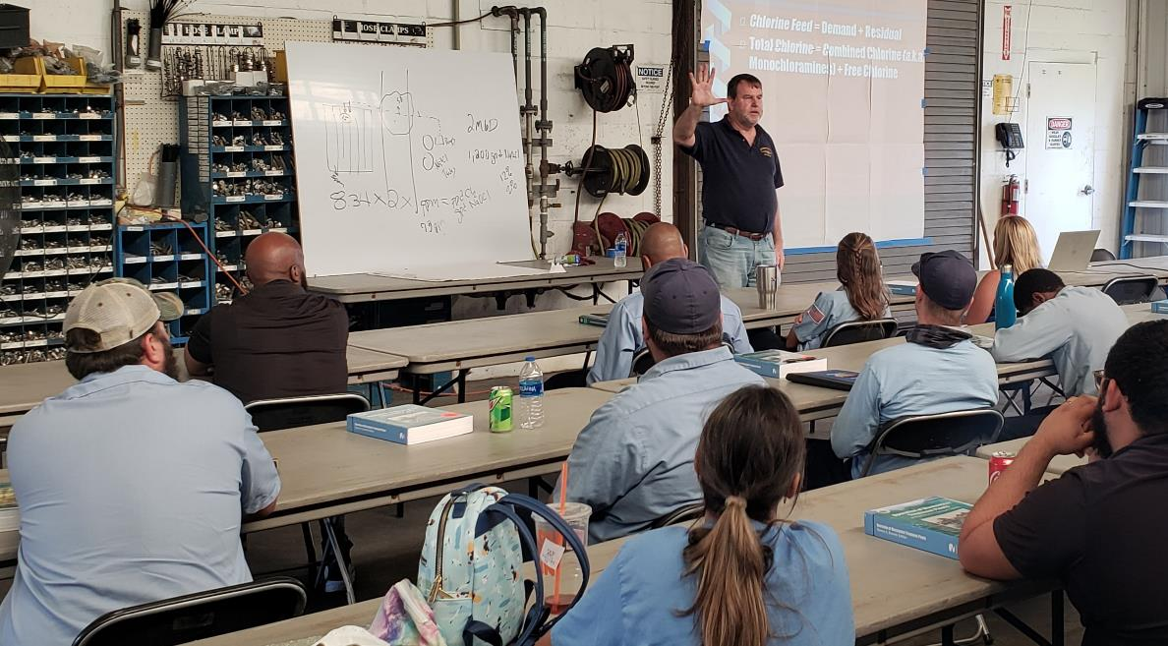

Slide 7
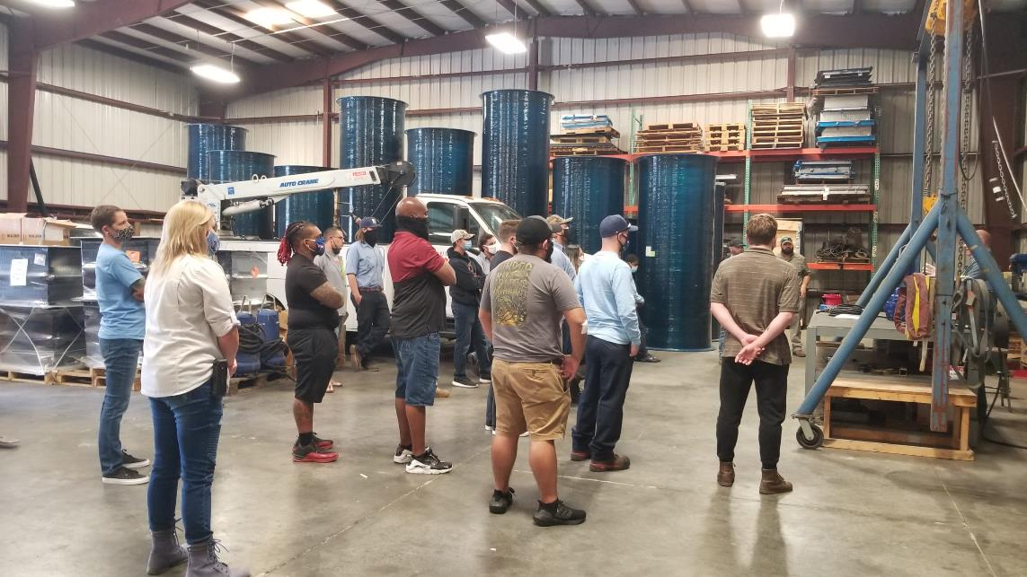

Slide 8


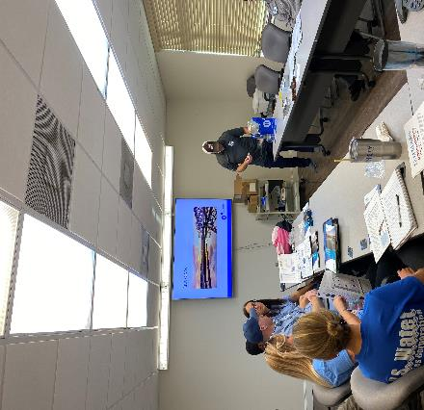
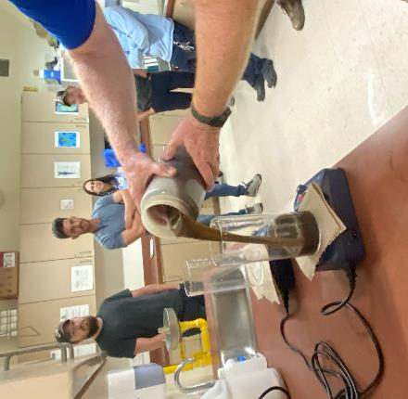
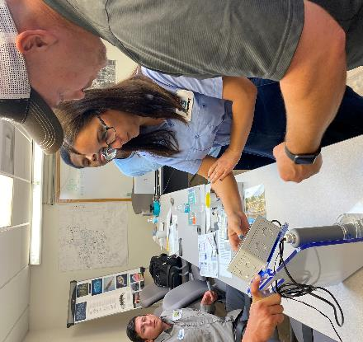
RTI: Instrumentation/polymers

Slide 9
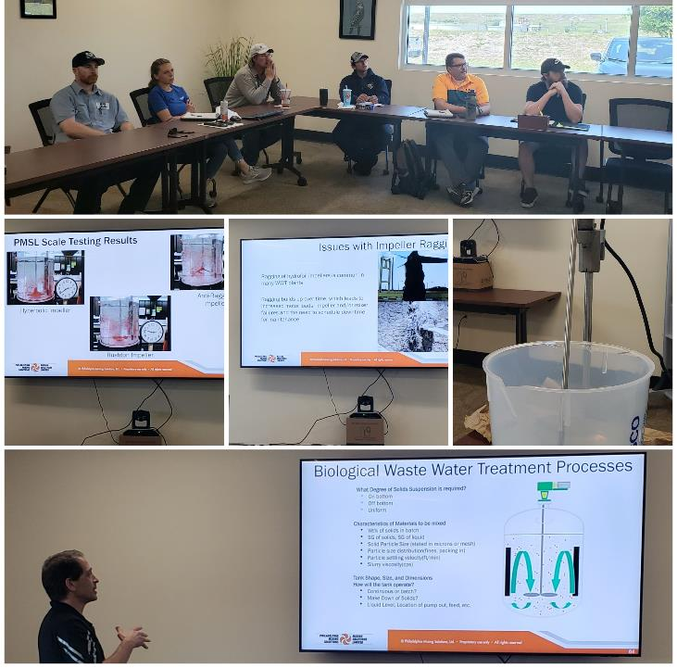
RTI: Mixing 101 Presentation

Slide 10

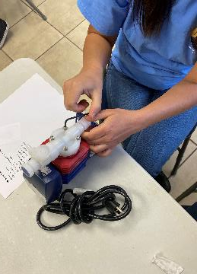
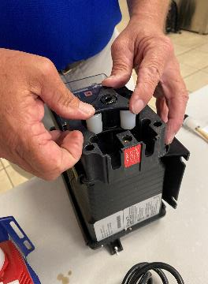
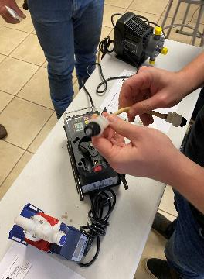
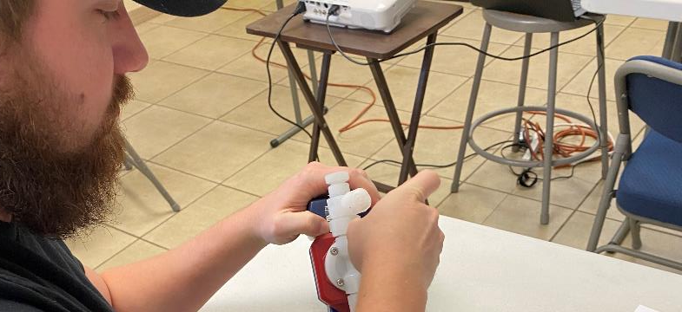
RTI: Dosing meters: operation, trouble shooting & maintenance

Slide 11
Focus on Southeast
FRWA is actively recruiting for a part-time or full-time trainer as soon as possible
Frwa aims to begin a drinking water and/or wastewater session as soon as possible

Slide 12
Contact:
Chris Muesing – FRWA Apprenticeship Coordinator
(859) 940-2599 or chris.muesing@frwa.net

