Slide 1
Florida Water and Wastewater Agency Response Network (FlaWARN) Update and Potential Regional Exercise
Southeast Florida Utility Council
September 13, 2021 Virtual Monthly Meeting
Kevin Carter
Broward County Water and Wastewater Services
kcarter@broward.org
954-831-0718
954-856-3879 mobile

Slide 2
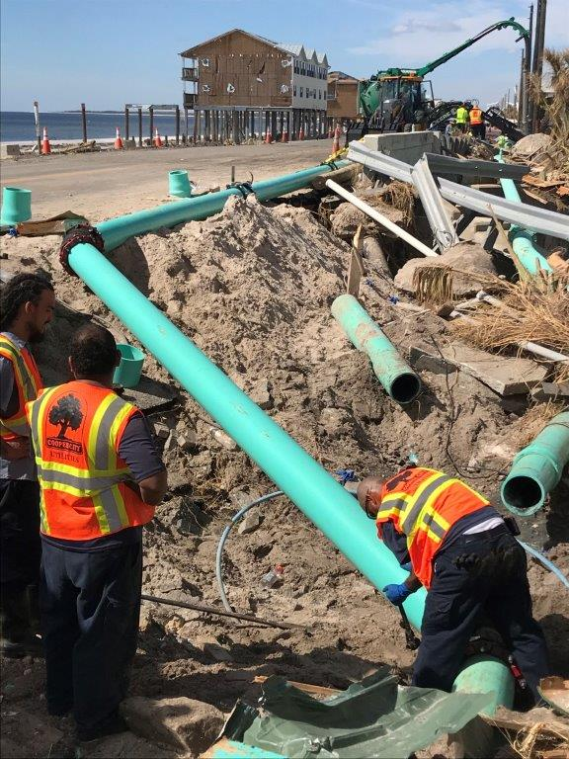


Florida Water and Wastewater Agency Response Network (FlaWARN)
https://flawarn.pwd.aa.ufl.edu/
FlaWARN is the formalized system of "utilities helping utilities" to address mutual aid during emergency:
  Originated while Florida impacted by 8 hurricanes in 2004 and 2005; Part of a national WARN system.
FlaWARN forms a nexus with governmental emergency managers as well as directly with utilities:
  Utilities not affected by disaster send crews and/or equipment to impacted utilities.
In 2018, 7 Southeast Florida Utility Council (SEFLUC) member utilities sent over 70 utility personnel to Florida's Panhandle after Hurricane Michael.
South Florida Crews Lending Assistance to Florida’s Panhandle after Hurricane Michael (October 2018)
Photo from Kara Mills’ (City of Boca Raton) SEFLUC presentation December 10, 2018
https://sefluc.org/

Slide 3
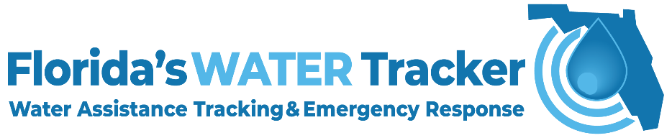
FlaWARN’s Major Platform:
WATER Tracker
WATER Tracker is FlaWARN’s major internet-based platform for utilities to notify state of Florida post storm status, resource needs and availability.
WATER Tracker is also a tool for other events such as the COVID 19 pandemic and resources still available online.
If you are utility, please log on occasionally to know your password and ensure your information is current: https://flwatertracker.com/.
Also, please confirm your utility has an approved mutual aid agreement (MAA). A MAA facilitates receiving assistance.
If you are experiencing difficulties with login either email: WATERTracker@floridadep.gov; call (866) 742-0481 or contact me.

Slide 4
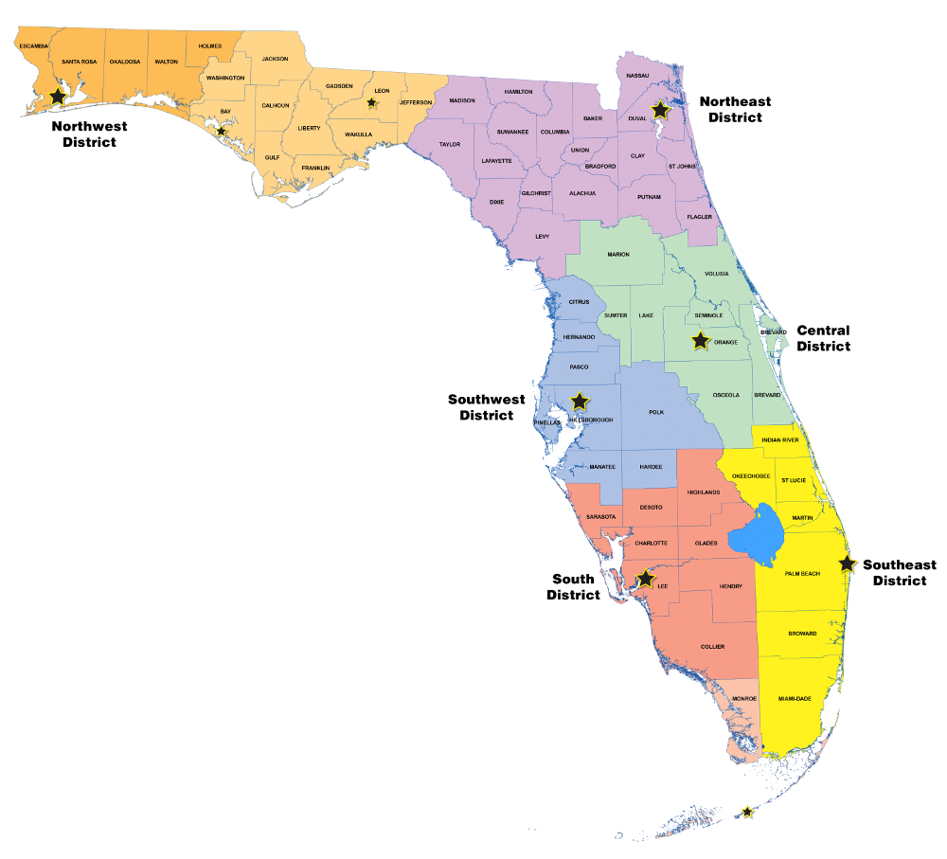
Jamie Shakar and Katie Downey FDEP
2021 FlaWARN
Steering Committee
Beth DeMio*
JEA
Scott Kelly, Chair
FRWA/ City of West Palm Beach
Lockwood Wernett*
Destin Water Users
Scott Aniheim
City of Starke
Gary Williams, Vice-Chair FRWA
Alicia Keeter*
South Walton Utilities
David Zusi City of Winter Park
Andy Campbell & Lauren McCain UF Office of Professional and Workforce Development
Brad Jewell OUC
Todd Swingle*, Rick Nipper (Alt.)
Toho Water Authority
Chris Saliba* US Water Corp.
Tony Fogel Town of Jupiter
Andy Koebel*
Bonita Springs Utilities
= Regional Coordinator
FDEP = Florida Dept. of Environmental Protection
FRWA = Florida Rural Water Association
Kevin Carter*
Broward County
Map from https://floridadep.gov/districts

Slide 5
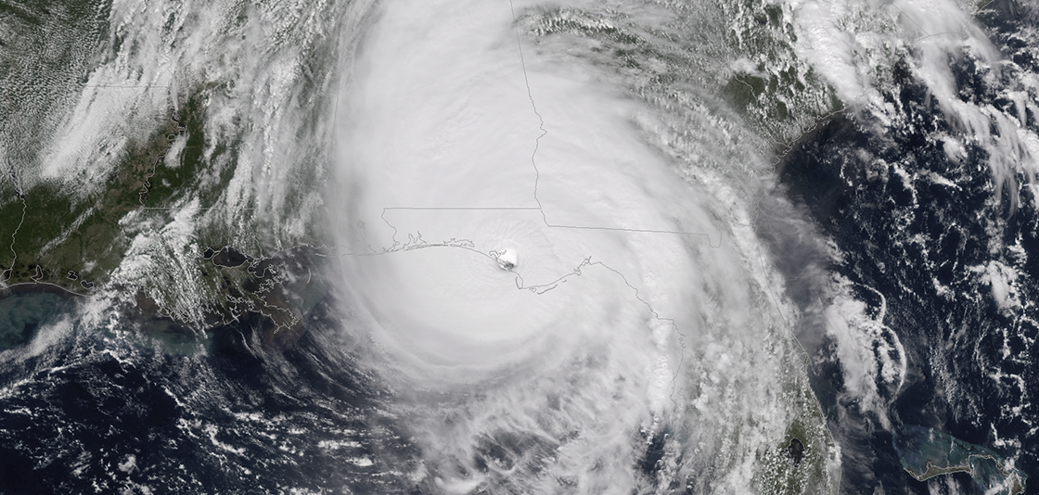
FlaWARN Regional Coordination During Hurricane Michael
Due in large part to Panhandle landfall and distance from Peninsula, regional coordination evolved rapidly during FlaWARN response.
Many people already on FlaWARN Steering Committee real time calls and regional contacts could streamline information back to region.
Regional Coordinators also assisted maintaining FlaWARN real time database.
https://www.noaa.gov/media-release/hurricane-michael-upgraded-to-category-5-at-time-of-us-landfall

Slide 6
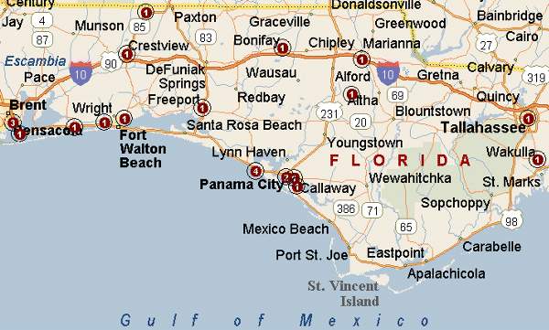
Southeast Florida Utility Council (SEFLUC) Connections
Key to 2018 Regional FlaWARN Coordination and beyond
FlaWARN
https://wiki--travel.com
From website* “SEFLUC provides a communications, networking, and support structure for member utilities to continue to provide superior-quality water supply and wastewater management services to its customers in a cost-effective manner.”
From bylaws’ objectives “A. To develop a support system for member utilities to rely upon during natural or human-made disasters.”
*https://sefluc.org/

Slide 7
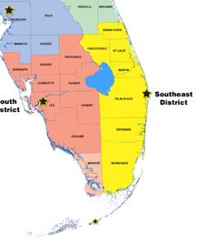
Let’s Virtually Tour Our FlaWARN Southeast Region
(Florida Department of Environmental Protection’s Southeast District)
While SEFLUC very important part, we have some counties outside the SEFLUC area. Overall, 70 drinking water utilities in district.
I am going to lead you through a tour through the region’s public water supply facilities. Similar information available from the links provided for wastewater entities.
Purpose is to provide perspective and geographic information within and outside our region.
Also for general reference material should we need to assist within our region or use in an exercise.

Slide 8
2 public water supply entities* in Okeechobee County
3 public water supply entities in Indian River County**
*Volume delivered > 0.1 million gallons per day;
*Map and data from: 2019 Lower Kissimmee Basin Water Supply Plan Update (sfwmd.gov)
** FDEP Basic Facility Reports District 4 Basic Facility Reports District 4 | Florida Department of Environmental Protection
https://www.sfwmd.gov/sites/default/files/documents/2018_lec_plan_appendices.pdf

Slide 9
10 public water supply entities* in St. Lucie County
*Volume delivered > 0.1 million gallons per day;
*Map and data from: uec_2016_plan_appendices.pdf (sfwmd.gov)

Slide 10
7 public water supply entities* in Martin County
*Volume delivered > 0.1 million gallons per day;
*Map and data from: uec_2016_plan_appendices.pdf (sfwmd.gov)
https://www.sfwmd.gov/sites/default/files/documents/2018_lec_plan_appendices.pdf

Slide 11
17 public water supply entities* in Palm Beach County
*Volume delivered > 0.1 million gallons per day;
*Map and data from: 2018 Lower East Coast Water Supply Plan Appendices (sfwmd.gov)

Slide 12
25 public water supply entities* in
Broward County
*Volume delivered > 0.1 million gallons per day;
* Does not include cities who distribute wholesale (e.g., Coconut Creek)
*Map and data from: 2018 Lower East Coast Water Supply Plan Appendices (sfwmd.gov)

Slide 13
6 public water supply entities* in
Miami-Dade County
Plus, Florida Keys Aqueduct Authority water facility in south Miami-Dade County
*Volume delivered > 0.1 million gallons per day;
*Map and data from: 2018 Lower East Coast Water Supply Plan Appendices (sfwmd.gov)

Slide 14
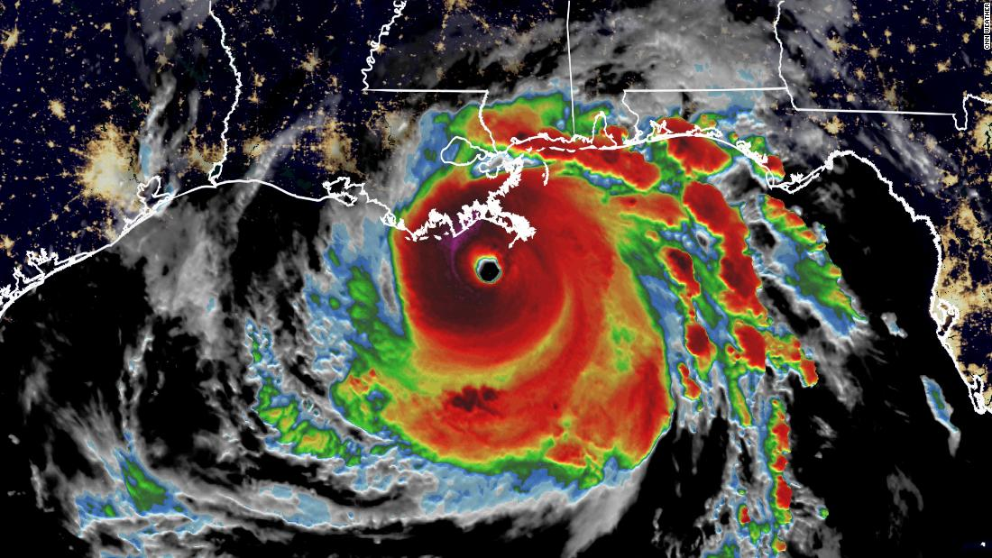
FlaWARN Update: Hurricane Ida Response
FlaWARN responded to Louisiana with 20 generators (all deployed) and also 13 people deployed.
As our Vice Chair Gary Williams likes to say: “Pay it Back” as they assisted in past and “Pay it Forward” as we may need it again.
Currently there are 158 systems receiving assistance from several states including the largest utilities.
After the storm: “18 water systems have gone out, affecting more than 312,000 people, and an additional 14 systems serving 329,000 people were under boil-water advisories.”
(from https://www.cnbc.com/2021/08/31/hurricane-ida-causes-supply-shortages-officials-warn-of-long-recovery.html)
https://cdn.cnn.com/cnnnext/dam/assets/210829083521-01-hurricane-ida-stormbot-08-29-2021-super-tease.jpg

Slide 15
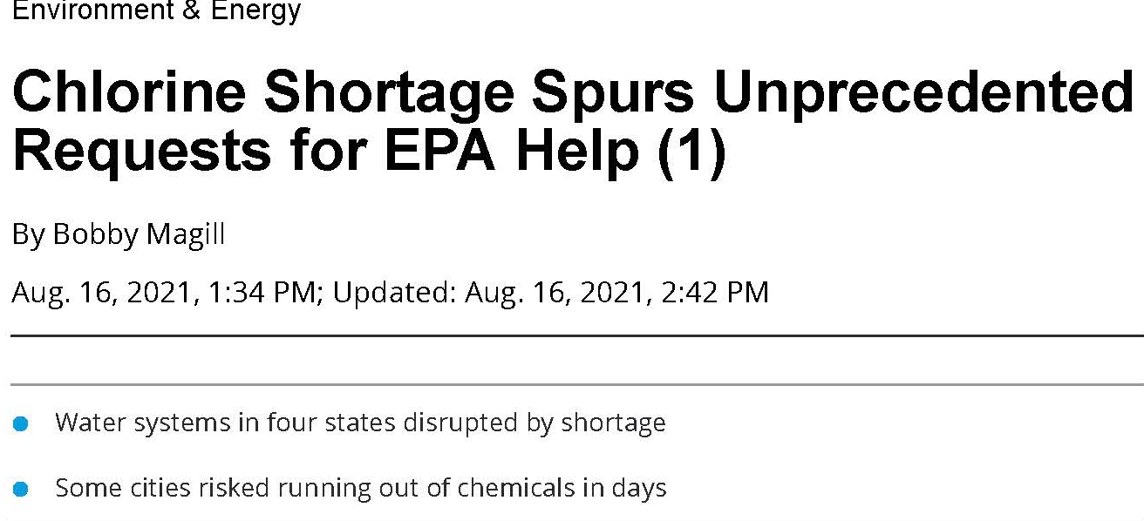
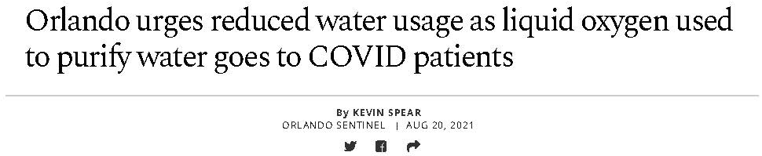
FlaWARN Update: Supply Chain Reduction Response
FlaWARN participates with the FWEA Utility Council and FSAWWA Water Utility Council’s COVID Coordination calls that are happening again (Thank you Lisa Wilson-Davis for leading our 46th meeting today!).
Supply chain issues have been front and center (e.g., Orlando Utilities Commission (OUC) oxygen; national level with chorine).
Has anyone in SEFLUC had issues? If so, please contact me. Working on FDEP communications and AWWA is communicating with USEPA.
https://bnanews202.bna.com/environment-and-energy/chlorine-shortage-leads-u-s-water-systems-to-seek-epas-help (from Bloomberg News)
https://www.orlandosentinel.com/coronavirus/os-ne-orlando-water-shortage-covid-oxygen-use-20210820-f522oks5dvfwbozl5w7gcxg4oy-story.html

Slide 16

Shifting Gears…
Potential SE FlaWARN Region Exercise Discussion

Slide 17
After Hurricane Michael Assessment:
Some Regional (and Local) Coordination Growth Areas
Are there ways to optimize personnel and/or resource deployment among different utilities to areas outside region (during COVID-19 and beyond)?
  Potential to share rental hauling vehicles but challenging (thank you Scott Kelly for investigating last year)
  Potential for strike team development; still conceptual (thank you Lisa Wilson-Davis, Boca Raton for this idea)
  Other South Florida regional ideas?
  International aid (e.g., Operators Without Borders* need in Bahamas post Hurricane Dorian; future twinning opportunities, translators for training materials)
*https://operatorswithoutborders.org/

Slide 18
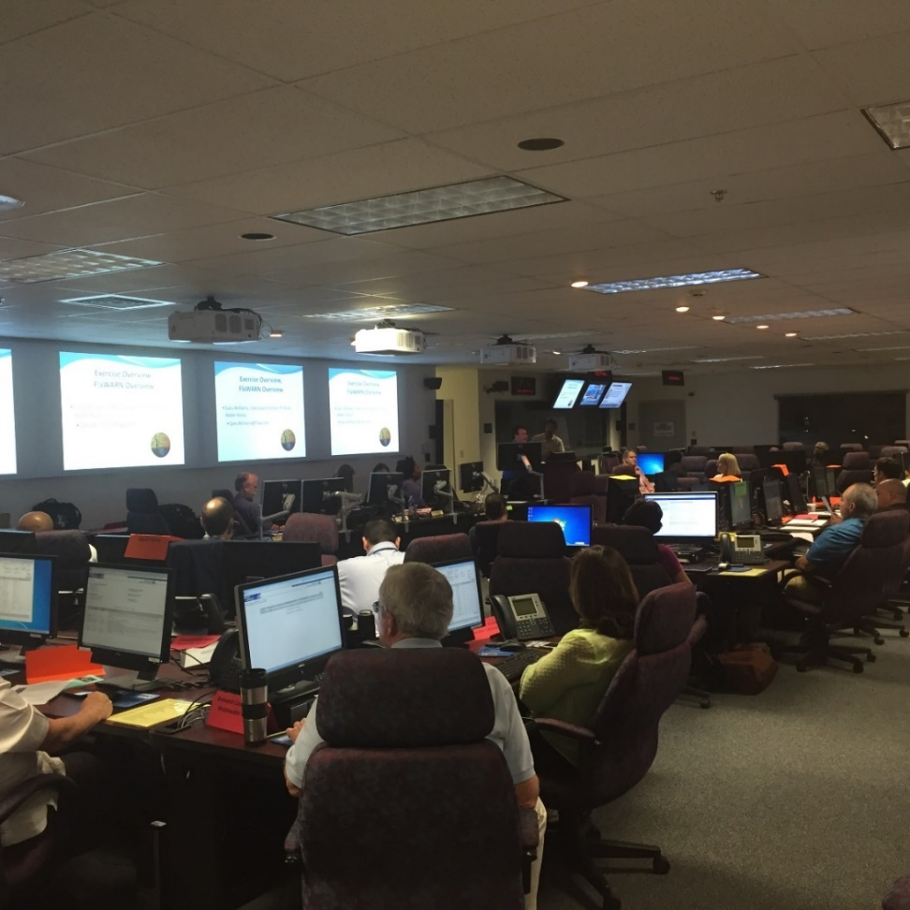
After Hurricane Michael Assessment (cont.):
Some Regional (and Local) Coordination Growth Areas
Is it time to plan for another Regional or Local Exercises?
In 2016, 14 of Broward County’s 20 FlaWARN members participated including 11 cities with some emergency management division representation:
  Injects (scenarios) were given to participants to resolve and request assistance.
  Exercise also assisted networking and meeting people.
Future exercise could focus on our region assisting another region. Or could be within regions assistance or both.
Broward FlaWARN exercise September 7, 2016

Slide 19

Conversations Lead to Solutions – Let’s Talk!
Time For Regional Exercise Discussion
Many thanks to Carol Hinton!, “the glue that kept us together” since FlaWARN’s beginning. Happy Retirement and Enjoy the Next Chapter!
Welcome to UF’s Andrew Campbell and Laura McCain as the new administrators
    Kevin Carter
    Broward County Water and Wastewater Services
    kcarter@broward.org; 954-831-0718
    954-856-3879 mobile

Slide 20
Extra Slides

Slide 21

Regional (and Local) Coordination: Pre-Event Activities
Go through main contacts in region:
  Determine if current (either by contacting or regular contact).
  Crosswalk with FlaWARN’s main contact list.
  Place in E-mail and mobile phone contacts.
  Set up spreadsheets with main contacts.
Attend state, regional and local meetings; perfect platform to create relationships and network over time.
Attend local exercises (e.g., your Emergency Operations Center).
Review Plans, BMPs, other Guidance Documents:
  FlaWARN BMPS Microsoft Word - BMPs 8-08 (ufl.edu)
  AWWA Resource Typing AWWA_RT Guidance_FINAL_ Nov2019.pdf
  USEPA Emergency Check Lists Incident Action Checklists for Water Utilities | Emergency Response for Drinking Water and Wastewater Utilities | US EPA

Slide 22
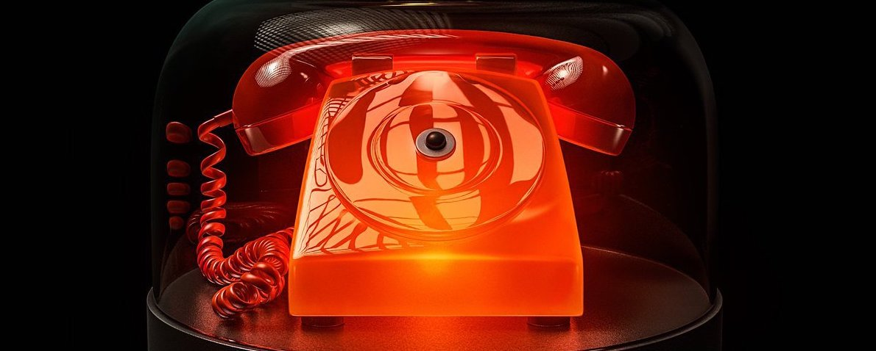
Regional (and Local) Coordination: During Event
Track storm’s path and coordinate closely with FlaWARN and local EOC.
Send initial E-mails with FlaWARN information to regional contacts; Begin and continue individual conversations.
Very “fluid” needs assessment and resources available process requires many one-on-one communications (keep that mobile phone charged as long as possible!).
Coordinate with FlaWARN and responding utilities on travel logistics; Continue communication throughout deployment.
Scott Kelly and Gary Williams FlaWARN “Bat Phone”

Slide 23

Regional (and Local) Coordination: After Event
Participate in FlaWARN’s After Action Reporting as well as similar regional and local activities.
Talk with individual utilities on their positive experiences and areas to learn from (SEFLUC great forum for this).
Continue to broaden network contact list in hurricane offseason.
Learn more about other emergency management actions (e.g., other state WARNs’) activities and lessons learned particularly in operational events as well as hurricanes.
Many, many thank you E-mails, calls, etc. Big Team Effort!

